Slide 1

POETIC TERMS
English III
Mr. Wallock

Slide 2

ALLUSION
A reference to a historical figure, place, or event.

Slide 3
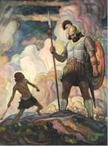
ALLUSION
The teams competed in a David and Goliath struggle.

Slide 4
ANALOGY
A broad comparison between two basically different things that have some points in common.

Slide 5
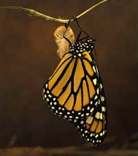
ANALOGY
Aspirations toward space are not new. Consider the worm that becomes a butterfly.

Slide 6
SIMILE
A direct comparison between two basically different things. A simile is introduced by the words “like” or “as”.

Slide 7
SIMILE
My love is like a red, red rose.

Slide 8
METAPHOR
An implied comparison between two basically different things. Is not introduced with the words “like” or “as”.

Slide 9
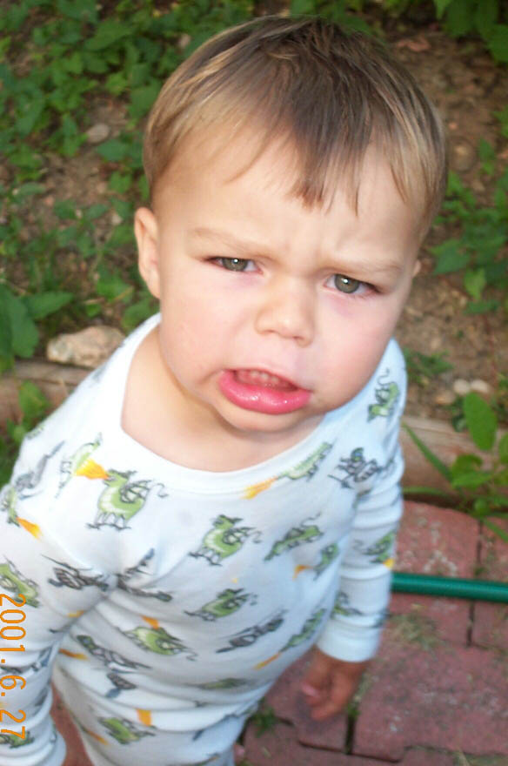
METAPHOR
His eyes were daggers that cut right through me.

Slide 10
HYPERBOLE
A great exaggeration to emphasize strong feeling.

Slide 11

HYPERBOLE
I will love you until all the seas go dry.

Slide 12
PERSONIFICATION
Human characteristics are given to non-human animals, objects, or ideas.

Slide 13
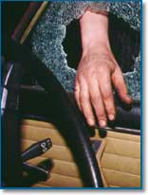
PERSONIFICATION
My stereo walked out of my car.

Slide 14
APOSTROPHE
An absent person or inanimate object is directly spoken to as though they were present.

Slide 15

APOSTROPHE
Brutus: “Ceasar, now be still. I killed not thee with half so good a will.”

Slide 16
SYNECDOCHE
A part stands for the whole or vice versa.

Slide 17
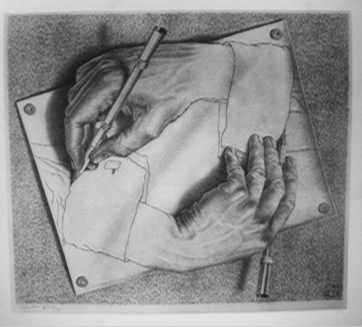
SYNECDOCHE
The hands that created the work of art were masterful.

Slide 18
FORESHADOWING
Hints given to the reader of what is to come.

Slide 19
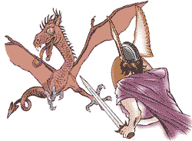
FORESHADOWING
“The stalwart hero was doomed to suffer the destined end of his days.”

Slide 20
IMAGERY
The use of concrete details that appeal to the five senses.

Slide 21

IMAGERY
Cold, wet leaves floating on moss-colored water.

Slide 22
IRONY
A contrast between what is said and what is meant. Also, when things turn out different than what is expected.

Slide 23
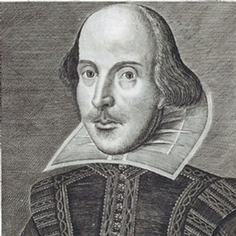
IRONY
“The treacherous instrument is in thy hand, unbated and envenomed. The foul practice has turned itself on me.” Laertes

Slide 24
MOOD
The overall atmosphere or prevailing emotional feeling of a work.

Slide 25
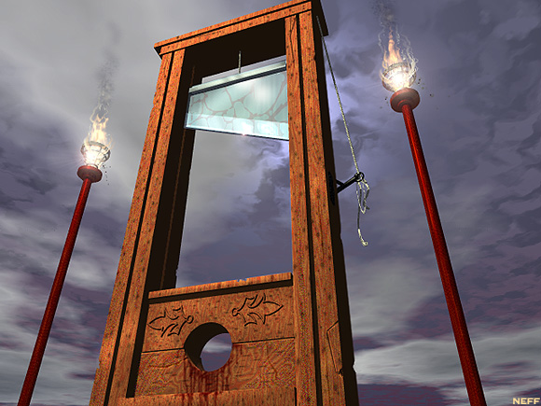
MOOD
“It was the best of times, it was the worst of times.”

Slide 26
PARADOX
A seemingly self-contradictory statement that still is true.

Slide 27
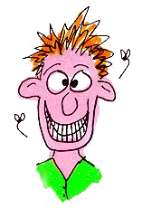
PARADOX
The more we learn, the less we know.

Slide 28
PLOT
A series of events that present and resolve a conflict. The story being told.

Slide 29

PLOT
The plot of “The Most Dangerous Game” is that Rainsford is being hunted by General Zaroff.

Slide 30
POINT OF VIEW
The vantage point from which an author presents the action in a work.

Slide 31
POINT OF VIEW
1st person-tale related by a character in the story. “I or me”
3rd person-story told by someone not participating in the plot. “he, she, they”

Slide 32
END RHYME
The repetition of identical sounds at the ends of lines of poetry.

Slide 33
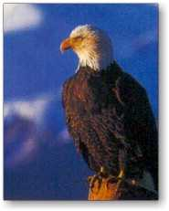
END RHYME
“He clasps the crag with crooked hands
Close to the sun in lonely lands”
from “The Eagle”

Slide 34
INTERNAL RHYME
The repetition of identical sounds within a line of poetry.

Slide 35
INTERNAL RHYME
“We three shall flee across the sea to Italy.”
Or
“Hold infinity in the palm of your hand
And eternity in an hour.”

Slide 36
SLANT RHYME
A slant rhyme or half rhyme occurs when the vowel sounds are not quite identical.

Slide 37
SLANT RHYME
“And on that cheek and o’er that brow”
A mind at peace with all below”

Slide 38
SETTING
The time (both the time of day and period in history) and place in which the action of a literary work takes place.

Slide 39
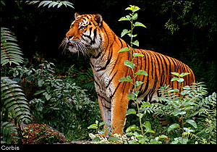
SETTING
“Tiger! Tiger! burning bright
In the forests of the night”

Slide 40
REPETITION
The repeating of a sound, word, phrase, or more in a given literary work.

Slide 41
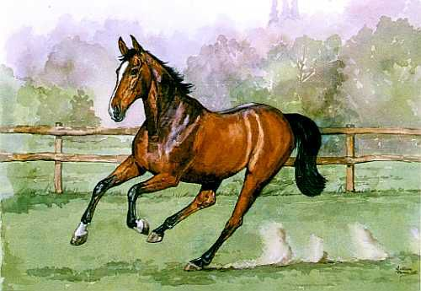
REPETITION
“I sprang to the stirrup, and Jarvis, and he;
I galloped, Derrick galloped, we galloped all three”

Slide 42
ALLITERATION
The repetition of consonant sounds at the beginnings of words.

Slide 43
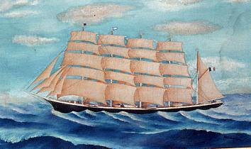
ALLITERATION
“Swiftly, swiftly flew the ship”

Slide 44
ASSONANCE
The repetition of similar vowel sounds followed by different consonant.

Slide 45
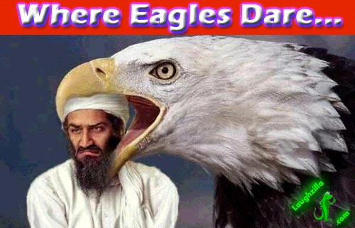
ASSONANCE
“. . .that hoard, and sleep, and feed, and know not me.”

Slide 46
CONSONANCE
The repetition of consonant sounds that are preceded by different vowel sounds.

Slide 47
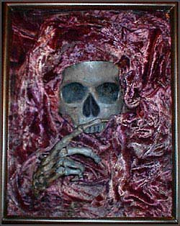
CONSONANCE
“Wherever we go
Silence will fall like dews”

Slide 48
ONOMATOPOEIA
The use of words whose sounds suggest the sounds made by objects or activities.

Slide 49

Other examples:
buzz, hum, kiss
ONOMATOPOEIA
“Blind eyes could blaze like meteors”

Slide 50
SYMBOL/SYMBOLISM
Something concrete, such as an object, action, character, or scene that stands for something abstract such as a concept or an idea.

Slide 51
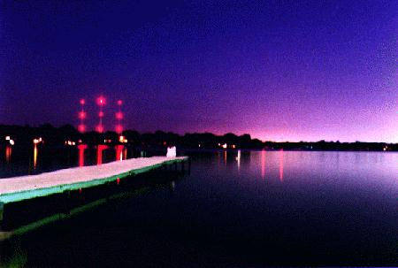
Both phrases are symbols that
stand for death.
SYMBOL/SYMBOLISM
“Do not go gentle into that good night
Rage, Rage against the dying of the light”

Slide 52
THEME
The main idea or underlying meaning of a literary work.

Slide 53
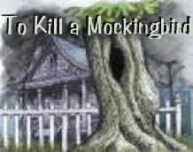
THEME
“Don’t judge a man until you’ve walked a mile in his shoes”

Slide 54
CONCEIT
Comparing two very dissimilar things. Usually involves cleverness and ingenuity.

Slide 55
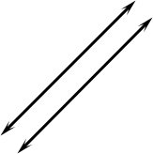
This is also a simile.
CONCEIT
“Our love is like parallel lines”

Slide 56
METONYMY
A term naming an object is substituted for another word with which it is closely associated with.

Slide 57
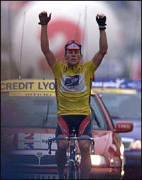
“Sweat” stands for hard work.
METONYMY
“Only through the sweat of your brow can you achieve success”

Slide 58
HEROIC COUPLET
A pair of rhymed verse lines that contain a complete thought.

Slide 59
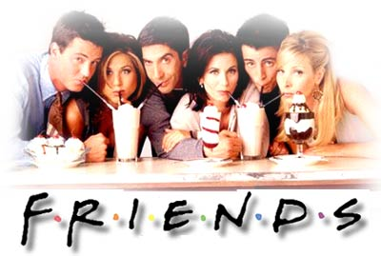
HEROIC COUPLET
“But if the while I think on thee, dear friend,
All losses are restor’d and sorrows end.”

Slide 60
This powerpoint was kindly donated to www.worldofteaching.com
http://www.worldofteaching.com is home to over a thousand powerpoints submitted by teachers. This is a completely free site and requires no registration. Please visit and I hope it will help in your teaching.

