Slide 1





PART I Is Music Poetry?
Looking at lyrics in popular music

Slide 2

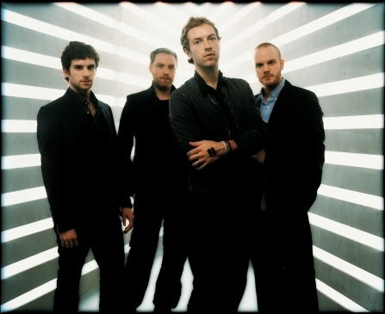
Coldplay’-Viva La Vida

Slide 3


Slide 4

The Lyrics to Viva la Vida
I used to rule the world Seas would rise when I gave the word Now in the morning I sleep alone Sweep the streets I used to own
I used to roll the dice Feel the fear in my enemies eyes Listen as the crowd would sing "Now the old king is dead! Long live the King!"
One minute I held the key Next the walls were closed on me And I discovered that my castles stand Upon pillars of salt and pillars of sand
I hear Jerusalem bells are ringing Roman Calvary choirs are singing Be my mirror my sword and shield My missionaries in a foreign field For some reason I can’t explain Once you know there was never, never an honest word That was when I ruled the world
It was the wicked and wild wind Blew down the doors to let me in Shattered windows and the sound of drums
People could not believe what I'd become Revolutionaries wait For my head on a silver plate Just a puppet on a lonely string Oh who would ever want to be King?
I hear Jerusalem bells are ringing Roman Calvary choirs are singing Be my mirror my sword and shield My missionaries in a foreign field For some reason I can’t explain I know Saint Peter won't call my name Never an honest word And that was when I ruled the world (Repeat)

Slide 5

Biblical allusion
The Bible is a powerful and influential book. Many of the worlds greatest authors, Christian or not, have recognized the Bible in their writings by using biblical allusions, or references. In fact, it is one of the common sources for literary allusions. Poems, novels, short stories, essays, and plays written by a myriad of writers include references, both direct and subtle, to the Bible.
But, allusions are only significant when you recognize them and their meaning. Let’s see if we can find some!

Slide 6


“Seas would rise when I gave the word”
Exodus 14:21 And Moses stretched out his hand over the sea; and the LORD caused the sea to go back by a strong east wind all the night, and made the sea dry land, and the waters were divided.

Slide 7
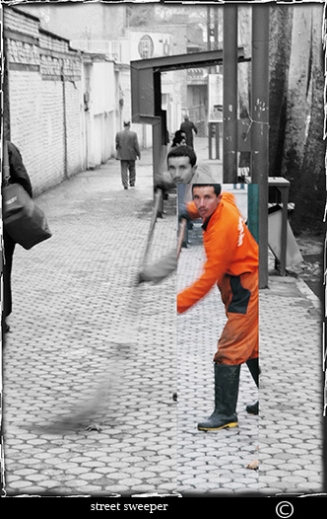

“Sweep the streets I used to own.”
From the words of Martin Luther King, Jr., "If a man is called to be a street sweeper, he should sweep streets even as Michelangelo painted or as Beethoven composed music. He should sweep streets so well that all the host of heaven and earth will pause and say, here lived a great street sweeper who did his job well."
Notes:
http://www.worldsweeper.com/History/index.html

Slide 8
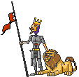
“The old king is dead. Long live the king!”
"The King is dead. Long live the King!” is a traditional proclamation made following the succession of a new monarch in various countries, such as the United Kingdom, Canada and others.

Slide 9
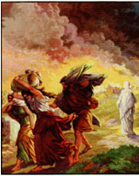
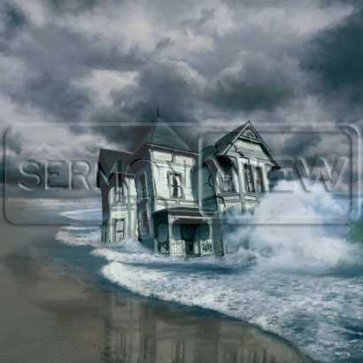
“Upon pillars of salt and pillars of sand.”
In a very familiar parable, Jesus tells the story of two home builders. One built a house on sand, the other on rock. The house on the rock withstood the weather. The one that built on sand did not fare so well: “The rain fell, and the floods came, and the winds blew, and they beat upon that house, and it fell, and great was the fall thereof” (Matthew 7:24-29).
Gen. 19:23 "the LORD rained upon Sodom and upon Gomorrah brimstone and fire from the LORD out of heaven; (25) And he overthrew those cities, and all the plain, and all the inhabitants of the cities, and that which grew upon the ground. (26) But his wife looked back from behind him, and she became a pillar of salt."

Slide 10
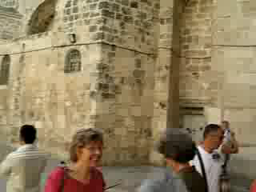
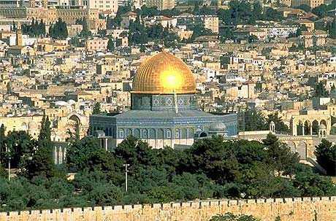
“I hear Jerusalem bells are ringing.”

Slide 11
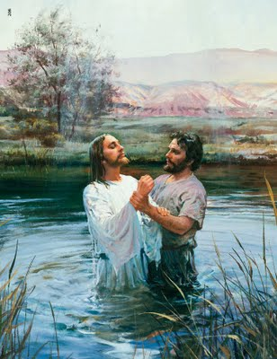
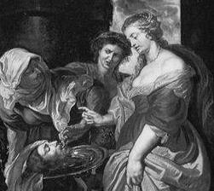
“Revolutionaries wait for my head on a silver plate”
Matthew 14:6-8
⁶ On Herod's birthday the daughter of Herodias danced for Herod and his guests. She pleased Herod very much. ⁷ So he promised with an oath to give her anything she asked for. ⁸ Her mother told her what to say. So the girl said to Herod, "Give me the head of John the Baptist on a big plate."

Slide 12
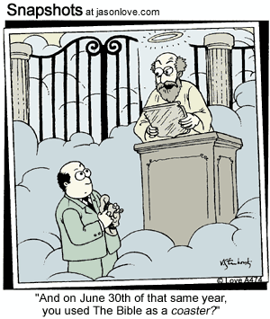
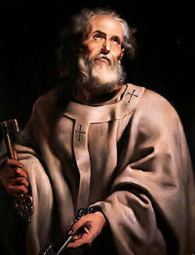
“I know St. Peter won’t call my name”
A leader in the early Christian church. Roman Catholic tradition states
that he was the first pope and thus holds the keys to heaven. In popular culture he is often depicted as a man who stands at the pearly gates of heaven's main entrance, acting as a sort of hotel-style doorman/ bouncer who personally interviews prospective entrants into Heaven.

Slide 13

Let’s review!!
I used to rule the world Seas would rise when I gave the word Now in the morning I sleep alone Sweep the streets I used to own
I used to roll the dice Feel the fear in my enemies eyes Listen as the crowd would sing "Now the old king is dead! Long live the King!"
One minute I held the key Next the walls were closed on me And I discovered that my castles stand Upon pillars of salt and pillars of sand
I hear Jerusalem bells are ringing Roman Calvary choirs are singing Be my mirror my sword and shield My missionaries in a foreign field For some reason I can not explain Once you know there was never, never an honest word That was when I ruled the world
-I used to rule the world
-I almost had supernatural power.
-Now in the morning I sleep alone.
-I have to serve others.
-I used to take chances.
-People were frightened of me.
-People proclaimed me as king when I took over the old king’s position.
-I used to be in charge.
-Then everything crumbled around me.
-Everything I had built and achieved was destroyed.
-Now I am turning towards spiritual help.
-I need strength and protection.
-I am lost and can only reflect on how it used to be.

Slide 14

Let’s Review!
-It was like an act of God knocked everything I had down.
-It shattered everything.
-People were shocked to see how far I had fallen.
-I used to be so important and powerful that those against me (my enemies) wanted me dead. But, I was really just doing what other people wanted me to. Who would want to be king?
- Saint Peter won’t find me worthy to enter the gates of heaven. I will be turned away.
It was the wicked and wild wind Blew down the doors to let me in Shattered windows and the sound of drums
People could not believe what I'd become Revolutionaries wait For my head on a silver plate Just a puppet on a lonely string Oh who would ever want to be King?
I hear Jerusalem bells are ringing Roman Calvary choirs are singing Be my mirror my sword and shield My missionaries in a foreign field For some reason I can not explain I know Saint Peter won't call my name Never an honest word And that was when I ruled the world (Repeat)

Slide 15
So what does the song mean?
Here’s what some people think:
*a paranoid monarch (king)?
*Jesus Christ?
*Napoleon Bonaparte?
*King Louis XVI?
*Pontius Pilate

Slide 16

Do your own poetic analysis.
Label the rhyme scheme on your paper.
REMEMBER: the first line will be “A” and any other end line word that rhymes with it will be “A” no matter where it is in the poem.

Slide 17

Part II
FREE VERSE POETRY-
a type of poetry that does not have a specific structured rhythm or rhyme and can sound very conversational.

Slide 18
FOUND POETRY:
is a specific type of Free Verse poetry created by taking specific words and phrases (sometimes whole passages) from other sources and reframing them as poetry.
EXAMPLE:
Written by Anonymous Scale in Men’s Locker Room, YMCA Boston, MA, 2009
Set the scale to zero before using
Written by Anonymous McDonald’s Marquee Stoughton, MA, 2004
August Seniors Welcome

Slide 19

Things that Go Away and Come Back Again a Free Verse poem by Anne Waldman
Thoughts
Airplanes
Boats
Trains
People
Dreams
Animals
Songs
Husbands
Boomerangs
Lightning
The sun, the moon, the stars
Bad weather
The seasons
Soldiers
Good luck
Health
Depression
Joy Laundry

Slide 20
Your mission:
To create your own Free Verse poem.
Specifically FOUND POETRY-(word snippets from magazines or newspapers)
1. every group will be given:
*paper *a packet of words
*glue stick
2. Your job is to create a Free Verse poem using at least 12 of the words you have been given. Paste them on your paper and be prepared to share what you’ve FOUND!

Slide 21
This powerpoint was kindly donated to www.worldofteahing.com
http://www.worldofteaching.com Is home to well over a thousand powerpoints submitted by teachers. This is a free site. Please visit and I hope it will help in your teaching

