Slide 1

Pop Music and Movies

Slide 2
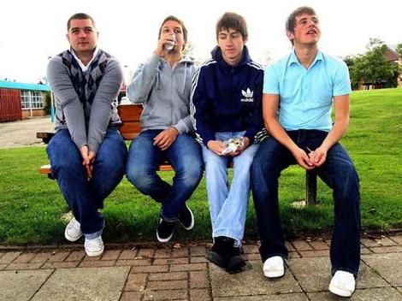
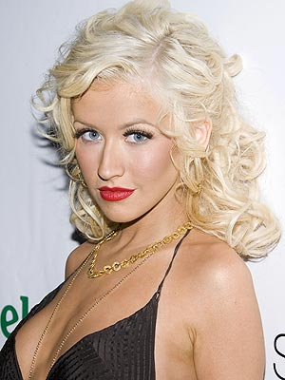
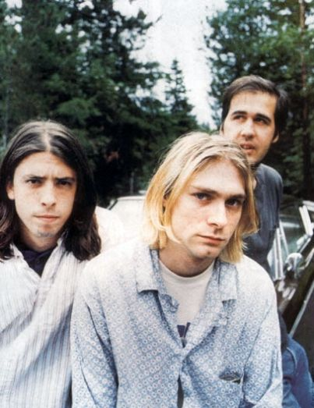
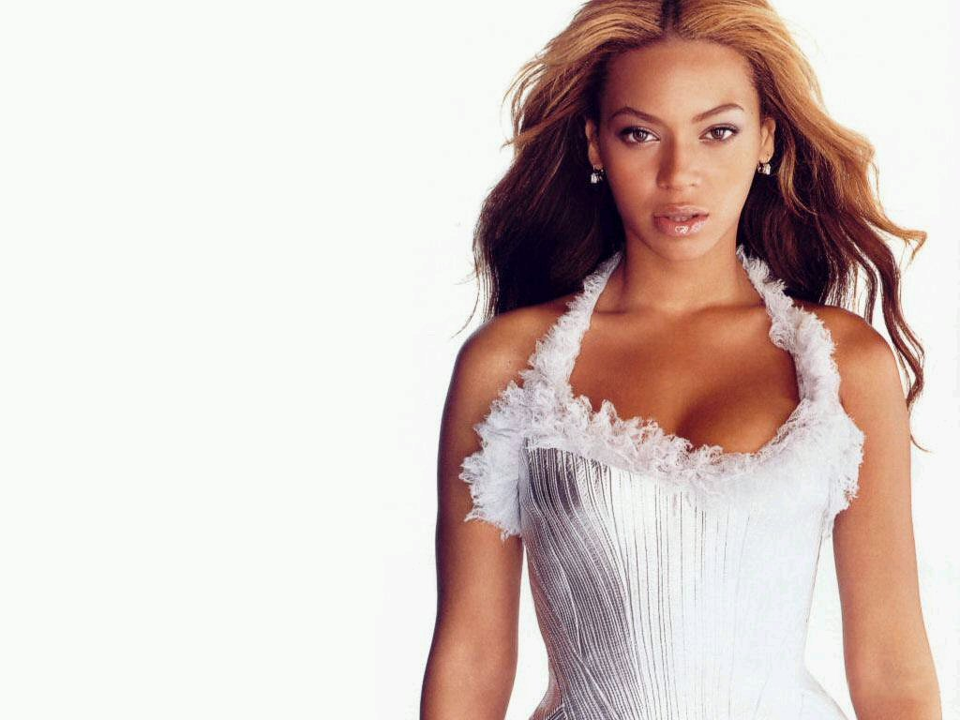
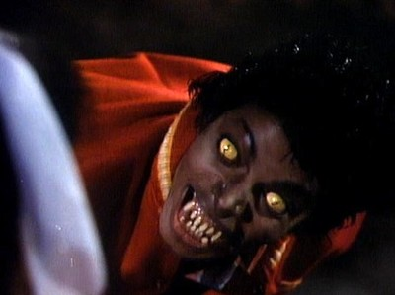
Pop Music and Movies
Discussion point – do the people below justify the fame, money and status they enjoy?
Do some deserve
more than others?

Slide 3

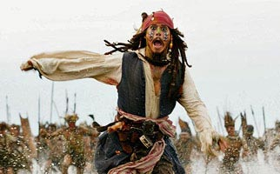
Pop Music and Movies
*Should there be a maximum
wage, for instance, for everyone,
big stars included?
* Do all such stars have the
genuine talent that no-one else
has?

Slide 4
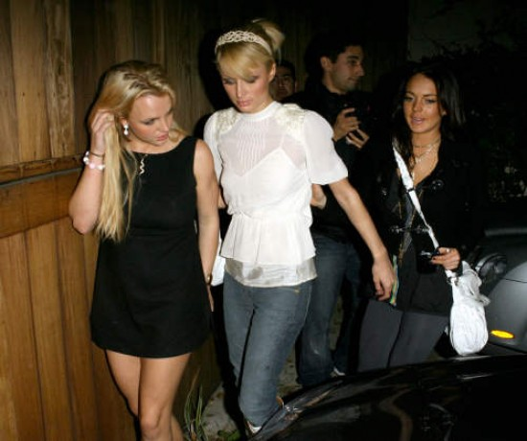
Pop Stars and Movies
Should stars like
these be left alone to
enjoy their night?
Or have they, by
becoming famous,
given up the right to the
privacy that you and
I take for granted?
And if they know that
they are in the public
eye, should they be aware of how their behaviour might influence fans?

Slide 5




Pop Stars and Movies
What about movie ratings? Can you name the 5 different ratings films must be given before they can be shown to the general public?
U
PG
12
15
18
If a movie is given one of these categories, what does it mean is contained within the film?

Slide 6

Pop Stars and Movies
Should people be allowed, in a democracy, to watch any movie they feel like, regardless of age? What restrictions would you make, if any, were someone to give you the authority…

