Slide 1
Quick Writing Review
The purpose of writing is to communicate your thoughts and feelings. This is your voice.

Slide 2

Your voice can be heard through writing.

Slide 3
Organize Your Thoughts
You must Organize Your Writing!

Slide 4
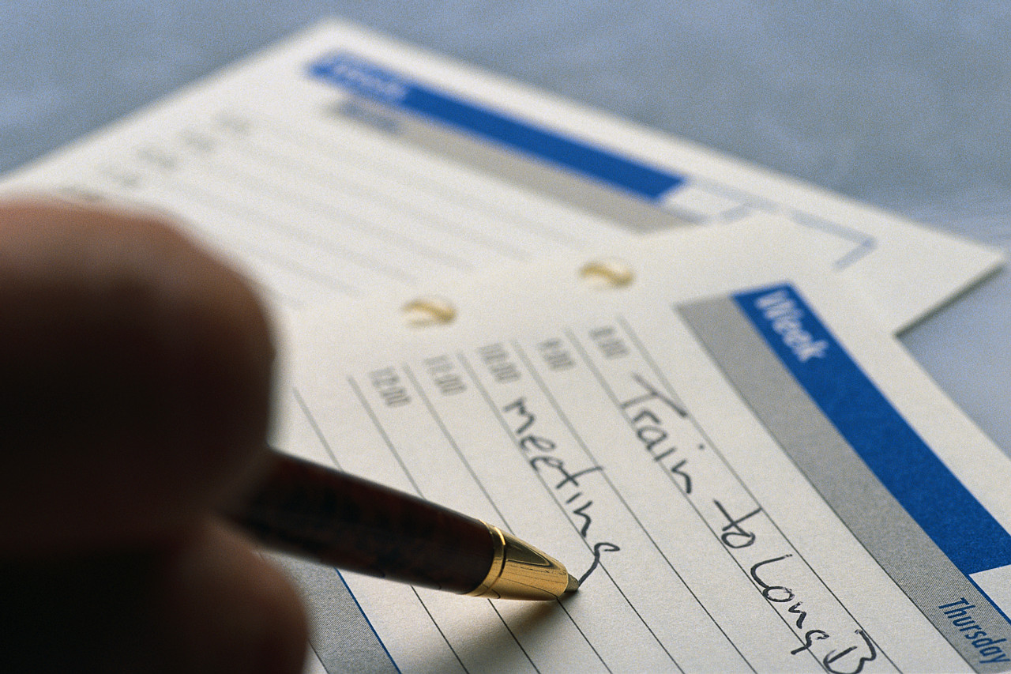
How to Organize
Introduction
Body Paragraph(s)
Conclusion

Slide 5
Introduction
The first paragraph should introduce the subject.
The first sentence of the introductory paragraph should start with a general statement.
Example: Most high school students are proficient at text messaging, however their writing skills are limited.

Slide 6
Introduction
The sentences following the general statement will be the basis for your body paragraph(s).

Slide 7

Body Paragraph(s)
The body paragraph(s) is where you elaborate on the subject.

Slide 8

Conclusion Paragraph
This “ties” together all that you have written.

Slide 9

i lk u 4 mi frnd
Yes!
Text messaging is communicating.
However, in English and the workforce this is unacceptable!

Slide 10

READ WHAT YOU WRITE
Read what you write, this will help you edit your paper.

Slide 11
This powerpoint was kindly donated to www.worldofteaching.com
http://www.worldofteaching.com is home to over a thousand powerpoints submitted by teachers. This is a completely free site and requires no registration. Please visit and I hope it will help in your teaching.

