Slide 1

Racism and Language
We often hear people complain about how ‘political correctness’ has ‘gotten out of hand.’ It is said by some that it is impossible to know what words are offensive and inoffensive to others. The implication is that society has become far too sensitive about identity.
Firstly, can you give a good working definition of the term ‘political correctness?’ What does it mean to you? Where and how did you come into contact with this particular definition?
What are the intentions behind this idea? What was it trying to do?

Slide 2
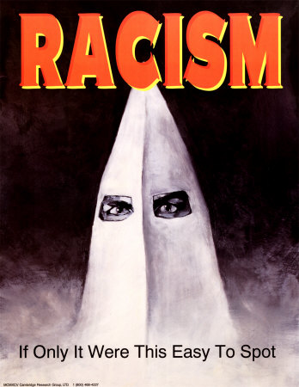
Racism and Language
3. Now list as many words or terms that you know are perceived as insulting, or belittling to different social groups (see Wikipedia for a full rundown of ‘ethnic slurs’). Do you know the provenance of any of these terms? Where did they originate and in what context are they used?
4. Political correctness – in its modern usage,
the term ‘political correctness’ is said to
have emerged in the 1960s. It was initially
taken seriously as an idea by the Radical Left
but its meaning mutated to the extent that it
became a means of self-criticism and
self-satire.

Slide 3
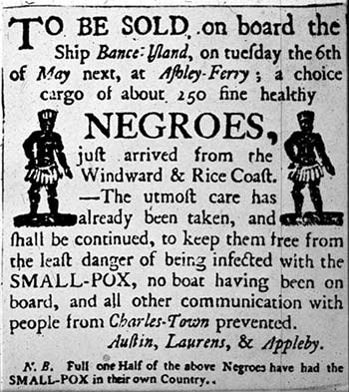
Racism and Language
For instance, T.Bambara’s ‘The Black Woman’ argued that ‘a man cannot be politically correct and a male chauvinist too.’ At this stage the term is taken seriously. Personal behaviour was under scrutiny, and was expected to reflect the individual's professed politics. Fair enough you might say. Pulling out ‘Penthouse’ and expecting your partner to get the household chores completed, whilst simultaneously defining yourself as a Feminist was not particularly consistent!
However as the term took on a different meaning
it became a means of self-satire, a guard
against orthodoxy in progressive social movements,
for instance in Feminism’s criticisms of the anti-
-pornography movement. (E. Willis)

Slide 4
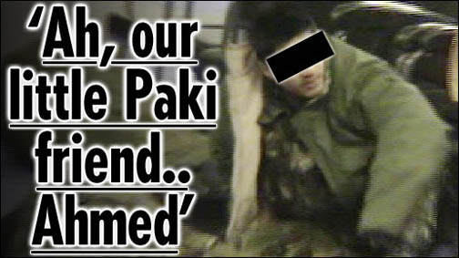
Racism and Language
However, before elements of Political Correctness began to reflect on the power of language, it was routine to hear racist, sexist, homophobic and xenophobic language on a daily basis, from buses and street corners to comedians, journalists and politicians.
Question – write done a list of emotions that might be experienced were you to be the subject of an insult that homes in on your race, sexuality, gender, disability. Why do these words have such an impact?
On the question of Prince Harry’s (and subsequently Prince Charles – heirs to the throne both), do you believe the response to their comments was disproportionate? Can such terms be seen as affectionate ‘nicknames?’

Slide 5
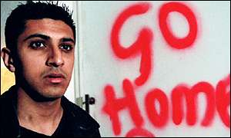
Racism and Language
The journalist Riazitt Butt reflects on
his experiences growing up in the UK in
the 1970s;
‘Growing up in the late 70s and 80s it was something that I often heard in the playground. It was something my dad heard at the factory he worked in. And there was never any reply. What do you say to someone who, in two syllables, has judged you to be second-class, dirty and disgusting?
Paki is the reason someone threw an egg at my brothers and sisters and me as we walked to school. I can't forget the shock, thinking someone had chucked a glass bottle at us. An egg, thrown from a moving car, really hurts. And what can you do when you're halfway between home and school with yolk running down the side of your face? You wipe it off with your sleeve and keep walking. It's a word that takes me back to my childhood, a time of fear and prejudice, when people could get away with racial abuse because it wasn't seen as racial abuse but as an acceptable term for a minority that looked funny and smelled funny.’
In other words, terms such as ‘Paki’ are not inoffensive terms of affection. They are often the prelude to vicious racist attacks.

Slide 6
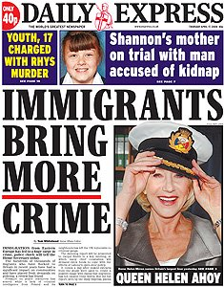
Racism and Language
What kind of society accustoms itself to perceiving women as ‘sluts,’ ‘dogs,’ ‘bitches,’ and regards such words as ‘only a bit of fun?’
Such terms originate as unambiguously pejorative. They are intended, without irony or humour, to undermine and dehumanise the individual. Suddenly, with the trigger of a single phrase, the individual is reduced to a ‘thing;’ a sum total of stereotypes and caricatures. S/he no longer has to be confronted as a human being, but as ‘culturally backward,’ ‘criminal,’ or ‘less than human’, and thereby less deriving of the rights others take for granted.
The process of dehumanisation has been used to justify slavery and the Jewish Holocaust. Words work. They lay the groundwork and offer licence to real, political bigots.
Words are simply the thin end of the wedge; headlines like
the one opposite serve simply to soften up public opinion
so that the groups targeted feel powerless and alone, while
the rest of us feel under no obligation to offer support or
sympathy. Why should we? They are taking our jobs and
bringing crime to our streets.

Slide 7
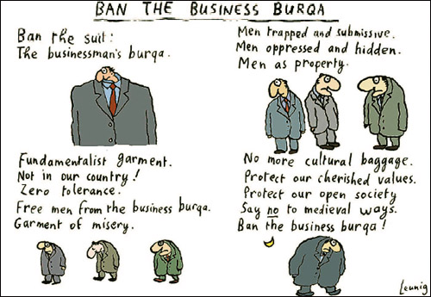
Racism and Language
Can language be reclaimed? Many black males call one another ‘nigger,’ a powerful word infused with racist meaning.
Hip hop music in particular is littered with its usage. But many black people are uncomfortable about this attempt to diffuse a term previously burdened with racist baggage. Use of the word is now banned from stages around New York.
Gay men and women have also attempted to reconfigure the meanings of ‘queer’ and ‘dyke.’
But for Riazat Butt: ‘There is always talk when incidents like these occur of the power that can be derived from reclaiming a word. But I never associated ‘Paki’ with anything positive. Nobody could or should try to reclaim it.’

Slide 8
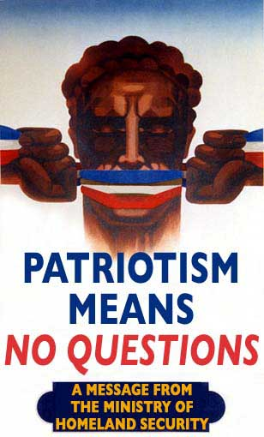
Racism and Language
In fact it is often the political Right who seek to police our thoughts and language, and from far more sinister motives than the empowering of marginalised social groups.
‘The ugliest forms of political correctness occur when there is a war on. Then you’d better watch what you say.’ (D.Williams)
In the aftermath of 9/11, any US citizen seeking to question the strategy of their government left them vulnerable to attacks from powerful voices. Dissenting ideas were labelled as ‘treasonous’ by shock-jocks such as Bill O’Reilly. A mood of fear and loathing overtook both the printed and visual media. They became besotted with their own version of
‘political correctness’: Thou Shalt Not Question Anything.

Slide 9
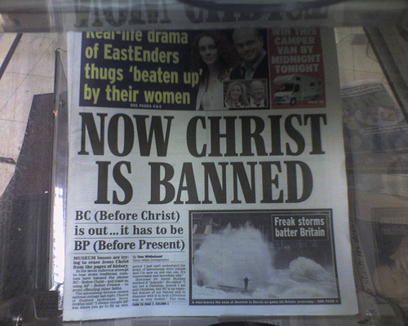
Racism and Language
Critics of political correctness have been accused of showing the same sensitivity to words as those they claim to be opposing, and of perceiving a political agenda where none exists. For example, during the 1980s, a number of news outlets claimed that a school altered the nursery rhyme "Baa Baa Black Sheep" to read "Baa Baa Rainbow Sheep." In fact, the nursery, run by Parents and Children Together (Pact), simply had the kids "turn the song into an action rhyme. ... They sing happy, sad, bouncing, hopping, pink, blue, black and white sheep etc." The spurious claim about the nursery rhyme was widely circulated and later amplified into a suggestion that similar bans applied to the terms "black coffee" and "blackboard." According to Private Eye magazine, similar stories, all without factual basis, have run in the British press since first appearing in The Sun in 1986.

Slide 10
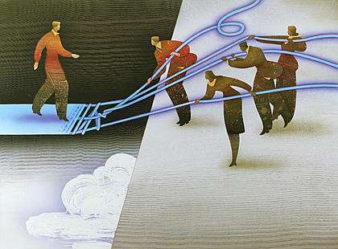
Racism and Language
So, language and our use of words clearly have an impact. They can be used to unite and find common identities and values, or they can be used to drive a wedge between people from diverse social groups. They can confirm or they can diminish an individual’s humanity and individuality.
But the controversy remains: we should of course be able to talk to each other about any issue at all. This is how people come to understand one another. By talking we can identify common values. ‘Political correctness’ or whatever you wish to call it, should not be about a simple censorship of words. There are words and phrases which are designed to offend and intimidate. But that should not stop us from discussing the subjects they often refer to: gender, sexuality, race, ethnicity, class.
In what ways should people approach such subjects? Can you think of descriptive words that define how we might begin to open up and talk honestly about these subjects that concern us all?

Slide 11
This powerpoint was kindly donated to www.worldofteaching.com
http://www.worldofteaching.com is home to over a thousand powerpoints submitted by teachers. This is a completely free site and requires no registration. Please visit and I hope it will help in your teaching.

