Slide 1
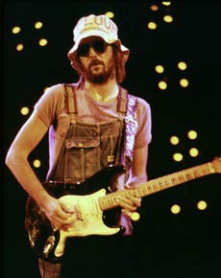
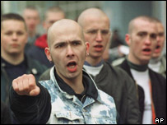
Rock Against Racism
On the 5th August, Eric Clapton took the stage at the Birmingham Odeon. ‘Enoch was right,’ he said. ‘We should send them all back.’ According to Clapton, a musician who throughout his life had appropriated African American music to inspire and underwrite his own creativity and success, Britain was in danger of becoming a ‘black colony.’
His drunken invective was not released into a vacuum. The National Front had recently won around 40% of the vote in Blackburn. Racist attacks were on the rise. The intervention of fascist ideas into mainstream politics seemed a real possibility. Significant numbers of the population were being seduced by the Far Right and the violent solutions they offered to economic and social ills. An ugly mood pervaded the country.
Gurdip Singh Chaggar had been murdered by a gang of racists in Southall. The NF commented ‘One down, a million to go.’
Musicians as diverse as Sid Vicious and David Bowie were flirting with Nazi imagery and rhetoric. Much of this represented a desire to shock. Others were perhaps less innocent. Bowie thought Hitler ‘one of the first rock stars.’

Slide 2
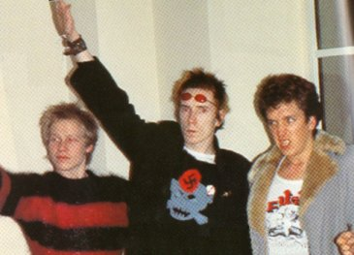

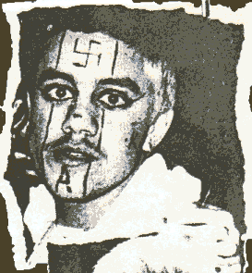
Rock Against Racism
It was against this background that a number of people – Red Saunders amongst them – decided to act.
Following Clapton’s drunken outburst, a letter appeared in a number of publications, the Melody Maker and NME included. It was a call to arms against fascism and racism, a public riposte to Clapton’s bigotry.
Rock Against Racism was born.
Soon, gigs began to spring up around the country. A RAR magazine, Temporary Hoarding, began publishing. ‘We want Rebel music, street music, music that breaks down people's fear of one another. Crisis music. Now music. Music that knows who the real enemy is,’ said editor David Widgery.

Slide 3

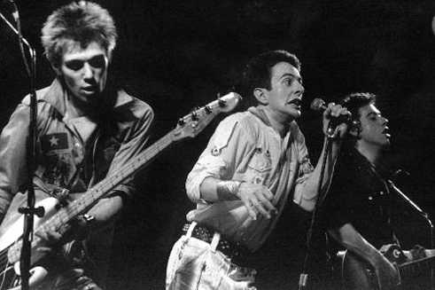
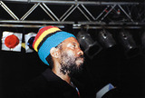
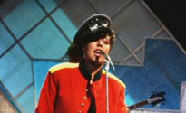
Rock Against Racism,
As momentum began to build, a concert was planned for Victoria Park on 30th April 1978. The Clash were to headline, and in the tradition of the RAR gigs up until that time, a line-up reflecting the diversity of the UK was booked. Punk, reggae and everything in between was represented.
Three weeks before the concert, 10 year old Kenneth Singh was murdered in a racist attack yards from his home in East London. It was a brutal reminder of what ethnic minority communities were up against. His killers have never been identified.

Slide 4


Rock Against Racism
What remains a central and crucial feature of RAR is its grassroots identity.
‘I remember that we would get a phone call,’ says Saunders. ‘They would say I want to join my nearest RAR group, and we would say where do you live, and they would say Lowestoft, so we’d say: you are now the Lowestoft RAR.’
It is this that most distinguishes Love Music Hate Racism from the passive spectacles of Band Aid or Live 8.
However well-meaning, these are ‘events.’ They are not designed to mobilise people, or to engineer a shift in political consciousness.
RAR and LMHR have higher ambitions…

Slide 5
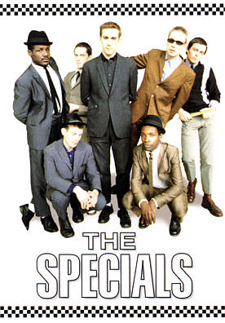

Love Music Hate Racism
The official history charting the demise of the National Front suggests Mrs Thatcher’s Conservatives stole the political rug from under the fascists with her talk of ‘alien cultures swamping Britain.’ Reasserting the grassroots roles played by people organising in their communities can be difficult. It is a valuable lesson; fascism and racism are most effectively confronted by ordinary people.
Clapton has never retracted his remarks. In fact he has restated them as recently as 2007. ‘Powell was outrageously brave,’ he says now.
Don Letts, a DJ and video director, pinpoints how racist ideas can adapt and mutate like a virus to exploit modern insecurities. ‘I was talking to my brothers and other black friends, and they are complaining about the Poles, and I say to them – brethren, that was us 40 years ago.’
As Jerry Dammers of the Specials says, the fascism we have now is of a ‘bland’ variety. It may be all the more dangerous as it attempts to superficially shed its baggage of thuggish racism.

Slide 6
This powerpoint was kindly donated to www.worldofteaching.com
http://www.worldofteaching.com is home to over a thousand powerpoints submitted by teachers. This is a completely free site and requires no registration. Please visit and I hope it will help in your teaching.

