Slide 1
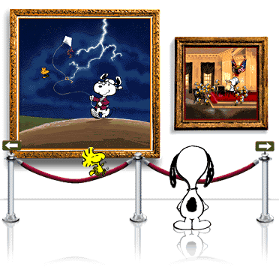
What is this stuff?
Shakespeare’s Quotable Quotes from Romeo and Juliet
By Tricia Cooney

Slide 2


“My child is yet a stranger in the world,
She hath not seen the change of fourteen years,
Let two more summers wither in their pride
Ere we may think her ripe to be a bride.”
“here is much to do with hate, but more with love,

Slide 3
I ii 9-11
P 744 (text)
My daughter Juliet is only 13
Let’s wait two more years, then she will be ready to be married.

Slide 4

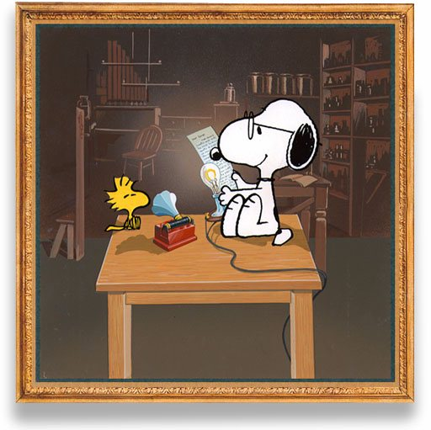
LINE SEARCH!!
I ii 24-28
Look this up!
What is being said?

Slide 5
P 745
Party – my house tonight!
Young, beautiful girls will be there
You will forget about marrying Juliet so soon.

Slide 6
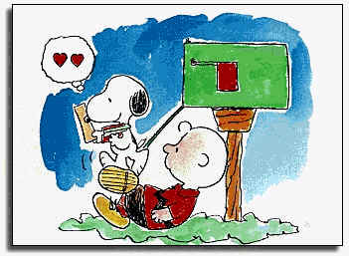
…if you be not from the house of Montagues, I pray come and crush a cup of wine. Rest you merry.
I ii 82-84

Slide 7
P 747
If you are NOT a Montague you are welcome to come to the party.
This is how Romeo finds out there will be a party and that Rosaline will be there.
Check several lines earlier for confirmation of who will be hosting the party.

Slide 8

“Go, girl, seek happy nights to happy days”
I iii 106

Slide 9
P 751
Nurse is speaking to Juliet
The Nurse is her friend and counsel
The Nurse encourages Juliet to find a suitable husband so she can have a happy life.

Slide 10












Slide 11
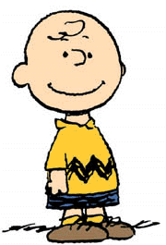
“With Rosaline my ghostly father? No I have forgot that name and that names woe.”
II iii 46

Slide 12
Page ??
Romeo is speaking to Friar Lawrence
Romeo tells Friar Lawrence that he has forgotten Rosaline and all the heartache associated with her.
Romeo has fallen in love with Juliet and he feels certain of this because he no longer remembers Rosaline.

Slide 13

“Wisely and slow. They stumble that run fast.”

Slide 14
II iv 94
P 776
Friar Lawrence speaks to Romeo about the dangers of rushing into a situation.
Friar Lawerence speaking to Romeo
Why might anyone think Romeo is RUSHING into anything?

Slide 15
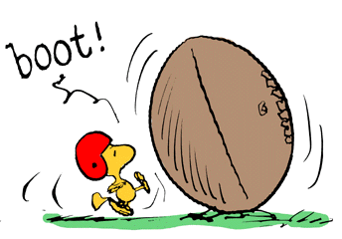
“Well, do not swear. Although I joy in thee,
I have no joy of this contract to night.
II ii 116-117

Slide 16
Juliet says that things are moving too quickly
She thinks they cannot swear their love tonight
Romeo will reply how?

Slide 17
“Go, you cotquean, go.”
IV iv 6

Slide 18
P 827
The Nurse is speaking to Lord Capulet
Cotquean – old woman (a man who acts like an old woman)
Capulet is up tending to the preparations of the feast.
It’s almost three in the morning
The nurse is making fun of him and trying to send him to bed.

Slide 19
“Death lies on her like an untimely frost
Upon the sweetest flower of the field”
IV v 29
P 829
Lord Capulet upon seeing his daughter dead
She was too young to die

Slide 20

I hope you have a great day!
A.C.A.

Slide 21

“Parting is such sweet sorrow that I shall say good night till it be morrow.
I love you and want to be with you all the time – it’s so hard to leave you ….

Slide 22
BUT …
I’VE HAD ENOUGH OF YOU TODAY!!!

Slide 23
This powerpoint was kindly donated to www.worldofteaching.com
http://www.worldofteaching.com is home to over a thousand powerpoints submitted by teachers. This is a completely free site and requires no registration. Please visit and I hope it will help in your teaching.

