Slide 1
Michele Douglas
Graves County High School
Introduction to
Romeo and Juliet
Presented November 2002

Slide 2
William Shakeapeare’s
Life and Times

Slide 3
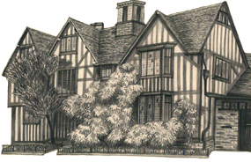
Hall’s Croft
Shakespeare was born in 1564 in Stratford-on-Avon
Son of John & Mary Arden
Similar to the home young Shakespeare may have grown up in.

Slide 4
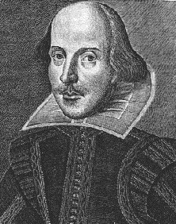
William Shakespeare
Grammar School
1583 Married Anne Hathaway
Susanna, Hamnet, Judith
Seven Dark Years

Slide 5
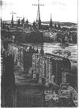
London in 1600’s
Conditions in London were not pleasant.
Homes of the poor were small and dirty
Sewage ran in open ditches in the streets
Overcrowding and unemployment were major problems.

Slide 6
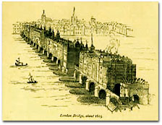
London Bridge
Heads of traitors were displayed on pikes on the city’s main bridge.

Slide 7


The New Globe

Slide 8
The Globe
Located on the south bank of the Thames
The most famous London Playhouse
Owned by the Burbage family
Flew a flag to announce a performance
Acting companies used boys to play female roles.
Shakespeare was a member of Lord Chamberlain’s Company. Later called the King’s Men.

Slide 9
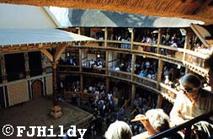
The wealthy’s view of the stage

Slide 10
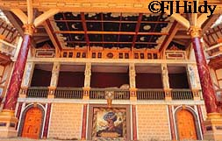
“The Heavens”
as seen by the groundlings

Slide 11
Objections to Theaters
Large assemblies of people
Spread diseases
Guilt by association
Theaters were often located outside the city walls to avoid censor by London’s Lord Mayor.

Slide 12
Romeo and Juliet
Written in 1599
Celebrates the passion of youthful love
Dates back to 400 AD in a Greek Romance
Feud--a prolonged conflict between families.
The feud is so old that the cause has been forgotten.

Slide 13
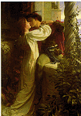
The Balcony Scene
“Romeo, Romeo, Wherefore art thou Romeo?”
Remember: Wherefore means “Why”

Slide 14
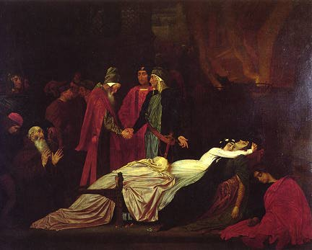
Star Crossed Lovers
Romeo and Juliet is a tragedy.
In a tragedy many of the main characters die.

Slide 15
The End

Slide 16
This powerpoint was kindly donated to www.worldofteaching.com
http://www.worldofteaching.com is home to over a thousand powerpoints submitted by teachers. This is a completely free site and requires no registration. Please visit and I hope it will help in your teaching.

