Slide 1
How to make your
Schoolnotes.com
page exciting!!

Slide 2
Set up your account
Go to www.schoolnotes.com
Click Teachers Register Here
You can go to User’s Guide(at the top corner of the page) for help in setting up your account.
To access your account go to www.schoolnotes.com and click on the Edit Notes tab.

Slide 3
Parent Contact
Schoolnotes.com allows parents to log on and see what is going on in class.
This is a good way to document parent contact by checking the number of visits to your site each month.
Parents can email you with questions or comments.
Students (or their parents) can log on to see what assignments they missed while absent.

Slide 4
Text/Assignments
Put your lesson plans and/or homework assignments
Update daily or weekly
Ideas to leave on your page:
Birthdays for the month
Class rules/Discipline Procedures
Teacher wish list
Classroom updates, special days, etc.

Slide 5
Keep your “original” in Word
Type your setup in Word and save it
Each time you update your page, type it in word to check for grammar/spelling errors.
Copy & paste your assignments from Word to your schoolnotes.com page.
SAVE, SAVE, SAVE!!! Make sure to click on the save button when you finish your page, even before previewing it!

Slide 6
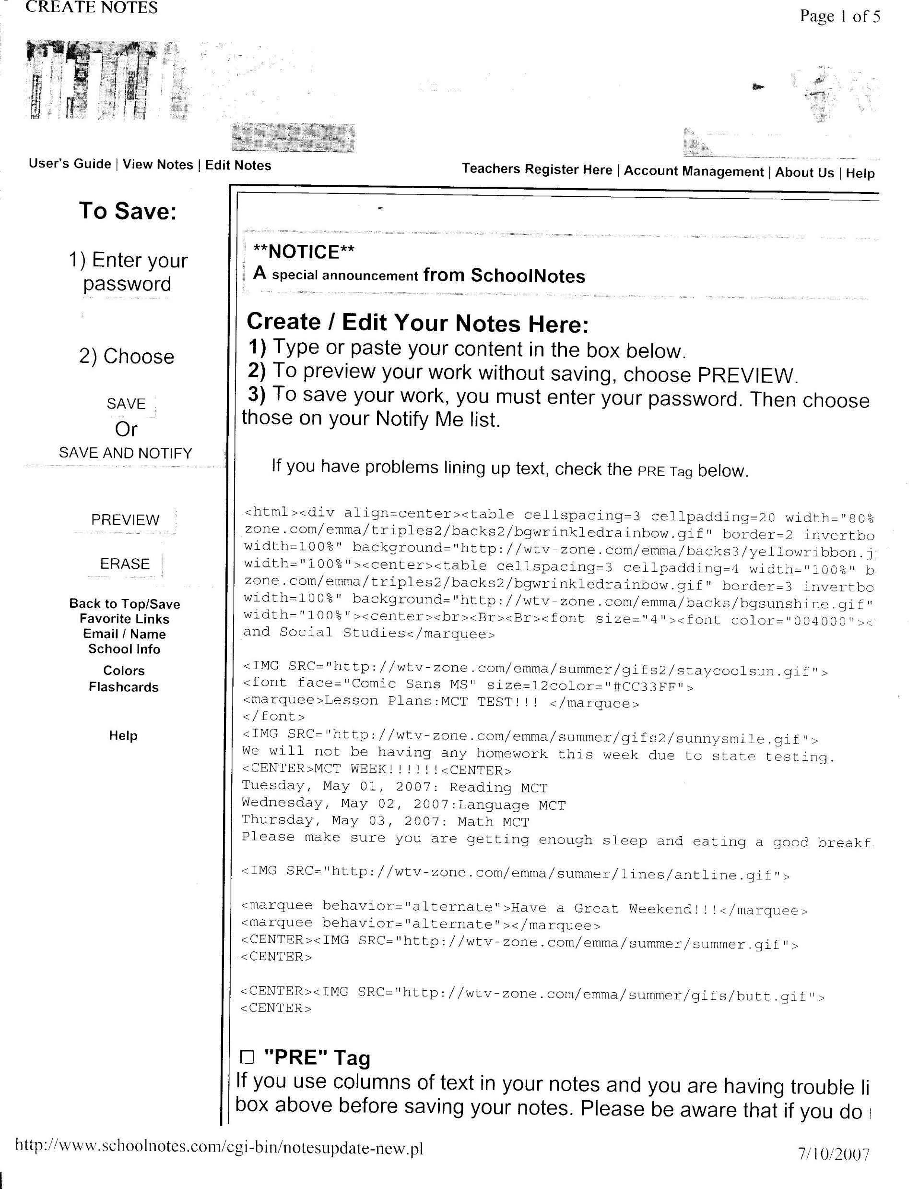
Example page:
Password
Type Notes in box
SAVE!!!
The SAVE & NOTIFY button allows you to notify parents who have signed up for automatic updates to receive an email saying your page has been updated.

Slide 7
Have fun with your text
Create some scrolling marquees to break the monotony of your page
Annabella’s HTML Help will give you commands to use with your text.
Example of a command:
<marquee behavior=“alternate”>Have a great weekend!!!</marquee>
Your text goes in between the command.

Slide 8
Background
Backgrounds are a fun way to add spice to your page!
Triple Back Sets with Emma is a great site to get a variety of backgrounds to use. It is a long & strange looking command to paste but it makes a great difference to your page.
You can also use the default backgrounds on your schoolnotes.com page for plain color backgrounds.

Slide 9
Graphics
In order for an image to appear on your page, you must copy the shortcut link from the WebPages and paste it on you schoolnotes.com page.
You must type in the command <IMG SRC=“”>
The WebPage you copied the shortcut from is pasted in between the quotation marks.
Example:
<IMG SRC=“http://snhelp.edgate.com/images/penc2-I.gif”>

Slide 10
List of sites to aid you
Annabella’s HTML Help
http://www.annabella.net/marquee.html
Triple Back Sets with Emma
http://wtv.zone.com/emma/triples.html
School Days with Emma
http://wtv.zone.com/emma/school/school.html
Welcome to the Zoo
http://wtv.zone.com/zoo/zoo.html
Schoolnotes.com Sound Page
http://snhelp.edgate.com/sound_webpage/Sound.htm
Schoolnotes.com Image Tag Examples
http://snhelp.edgate.com/image_tag_webpage/Image_Tag_Examples.htm
Midis with Emma
http://d21c.com/emma3/midis2.html

Slide 11
Don’t stress out!
If you can’t “get it” as far as the graphics and background go, just do the main objective.
Get the lesson plans and homework online, then take the “pretty stuff” a little at a time.
When in doubt…ASK FOR HELP!!!

Slide 12
Good Luck
&
Have Fun !

Slide 13
This powerpoint was kindly donated to www.worldofteaching.com
http://www.worldofteaching.com is home to over a thousand powerpoints submitted by teachers. This is a completely free site and requires no registration. Please visit and I hope it will help in your teaching.

