Slide 1
Shakespeare Sonnets
English
Year 9

Slide 2
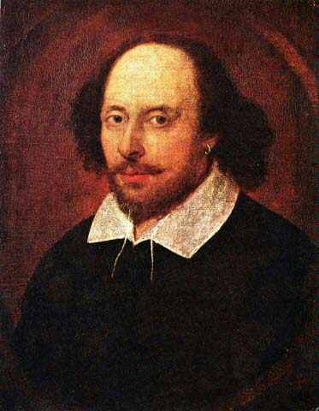
William Shakespeare

Slide 3

What is a sonnet?
Iambic what?
Oh dear, this is
going to be a
weird lesson!
A sonnet is a fourteen-line poem in iambic pentameter.

Slide 4

Iambic Pentameter
Iambic Pentameter is the rhythm and metre in which poets and playwrights wrote in Elizabethan England. It is a metre that Shakespeare uses.

Slide 5
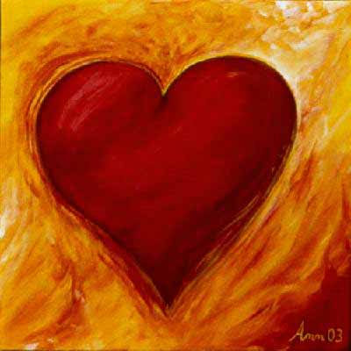
Heartbeat.
Quite simply, it sounds like this: dee DUM, dee DUM, dee DUM, dee DUM, dee DUM. It consists of a line of five iambic feet, ten syllables with five unstressed and five stressed syllables. It is the first and last sound we ever hear, it is the rhythm of the human heart beat.

Slide 6
Pentameter?
Well an ‘iamb’ is ‘dee Dum’ – it is the heart beat.
Penta is from the Greek for five.
Meter is really the pattern
So, there are five iambs per line!
(Iambic penta meter )

Slide 7
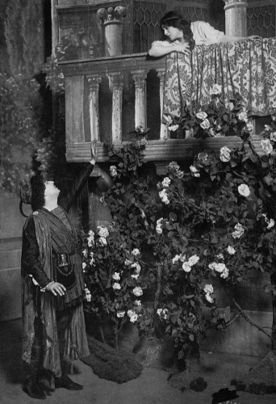
It is percussive and attractive to the ear and has an effect on the listener's central nervous system. An Example of Pentameter from Shakespeare: but SOFT what LIGHT through YONder WINdow BREAKS

Slide 8
Syllables
What is a syllable?
Well, there are three syllables (separate sounds) in the word syllable!
“But soft, what light through yonder window breaks.”
How many syllables are there in that quotation?

Slide 9
“But soft, what light through yonder window breaks.”
Write this down and underline the stressed words. If you cannot remember, go back to slide 5.
This rhythm is iambic pentameter!
Well done!

Slide 10
Back to sonnets.
Well, it is a poetic form.
But it has a certain structure as well as a rhyming pattern.

Slide 11
Rhyming patterns
The Shakespearean sonnet has three quatrains followed by a couplet, the scheme being: abab cdcd efef gg.
More head scratching?

Slide 12
Quatrain?
Quatrains are four line stanzas of any kind
I have divided the following sonnet into the three quatrains.
You will also see the rhyming pattern
marked out for you.

Slide 13
Sonnet 116
Let me not to the marriage of true minds (a)
Admit impediments. Love is not love (b)
Which alters when it alteration finds,(a)
Or bends with the remover to remove:(b)
O, no! it is an ever-fixed mark,(c)
That looks on tempests and is never shaken;(d)
It is the star to every wandering bark,(c)
Whose worth's unknown, although his height be taken.(d)
Love's not Time's fool, though rosy lips and cheeks(e)
Within his bending sickle's compass come;(f)
Love alters not with his brief hours and weeks,(e)
But bears it out even to the edge of doom.(f)
If this be error and upon me proved,(g)
I never writ, nor no man ever loved.(g)

Slide 14
What does it mean?
Let me not declare any reasons why two
True-minded people should not be married. Love is not love
Which changes when it finds a change in circumstances,
Or bends from its firm stand even when a lover is unfaithful:
Oh no! it is a lighthouse
That sees storms but it never shaken;
Love is the guiding north star to every lost ship,
Whose value cannot be calculated, although its altitude can be measured.
Love is not at the mercy of Time, though physical beauty
Comes within the compass of his sickle.
Love does not alter with hours and weeks,
But, rather, it endures until the last day of life.
If I am proved wrong about these thoughts on love
Then I recant all that I have written, and no man has ever [truly] loved.

Slide 15
Homework
1. What is a sonnet?
2. What is iambic pentameter?
3. What is the rhyming pattern of a Shakespearean sonnet?

