Slide 1
Spelling Spiders
Spelling Spiders Missing Letters - This is a literacy based activity that can be used again and again. There are twelve pre prepared slides that each has a bug related word of varying length and difficulty. The pupils are to write down what letter they think the missing one is before it is revealed by the spelling spider. A good way of assessing progress of the class is to use have the class hold up there answers thus giving a snapshot of your classes levels.
To change to words follow these steps;
  Choose a new word with 3,4,5 or 6 letters.
  Find one of the spider slides that have the same length word as your new word.
  Delete each letter and write your own letters in with a ‘?’ in the space for the missing letter/s.
  Put the missing letter/s in the speech bubble at the bottom of the page.

Slide 2

Spelling Spiders
A free resource from Lion Learners
Lion Learners
www.lionlearners.co.uk/resourcepacks

Slide 3
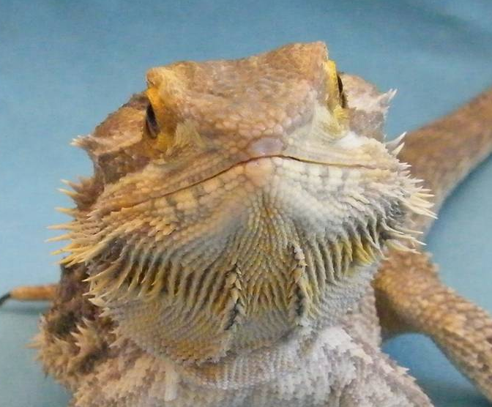
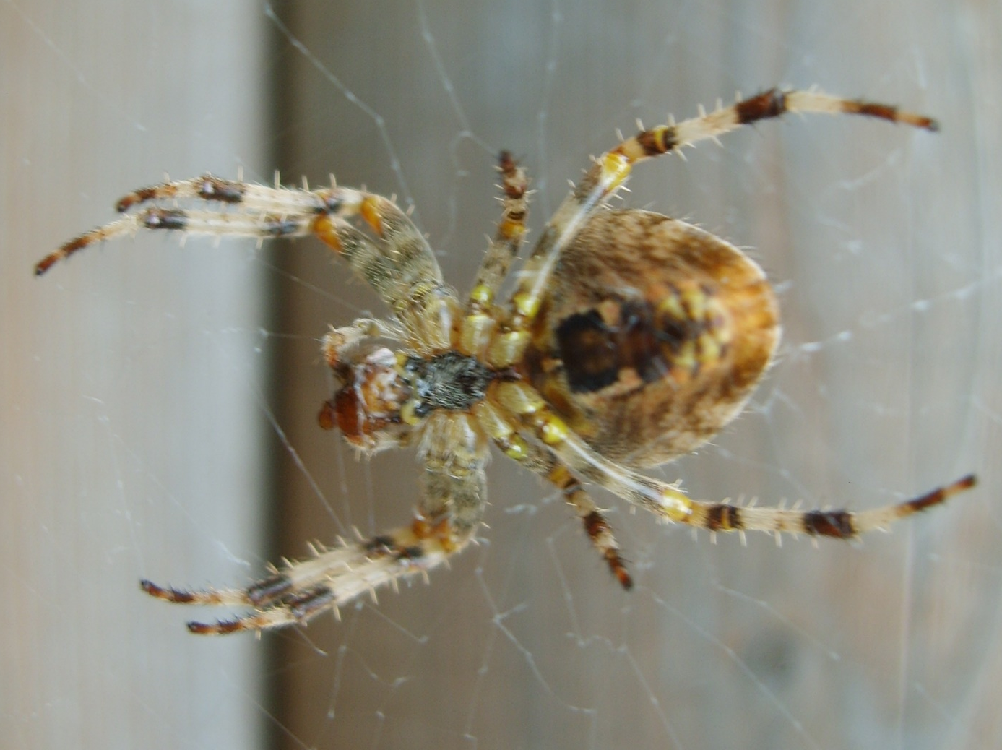
Spiders!
All spiders have 8 legs and are part of the arachnid
family which includes spiders, scorpions,
daddy-long-legs, ticks and mites. There are 640
different species of spider in the UK!
All spiders produce silk but not all spiders spin webs. Silk is used for climbing, to create webs and wrap prey.

Slide 4
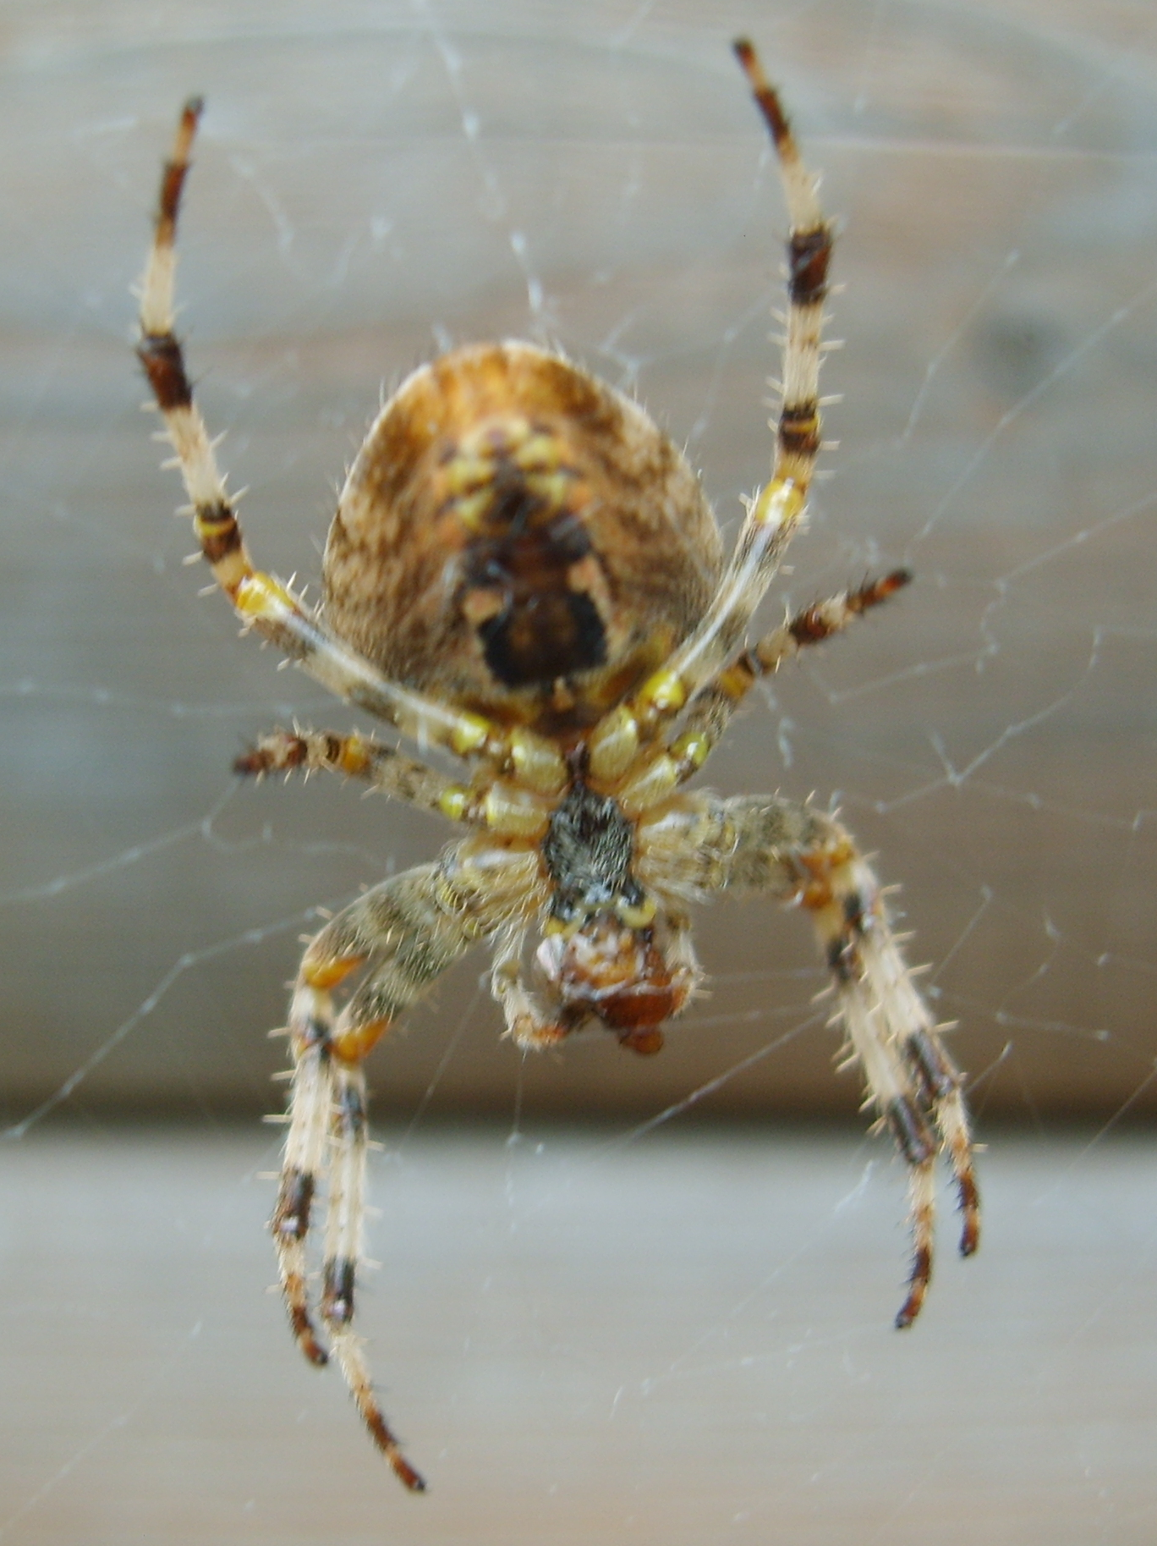
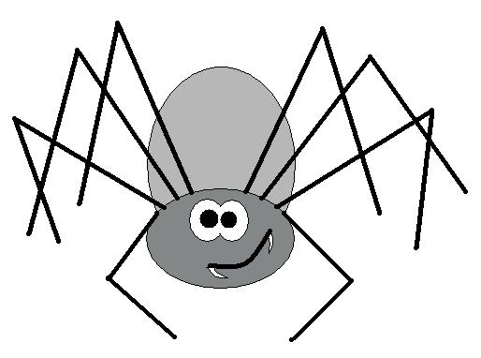
Spelling Spiders!
The spiders are going to spell out some key words and you have to guess the missing letter.
Lets find out if you’re a super spider speller!

Slide 5
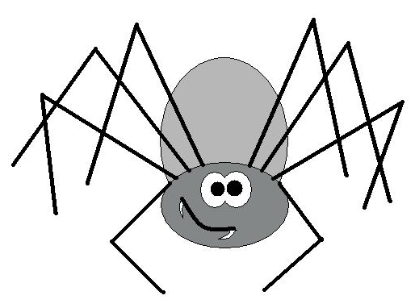
Can you guess the missing letter for each word?
?
P
I
D
E
R
The missing letter is
S

Slide 6
Can you guess the missing letter for each word?
B
?
E
The missing letter is
E

Slide 7
Can you guess the missing letter for each word?
E
?
G
The missing letter is
G

Slide 8
Can you guess the missing letter for each word?
F
L
?
The missing letter is
Y

Slide 9
Can you guess the missing letter for each word?
?
N
T
The missing letter is
A

Slide 10
Can you guess the missing letter for each word?
W
O
?
M
The missing letter is
R

Slide 11
Can you guess the missing letter for each word?
S
N
A
?
L
The missing letter is
I

Slide 12
Can you guess the missing letter for each word?
L
A
R
?
A
E
The missing letter is
V

Slide 13
Can you guess the missing letter for each word?
T
H
O
R
A
?
The missing letter is
X

Slide 14
Can you guess the missing letter for each word?
F
L
?
I
N
G
The missing letter is
Y

Slide 15
Can you guess the missing letter for each word?
?
E
E
T
L
E
The missing letter is
B

Slide 16
Can you guess the missing letter for each word?
I
N
?
E
C
T
The missing letter is
S

Slide 17
This powerpoint was kindly donated to
www.worldofteaching.com
http://www.worldofteaching.com
Is home to well over a thousand powerpoints submitted by teachers. This a free site. Please visit and I hope it will help in your teaching
Notes:
17

