Slide 1
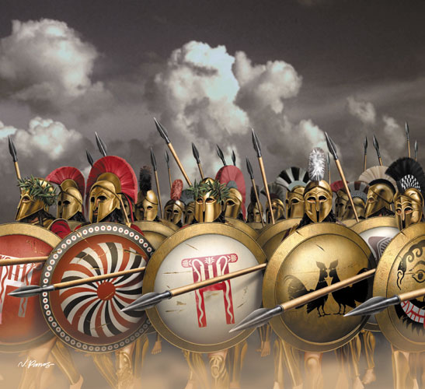
The Characteristics of the Greek Hero

Slide 2
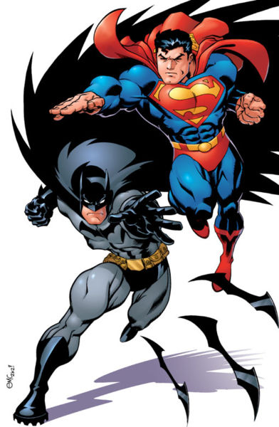
When we think of the word hero, what comes to mind?
Masked men in spandex, tights, and capes?
Tortured loners with no one to love?
Cool cars, hot women, and high-tech gadgets?
Superman?
Batman?
Spiderman?
Fireman?
Policeman?
Everyman?

Slide 3
What makes a hero in Greek Mythology?
Having one immortal parent
Being born into royalty
Having an unusual conception or birth
Being favored by the gods
Being the subject of a prophesy
Being abandoned at birth or while very young
Performing an amazing feat at a young age
Going on a quest
Traveling to the underworld
Marrying a princess
Dying an ignoble death

Slide 4
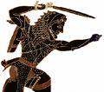
Unusual Conception / Birth
Heroes are often called “Demi-gods” because one parent is immortal and the other is mortal
Most famous heroes were the offspring of Zeus or Poseidon, but sometimes the parent was a goddess such as Aphrodite or Thetis
To further complicate things, often the heroes’ actual births involved strange complications

Slide 5
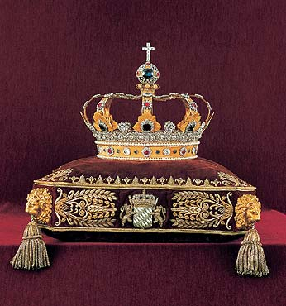
Born into Royalty
Heroes were almost always the offspring of a princess or queen
Typically the god responsible for the hero either came disguised as the husband of the queen, or the princess slept with a god and a mortal on the same night
Invariably the hero was claimed by his earthly father as well as his Olympian one

Slide 6
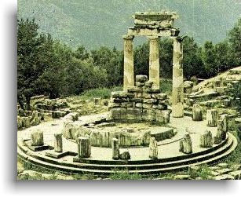
Prophesy / Abandoned at Birth
The fates or the oracle often had something to say about the birth of a hero
Often the prediction so frightened the parents that they abandoned the child in the wilderness, but since the heroic child was favored by the gods, he was saved and raised by someone other than his parents
Sometimes, through no fault of the parents, the child needed to be raised away from home

Slide 7
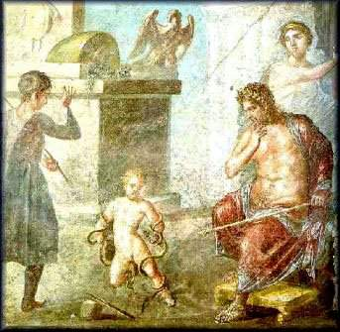
Performing an amazing feat at a young age
Young heroes invariable found a way to “strut their stuff” when they were wee tykes.
Heracles killed two snakes as a youngster, Theseus moved a huge rock and fought what he thought was a lion
These events were a heads
up that great things were in store for our heroes

Slide 8
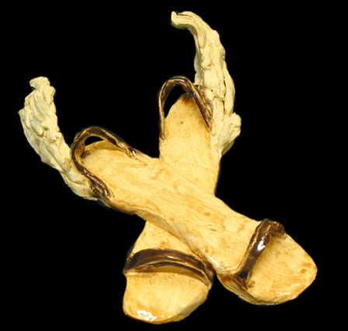
Favored by the Gods
Since heroes were the offspring of gods, usually they were favored by the gods.
A child of Zeus would get help on a quest by Zeus or another Olympian
Special gifts such as helmets, winged sandals, and golden bridles were loaned to the heroes

Slide 9
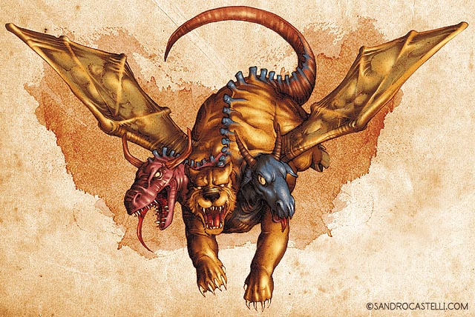
Quests, Kleos and Aristea
Heroes made the world a safer place by defeating a monster, killing an evil king, or righting a wrong
Heroes wanted their names to live forever since they could not.
Songs must be sung that would perpetuate the stories of their great deeds

Slide 10
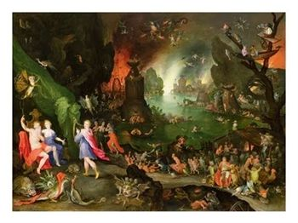
Travel to the Underworld
The hero had to confront death and come back stronger and rejuvenated
Heroes were mortal, so confronting death allowed them to face their own mortality

Slide 11
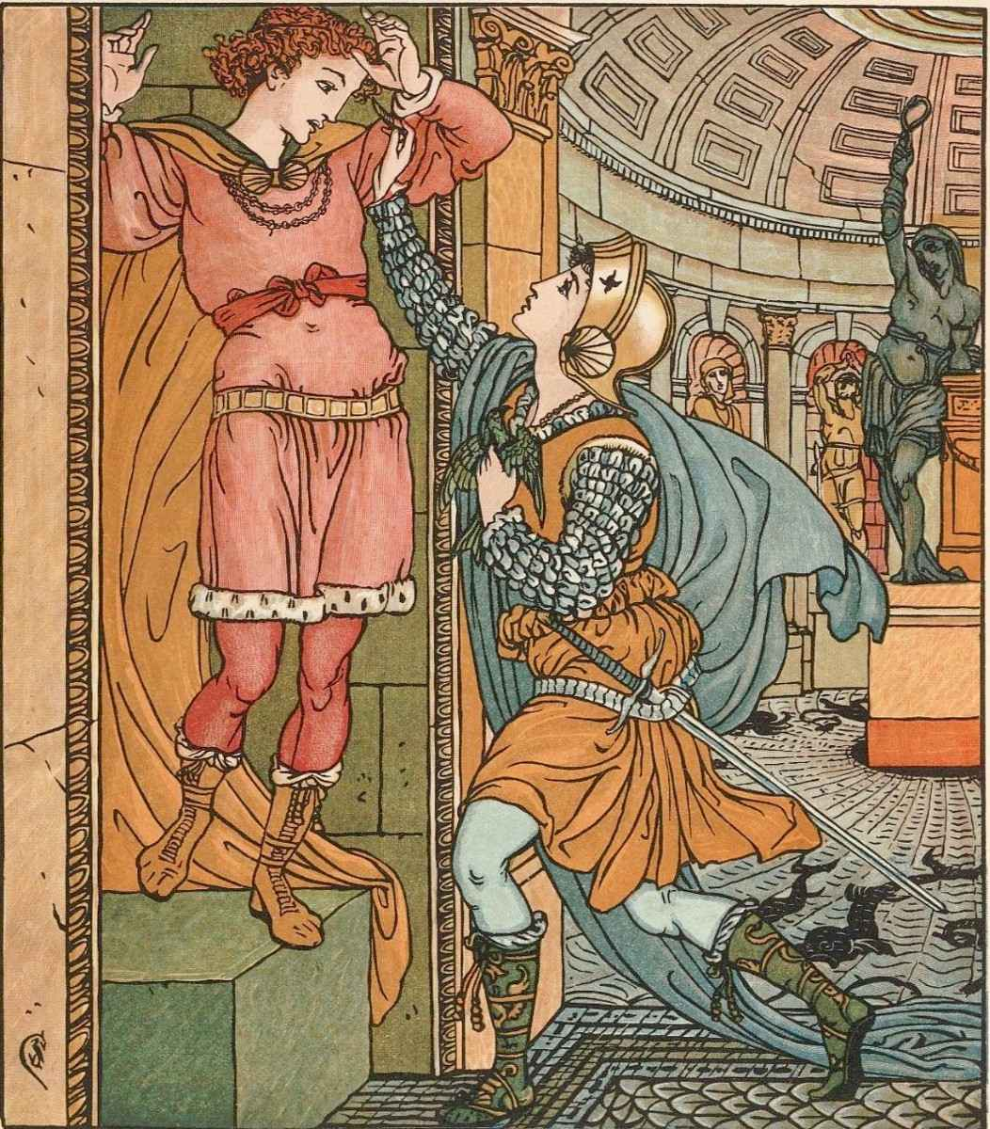
Married a Princess
Heroes invariable married a princess, but instead of marital bliss, this frequently brought turmoil and unhappiness

Slide 12
Ignoble Death
The hero had larger than life attributes, but he also had larger than life flaws
Aristotle would have called this hamartia, and it was usually brought on by hybris
Very few heroes could come to grips with their gifts and their mortality, but that humanity is part of their appeal
That appeal is what allowed their societies to forgive them and is also what kept the heroes alive for thousands of years after their deaths

Slide 13
This powerpoint was kindly donated to www.worldofteaching.com
http://www.worldofteaching.com is home to over a thousand powerpoints submitted by teachers. This is a completely free site and requires no registration. Please visit and I hope it will help in your teaching.

