Slide 1
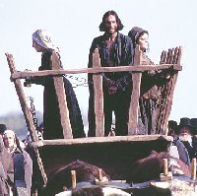
The Crucible
By Arthur Miller
. . . When History and Literature Collide

Slide 2
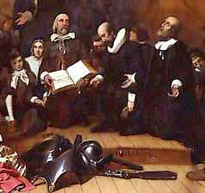
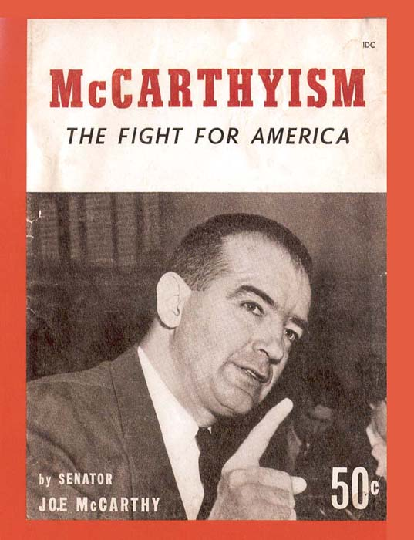
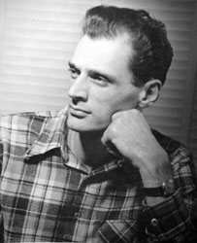
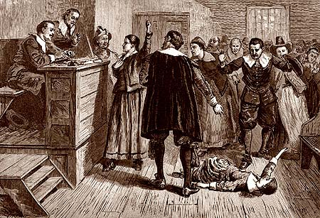
The Crucible is . . .
Puritanism
+
Witchcraft
+
McCarthyism
+
Arthur Miller

Slide 3
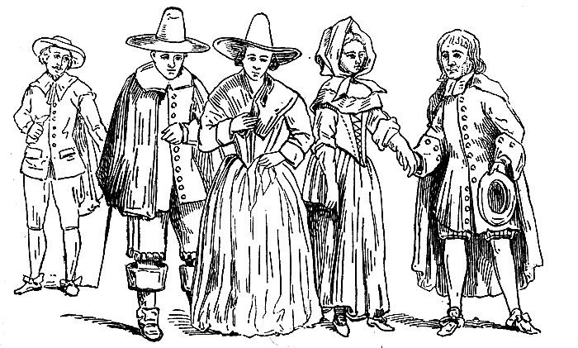
Puritanism
Christian faith that originated in England during the early 1600s
Puritans believed in predestination
They split from the Church of England in 1633
Many emigrated to the American colonies
Their radical beliefs flourished in the new world

Slide 4
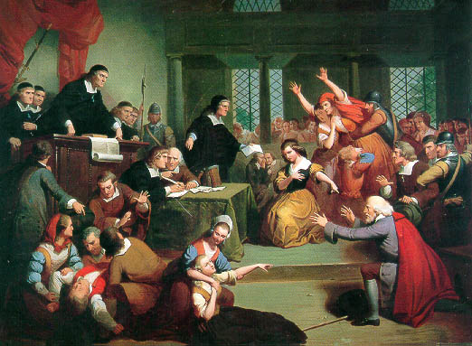
Witchcraft in Salem
Like all Puritans, the residents of Salem Village believed in witches and in witchcraft.
They believed that witchcraft was “entering into a compact with the devil in exchange for certain powers to do evil.”
They considered witchcraft both a sin and a crime; it was a very serious accusation, which was carefully and thoroughly investigated.

Slide 5
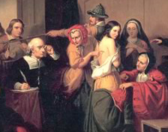
Witchcraft in Salem
The witchcraft hysteria began in Salem, Massachusetts, in early 1692.
Reverend Samuel Parris’s daughter and Abigail Williams started having fits of convulsion, screaming, and hallucination.
A doctor examined the girls and concluded that the only explanation for these bizarre behaviors was witchcraft.

Slide 6

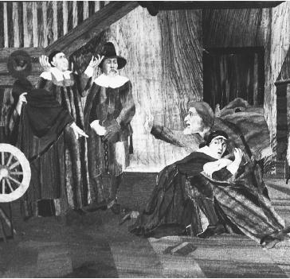
Witchcraft in Salem
A recently published book of the time detailed the symptoms of witchcraft; the girls’ fits were much like those described in the book.
Therefore, the Puritans of Salem were quick to believe the doctor’s diagnosis.

Slide 7
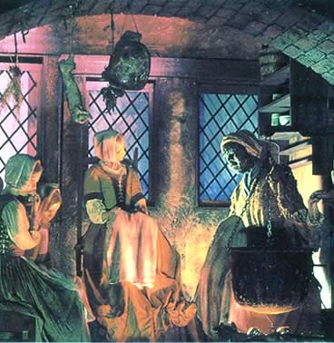
Witchcraft in Salem
The girls pointed fingers at Tituba (the Parris’ slave), Sarah Good, and Sarah Osborn, which sparked a witch hunt.

Slide 8
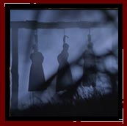
Witchcraft in Salem
During the next eight months of terror, more than 150 people were imprisoned for witchcraft.
By the time court was dismissed, 27 people had been convicted, 19 hanged, and 1 pressed to death.
The hysteria that snowballed in Salem reveals how deep the belief in the supernatural ran in colonial America.

Slide 9
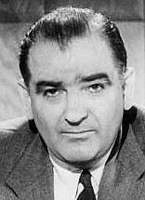
McCarthyism
McCarthyism is the term used to describe a period of intense suspicion in the United States during the early 1950s.
It began when Senator Joseph McCarthy, a U.S. senator from Wisconsin, claimed that communists had infiltrated the Department of State.
A special House Committee on Un-American Activities was formed to investigate allegations of communism.
During this period, people from all walks of life became the subjects of aggressive “witch hunts” often based on inconclusive, questionable evidence.

Slide 10
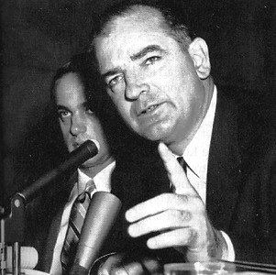
McCarthyism
Persons accused of being communists were often denied employment in both the public and private sector.
In the film industry alone, over 300 actors, writers, and directors were denied work in the U.S.
American writer, Arthur Miller, was one of those alleged to have been “blacklisted.”

Slide 11
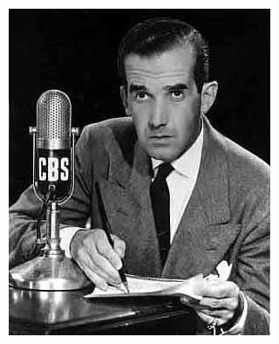
McCarthyism
McCarthy’s influence finally faltered in 1954 when a famous CBS newsman, Edward R. Murrow, aired an investigative news report which revealed McCarthy as dishonest in his speeches and abusive in his interrogation of witnesses.
The public was finally made aware of how McCarthy was ruining the reputations of many individuals through false accusations of communism.
Edward R. Murrow

Slide 12
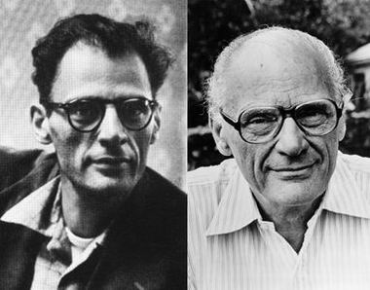
Arthur Miller
1915-2005
American Playwright and Writer
In 1953 he wrote The Crucible, which uses the Salem witchcraft trials of 1692 to attack the anti-communist “witch hunts” of the 1950s.
He believed the hysteria surrounding the witch craft trials in Puritan New England paralleled the climate of McCarthyism – Senator Joseph McCarthy’s obsessive quest to uncover communist party infiltration of American institutions.
After the publication of the The Crucible, Miller himself was investigated for possible associations with the communist party.
He refused to give information regarding his colleagues and was found guilty of contempt of court. His sentence was later overturned.

Slide 13
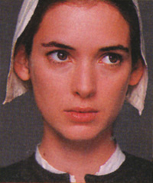
Abigail Williams
Orphaned niece of Reverend Parris
She was once the mistress of John Proctor but was turned out when his wife discovered the affair.
She is extremely jealous of Elizabeth Proctor and uses her power in the town to rid herself of Elizabeth as well as any others who have insulted her in the past.
She cannot let go of her obsession with Proctor.
She is the leader of the girls.

Slide 14
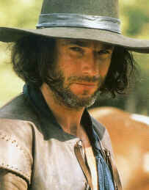
John Proctor
Husband to Elizabeth
He had an affair with Abigail when she was employed in his household.
He knows that the girls are pretending but cannot tell what he knows without revealing having been alone with Abigail. When
Abigail uses her influence to convict his wife, he tries to tell the truth and finds himself condemned.
He refuses to admit to witchcraft or to consider Abigail as anything more than a liar.
He is hanged.

Slide 15
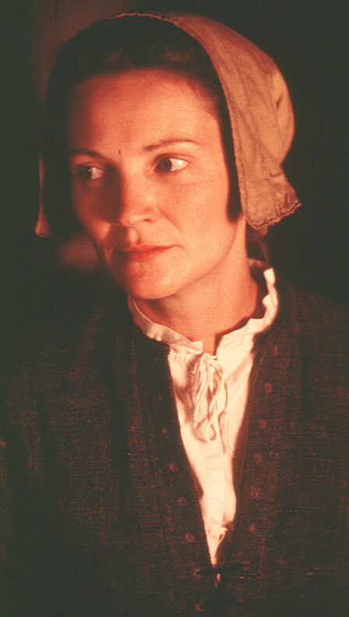
Elizabeth Proctor
Wife of John Proctor
She discovered an affair going on between her husband and Abigail Williams and turned Abigail out of her house.
She is Abigail's main target but is saved from hanging because of her pregnancy.
She feels responsible for driving her husband to infidelity.

Slide 16
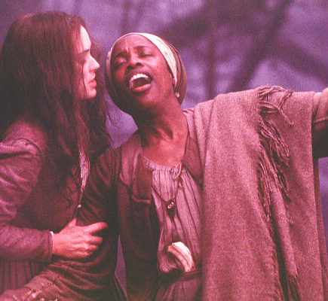
Tituba
Servant to the Parris household
She is a native of Barbados.
She is enlisted by Ruth Putnam and Abigail to cast spells and create charms.
When Abigail turns on her to save herself from punishment, Tituba confesses to all and saves herself.

Slide 17
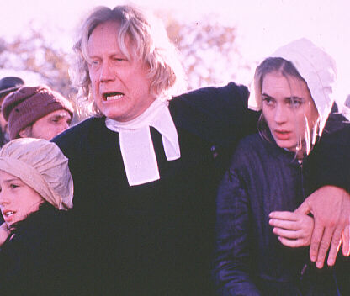
Reverend Parris
Pastor of the church in Salem
He is the father of Betty and the uncle of Abigail Williams.
He believes that he is being persecuted and that the townspeople do not respect his position as a man of God.

Slide 18
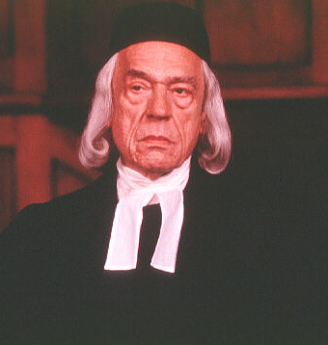
Deputy Governor Danforth
He seems to feel particularly strongly that the girls are honest.
He is sensitive to the presence of the devil and reacts explosively to whatever evidence is presented.

Slide 19
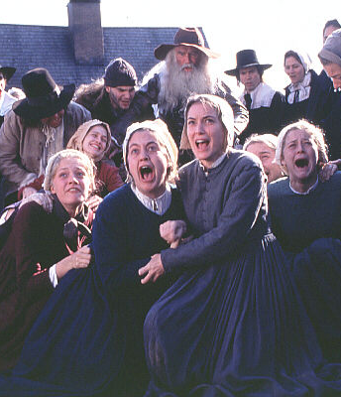
The Girls
Betty Parris- Daughter of the Reverend, cousin to Abigail Williams. She is a weak girl who goes along with her cousin as soon as she is threatened.
Susanna Walcott-One of the girls. She is initially sent between Parris and Dr. Griggs to determine the cause of Betty's ailment. She is easily guided by Abigail.
Mercy Lewis- Servant to the Putnam household. She is a merciless girl who seems to delight in the girls' activities.
Mary Warren-Servant to the Proctor household. Abigail uses her to effectively accuse Elizabeth. John Proctor takes Mary to the court to confess that the girls are only pretending. She is not strong enough to fight Abigail and as soon as Abigail leads the other girls against her, Mary caves and runs back to her side by accusing Proctor himself.

Slide 20
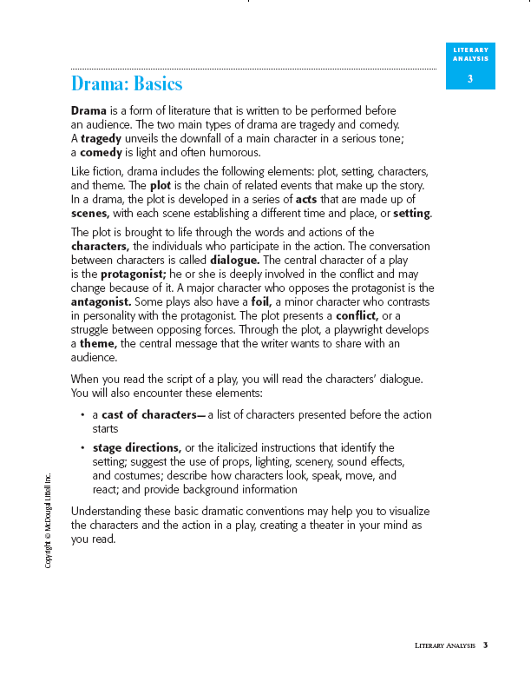
Drama Basics

Slide 21
Drama Basics (cont’d)

Slide 22
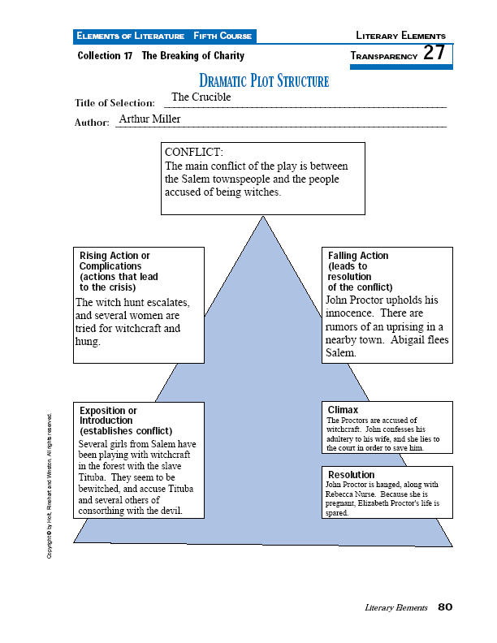

Slide 23
American Drama
Drama is probably the most difficult form of writing.
A play is not finished in the same way that a poem or novel is because after it is written, it still needs to be brought to life on a stage.
A play primarily engages the enthusiasm of directors, actors, and technicians through the story.
The playwright makes the audience concerned for a character by focusing on a conflict that involves something important to the characters.
The protagonist of a play is the major character who usually drives the action forward.
Exposition gives the audience background information.
Most of the plays that are produced in the United States today are produced with the hope that they will make money.

Slide 24
American Drama (cont’d)
Playwrights must usually find an agent who submits a play to producers who are likely to consider it.
The producer . . . .
advances money to finance a play.
meets with agents who represent the playwrights.
works with a playwright on changes to a play.
Theater is a collaborative medium.
A director and actors “take away” a play from its author.
Rehearsals are both pleasant and tense.
Producers seldom take risks on plays.
Thousands of plays are copyrighted each year.
The audience can contribute to a good performance.

Slide 25
This powerpoint was kindly donated to www.worldofteaching.com
http://www.worldofteaching.com is home to over a thousand powerpoints submitted by teachers. This is a completely free site and requires no registration. Please visit and I hope it will help in your teaching.

