Slide 1
The Fall of Icarus

Slide 2
Icarus
Icarus was an ancient Greek god
His father was Daedalus, an artificer, or artist
Daedalus gave Icarus wings made of wax so he could fly

Slide 3
Icarus’ father warned him not to fly too close to the sun, or the heat from the sun would melt the wax in the wings and he would fall.
Icarus began to fly around the world, and the feeling of soaring in the sky was so exhilarating that he forgot his father’s advice and began to soar closer and closer to the sun.

Slide 4
The closer Icarus got to the sun, the warmer the wax became. Soon his wings began to melt.
His wings were quickly gone. Icarus fell to his death into the sea.

Slide 5
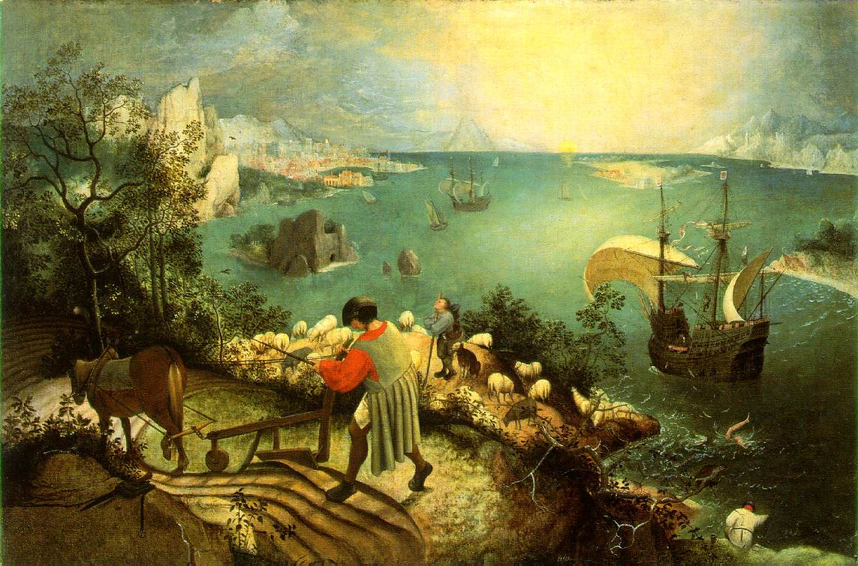

Slide 6
Musee Des Beaux Arts
By W.H. Auden
About suffering they were never wrong,
The Old Masters: how well they understood
Its human position; how it takes place
While someone else is eating or opening a window or just walking dully along;
How, when the aged are reverently, passionately waiting
For the miraculous birth, there always must be
Children who did not specially want it to happen, skating
On a pond at the edge of the wood:
They never forgot
That even the dreadful martyrdom must run its course
Anyhow in a corner, some untidy spot
Where the dogs go on with their doggy life and the torturer’s horse
Scratches its innocent behind on a tree.

Slide 7
In Bruegel’s Icarus, for instance: how everything turns away
Quite leisurely from the disaster; the ploughman may
Have heard the splash, the forsaken cry,
But for him it was not an important failure; the sun shone
As it had to on the white legs disappearing into the green
Water; and the expensive delicate ship that must have seen
Something amazing, a boy falling out of the sky,
Had somewhere to get to and sailed calmly on.

Slide 9
This powerpoint was kindly donated to www.worldofteaching.com
http://www.worldofteaching.com is home to over a thousand powerpoints submitted by teachers. This is a completely free site and requires no registration. Please visit and I hope it will help in your teaching.

