Slide 1
“The Third Wish” by Joan Aiken
Focus: Mood and Conflict
Comparison w/ “The Monkey’s Paw”
Notes:
http://www.bufordcityschools.org/bms/Teachers/katieperry/documents/TheThirdWish.ppt

Slide 2
Let’s Review
What are the five stages of a plot?
Exposition
Rising Action
Climax
Falling Action
Resolution

Slide 3
Conflict
For this lesson we are going to look at both the stages of the plot and how the mood of a story can influence the major conflict.
Another Review: What are the two types of conflict?
Internal Conflict & External Conflict

Slide 4
Essential Question
What influence does mood have on the conflict in a short story?
As the plot builds in the story, the mood develops and enhances the conflict and encourages the reader to become more involved in their reading.

Slide 5
Brainstorming Activity
Think about “Wishing.”
What kinds of things do you wish for? What wishing customs can you think of?
On a sheet of notebook paper, write down all you know about wishing.

Slide 6
Did you think about . . .
Wishing wells?

Slide 7

Did you think about . . .
Aladdin and the Genie?

Slide 8

Did you think about . . .
Throwing pennies in a fountain?

Slide 9

Did you think about . . .
Wishing on a shooting star?

Slide 10
Building Background
What do you know about swans?

Slide 11
Building Background
Swans have appeared in European folklore and mythology since ancient times, when people believed that Zeus, king of the gods, once came to earth disguised as a swan.
According to legend, a swan sings one strange and beautiful song in its lifetime—as it is dying.
The modern phrase “swan song,” meaning a person’s farewell appearance or final work, is based on this legend.

Slide 12
Vocabulary Preview
The beautiful swan sat preening itself, hoping to extricate the mud from its feathers. Some malicious person, sitting on the outskirts of the lake, had tried to harm the swan by throwing mud at it. It was presumptuous of that person to assume the swan would not swim away quickly after the first attack.
On your sheet of notebook paper, write the possible definitions for the underlined words.

Slide 13
Definitions
Preening: (n.) cleaning feathers with a beak
Extricate: (v.) to free from tangle or difficulty
Malicious: (adj.) showing ill will; spiteful
Outskirts: (n.) the region remote from the central district of a city or town
Presumptuous: (adj.) excessively bold, confident, or shameless

Slide 14
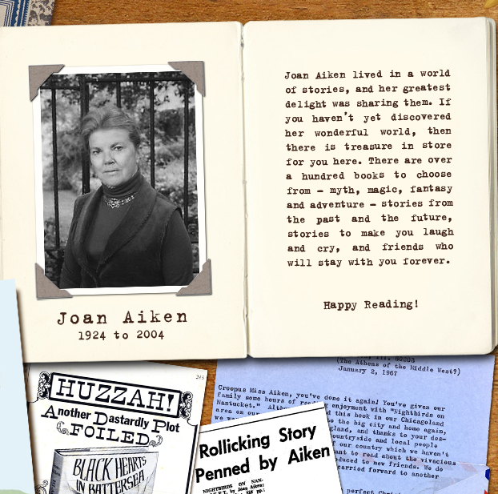

Slide 15
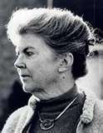

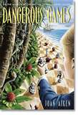

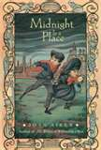
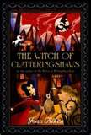
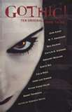
Joan Aiken
If you enjoy “The Third Wish,” you may enjoy….
Notes:
TE pg 679

Slide 16
Extra Credit Opportunity
http://joanaiken.com/

Slide 17
http://joanaiken.com/
Go to this website and complete one of the following
  10 facts about her life using the timeline (cannot be all from the same slide)
  Print a photo from the gallery and explain what you think it represents; print a photo from her “Joan’s art” and explain why you chose that particular piece.
  List the 13 groups/genre’s of books she has written and name one book title in each.

Slide 18
Let’s Get Started
Open your literature books to page 672. Let’s look at the “Focus Your Reading” section.
Once again, we will focus on the stages of the plot: exposition, rising action, climax, falling action, resolution.

Slide 19
Activity
Before we begin reading, look at the handout for this lesson. It has two sides: one about the plot, the other about character motivation.
Notice how the conflict is involved in setting up the rising action.
Look over this handout for a few minutes before we begin reading. You do not have to fill it out as we read; however, you need to know what to look for during the story.

Slide 20
This powerpoint was kindly donated to
www.worldofteaching.com
http://www.worldofteaching.com
Is home to well over a thousand powerpoints submitted by teachers. This a free site. Please visit and I hope it will help in your teaching
Notes:
20

