Slide 1
Atmosphere and symbolism in poetry.
LO’s:
By the end of this lesson students will...
Understand what atmosphere and symbolism are.
Be able to apply this knowledge by analysing a poem.

Slide 2
Describe the feelings that come to mind after reading these words:
Sorrow
Darkness
Dreary
Bleak
Grave
Lost
Stillness
Stern
Ghost
Melancholy

Slide 3
All of these words are from a very famous poem. Make some guesses about the setting and atmosphere of the poem such as:
What time of day is it?
What time of year?
How is the author feeling?
Is he alone or with other people?

Slide 4

The Raven
by Edgar Allan Poe
http://www.ojai.net/swanson/theraven.htm

Slide 5
Line:
Technique:
Effect:

Slide 6
What might have happened to the character before the events of the poem happen?

Slide 7

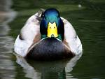
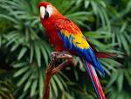

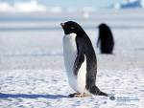
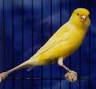
Why does Edgar Allan Poe use a raven instead of another bird as the major symbol of this poem?
Why not...?

Slide 8
What might we associate
with ravens?

Slide 9
So…
We could say that Edgar Allan Poe sets the scene and creates
an atmosphere by...
Also he uses the raven to symbolise…

Slide 10
Atmosphere and symbolism in poetry.
LO’s:
By the end of this lesson students will...
Understand what atmosphere and symbolism are.
Be able to apply this knowledge by analysing a poem.

Slide 11
This powerpoint was kindly donated to www.worldofteaching.com
http://www.worldofteaching.com is home to over a thousand powerpoints submitted by teachers. This is a completely free site and requires no registration. Please visit and I hope it will help in your teaching.

