Slide 1
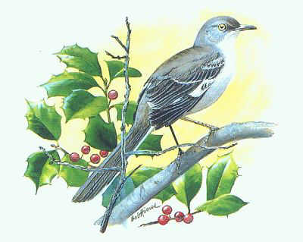
To Kill a Mockingbird
By Harper Lee

Slide 2
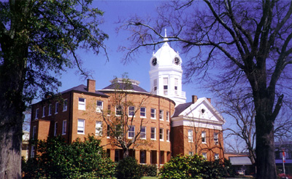
Setting
Maycomb, Alabama (fictional city)
1933-1935
Although slavery has long been abolished, the Southerners in Maycomb continue to believe in white supremacy.

Slide 3
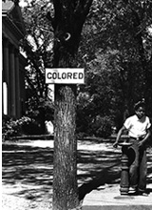
Themes
Racial Prejudice
Social Snobbery
Morality
Tolerance
Patience
Equality
The Need for Compassion
The Need for Conscience

Slide 4
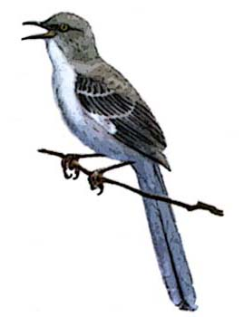
Symbolism
The Mockingbird: Symbolizes Everything That is Good and Harmless in This World
  The mockingbird only sings to please others and therefore it is considered a sin to shoot a mockingbird. They are considered harmless creatures who give joy with their song.
  The mockingbird image or symbol appears four times in the novel.
  Two characters in the novel symbolize the mockingbird: Tom Robinson & Boo Radley.

Slide 5
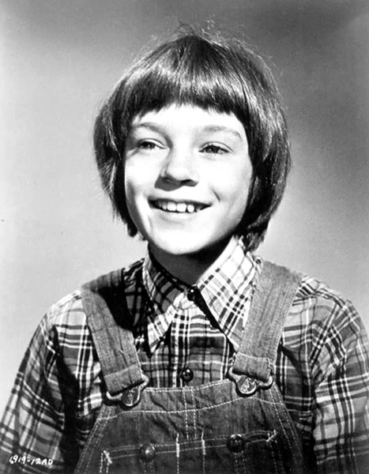
Jean Louis Finch – “Scout”
The story’s narrator
Although now an adult, Scout looks back at her childhood and tells of the momentous events and influential people of those years.
Scout is six when the story begins.
She is naturally curious about life.

Slide 6
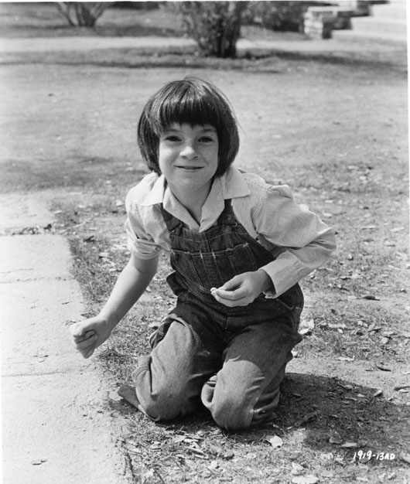
Scout’s Character Traits
Tomboy
Impulsive
Emotional
Warm & Friendly
Sensitive
Adorable
Gains in Maturity throughout the Novel

Slide 7
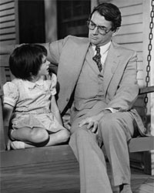
Atticus Finch
Father of Scout and Jem
A widower
An attorney by profession
Highly respected
Good citizen
Instills good values and morals in
his children.
His children call him “Atticus”
Honest
Typical southern gentleman
Brave
Courteous
Soft-spoken

Slide 8
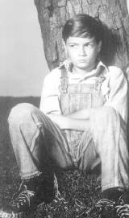
Jem Finch
Scout’s older brother
Looks up to his father Atticus
Usually looks out for Scout
Typical older brother at times
Smart
Compassionate
Matures as the story progresses

Slide 9
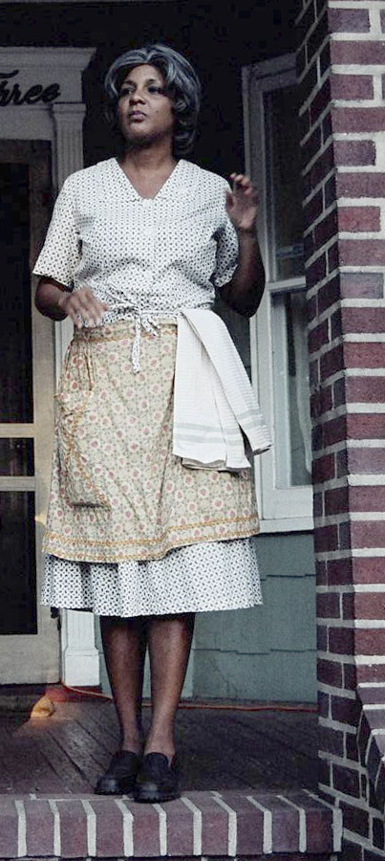
Calpurnia
The Finch’s black housekeeper
Has watched the children since their mother’s death
Has been a positive influence on the children.

Slide 10
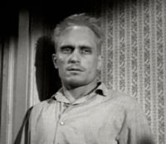
Arthur “Boo” Radley
An enigma
An adult man, whose father has “sentenced” him to a lifetime confinement to their house because of some mischief he got into when he was a teenager.
Has a reputation of being a lunatic
Basically a harmless, well-meaning person
Sometimes childlike in behavior
Starving for love and affection
Saves Jem and Scout from certain danger

Slide 11
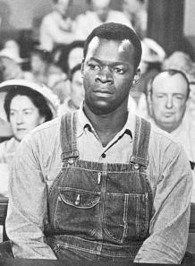
Tom Robinson
A young, harmless, innocent, hardworking black man
Has a crippled left hand
Married with three children. Works on a farm belonging to Mr. Link Deas, a white man
Will be falsely accused of raping a white girl, Mayella Ewell

Slide 12
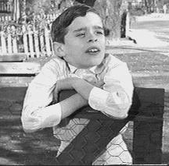
Dill
A close friend of Jem and Scout
Usually lives in Maycomb only during the summer (stays with a relative)
Tells “big stories”
Has been deprived of love and affection

Slide 13
Two Poor White Families:
The Cunninghams The Ewells
Poor white family
Hard-working
Honest
Proud
Survive on very little
Always pay back their debts – even if it is with hickory nuts, turnips, or holly.
Poor white trash
Dirty
Lazy
Good-for-nothing
Never done a day’s work
Foul-mouthed
Dishonest
Immoral

Slide 14
The Black Community
Simple
Honest
Clean
Hard-working
God fearing
Proud
Would never take anything with paying it back
Respectful
Had stronger character than most of the whites
Oppressed
Uneducated
Discriminated against
Talked about badly
Deserve better than what is dished out to them by society

Slide 15
Language
Sometimes the language of Scout will be that of her as a child; other times, she will be speaking in the voice of an adult
Atticus uses formal speech
Calpurnia uses “white language” in the Finch house and switches to “black jargon” when amidst blacks
The Ewells use foul words and obscenities
Jem, Scout, and Dill will use slang words, typical of their age
Tom Robinson uses language typical of the southern black such as “suh” for “sir” and “chillun” for “children”
Various derogatory terms for blacks will be used such as “nigger,” “darky,” “Negroes,” and “colored folk” – Lee uses such language to keep her novel naturally in sync with common language of the times

Slide 16
Tone
Somber
Serious
Humorous (at times)

Slide 17
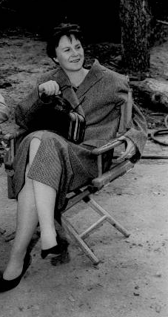
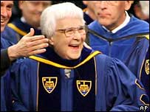
Harper Lee
She was born in 1926 in Monroeville, Alabama (the fictional “Maycomb, Alabama”)
Her father “Amasa” was a lawyer whom she deeply admired
Her mother’s maiden name was “Finch”
Her own childhood mirrors that of the character “Scout”
In 1960 she published her only novel – “To Kill a Mockingbird”
It received the Pulitzer Prize for Literature in 1961
Since 1960, “To Kill a Mockingbird” has never been out of print
At age 81, she is alive and resides in New York
She rarely makes public appearances or gives interviews

Slide 18
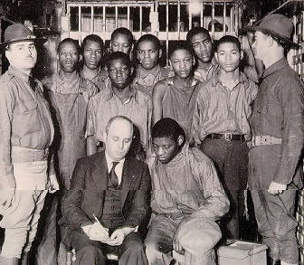
Life During the 1930s
Race Relations
  Nine black teenagers are falsely charged with raping two white women in Scottsboro, Alabama; eight are convicted and sentenced to death
  The U.S. Supreme Court reverses their convictions because their constitutional rights had been violated
  The teens are tried for a second time, and are again found guilty
  The Supreme Court reverses the convictions again
  Eventually, four of the defendants are freed; the other five serve prison terms
  The last Scottsboro defendant was paroled in 1950
  It was virtually impossible for a black to receive a fair trial

Slide 19
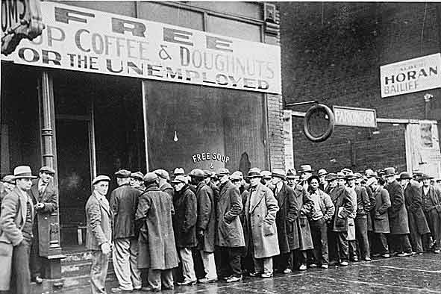
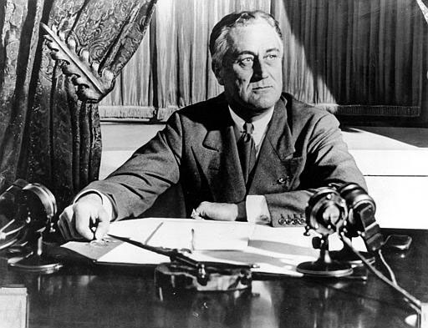
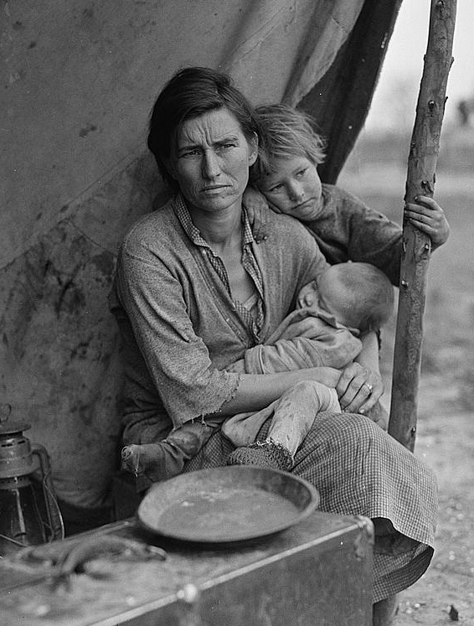
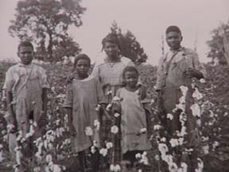
Life During the 1930s
The Great Depression sweeps the nation – Many families do not even have money for basic needs such as food, clothing, and shelter.
The per capita income for families in Alabama (and Oklahoma) is $125 - $250 a year
Many southern blacks pick cotton for a living
Franklin D. Roosevelt is President

Slide 20
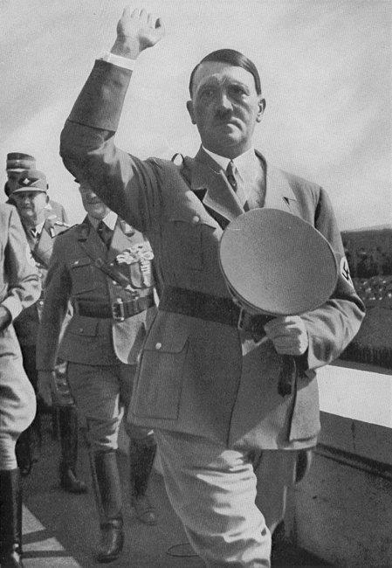
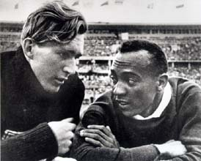
Life During the 1930s
Hitler is Chancellor of Germany
He believes that Jews, African Americans, and other races are inferior to Anglo-Saxons.
In 1936, Jesse Owens, a black American athlete, traveled to Germany to participate in the Summer Olympics.
Owens’ biggest competitor in the long jump was a German named Luz Long.
Despite racial tensions, the two became good friends.
Jesse Owens won the gold medal and Long won the silver.
Long was later killed during World War II, and Jesse Owens traveled back to Germany to pay his respects when the war was over.

Slide 21
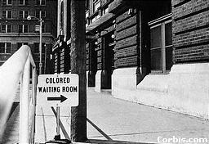
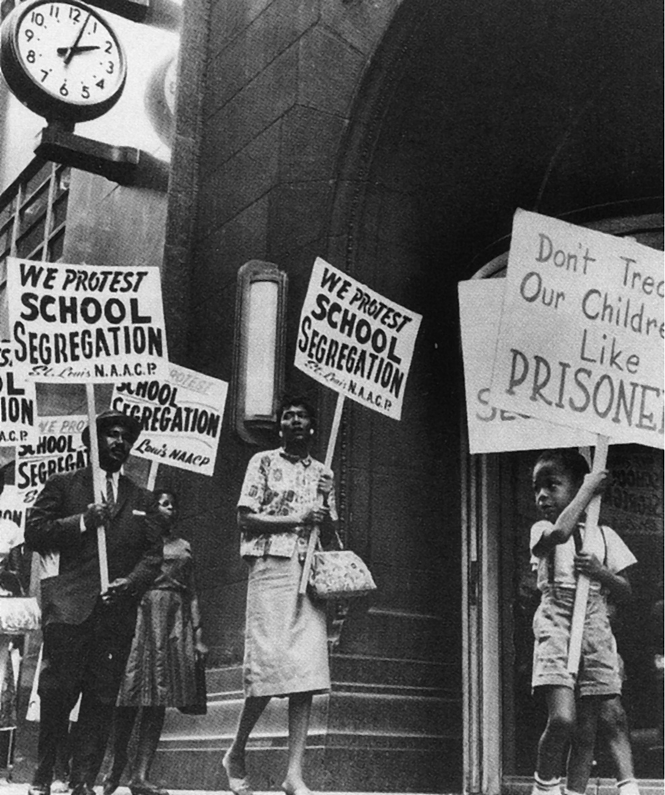
Legal Segregation in Alabama, 1923-1940
No white female nurses in hospitals that treat black men
Separate passenger cars for whites and blacks
Separate waiting rooms for whites and blacks
Separation of white and black convicts
Separate schools
No interracial marriages
Segregated water fountains
Segregated theatres

Slide 22
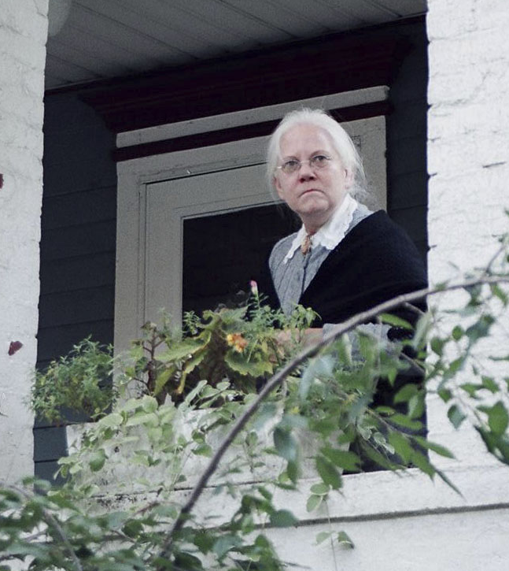
Morphine: A Southern Lady’s Drug
1930s Typical Morphine Addict:
  White female
  Middle-aged or older
  Widowed
  Homebound
  Lives in the south
  Property owner
  Began using morphine for medical reasons (pain relief)
In “To Kill a Mockingbird,” the Finch children will become acquainted with a morphine addict named Mrs. Dubose. Although only a fictitious character, she personifies the American morphine addict of the late nineteenth and early twentieth centuries.

Slide 23
This PowerPoint was created by Mrs. Ward especially for the 4th Hour English I students at Warner High School.
I hope you enjoy the book!

Slide 24
This powerpoint was kindly donated to www.worldofteaching.com
http://www.worldofteaching.com is home to over a thousand powerpoints submitted by teachers. This is a completely free site and requires no registration. Please visit and I hope it will help in your teaching.

