Slide 1
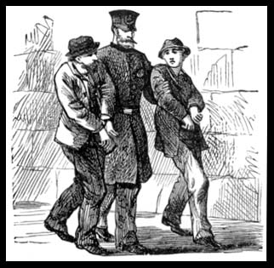
Traditional Marxism and crime and deviance
Crime is a product of poverty
Crime is brought about by capitalism

Slide 2
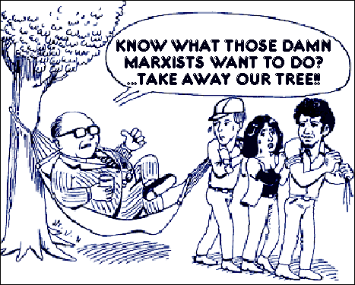
MANIPULATION OF VALUES
Manipulation of the basic values and morality of a society
Society is dominated and controlled by those at the helm
Control is maintained via the socialisation process and threat

Slide 3

MANIPULATION OF VALUES
VALUES OF FREEDOM
SELF-INTEREST
COMPETITION

Slide 4
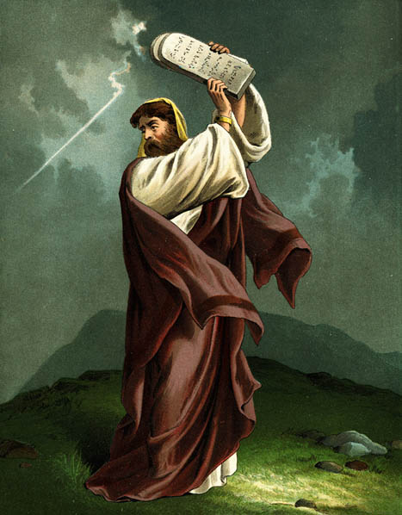
LAW CREATION
Functionalists: law reflects the will of the people
Marxists: law is a reflection of the will of the powerful
As economic power guarantees political and social power, the rich can manipulate the rest of us and pass laws that benefit them
They ‘set the agenda’

Slide 5
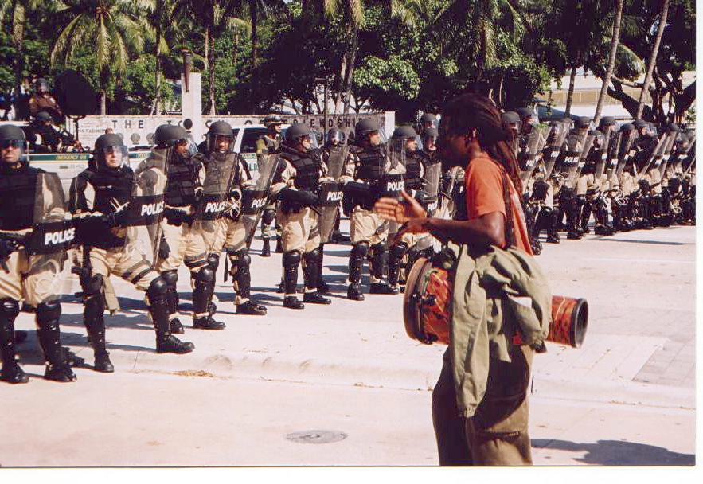
LAW CREATION
Public Order and Criminal Justice Act (1994)
Takes away civil liberties from the majority and limits the powers of the protest
Since 9/11, a raft of Anti-Terror legislation has been enacted, limiting freedoms we once took for granted.
Like the Prevention of Terrorism Act (designed to combat the IRA during the 1970s), it has been enforced against many others, criminalising people engaged in simple acts of protest.

Slide 6

LAW ENFORCEMENT
‘Street crime’ is more likely to be pursued by police than ‘white collar’ crime
Intensified policing and punishment of poorer individuals and communities
The poor are filtered into the criminal justice system while the rich are filtered out

Slide 7

INDIVIDUAL MOTIVATION FOR CRIME
In capitalist societies the cultural stress in on competition, not cooperation, and the acquisition of wealth
Desire for money can lead those who are blocked off from legitimate chances of gaining wealth to turn to criminal methods (anomie)
Greed is built into the capitalist system

Slide 8

CRITICISMS
Left idealism
Ignore the consequences for the victims of street crime
Street crime tends to be intra-class, not inter-class

Slide 9
CRITICISMS
Seems to suggest that the high rate of recorded crime among the working class, youth and blacks is solely the outcome of biased policing
At the same time they argue the laws are biased against the working class, forcing them into crime
Not all laws are in the interests of the ruling-class only

Slide 10
CRITICISMS
On the one hand it suggests that working-class people are simply innocent people who are picked on by the police
On the other hand it suggests that working class people who engage in crime are really engaged in political action by opposing the capitalist system

Slide 11
This powerpoint was kindly donated to www.worldofteaching.com
http://www.worldofteaching.com is home to over a thousand powerpoints submitted by teachers. This is a completely free site and requires no registration. Please visit and I hope it will help in your teaching.

