Slide 1
“Can you pass the salt?”

Slide 2
Why Conversation Works
(when it shouldn’t…) according to theorists…
Grice, Goffman, Brown, Levinson and Leech
A Level English Language

Slide 3
Grice’s
‘Logic of Conversation’
Conversation works - even when we don’t say what we mean.
Why it works so well fascinated philosopher Paul Grice. He wondered about conversations such as this:
Jack: You’ve got a mountain to climb!
Lily: It’s better than a slap in the face.
Grice wondered just how we make meaning out of such conversation.

Slide 4
Grice’s
‘Logic of Conversation’
Grice concluded that conversation must follow its own set of logical principles or ‘rules’.
He worked out how, even when we don’t mean what we say – that the full ‘pragmatic force’ of our utterance is easily understood, as in this third example:
Lily: This bottle’s half empty already!
Jack: Gosh - is that the time already?

Slide 5
Grice’s Insights
Communication is a co-operative activity: when two people communicate, it’s in their interests to make the communication go as smoothly as possible in order to achieve their aims.
Speakers behave in certain predictable ways.
When we, as hearers, try to work out what someone means, we do it by assuming they’re being co-operative.

Slide 6
Grice’s
‘Co-operative Principle’
“Make your conversational contribution such as is required, at the stage at which it occurs, by the accepted purpose and direction of the exchange in which you are engaged.”
Conversation works only with the co-operation of its participants.
Co-operation is built around a series of ‘Gricean maxims’:
Quality
Quantity
Manner
Relation

Slide 7
Gricean Maxims
1. Quality
  “Do not say what you believe to be false.”
  “Do not say that for which you lack evidence.”
So… when someone speaks to us, we assume:
  that what they say is not knowingly untruthful;
  that the truthfulness of what they say does not need to be made stated.

Slide 8
Gricean Maxims
2. Quantity
  “Make your contribution as informative as is required.”
  “Do not make your contribution more informative than is required.”
So… when someone speaks to us, we assume:
  they do not purposefully hold back anything that is important;
  they do not give more information than is asked.

Slide 9
Gricean Maxims
3. Manner
“Be perspicuous.”
  “Avoid obscurity of expression.”
  “Avoid ambiguity.”
  “Be brief.”
  “Be orderly.”
So… when someone speaks to us, we assume:
  that what they say is being said as straightforwardly as they can say it.

Slide 10
Gricean Maxims
4. Relevance
“Be relevant.”
So… when someone speaks to us , we assume:
  that what they say is relevant to the conversation.

Slide 11
‘The Gricean Maxims’
Be true
Be brief
Be clear
Be relevant
‘In short, these maxims specify what the participants have to do in order to converse in a maximally efficient, rational, co-operative way: they should speak sincerely, relevantly and clearly whilst providing sufficient information.’
Levinson (1983)

Slide 12
The maxims in action…
“How do I get to Sainsbury’s, mate?”
“Go straight ahead, turn right at the school, then left at the bus stop on the hill.”
Speaker A assumes that:
B believes his directions to be genuine – the maxim of quality;
B believes the information to be sufficient – the maxim of quantity;
B believes the information to be clear – the maxim of manner;
B believes his directions are to Sainsbury’s – the maxim of relation.

Slide 13
Not following the maxims…
Grice recognised that whilst we could choose not to follow a maxim, such a choice would be conscious and consequential.
A speaker can choose to…
  ‘violate’ a maxim and be intentionally misleading.
  ‘opt out’ of a maxim and refuse to co-operate.
  deal with a ‘clash’ of maxims, for instance, between saying enough and saying all that we know to be true.
  ‘flout’ a maxim and be intentionally ironic.

Slide 14
‘Violating’ a Maxim
In this BBC interview between Jeremy Paxman and Michael Howard, the leader of the opposition violates the maxim of relation by not giving an answer that relates to the question:
  Paxman: Did you threaten to overrule?
  Howard: I was not entitled to instruct Derek Lewis and I did not instruct him.
  Paxman: Did you threaten to overrule him?
  Howard: The truth of the matter is that.

Slide 15
‘Opting out’
Here, Paxman asks the Prime Minister a question; the minister opts out of the maxim of relation:
Paxman: “When will war become inevitable?”
PM: “Well I know you have to ask that question but it’s the kind of question I cannot answer.”

Slide 16
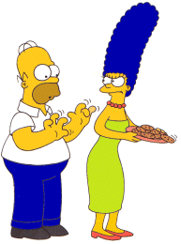
‘Flouting’
This is the most important ‘use’ of Grice’s maxims.
Unlike ‘violating’, ‘flouting’ a maxim allows a speaker to signal that although they seem to be ‘violating’ a maxim, they are still co-operating.
“Mmm… Do’nuts…”
“Homie, those pants look awful tight to me.”
Which leads us very nicely on to Grice’s key idea of “Implicature”…

Slide 17
‘Conversational Implicature’
‘Gricean Pragmatics’ – knowing what isn’t said
What Grice called ‘implicature’ occurs when a speaker chooses to flout a maxim.
The listener, assuming that the speaker still intends being cooperative, looks for meaning other than that which is said.
The intended meaning will be arrived at through the speaker working out the pragmatic force of the utterance rather than its semantic sense.

Slide 18
Implicature
Flouting the maxim of quantity…
A: I hear you went to the theatre last night; what play did you see?
B: Well, I watched a number of people stand on the stage in Elizabethan costumes uttering series of sentences which corresponded closely with the script of Twelfth Night.
Here, B’s verbose answer, although it doesn’t say anything more than “I saw a performance of Twelfth Night,” invites A to infer that the performers were doing a miserably bad job of acting.

Slide 19
Implicature
Flouting the maxim of quality
A: What are you baking?
B: Be i are tee aitch dee ay wye see ay kay ee.
By answering obscurely, B conveys to A the implicature that the information is to be kept secret from the young child who is in the room with them.

Slide 20
Implicature
Flouting the maxim of manner
When discussing an essay with a student, it is customary for a teacher to be polite and to find things to praise…
“So let me say straight away, James, that your essay is beautifully printed, the font has been immaculately well chosen and the positioning of those staples is a work of sheer genius...”

Slide 21
How the implicature works…
To James, such a comment is apparently not relevant to what he wants to hear – so he assumes his teacher has ‘flouted the maxim’ of relevance.
BUT… James assumes the teacher is still co-operating in the conversation by taking his ‘conversational turn’ leaving James to assume he is trying to convey something relevant about the quality of the essay.
SO… If James assumes the essay is other than worthless, then the teacher is observing the co-operative Principle.
The listener assumes that the speaker assumes that the listener can work it out.

Slide 22
Grice’s Maxims
In Writing?
Many kinds of communication operate as ‘interactions’ – a sort of ‘one sided’ conversation – letters, advertisements, and so on. Applying Grice’s maxims to written texts can allow you to develop subtle insights.
Flouting Grice’s maxims is more difficult in writing because it’s less easy to make sure that your reader understands what is happening.
This can be especially important in the ‘Language and Technology’ topic where much writing is ‘conversational’… but lacks the prosody and body-language of face-to-face interaction.

Slide 23
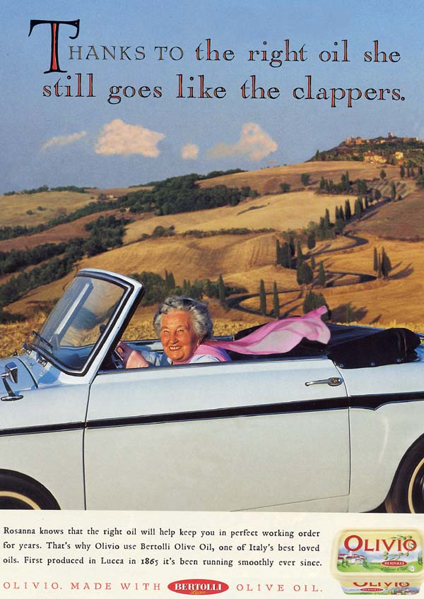
Grice’s Maxims and Implicature can be applied well beyond conversation…
What maxims are being flouted here?
What implicatures are being created?
To what effect?
For what purpose?

Slide 24
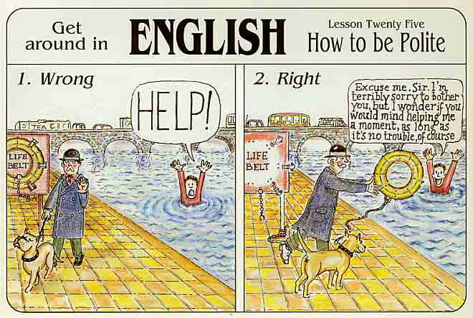
POLITENESS
If we really want co-operation…
… we also need to be polite

Slide 25
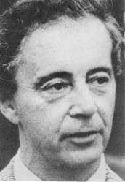
Goffman’s Face
Co-operation is vital to conversation, but without politeness, all is lost.
Erving Goffman was intrigued by what lay behind everyday expressions such as ‘losing face’, ‘saving face’ and ‘being shamefaced’.
He saw that without politeness, conversation didn’t work and that the need for politeness was rooted in ‘saving face’:
‘[face is…] the positive social value a person effectively claims for
himself by the line others assume he has taken during a personal
contact’
Goffman recognised that whenever we talk, we need to feel ‘liked’.
As a consequence, conversations are sites for potential ‘loss of face’ and that ‘face work’ must, therefore, be a part of talk if ‘loss of face’ is to be avoided and co-operation is to be maintained.

Slide 26
‘Negative’ and ‘Positive’ Face
Brown and Levinson developed Goffman’s ideas into the concepts of ‘positive’ and ‘negative’ face.
‘Negative’ Face
The desire to feel unimpeded, i.e. the freedom from feeling imposed upon by the interaction.
‘Positive’ Face
The desire to feel approved of , i.e. to maintain a positive and consistent self-image during the interaction.

Slide 27
‘Negative and Positive Face’
‘Face Threatening Acts’ (FTAs)
  conversational turns that risk a ‘loss of face’.
Positive politeness ‘face work’
  addresses ‘positive face’ concerns, by showing concern for the other’s face.
Negative politeness ‘face work’
  addresses ‘negative face’ concerns, by acknowledging the other’s face is threatened.

Slide 28
‘Face Threatening Acts’
‘Close your mouth when you eat, you fat swine’.
  A bald FTA
‘You have such beautiful teeth. I wish I didn’t see them when you eat.’
  An FTA using positive politeness
‘I know you’re very hungry and that steak is a bit tough, but I would appreciate it if you would chew with your mouth closed.’
  An FTA using negative politeness
‘I wonder how far a person’s lips can stretch yet remain closed when eating?’
  An ‘off record’ or ‘indirect’ FTA

Slide 29
The ‘Politeness Principle’
Geoffrey Leech proposed the need for ‘politeness maxims’ as a prerequisite for conversational co-operation.
In the absence of politeness, Leech suggested, it will be assumed that an attitude of politeness is absent.
Each maxim has two forms: positive and negative.
Each maxim has a lesser ‘sub-maxim’ that recognises the general law that negative politeness – that we seek to minimise discord – is more important than positive politeness – that we seek concord.

Slide 30
Leech’s Politeness Maxims (1)
Tact: minimise the cost to others [‘sub-maxim’: maximise benefit to others]
Generosity: minimise benefit to self [maximise cost to self]
Approbation: minimise dispraise of others [maximise praise of other]

Slide 31
Leech’s Politeness Maxims (2)
Modesty: minimise praise of self [maximise dispraise of self]
Agreement: minimise disagreement between self and others [maximise agreement between self and other]
Sympathy: minimise antipathy between self and others [maximise sympathy between self and other]

Slide 32
Cn u fnd sm mxms, face n plitns in ths txt msg?
Co-operation & Politeness
B. Heya! Im @ a party! Wikd 2 ere frm u! Aint gt mch batri so mayb txt u 2mz? D kj xxxx
A. Hii KJ Hows u doin? Avnt cht 2 U 4 ages yano! We shud catch up sometime!! TB xxxxx
A. [next day] U av a Gud time at da party? Il b online L8R!! lol! Tb xxx

Slide 33
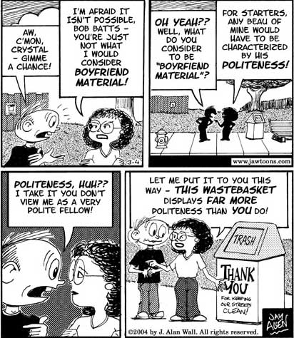
Politeness
Analyse this conversation at the level of co-operation and politeness.

Slide 34
This powerpoint was kindly donated to www.worldofteaching.com
http://www.worldofteaching.com is home to over a thousand powerpoints submitted by teachers. This is a completely free site and requires no registration. Please visit and I hope it will help in your teaching.

