Slide 1
Tricia Cooney
Stolen and tinkered with from:
Miranda Wilson at Graves County High School adapted from The Place and Face of Poetry www.csmonitor.com/atcsmonitor/specials/poetry/p-pteach
Poetry

Slide 2
What is poetry?
What were your past experiences with poetry?

Slide 3

Prose is walking, Poetry is dancing.
- Paul Valery

Slide 4

Poetry is not:
- Prose chopped up into lines
- Sweet, fluffy descriptions
- Aphorisms that end in rhymes
- Grand, stuffy language that sounds like something from the 16th century

Slide 5
Poetry is language that’s alive.
What are the 3 most important ingredients in a poem?
MUSIC
EMOTION
MAGIC
Question- Do you have music in you?

Slide 6
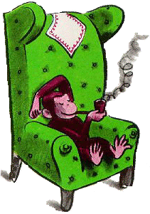
Music is about rhythm and the way sounds rub together. We’ve all appreciated that, beginning at a very early age. Did you ever bang pots and pans together or babble and mix up different sounds?

Slide 7

Everyone has emotions. Just think of how many emotions you have felt today. Now imagine all the emotions you have ever experienced in your life. Tap into one of these feelings and make the reader feel what you felt, experience that same emotion.

Slide 8
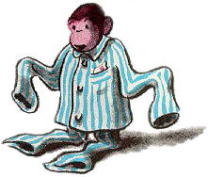
Magic- not hocus pocus, abra-cadabra magic, but the ability to see things around you in a whole new way.

Slide 9

Young people are good at this type of magic.
For example, seeing the desks in a room as rows of corn or walking on a tiled floor as stepping on the tops of large buildings.
Children have this ability. So do poets!

Slide 10
Activity:
Think about an animal, object, or place that says something about you. For example: someone who is quiet and shy may say “I’m a soft babbling brook.” Or someone who is outgoing and loud may say, “I’m thunder before a rainstorm.”
Avoid colorless statements like: “I smile a lot.”

Slide 11
You have just described something you know better than anything in a new way.
Now let’s practice making more magic.
Question- What does snow look like?
Example: powdered sugar or confetti.

Slide 12

Question-
What does a bicycle wheel look like?

Slide 13
We are going to create a group poem. Would you rather write it about snow or a bicycle wheel?
Someone come up with a first line and then another volunteer will add the second line and so on. Each line must relate to the one in front of it, and words that we already came up with should be used.
After the poem is finished, what do we want to change to make it better?

Slide 14
Word Strings
String together 10 words that sound good together. Make a coherent sentence but join the words in unusual ways. Focus on creating energy, momentum, and unique statements. Create a nice, natural music-like quality with your words.

Slide 15
Examples
Stars city bike bus smoke tail fly window please street money paper comet erase believe available
tiny go sorry night train whistle love adios animal goddess chocolate
fierce red engine you use easy tear true water blow smell man chant
bed could who not -ing shine little moon wax fluff visions stare
cold old always why garden blue boy girl cry white black friend
behind garden trudge through am is my power shadow worship
sausage arm incubate TV diamond asparagus suit cool tongue
music fiddle time boil dress drool juice knife sweat egg raw house
-ous peach honey blue bitter

Slide 16
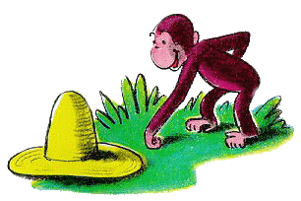
Writing a poem involves...
A careful choice and crafting of language
Reading a poem:
An experience that involves all the senses.

Slide 17
Form
the form of a poem is the physical
arrangement
of the words
on the page

Slide 18
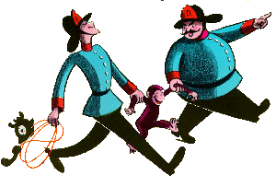
Now it’s your turn to put your words together and make a poem
Choose a childhood memory/experience to write about.

Slide 19
Remember to:
:- Choose a form and words carefully
- Do not forsake rhyme for meaning
- Use rich figurative language
- Use sensory details,
appealing to sight, sound, touch
smell

Slide 20
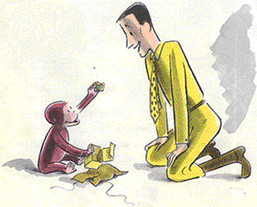
The Piano
by D.H. Lawrence
Softly, in the dusk, a woman singing to me;
Taking me back down the vista of years, till I see
A child sitting under the piano, in the boom of the tingling strings
And pressing the small, poised feet of a mother who smiles as she sings.
In spite of myself, the insidious mastery of song
Betrays me back, till the heart of me weeps to belong
To the old Sunday evenings at home, with winter outside
And hymns in the cozy parlour, the tinkling piano
our guide.

Slide 21


Slide 22
This powerpoint was kindly donated to www.worldofteaching.com
http://www.worldofteaching.com is home to over a thousand powerpoints submitted by teachers. This is a completely free site and requires no registration. Please visit and I hope it will help in your teaching.

