Slide 1
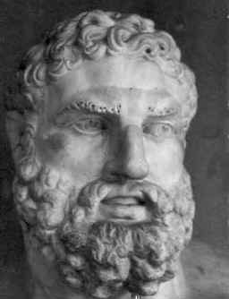
Greek Theatre
Overview
Greek Gods
Antigone
Medea

Slide 2
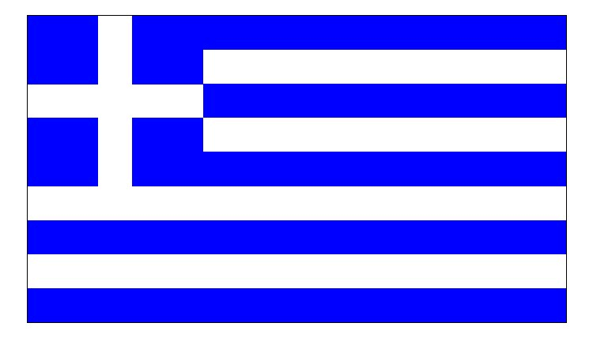
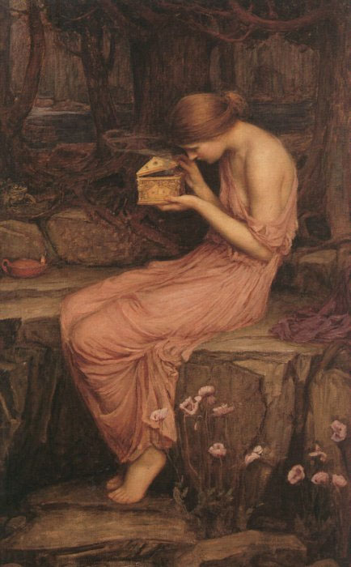
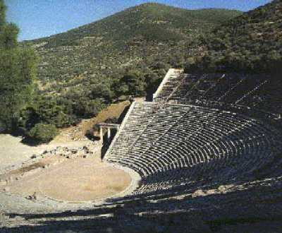
Overview of Greek Theatre
The land
The myths
The stage

Slide 3
The Land
Greece has thousands of inhabited islands and dramatic mountain ranges
Greece has a rich culture and history
Democracy was founded in Greece
Patriarchal (male dominated) society
Philosophy, as a practice, began in Greece (Socrates, Plato, Aristotle)

Slide 4
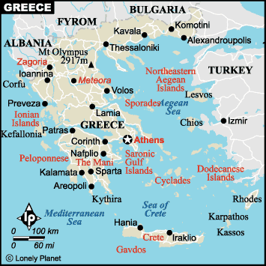
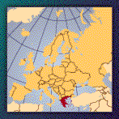
The Land
Located in Europe in the Aegean Sea

Slide 5
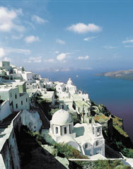
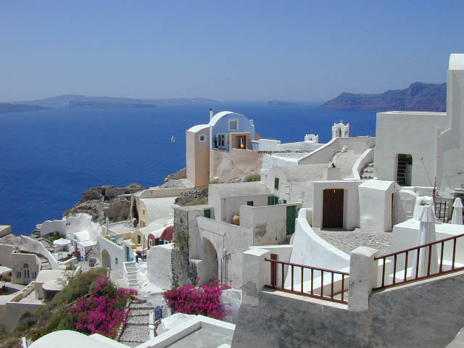
The Land

Slide 6
Overview of Greek Theatre
The land
The myths
The stage

Slide 7
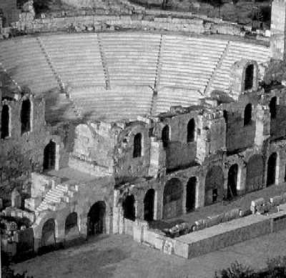
The Stage

Slide 8
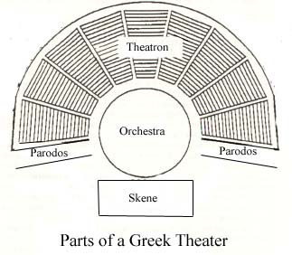
The Stage
Three Main Portions of Greek Theatre:
Skene – Portion of stage where actors performed (included 1-3 doors in and out)
Orchestra – “Dancing Place” where chorus sang to the audience
Theatron – Seating for audience

Slide 9
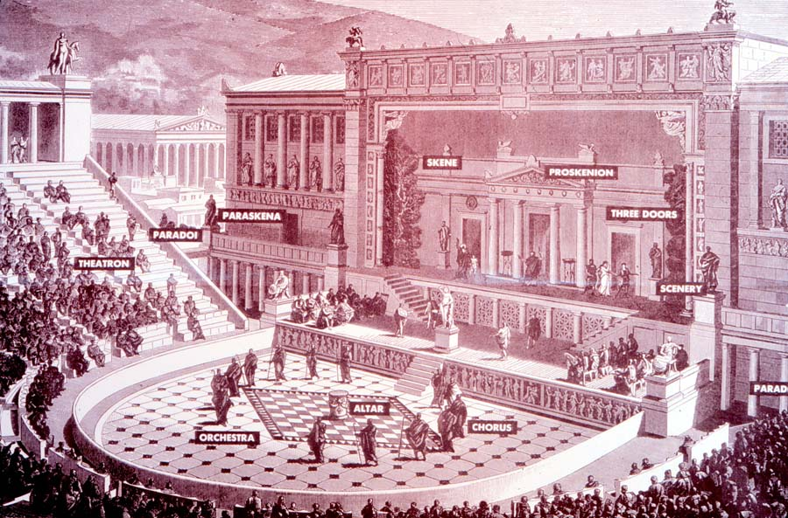
The Stage

Slide 10
The Stage
Greek plays were performed during religious ceremonies held in honor of Dionysus, the Greek god of wine and revelry (altars generally on stage)
Banks would shut down for days, people would travel from all around to see the drama competitions—even prisoners were temporarily released to see the plays
Tragedy means “goat song” (relates to Dionysian rituals)

Slide 11
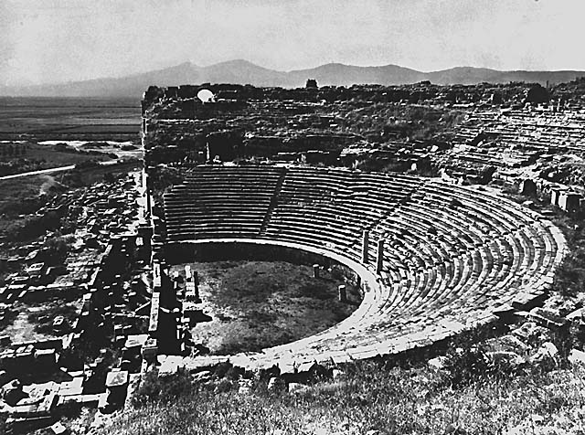
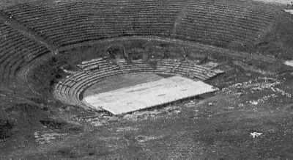
The Stage

Slide 12
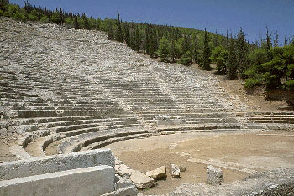
Where and how were the dramas performed?
…In an amphitheatre
…With a chorus who described most of the action.
…With masks
…With all the fighting and movement going on off stage.
….With tragedy first, then comedy later.

Slide 13
Major Greek Dramatists
Aeschylus | 524 B.C. | Seven Against Thebes
Sophocles | 496 B.C. | Antigone Oedipus
Euripides | 480 B.C. | Medea
Dramatist | Born | Wrote

Slide 14
Sophocles’ Antigone
Set in Thebes (a city in ancient Greece)
Antigone is the daughter of Oedipus and Jocasta
Antigone’s brothers, Eteokles and Polyneces, took opposite sides in a war
Eteokles and Polyneces killed each other in battle
Antigone’s uncle, Kreon, became king of Thebes

Slide 15
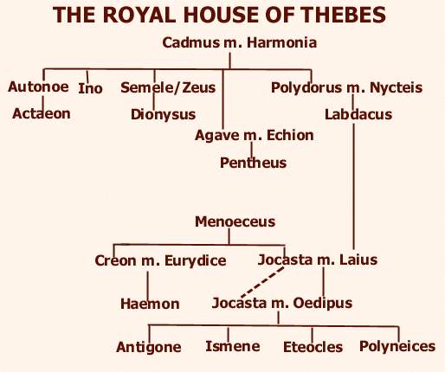
Copy Only The Boxed Portion!

Slide 16
Euripides’ Medea
Medea is a princess from Colchis
Medea marries Jason, who is in Colchis on a quest for the Golden Fleece
Medea betrays her father and murders her brother for her love of Jason
Medea has magical powers
Jason takes Medea back to his homeland, Corinth, where they have children
Jason takes another wife, the king of Corinth’s daughter

Slide 17
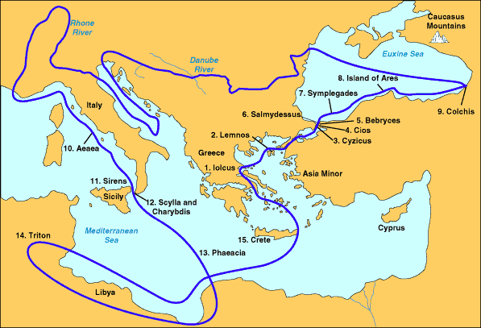
Jason’s Voyage on the Argo
Jason and Medea meet
Corinth: Where Jason and Medea settle down

Slide 18
Overview of Greek Theatre
The land
The myths
The stage

Slide 19
Myths played a key role in Greek drama

Slide 20
The Myths – Why they were written
Explained the unexplainable
Justified religious practices
Gave credibility to leaders
Gave hope
Polytheistic (more than one god)
Centered around the twelve Olympians (primary Greek gods)

Slide 21
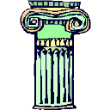
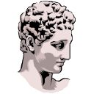
Explained the Unexplainable
When Echo tried to get Narcissus to love her, she was denied.
Saddened, she shriveled to nothing, her existence melting into a rock.
Only her voice remained.
Hence, the echo!

Slide 22
To justify religious practices
Dionysian cults in ancient Greece were founded to worship Dionysus, god of grapes, vegetation, and wine.

Slide 23
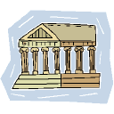
To give credibility to leaders
The Romans used myths to create family trees for their leaders, enforcing the made-up idea that the emperors were related to the gods and were, then, demigods.

Slide 24
To give hope
The ancient citizens of Greece would sacrifice and pray to an ORACLE.
An oracle was a priest or priestess who would send a message to the gods from mortals who brought their requests.
Where DID hope come from?
After unleashing suffering, famine, disease, and many other evils, the last thing Pandora let out was HOPE.

Slide 25
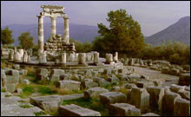
The Oracle at Delphi
Most famous oracle in Greek mythology.

Slide 26
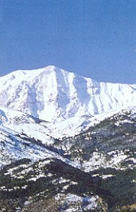
Mount Olympus…
…Where the
Olympians
lived.
Who are the Olympians?

Slide 27
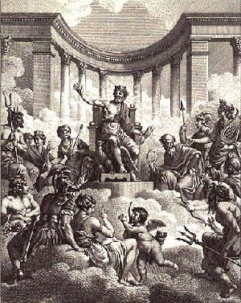
The Olympians Are the 12 Main Gods

Slide 28
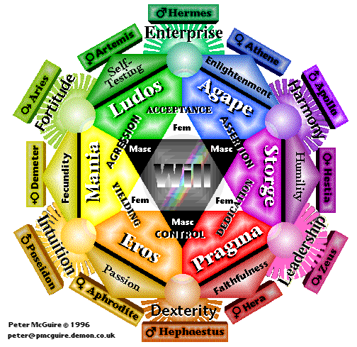
Temperaments of the Olympians

Slide 29
Zeus
King of gods
Heaven
Storms
Thunder
lightning

Slide 30
Poseidon
Zeus’s brother
King of the sea
Earthquakes
Horses

Slide 31
Hades
Brother to Zeus and Poseidon
King of the Underworld (Tartarus)
Husband of Persphone

Slide 32
Ares
God of war

Slide 33
Hephaestus
God of fire
Craftspeople
Metalworkers
Artisans

Slide 34
Apollo
God of the sun
Music
Poetry
Fine arts
Medicine

Slide 35
Hermes
Messenger to the gods
Trade
Commerce
Travelers
Thieves & scoundrels

Slide 36
Dionysus
God of Wine
Partying (Revelry)

Slide 37
Hera
Queen of gods
Women
Marriage
Childbirth

Slide 38
Demeter
Goddess of Harvest
Agriculture
Fertility
Fruitfulness
Mom to Persephone

Slide 39
Hestia
Goddess of Hearth
Home
Community

Slide 40
Athena
Goddess of wisdom
Practical arts
War

Slide 41
Aphrodite
Goddess of love and beauty

Slide 42
Artemis
Goddess of hunting and the moon.

Slide 43
The End

Slide 44
This powerpoint was kindly donated to www.worldofteaching.com
http://www.worldofteaching.com is home to over a thousand powerpoints submitted by teachers. This is a completely free site and requires no registration. Please visit and I hope it will help in your teaching.

