Slide 1
Themes in ‘Of Mice and Men’ -The American Dream -
The American Dream: Everyone has a dream to strive for. The poor ranch hands wish to be their own bosses, and actually have stability in their lives.

Slide 2
What is the American Dream
The term was first used by James Truslow Adams in his book The Epic of America which was written in 1931. He states:
"The American Dream is "that dream of a land in which life should be better and richer and fuller for everyone, with opportunity for each according to ability or achievement. It is not a dream of motor cars and high wages, but a dream of social order in which each man and each woman shall be able to achieve the fullest stature of which they are capable of, and be recognized by others for what they are, regardless of the circumstances of birth or position."

Slide 3
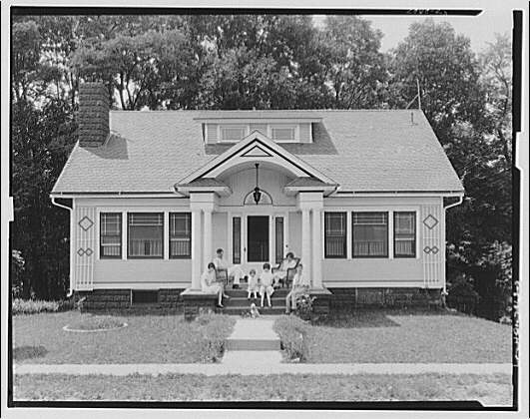
Is the American dream possible in the historical context of the novel?

Slide 4
"'Well,' said George, 'we'll have a big vegetable patch and a rabbit hutch and chickens. And when it rains in the winter, we'll just say the hell with goin' to work, and we'll build up a fire in the stove and set around it an' listen to the rain comin' down on the roof...'"

Slide 5
Their perfect world is one of independence. Workers like Lennie and George have no family, no home, and very little control over their lives. They have to do what the boss tells them and they have little to show for it. They only own what they can carry. Therefore, this idea of having such power over their lives is a strong motivation.

Slide 6
George and Lennie have a dream, even before they arrive at their new job on the ranch, to make enough money to live "off the fat of the land" and be their own bosses. Lennie will be permitted, then, to tend the rabbits.
Candy, upon hearing about the dream, wanted to join them so that he would not be left alone.
Crooks, the Negro outcast, wanted to join them so that he wouldn't be alone.

Slide 7
Dreams 2
When Whit brings in the pulp magazine with the letter written by Bill Tenner, the men are all very impressed. They are not certain that Bill wrote the letter, but Whit is convinced he did, and tries to convince the others.
In the transient life of these workers, it is rare to leave any kind of permanent mark on the world. In this letter Bill Tenner has achieved some of the immortality the other men cannot imagine for themselves.

Slide 8
Dreams 3
When George goes into a full description of the dream farm, its Eden-like qualities become even more apparent. All the food they want will be right there, with minimal effort. As Lennie says:
"We could live offa the fatta the lan'." Chapter 3, pg. 57.
When George talks about their farm, he twice describes it in terms of things he loved in childhood: "I could build a smoke house like the one gran'pa had..." Chapter 3, pg. 57.
George yearns for his future to reflect the beauty of his childhood. "An' we'd keep a few pigeons to go flyin' around the win'mill like they done when I was a kid."

Slide 9
Dreams 4
The ideal world presented by Crooks also reflects childhood. His father had a chicken ranch full of white chickens, a berry patch, and alfalfa. He and his brothers would sit and watch the chickens.
Companionship and plentiful food are both parts of Crooks' dream.

Slide 10
Dreams 5
Curley's wife has a dream that although different in detail from the other's dreams, is still very similar in its general desires.
She wants companionship so much that she will try to talk to people who don't want to talk to her, like all the men on the ranch.
Unsatisfied by her surly husband, she constantly lurks around the barn, trying to engage the workers in conversation.

Slide 11
The second part of her dream parallels the men's desire for their own land. She wanted to be an actress in Hollywood. She imagines how great it would be to stay in nice hotels, own lots of beautiful clothes, and have people want to take her photograph.
Both attention and financial security would have been hers. Like the men she desires friendship, and also material comforts, though the specifics of her dream differ from theirs.

Slide 12
Dreams 6
When George tells Lennie to look across the river and imagine their farm, he lets Lennie die with the hope that they will attain their dream, and attain it soon.
George, who must kill Lennie, is not allowed such comfort. He must go on living knowing the failure of their dream, as well as deal with the guilt of having killed his best friend.

Slide 13
The Futility of the American Dream (*In the context of the novel!!)
George and Lennie’s dream of owning a farm, which would enable them to sustain themselves, and, most important, offer them protection from an inhospitable world, represents a prototypically American ideal.
Their journey, which awakens George to the impossibility of this dream, sadly proves that the bitter Crooks is right: such paradises of freedom, contentment, and safety are not to be found in this* world.

Slide 14
Is the American dream possible in the historical context of the novel?

Slide 15
Dreams
Dreams are one of the ways in which the characters combat the loneliness and hopelessness of their existence.
The most obvious example is the dream farm, a dream shared at first only by George and Lennie, but which later spreads to include Candy and Crooks.
Crooks reveals that it is the favourite dream of the itinerant ranch hands:
'Seems like ever' guy got land in his head.'
It is a powerful dream, however, and even the cynical Crooks falls under its spell for a short time.
To Lennie, the dream is an antidote to disappointment and loneliness, and he often asks George to recite the description of the farm to him.
Curley's wife is another who has dreams, her fantasies of a part in the movies and a life of luxury. Part of her dissatisfaction with her life is that it can never measure up to her dreams.
Significantly, none of the characters ever achieve their dreams.

Slide 16
This powerpoint was kindly donated to www.worldofteaching.com
http://www.worldofteaching.com is home to over a thousand powerpoints submitted by teachers. This is a completely free site and requires no registration. Please visit and I hope it will help in your teaching.

