Slide 1
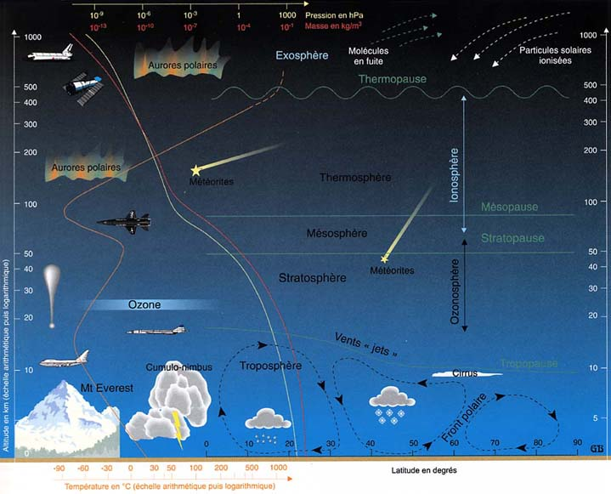
Atmosphere
The surrounding air of the Earth

Slide 2
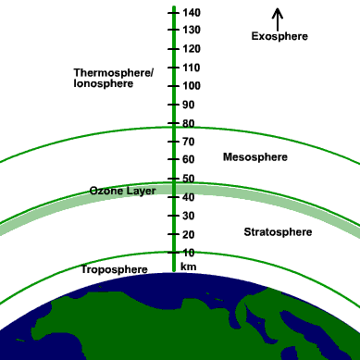
Layers of the atmosphere
There are 4 layers in the atmosphere
They are the troposphere, mesosphere, thermosphere, and stratosphere

Slide 3
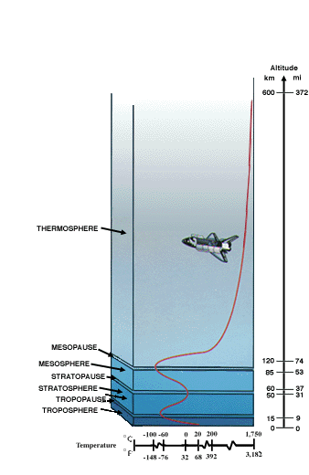
Troposphere
This is the layer that is closest to the surface of the earth
It’s elevation ranges from 0 to 10 km

Slide 4
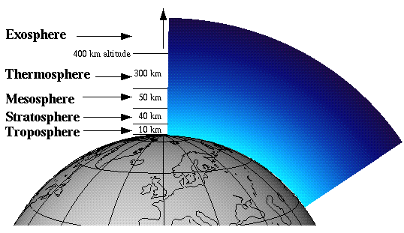
Stratosphere
This layer sits on top of the troposphere
It’s elevation ranges from 10 km to around 25 km
This layer contains the ozone layer, which protects us from harmful sunlight

Slide 5
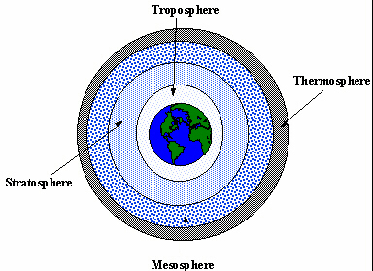
Mesosphere
This layer is above the stratosphere
It’s elevation ranges from 25 to 100 km

Slide 6
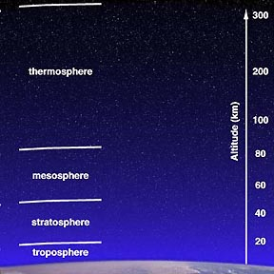
Thermosphere
This is the highest layer of the atmosphere
It’s height ranges from 100 to 400 km
This is where most small meteorites burn up and is also the location in the atmosphere that the northern lights occur (aurora borealis)

Slide 7
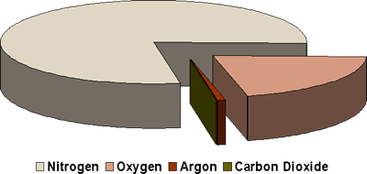
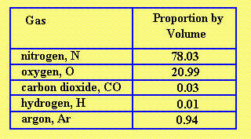
Composition of Air
There are many different types of gasses in the atmosphere
They include nitrogen, oxygen, argon, carbon dioxide and other noble gasses
The gas that is most abundant is nitrogen

Slide 8
This powerpoint was kindly donated to www.worldofteaching.com
http://www.worldofteaching.com is home to over a thousand powerpoints submitted by teachers. This is a completely free site and requires no registration. Please visit and I hope it will help in your teaching.

