Slide 1
Australia The Continent Series
VMS Library 2008-2009

Slide 2
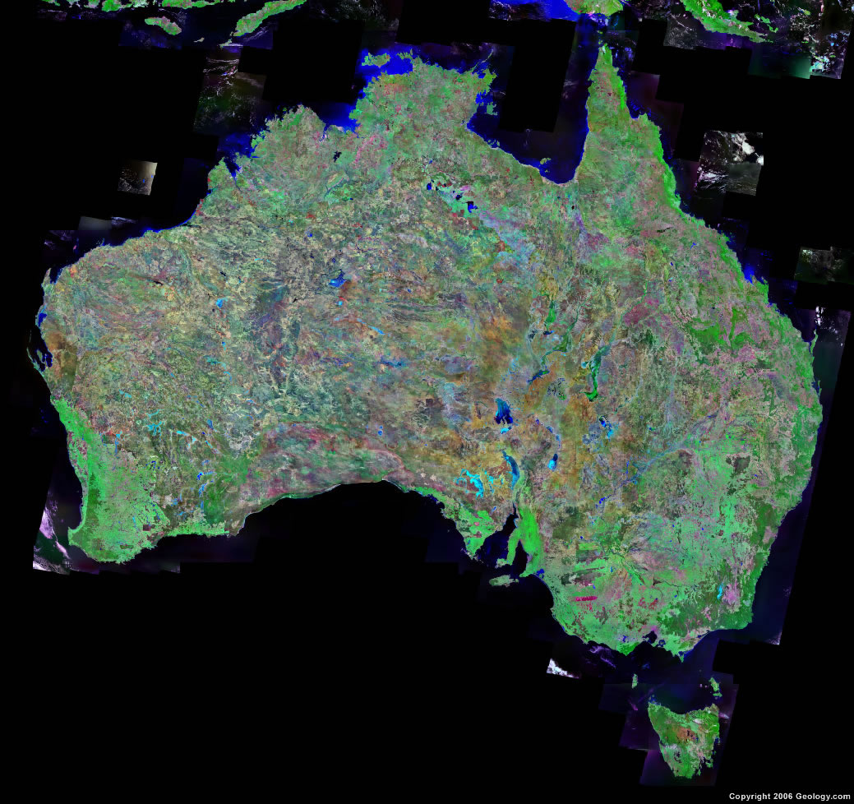
Satellite View

Slide 3
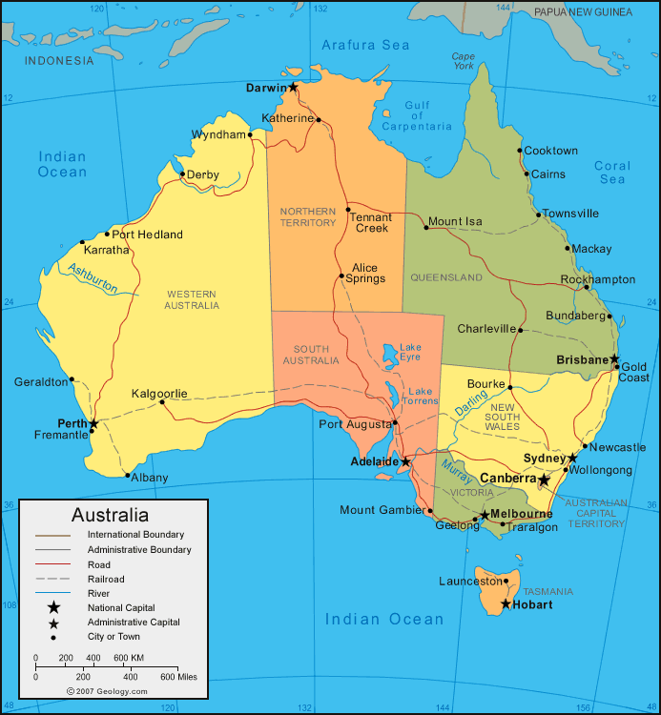
Getting to know Australia

Slide 4
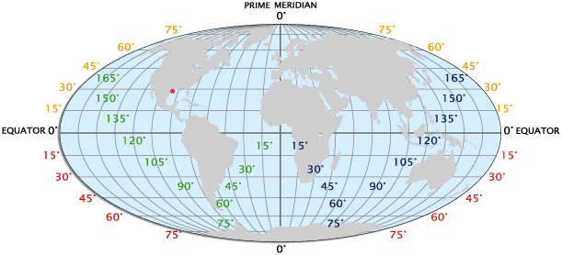
Longitude / Latitude

Slide 5
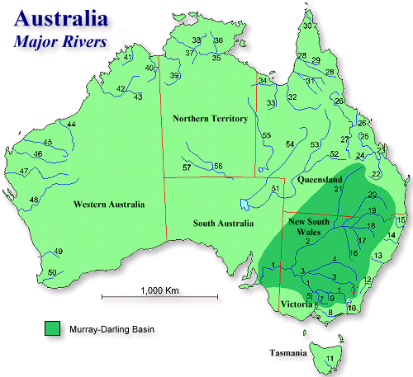
Rivers

Slide 6
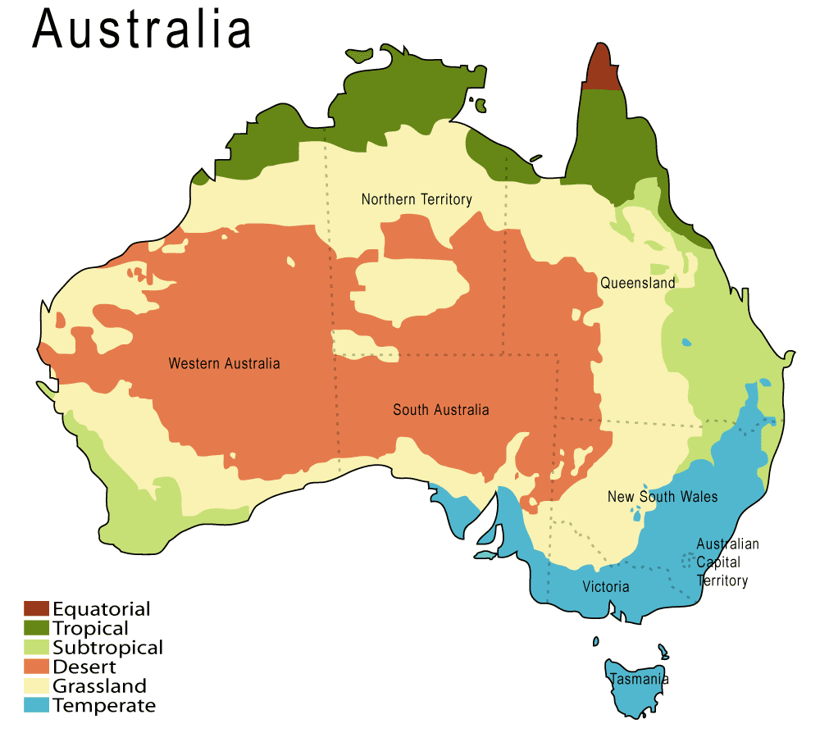
Climate

Slide 7
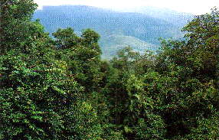
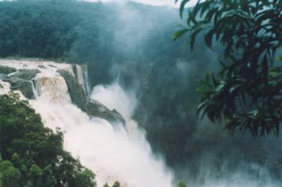
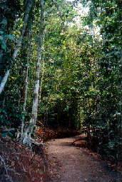
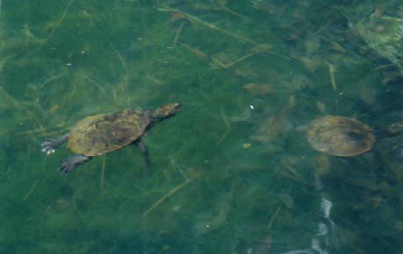
Tropical Area 75-91°
Lake Barrine Walk Snapping Turtle

Slide 8
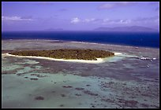
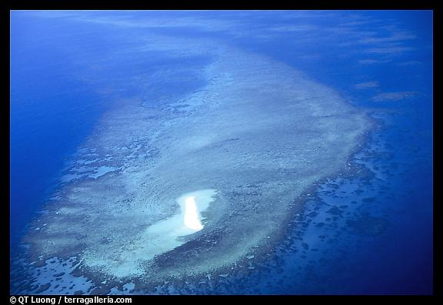
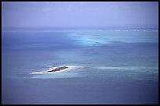
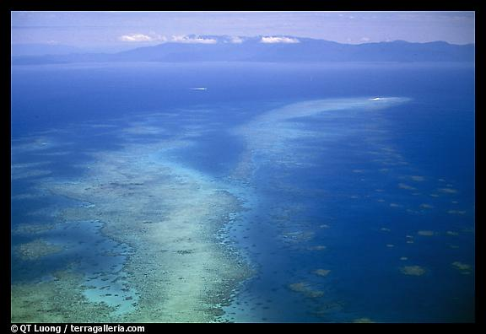
Great
Barrier
Reef

Slide 9
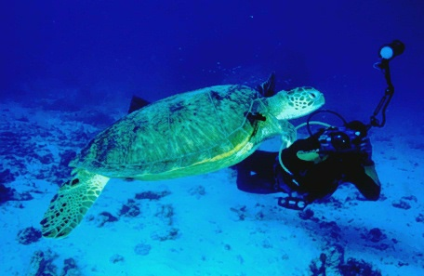
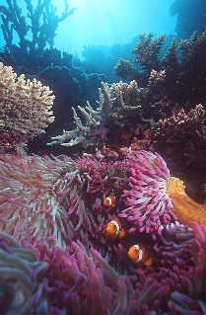
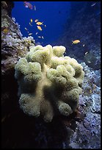
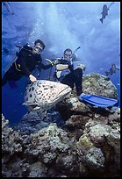
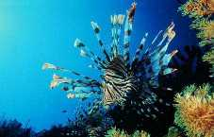
Great
Barrier
Reef

Slide 10
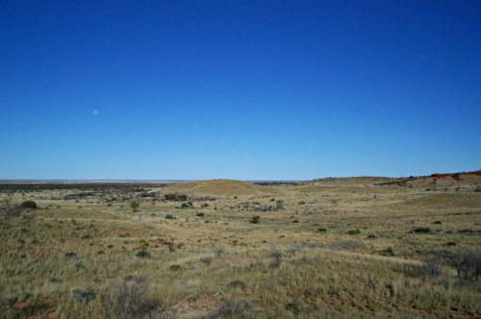
Desert
18% of the continent
Great Victoria
Great Sandy
Tanami
Gibson
Little Sandy
Sturt Stony
Tirari

Slide 11
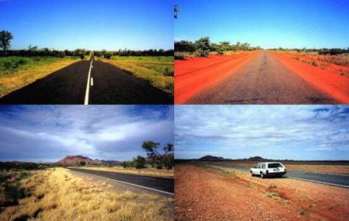
Outback Roads

Slide 12
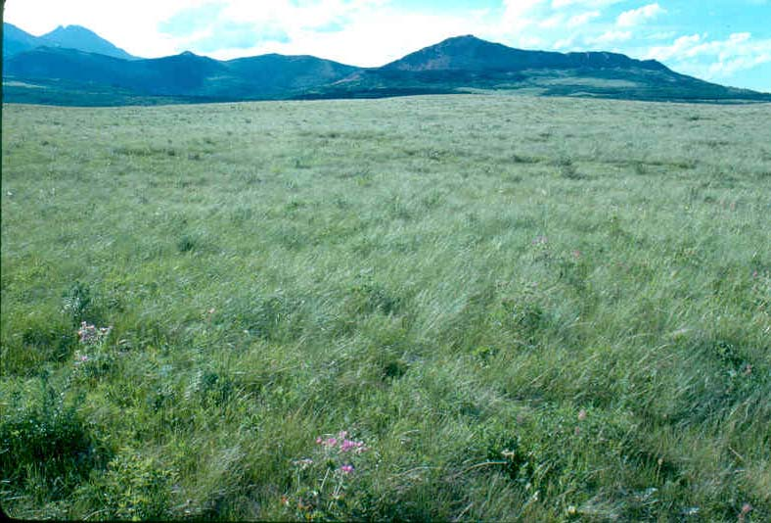
Grassland
Grasslands are open habitats covered mainly in grass, but also with other plants, wildflowers and a small number of trees and low shrubs. Grasslands contain the most species of plants in Australia.

Slide 13
Temperate

Slide 14
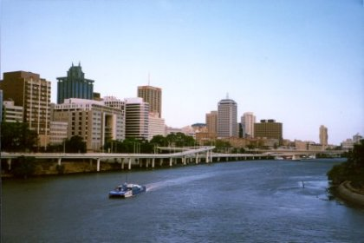
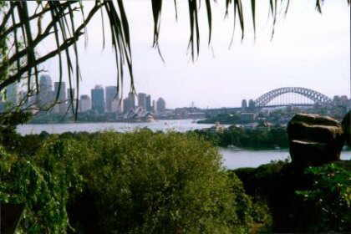
Brisbane
For other city slides click:
Australia Pics
Sydney

Slide 15
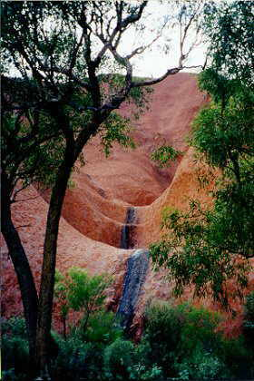
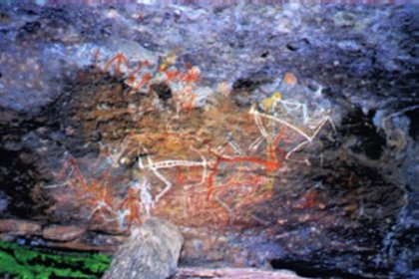
Ayers Rock
Aboriginal Art

Slide 16
This powerpoint was kindly donated to www.worldofteaching.com
http://www.worldofteaching.com is home to over a thousand powerpoints submitted by teachers. This is a completely free site and requires no registration. Please visit and I hope it will help in your teaching.

