Slide 1
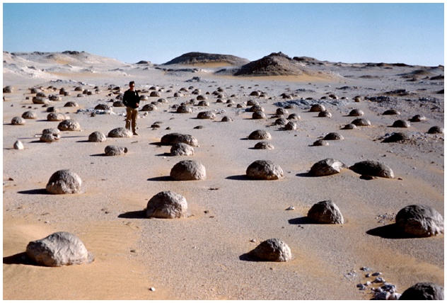
Today:
Ch 13: Deserts & Winds

Slide 2
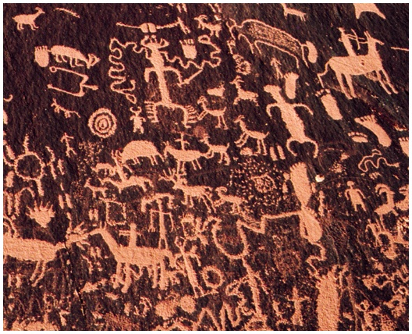
“We don’t survive the desert,
we live here”
- Pima Indian

Slide 3
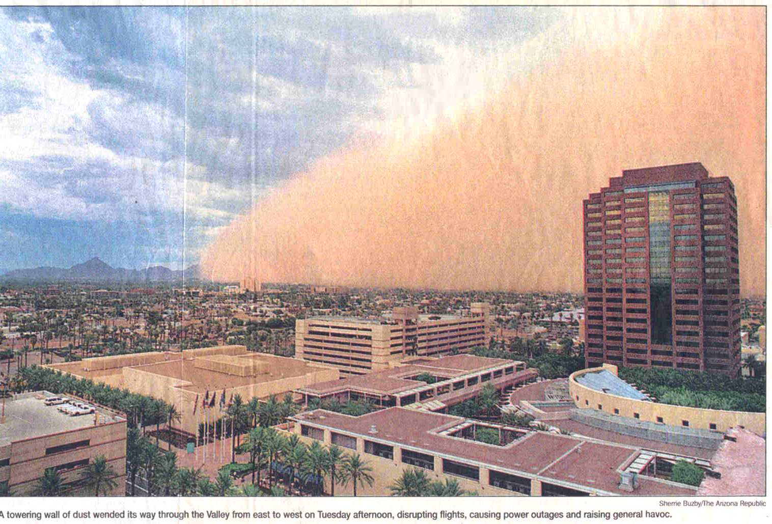

Slide 4
Deserts & winds
1) Deserts: where & why
Earth’s dry regions: 30% of all land
2 climate types of dry regions:
desert (arid)
steppe (semi-arid, surrounds deserts)
Question: how much rain do we get in Tempe every year?

Slide 5
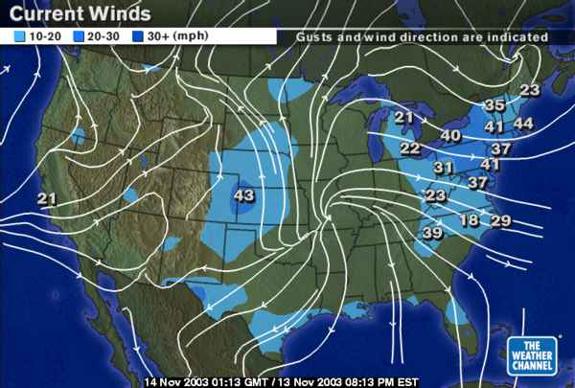
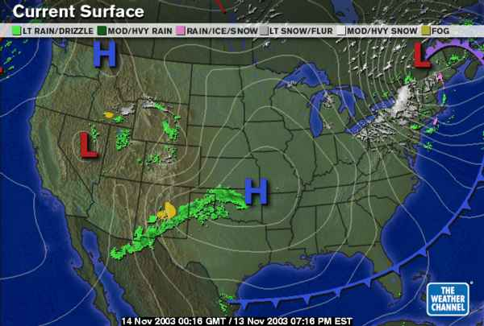
Deserts & winds
1) Deserts: where & why
What causes deserts?
Important factors:
Global distribution of
air pressure
wind
Relationship between
rainfall
evaporation
www.weatherchannel.com

Slide 6
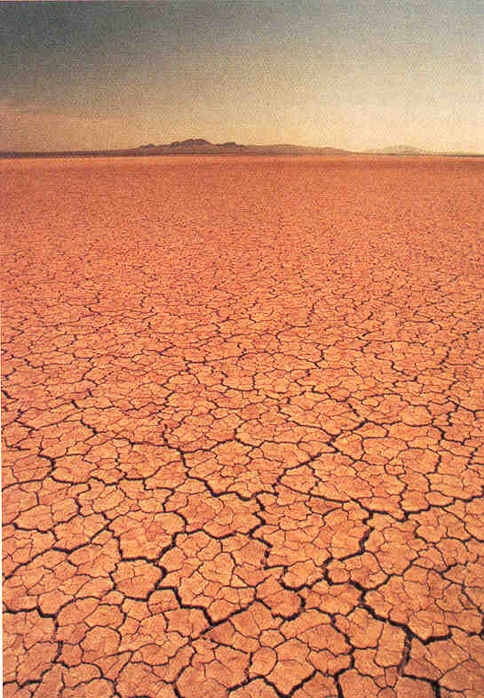
Deserts & winds
1) Deserts: where & why

Slide 7
Deserts & winds
1) Deserts: where & why
Low-latitude deserts
(recall: “latitude” = east-west line on the globe)
Tropic of Cancer
Tropic of Capricorn
In contrast….
Equator:
hot air
rises to 15-20 km
low pressure belt

Slide 8
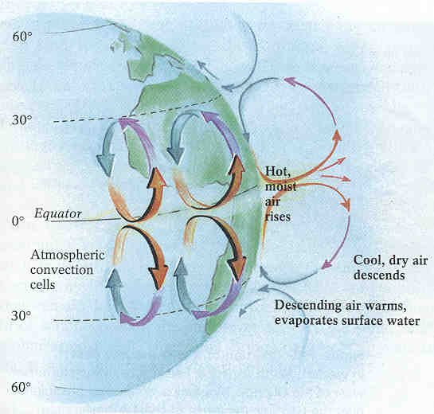
Deserts & winds
1) Deserts: where & why

Slide 9
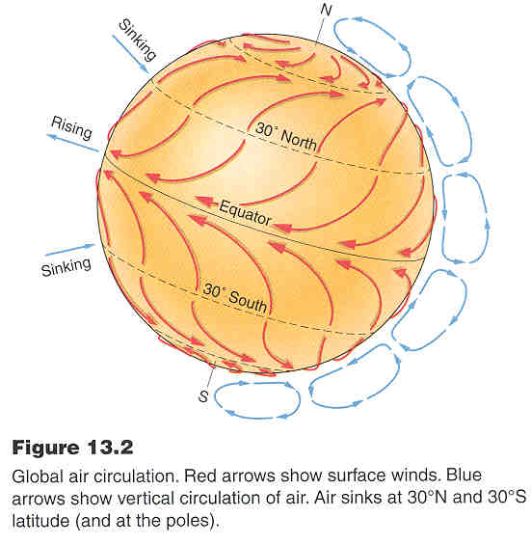
Deserts & winds
1) Deserts: where & why

Slide 10
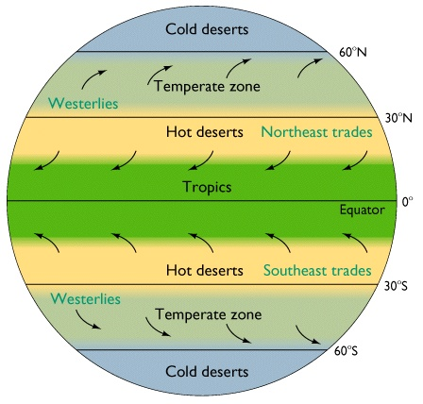
Deserts & winds
1) Deserts: where & why

Slide 11
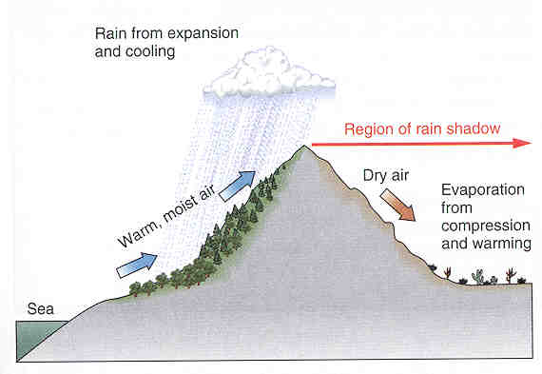
Deserts & winds
1) Deserts: where & why
Middle-latitude deserts
exist in rain shadows.

Slide 12
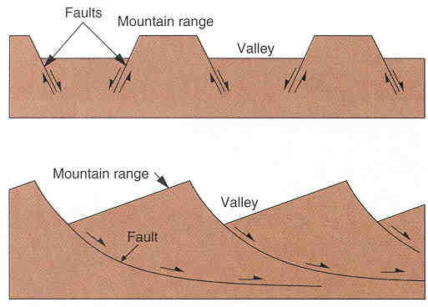
Deserts & winds
2) Basin and range
Basin and range
mountainous desert landscape

Slide 13
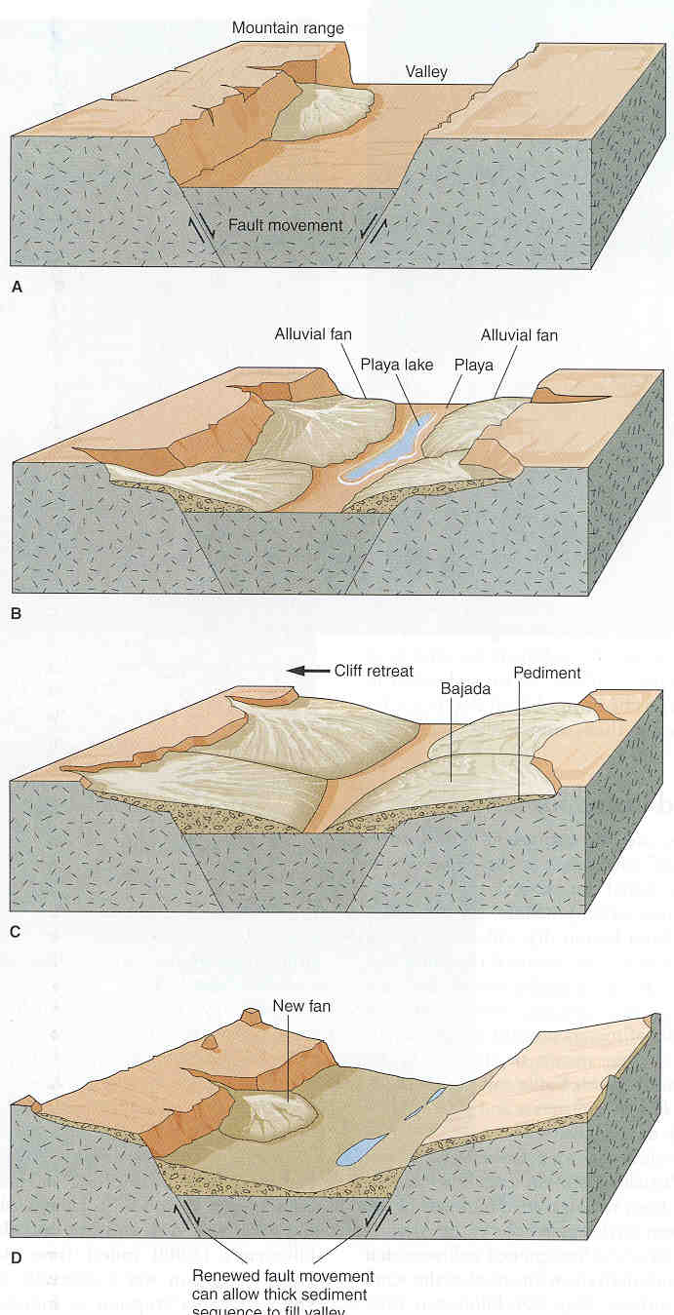
Deserts & winds
2) Basin and range
Basin and range
mountainous desert landscape

Slide 14
3) Wind erosion/ deposits
Deserts & winds
Wind erosion: Important in arid environments
Example: Types of sand dunes:
Sand dune shape depends on:
Flat or hilly?
How much sand?
Winds steady or intermittent?
Wind direction constant?
Vegetation present?

Slide 16
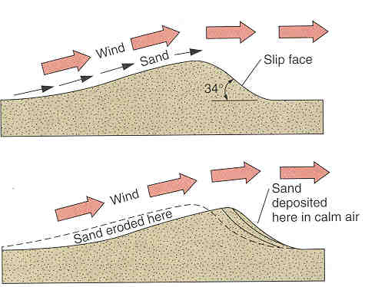
3) Wind erosion/ deposits
Deserts & winds
Sand dune formation

Slide 17
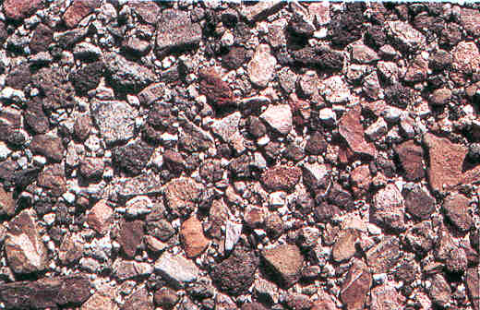
3) Wind erosion/ deposits
Deserts & winds
Desert pavement

Slide 18
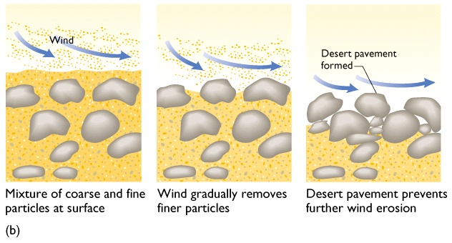
3) Wind erosion/ deposits
Deserts & winds

Slide 20
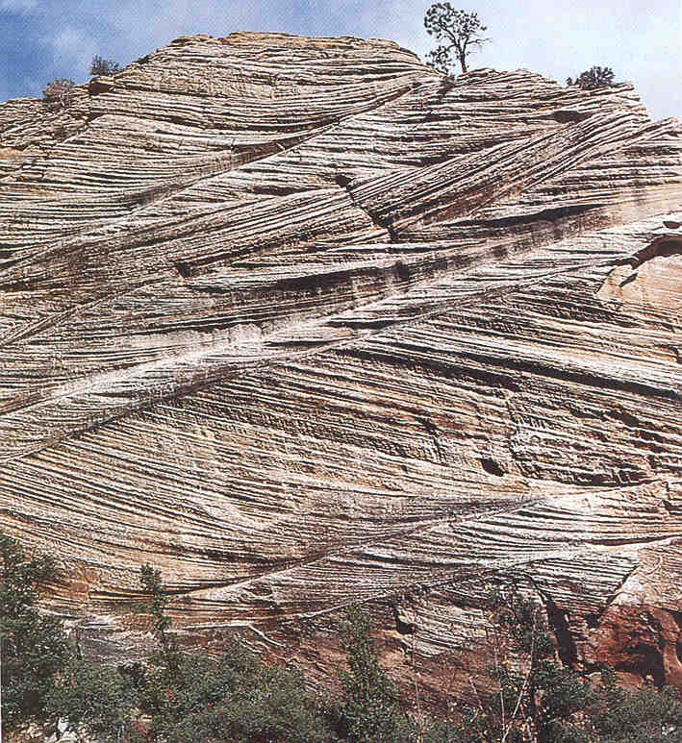
3) Wind erosion/ deposits
Deserts & winds
Graded beds

Slide 21
This powerpoint was kindly donated to www.worldofteaching.com
http://www.worldofteaching.com is home to over a thousand powerpoints submitted by teachers. This is a completely free site and requires no registration. Please visit and I hope it will help in your teaching.

