Slide 1
Hurricanes
By: Mrs. Sanders

Slide 2
Introduction to hurricanes
Hurricanes are the planet’s most ferocious storms.
They are known as cyclones in Australia and typhoons in southeast Asia.
They bring massive waves and wind speeds that can gust up to 186 mph.
Hurricanes are not the normal storms created when cold and warm fronts collide.

Slide 3
Birth of a Hurricane
A hurricane is made up of bands of thunderclouds that spin around a clear, still center called the eye.
Winds blowing across the warm seas close to the equator suck up heat and water vapor to form the storms that produce hurricanes.
The swirling mass of thunderclouds is set spinning by the rotation of the earth and by winds from the poles
A hurricane can last for weeks and travel many thousands of miles.

Slide 4
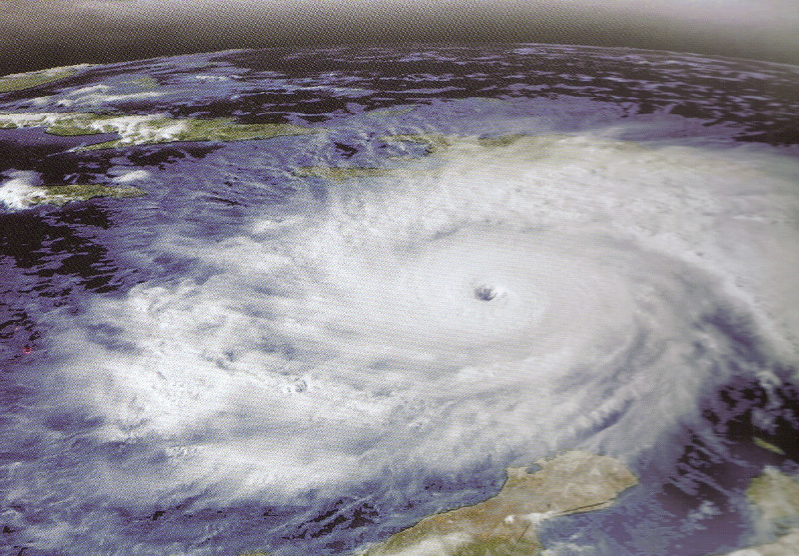
This satellite picture shows Hurricane Ivan over the Caribbean Sea in September 2004.

Slide 5
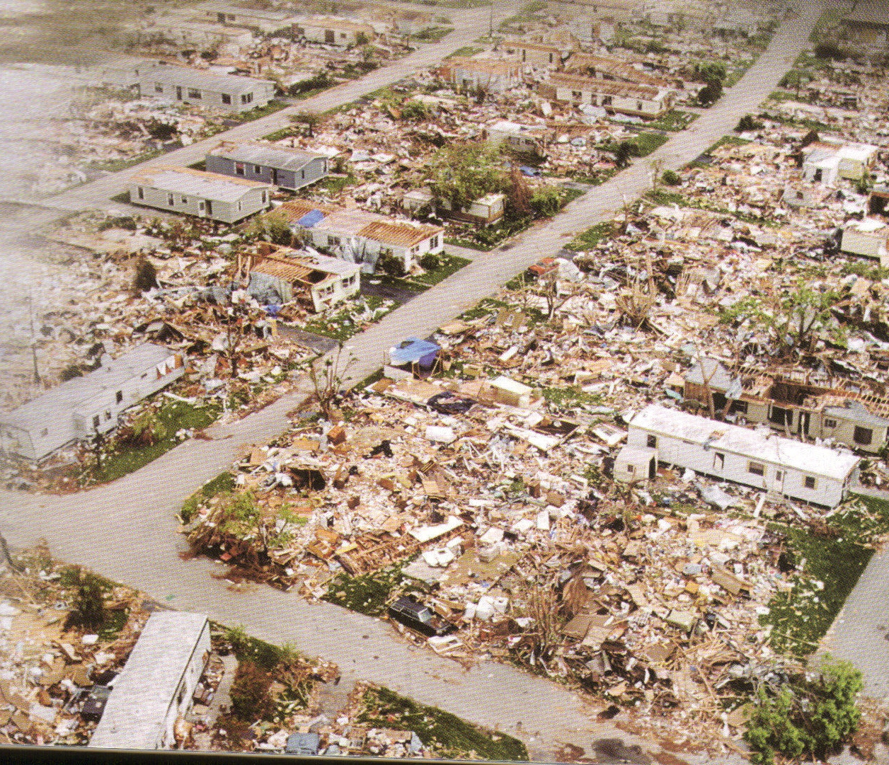
Landfall
The strength of the wind can tear down trees and flatten buildings.
Hurricanes can also cause a rise in the ocean level, or storm surge, which can drive the sea far inland
Hurricane Andrew landfall in Florida in August 1992.
More than 100,000 homes were damaged such as this trailer park that was flattened.

Slide 6
Public Awareness
In the early part of this century, coastal residents may have had less than a day to prepare or evacuate their homes from an oncoming hurricane.
Today these same locations receive warnings to evacuate from one to two days in advance.
Meteorologists and the public rely on hurricane hunters to learn more about the hurricane.
They do this by flying aircraft equipped with weather instruments straight into the middle of these powerful storms.
Hurricane hunters are operated by both the Air Force Reserve based at Keesler Air Force Base in Mississippi and the National Oceanic and Atmospheric Administration (NOAA).

Slide 7
How Are They Named
Since 1953, the Tropical Prediction Center has produced lists of names for hurricanes. As a tropical depression develops into a tropical storm it is given the next available name on the list, which is prepared in alphabetical order and alternates from between male and female names. The list for 2007 is listed below:
Andrea
Barry
Chantal
Dean
Erin
Felix
Gabrielle
Humberto
Ingrid
Jerry
Karen
Lorenzo
Melissa
Noel
Olga
Pablo
Rebekah
Sebastian
Tanya
Van
Wendy

Slide 8
Hurricane
Katrina
August 29, 2005

Slide 9
Hurricane Katrina hit the U.S. on August 29, 2005.
Winds of 140 mph created a 30-foot storm surge.
Water breached the dam that protected the city of New Orleans and flooded the low-lying coastlines of Louisiana, Alabama, and Mississippi.
With the damage estimated at more than $200 million, and more than one million people forced to leave their homes, Katrina is the most expensive and most destructive natural disaster in U.S. history.

Slide 10
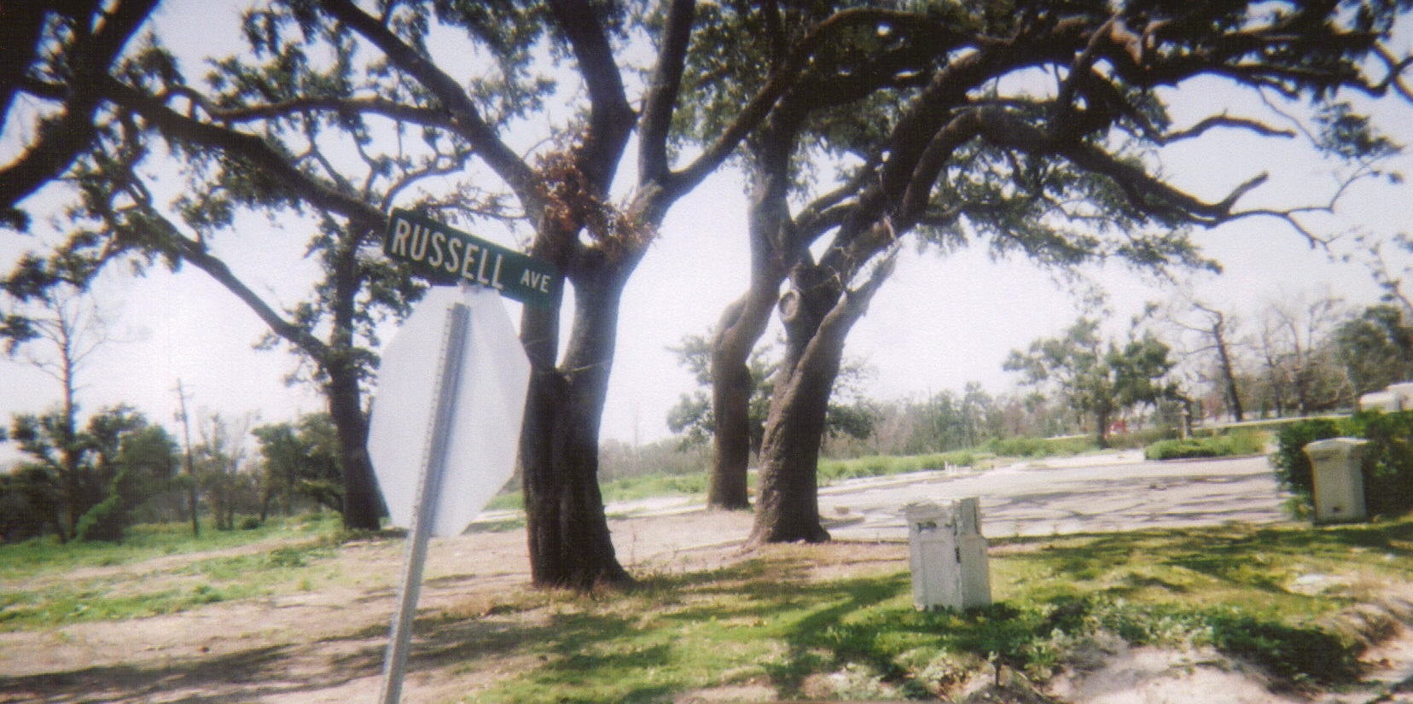
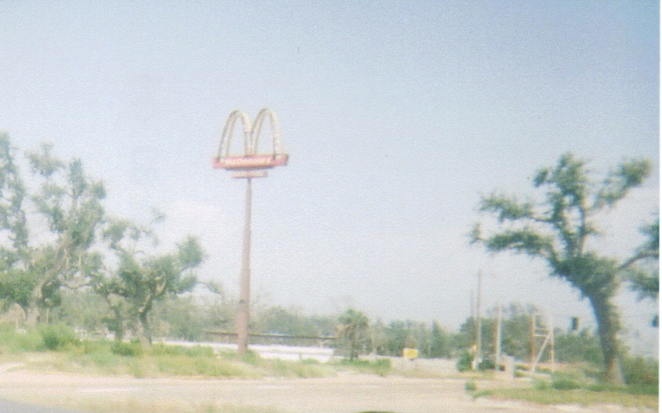
Damage to Long Beach, MS
Hurricane Katrina 2005
Russell Ave.
Best Western Hotel Slab
McDonald’s sign still stands but restaurant is gone.

Slide 11
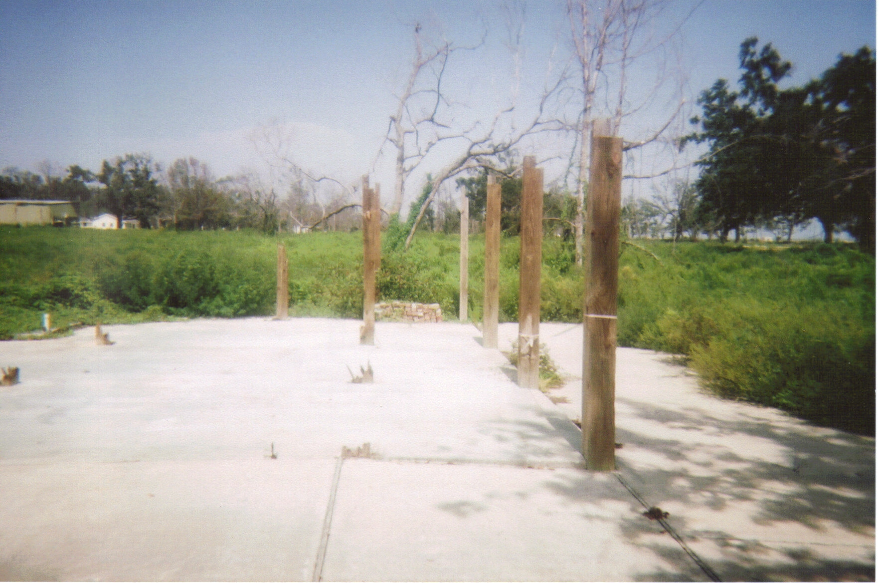
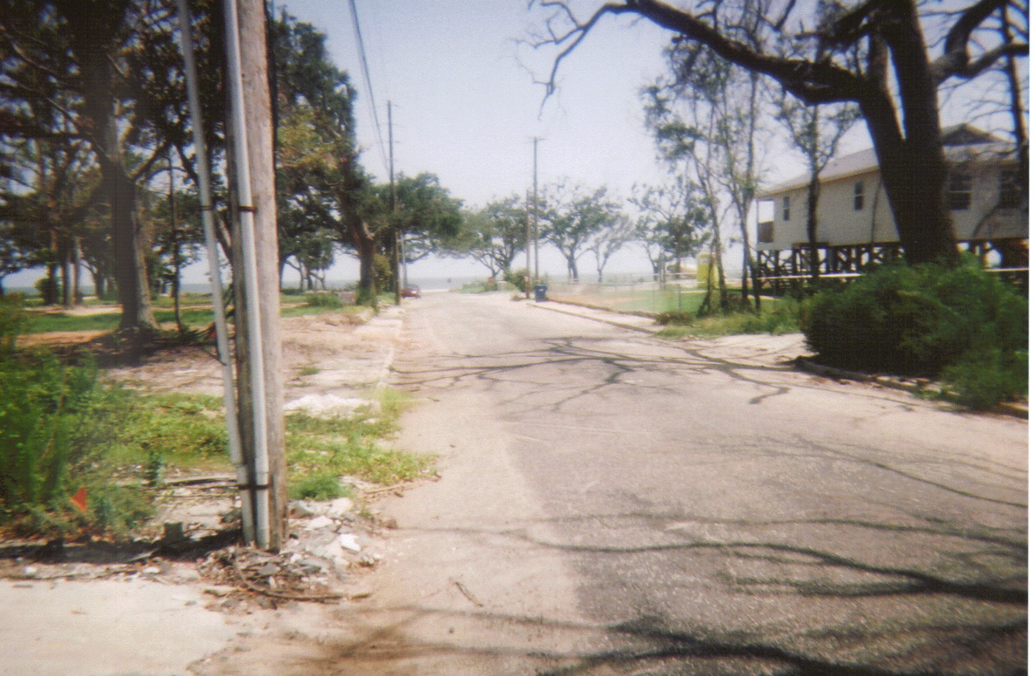
Damage to Long Beach, MS
Hurricane Katrina 2005
My grandmother’s house was here on this concrete slab.
This is the view from her driveway to the beach.

Slide 12
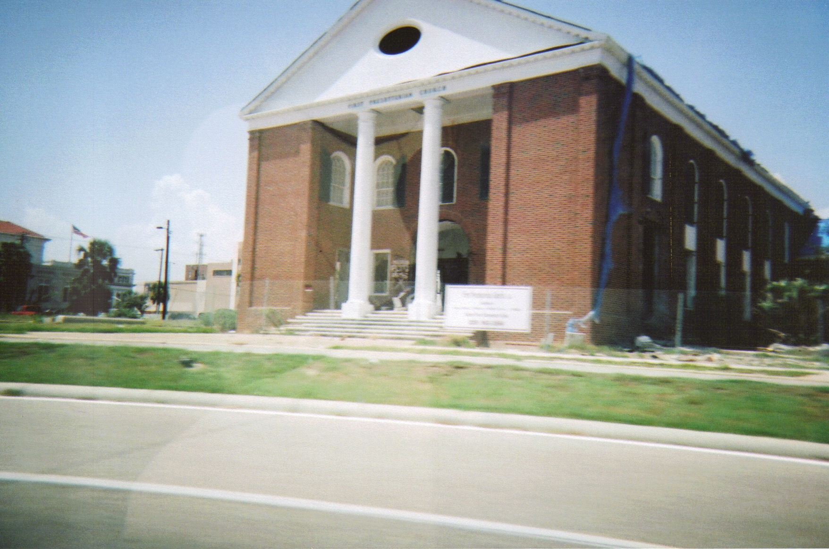
Damage to Long Beach, MS
Hurricane Katrina 2005
First Presbyterian Church on Hwy. 90

Slide 13
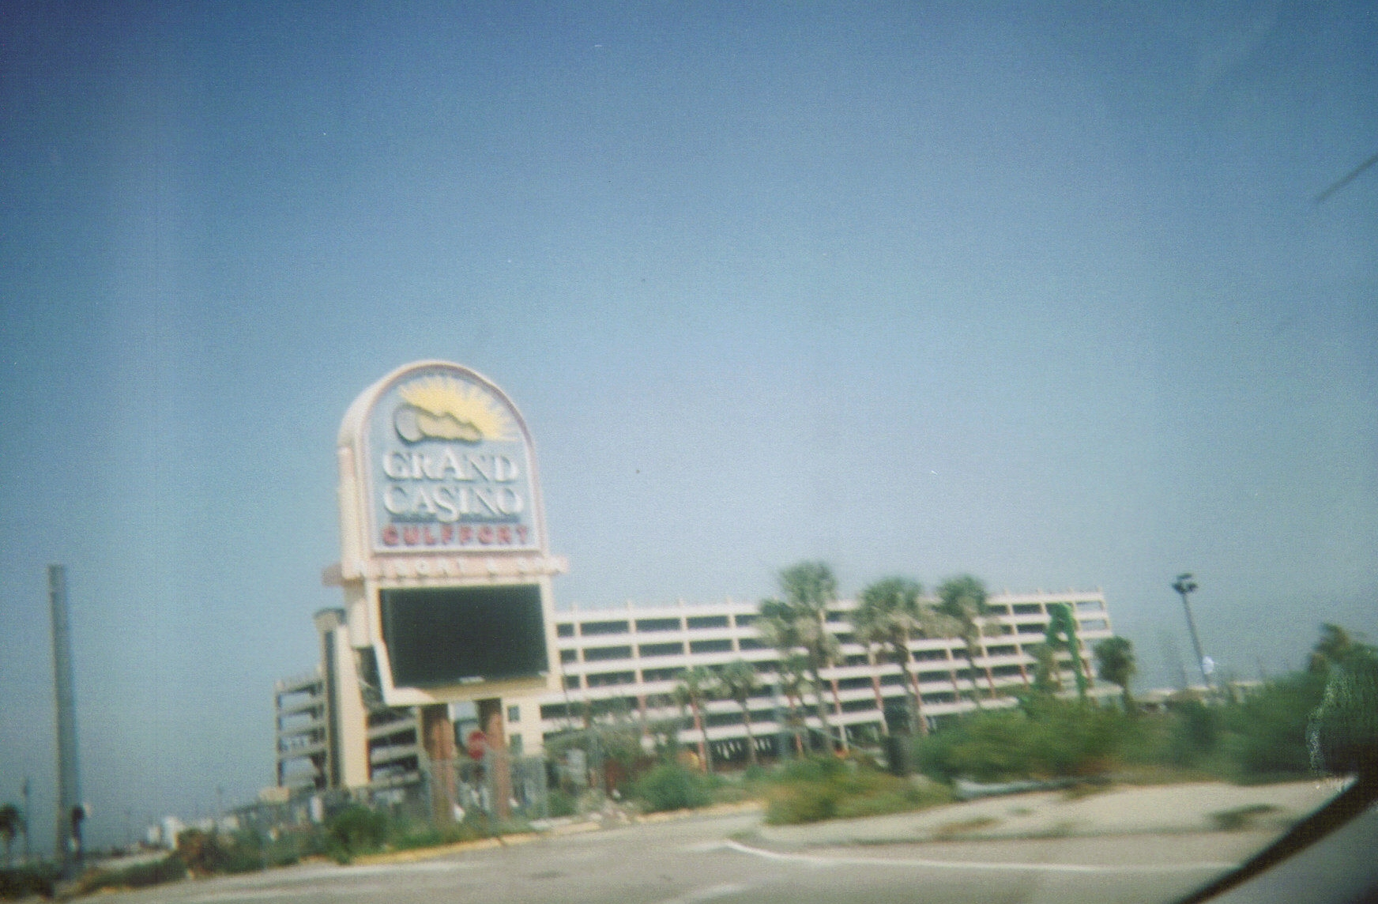
Damage to Long Beach, MS
Hurricane Katrina 2005
Grand Casino in Gulfport

Slide 14
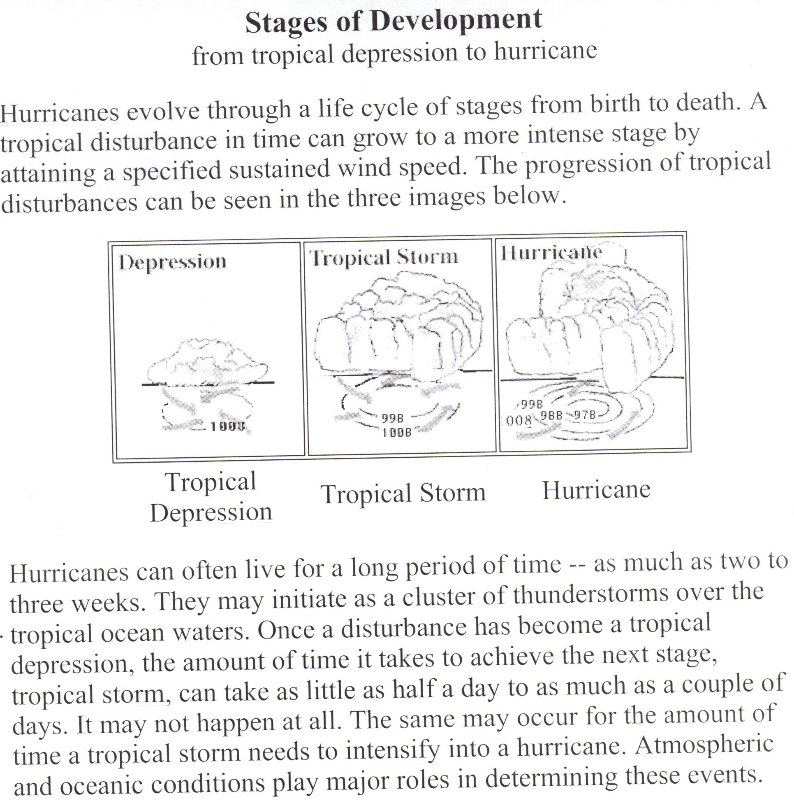

Slide 15
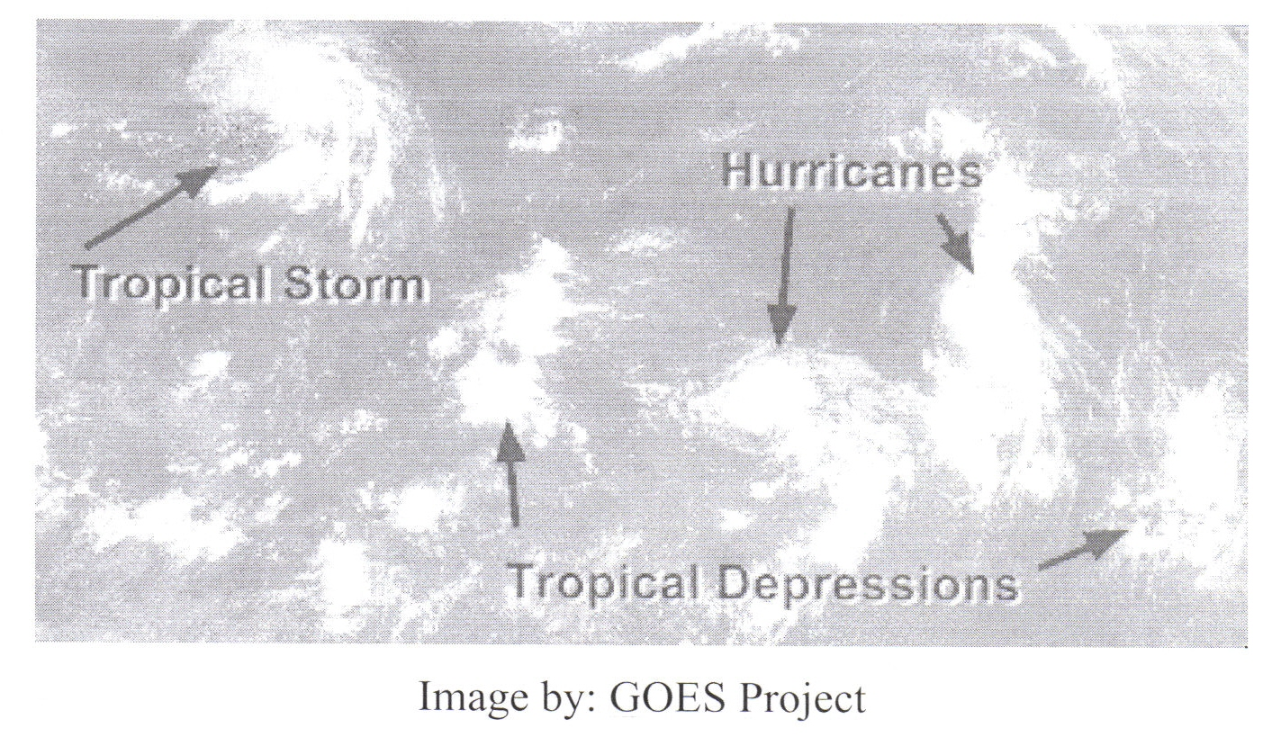
Satellite Image

Slide 16
Resources:
Kingfisher Knowledge Hurricanes, Tsunamis, and Other Natural Disasters by Andrew Langley
http://ww2010.atmos.uiuc.edu/(Gh)/guides/mtr/hurr/grow/home.rxml
Pictures of Long Beach, MS by Dustan Sanders

Slide 17
This powerpoint was kindly donated to www.worldofteaching.com
http://www.worldofteaching.com is home to over a thousand powerpoints submitted by teachers. This is a completely free site and requires no registration. Please visit and I hope it will help in your teaching.

