Slide 1
Landforms
Features of the Earth’s surface and how they are formed and changed

Slide 2
Beaches
Beach formed by water erosion - ocean

Slide 3
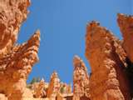
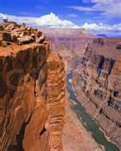
Canyons
Canyons formed by water erosion – river
OR by wind erosion

Slide 4
Cliffs

Slide 5
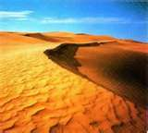
Deserts
Deserts formed by wind deposition

Slide 6
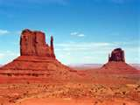
Mesas and Plateaus
Mesas and plateaus formed by wind erosion

Slide 7
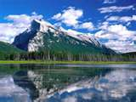
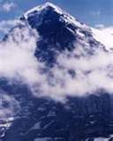
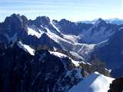
Mountains formed by earthquakes and pushing up of crust

Slide 8
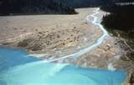
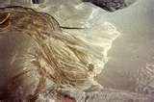
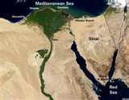
New land formed by deposition of rivers/floodwaters

Slide 9
Forces that shape the Earth’s surface
Volcanoes and Earthquakes
Rivers and Rain
Floods and Mud slides
Wind and water erosion
Weathering
Ice and Glaciers
Deposition

Slide 10
This powerpoint was kindly donated to
www.worldofteaching.com
http://www.worldofteaching.com
Is home to well over a thousand powerpoints submitted by teachers. This a free site. Please visit and I hope it will help in your teaching

