Slide 1
Mapping

Slide 2
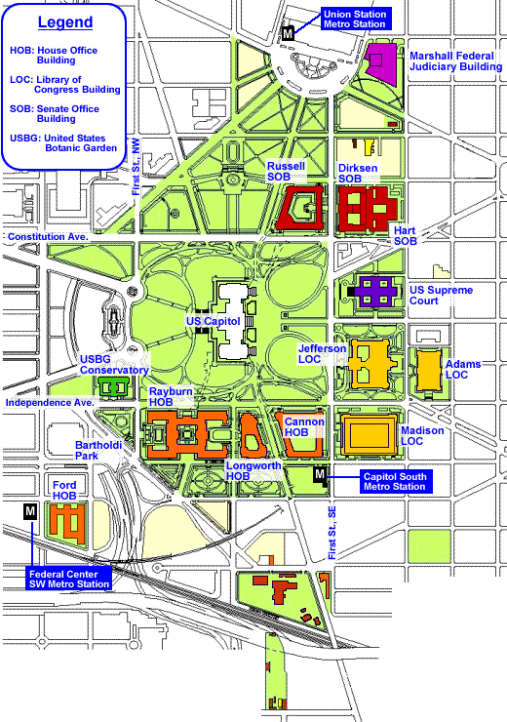
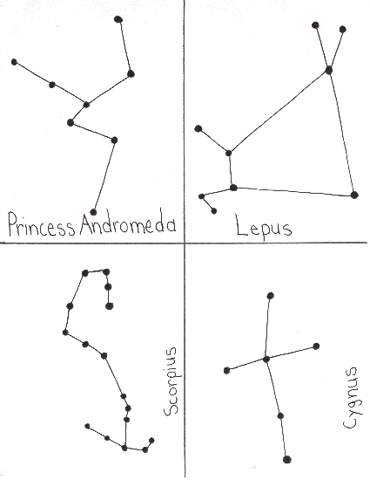
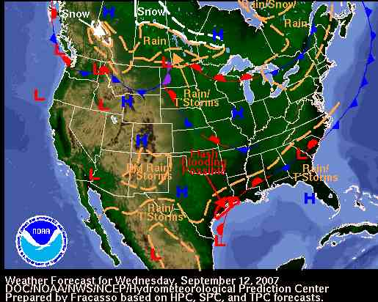
What is a map?
It is a representation of something (Earth, stars, solar system, a building, etc…

Slide 3
Uses of Maps
To determine where you are going.
To act as a model of Earth’s surface.
Used to locate various places
To show the distribution of various features or types of materials.

Slide 4
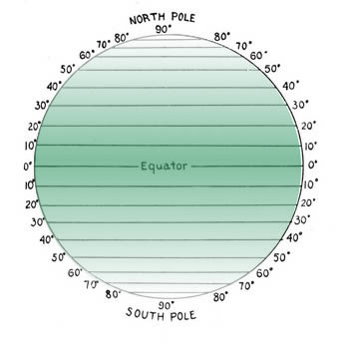
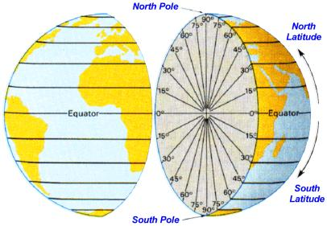
Quick Review of Latitude and Longitude
Latitude
Measured in degrees North and South of the Equator.
Lines drawn parallel to each other running west to east.

Slide 5
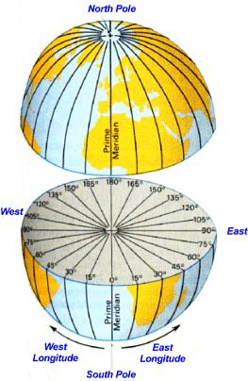
Quick Review of Latitude and Longitude
Longitude
Measured in degrees East or West of the prime meridian.
Lines drawn running North and South.

Slide 6
Topography
The lay of the land.
Shows relief using contour lines.
Relief- highs and lows of Earth’s surface.
Relief can be calculated
Take the difference between the highest point and the lowest.
Ex: Mountain peak 20 m. lake 10m
20m- 10m= 10m
The relief of this area is 10m

Slide 7
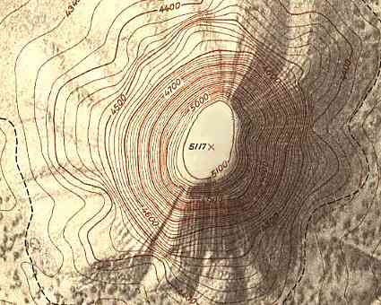
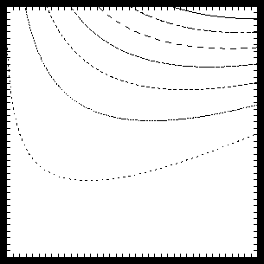
Reading a topographic map- Contour Lines
Lines on topographic maps.
Connect points of equal elevation.
Everything connected to that line has the same elevation.
Elevation- the distance something is above sea level. Sea level= 0m or 0ft.

Slide 8
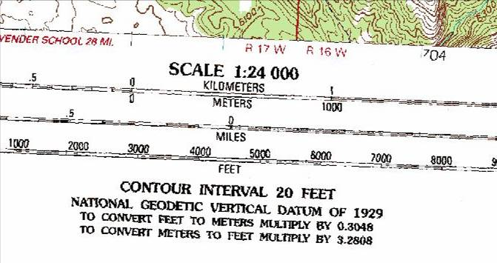
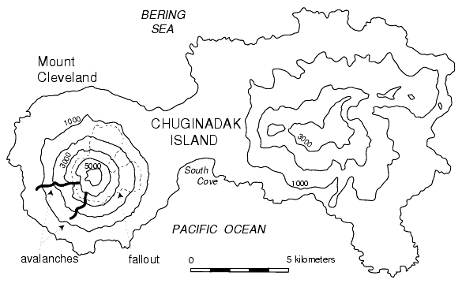
Reading a topographic map- Contour Intervals
Contour interval- gives the difference in elevation between 2 contour lines.
Another indicator of height.
Shown on maps as C.I.= 10ft.
Used to count contour lines.
How it will look on a map
←C.I.= 1000ft

Slide 9
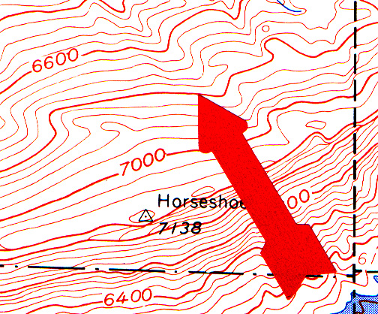
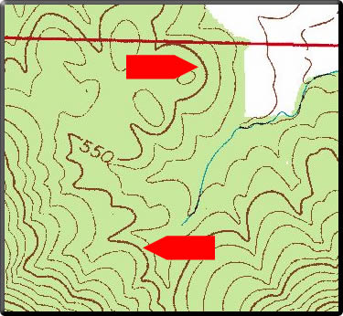
Reading a topographic map- Index Contours
A index contour is a contour line that is accentuated in thickness and is labeled with the appropriate measure of elevation.
Index contours occur every fifth contour line.
Help the map user read elevations on a map.
Red arrows indicate location of index contours.

Slide 10
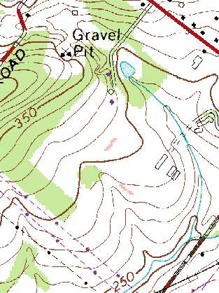
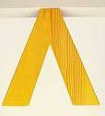
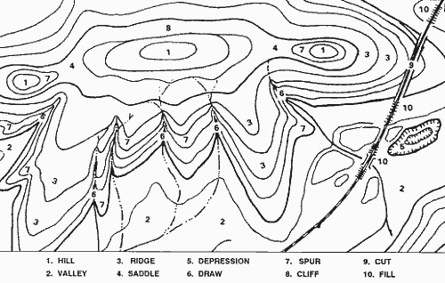
Reading a topographic map- Streams
The direction a streams is flowing is shown on a topographic map by the way a contour line crosses the stream.
Streams are shown as a blue line on maps.
When contour lines cross a stream it looks like an upside down V.
The point in the V points
upstream. It opens in the direction the water is flowing.

Slide 11
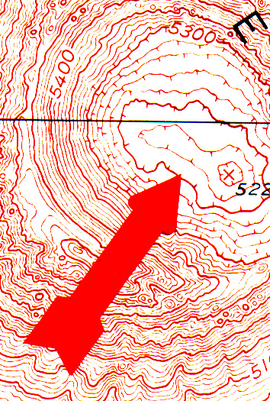
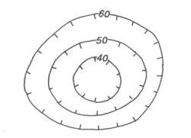
Reading a topographic map- Depression Contours
Depression contours show areas of lower elevation.
Drawn like contour lines with marks on the inside.
Hachure marks- tick marks on inside of closed circle.

Slide 12
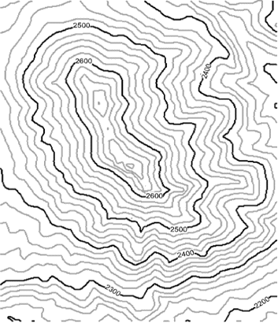
Reading a topographic map- Hills
Hills are represented on a topographic map by a series of concentric contour lines in a rough circle

Slide 13
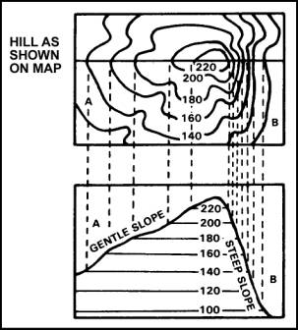
Reading a topographic map- Slope
Closely spaced contour lines represent steep slopes.
Widely spaced contour lines represent gentle slopes.

Slide 14
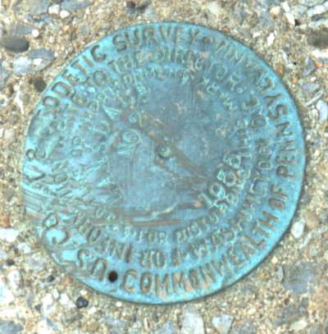
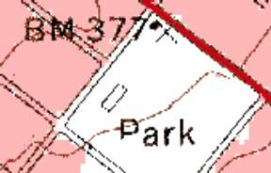
Reading a topographic map- Benchmarks
A benchmark is a place where exact elevation is known.
Shown by a B.M. on map
Ex: BM 60

Slide 15
Reading a topographic map- Colors
The colors on a topographic map are symbolic of different map features.
Blue = water
Green = forest
Brown = contour lines
Black = cultural features (buildings, place names, boundary lines, roads, etc.)
Red = principal roads
Pink = urban areas
Purple = revisions to an older map, compiled from aerial photos. If an area has become urbanized, this may be shown as purple shading on the new, revised map.

Slide 16
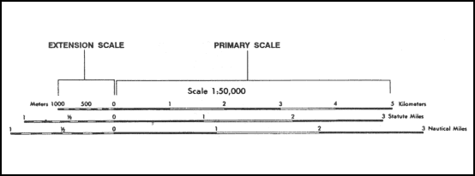
Reading a topographic map- Map Scale
Map scale indicates your distance along the ground, or the amount of ground covered by the map.
USGS- United States Geologic Survey
Ratio- 1:24000
one unit on the map is equal to 24,000 units of the same size on the ground.
Ex:1 inch on the map = 24000 inches on Earth.
Or after converting 1 inch = 2000ft.
Bar scale-indicated by a line or bar with distances marked in miles, feet, or kilometers.

Slide 17
Reading a topographic map- Map Scale

Slide 18
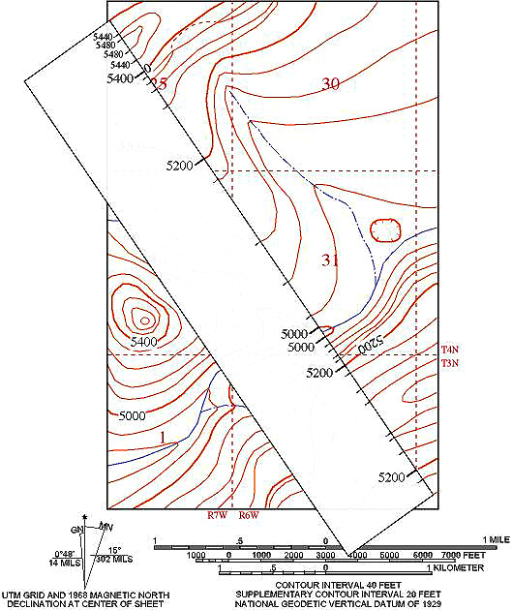
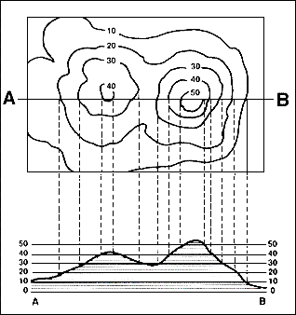
Reading a topographic map- Profiles
A topographic profile is a cross-sectional view along a line drawn through a portion of a topographic map.
It is like taking a slice out of a portion of the Earth and looking at it from the side.

Slide 20
This powerpoint was kindly donated to www.worldofteaching.com
http://www.worldofteaching.com is home to over a thousand powerpoints submitted by teachers. This is a completely free site and requires no registration. Please visit and I hope it will help in your teaching.

