Slide 1
Coastal Ecosystems: Salt Marshes and Mangroves
Marine Biology
Dr. Ouida Meier

Slide 2
Factors Driving Coastal Ecosystems
Latitude
temperature
light, seasonality
Tidal cycles
amplitude
frequency
Wave energy
Degree of riverine input
freshwater input
alluvial sediments and deposition
turbidity

Slide 3
Factors Driving Coastal Ecosystems
(cont.)
Geological characteristics
rock
sand
sediment
Hydrological characteristics
nearshore currents
transport
Continental proximity
nutrient input
anthropogenic impacts

Slide 4
Recap: Rocky Intertidal
Our example (Pacific Northwest): high latitude, so
Cold Pacific waters, strong seasonality
Tidal cycle: high amplitude, semi-diurnal
Wave energy high
Freshwater input – riverine characteristics modified by bay / estuary
Geology: rocky cliffs, interspersed w/sandy beach
Hydrology: strong nearshore currents & transport
Continental edge, input via interaction with terrestrial systems

Slide 5
Salt Marsh Ecosystems
Our example (southeastern U.S.: Gulf and Atlantic coasts): moderate latitude, so
“Warm” Atlantic and warmer Gulf and Gulf stream waters, moderated seasonality
Tidal cycle: low amplitude
Wave energy low
Freshwater input often critical – deltaic riverine input can result in extensive marsh systems, abundant alluvial sediment input. Salt accumulation a challenge.
Geology: long-term alluvial sediment accumulation
Hydrology: nearshore currents & transport important
Continental edge, nutrient input via runoff, rivers

Slide 6
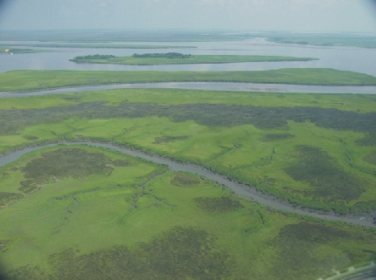
Salt marsh and tidal channels in coastal Georgia

Slide 7
Plants of the Salt Marsh Community
Spartina alterniflora – marsh cordgrass
height depends on riverine or tidal flushing
export of dried mats during winter storms
exclude salt from roots
Salicornia – a succulent
Salt pans
Fresher water and soils / higher ground: other grasses (Spartina patens), rushes (Juncus romerianus), sedges
Zonation based on topography, inundation of freshwater, fresh/salt fluctuation, tidal flushing, relative stresses, anoxia of soils, latitudinal gradient (e.g., east coast U.S.).

Slide 8
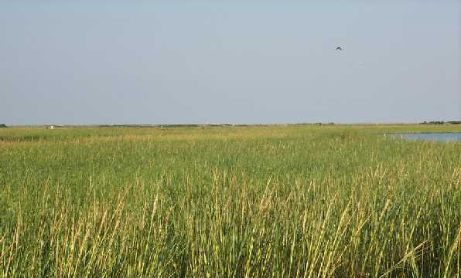
Salt marsh replanted after a break in an oil pipeline

Slide 9
Animals of the Salt Marsh Community
Geukensia demissa – dominant mussel
lives in sediment
physiological variation with tidal cycles
Crassostrea virginica – oyster
dense beds in well-flushed tidal channels
Littorina irrorata – salt marsh snails; pulmonates
Thais haemostoma – oyster drill
Uca pugnax, other Uca spp. – fiddler crabs
Sesarma cinereum - marsh crabs
(These examples are particularly for south Louisiana and coastal Georgia; other species will occur elsewhere, filling slightly modified niches depending upon range, region, and local conditions.)

Slide 10
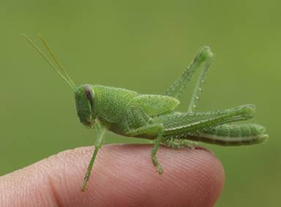
An herbivore in the salt marsh community

Slide 11
Salt Marsh Communities:
Highly productive
Very stressful
Trap sediment
Stabilize and extend coastlines, especially those with fluvial input
Food webs detritus-based; herbivory may be more important than previously thought; “trophic relays” convey biomass to adjacent ecosystems
Low diversity, high productivity

Slide 12
Wetlands Loss: Salt Marshes
Coastal erosion and wetland loss due to channelization and levees along the Mississippi, dams on its tributaries, land settling from groundwater pumping and use, and channels cut through the marsh for offshore drilling platforms.
Estimates of Louisiana coastal wetland loss for 1978-90 indicate a loss of about 35 square miles a year of freshwater and non-freshwater marshes and forested and scrub-shrub wetlands. From 1978-90, that equalled a 12-year loss of about 420 square miles, an area twice the size of the populated greater New Orleans area.
http://www.lacoast.gov/news/press/1997-10-27.htm
http://www.tulane.edu/~bfleury/envirobio/saltmarsh.html
http://www.bonitanews.com/03/10/naples/e1631a.htm

Slide 13
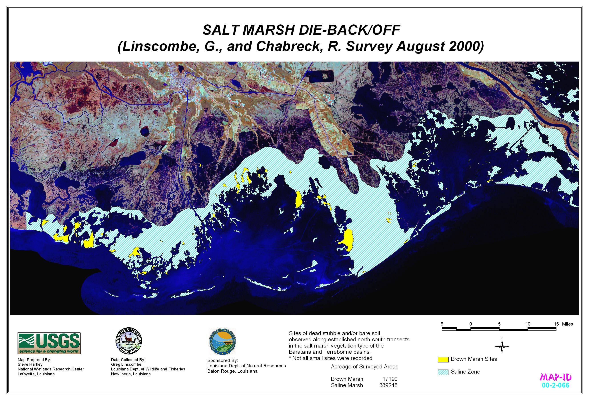
Example of salt marsh decline in south Louisiana, http://www.brownmarsh.net

Slide 14
Mangrove Ecosystems
Our example (south Florida): subtropical latitude, so
“Warm” Atlantic and warmer Gulf and Gulf stream waters, limited seasonality (moving toward rainy/dry seasons)
Tidal cycle: low amplitude
Wave energy low
Freshwater input important – can be sheetlike (Everglades) rather than distinctly riverine; alluvial sediment input. High tannins from leaf input.
Geology: long-term alluvial and peat accumulation
Hydrology: more inundated than salt marshes; nearshore currents & transport important
Continental edge, nutrient input via runoff, rivers

Slide 15
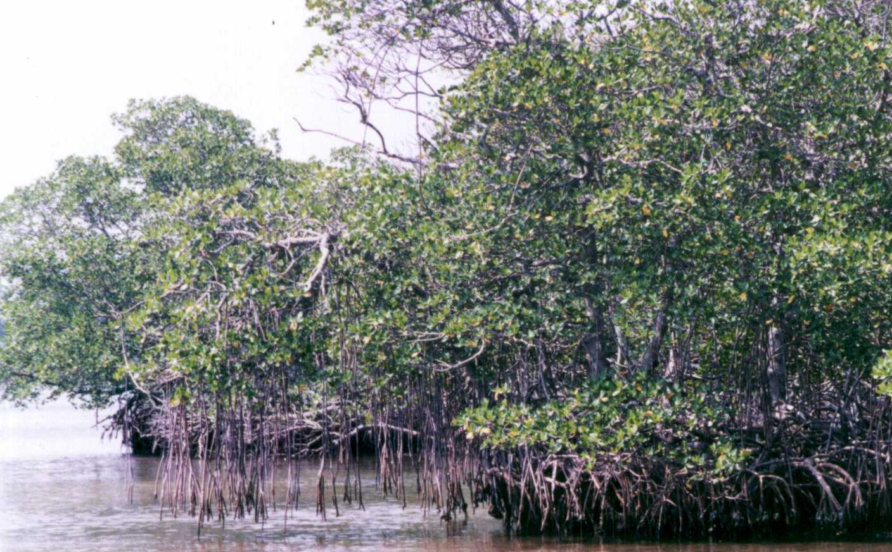
Red mangroves, low tide, south Florida

Slide 16
Plants of the Mangrove Community
Rhizophora mangle – red mangrove
prop roots; extrudes salt
Avicennia germinans – black mangrove
pneumatophores; extends to coastal Louisiana where it, unusually, coexists w/ Spartina
Laguncularia racemosa – white mangrove
These have viviparous propagules
Much higher diversity in the Indo-Pacific

Slide 17
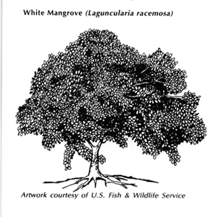
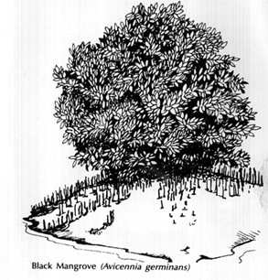
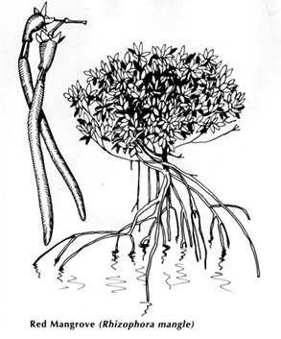
Zonation and Distribution of mangroves is affected by flooding, salinity, temperature fluctuations (air/soil/water), and soil.

Slide 18
Animals of the Mangrove Community
Prop roots of red mangroves provide substrate for benthic organisms (algae, sponges, hydroids, tunicates, bryozoans)
Mangrove swamps provide critical protected nursery areas for fishes, crustaceans, and shellfish.
Dense mangrove branches serve as rookeries for many coastal species of birds
Organisms reared in mangrove swamps become food for fish (snook, snapper, tarpon, jack, sheepshead, red drum) oysters, and shrimp.

Slide 19
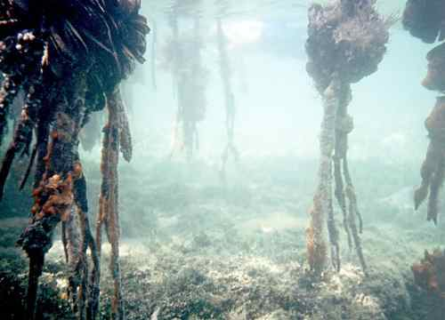
Prop root communities

Slide 20
Wetlands Loss: Mangrove Swamps
Many acres of mangroves in south Florida have been lost to development and to anthropogenic changes in hydrology.
Globally, many areas of mangroves are being cut for wood or converted to aquaculture or mariculture ponds (e.g., fish, shrimp, prawns for seafood restaurants).
Concomitant declines in offshore fisheries can be expected and have been seen.

Slide 21
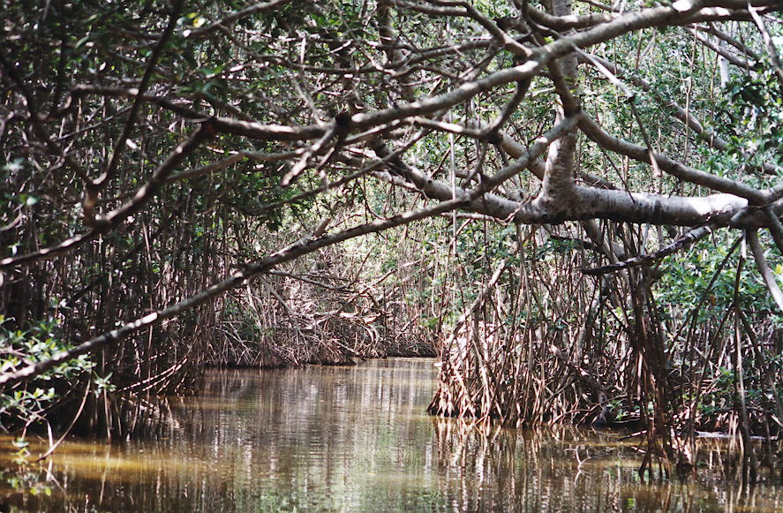
Mangrove swamp in Mexico

Slide 22
This powerpoint was kindly donated to www.worldofteaching.com
http://www.worldofteaching.com is home to over a thousand powerpoints submitted by teachers. This is a completely free site and requires no registration. Please visit and I hope it will help in your teaching.

