Slide 1
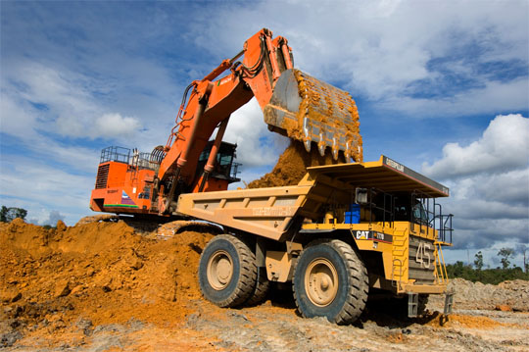
Minerals are naturally-occurring inorganic substances with a definite and predictable chemical composition and physical properties

Slide 2
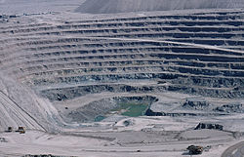
Classification of Minerals
Metallic Ferrous
Non-ferrous
Precious
Non-metallic
Energy Minerals

Slide 3
CLASSIFICATION OF MINERALS
ENERGY
METALLIC
NON - METALLIC
FERROUS
PRECIOUS
NON - FERROUS

Slide 4
Ferrous – Iron Ore, Manganese, Nickel, Cobalt
Non-ferrous – Copper, Lead, Tin, Bauxite
Precious – Gold, Silver, Platinum
Non-metallic – Mica, Salt, Potash, Sulphur
Energy Minerals – Coal, Petroleum, Natural Gas

Slide 5
Ore
A mineral or an aggregate of minerals from which a valuable constituent, especially a metal, can be profitably mined or extracted

Slide 6
All Minerals are Ore
but
All Ore are not Minerals

Slide 7
OCCURANCE OF MINERALS
Minerals generally occur in the form:
Igneous and Metamorphic rocks
Sedimentary rocks
Decomposition of surface rocks

Slide 8
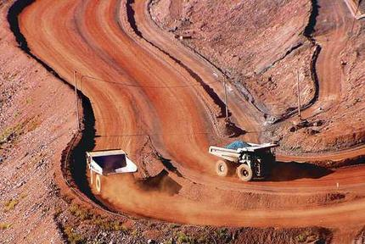
IRON
Iron Ore is the basic mineral and is the backbone of Industrial development. Magnetite is the finest iron ore with a very high content of iron. Hematite ore is the most important industrial iron ore.

Slide 9
Metallurgy of Iron
Iron is found in great abundance in nature. It is highly reactive and is hardly available in free state. Iron exists in the combined form in nature in various minerals among which oxide and sulphide ores of iron are vastly used.

Slide 10
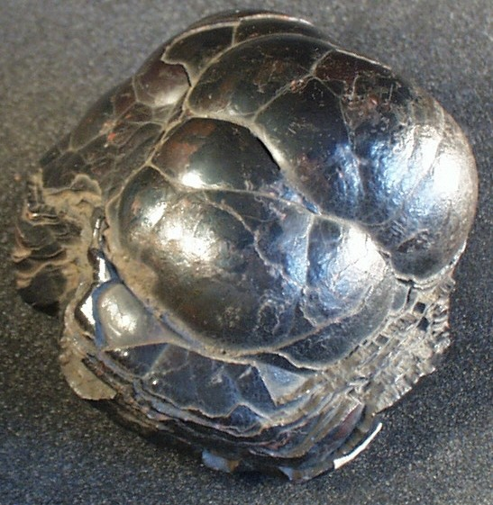
Most common Ores of Iron
Hematite Fe₂O₃
Limonite Fe₂O₃.3H₂O
Magnetite Fe₃O₄
Siderite FeCO₃
Iron pyrite FeS₂
Copper pyrite CuFeS₂

Slide 11
METALLURGY
Dressing of ore
pulverization
Concentration of ore
removal of moisture, volatile impurities
converting sulphur, phosphorus into their oxides
converting ferrous to ferric oxide
Reduction of ore
smelting

Slide 12
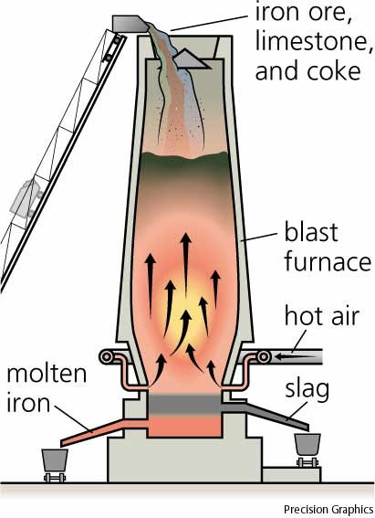
BLAST FURNACE

Slide 14
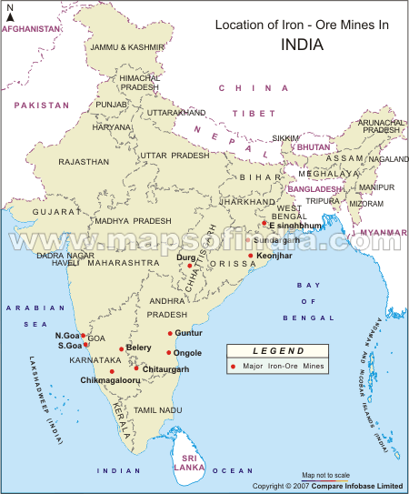

Slide 15
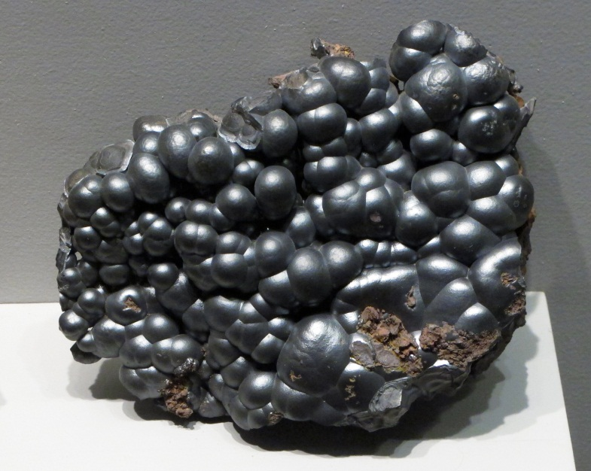
Manganese
Manganese is mainly used in the manufacturing of steel and ferro-manganese alloy, bleaching powder, insecticides and paints.
Orissa is the largest producer of manganese ores in India accounting for one-third of the total production.

Slide 16
ORES OF MANGANEESE
Pyrolusite MnO₂
Hausmannite Mn²⁺Mn³⁺₂O₄
Rhodochrosite MnCO₃

Slide 17
Metallurgy of manganese
Dressing of ore
pulverization
Extraction
Thermite Reaction

Slide 18
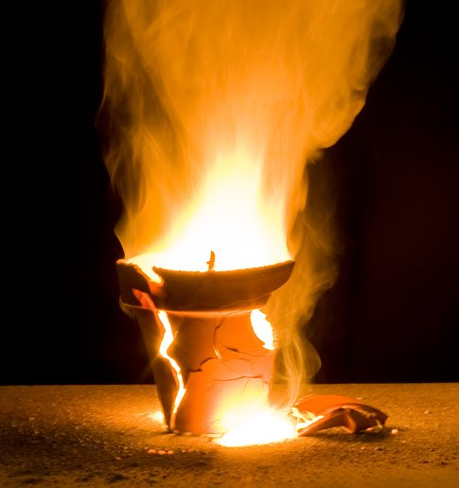
Thermite reaction

Slide 20
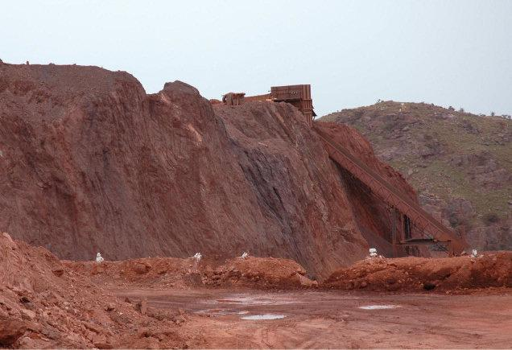
Thank You

