Slide 1
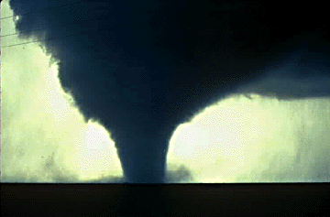
TORNADOS

Slide 2
Do Tornados Really Sound Like Freight Trains??
http://www.interaxs.net/pub/hgr/xenia_tornado.mp3
What do you think after listening to the Xenia Tornado of April 3, 1974?

Slide 3
Tornado Facts
Winds can exceed 300 mph!!!
Around 1,000 occur on average each year in the U.S.
Kill 80, injure 1,500 people each year on average
Can have a path up to a mile wide!!!
Can occur any time of the year, but peak during the spring (March-June)
Occur most frequently in the central U.S. in a region nicknamed “Tornado Alley”

Slide 4
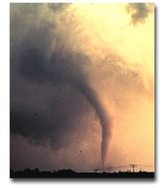
What Exactly Is A Tornado?
Violently rotating column of air (Vortex) extending from a thunderstorm to the ground

Slide 5
How Do They Form?
Actually, no one knows for sure!
But…We have a pretty good idea…

Slide 6
Step 1
Before a t-storm, a change in wind direction and an increase in speed forms an invisible, horizontal spinning effect in the lower atmosphere (at the base of the storm)

Slide 7
Step 2
Rising air within the t-storm (updrafts) tilts the rotating air from horizontal to vertical

Slide 8
Step 3
Vertical rotation now extends 2-6 miles up into the t-storm. Now a tornado may form and extend from this area of rotation to the ground.

Slide 9
Convection Demo
Same basic principle behind a tornado vortex (funnel; column of fire in this case)
Warm air moves up the vortex (updraft)
Cools and sinks as it funnels out of the top (downdraft)
The more air drawn in = faster and tighter spin
This is called a convection cycle

Slide 10
How Strong Are Tornados?
Strength is measured by the Fujita Scale...
F0 = weakest, F5 = Strongest

Slide 11
Are Most Tornados Strong?
All tornados are potentially deadly, but most are actually relatively weak (74%)…!
Only 1% of all tornados fall in the F4 – F5 range

Slide 12
What’s Up With Xenia, OH?
Xenia has been the target of several major tornados down through the years…
Most recent: Sept. 2000
Most Notable: April 3, 1974

Slide 13
Sept. 2000 Damage
Where do you think this Tornado ranked on the Fujita Scale?

Slide 14
April 3, 1974 Tornado

Slide 15
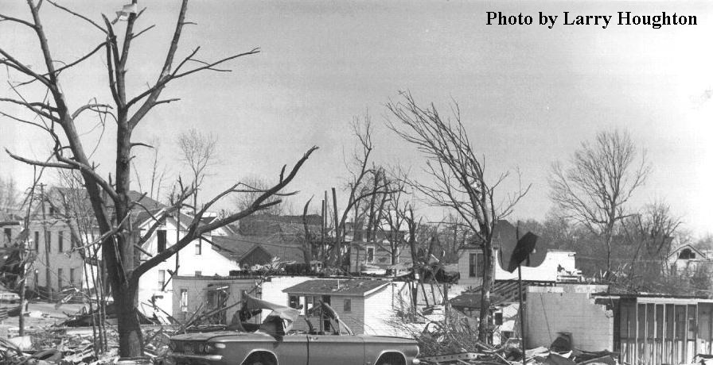
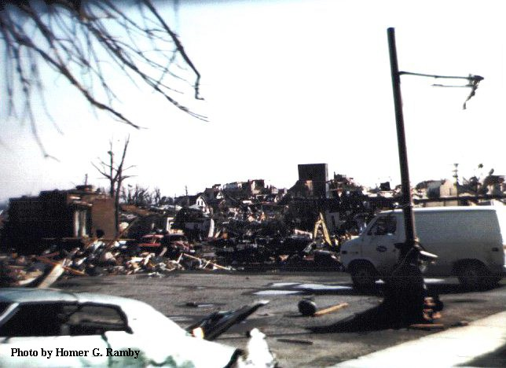
April 3, 1974 Damage
Where do you think this tornado ranked on the Fujita Scale?

Slide 16
Answers
Sept. 2000 = F3-F4 (Severe/Devastating Damage; Winds of 200-260 mph)
April 1974 = F5 (Incredible Damage; Winds of 260-300+ mph!!!)

Slide 17
Quick Review
Are most tornados strong or weak?
Which would cause more damage, an F1 or an F5 tornado?
During which season do most tornados occur in the U.S.?
What is the nickname of the region in the U.S. where many tornados occur?
What is used to classify the intensity of tornados?
Bonus**: How do experts think tornados form?

Slide 18
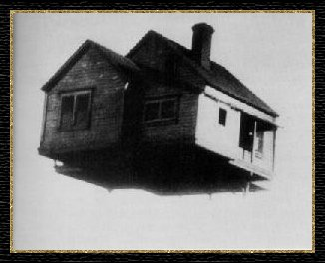
THE END

Slide 19
This powerpoint was kindly donated to www.worldofteaching.com
http://www.worldofteaching.com is home to over a thousand powerpoints submitted by teachers. This is a completely free site and requires no registration. Please visit and I hope it will help in your teaching.

