Slide 1
Main Idea: Volcanoes

Slide 2
A. Structure of volcano
Volcanoes contain a vent, crater and slopes.
A vent is an opening in the crusts surface in which lava is emitted.
A crater is connected to the magma chamber that is located near the vent.

Slide 3
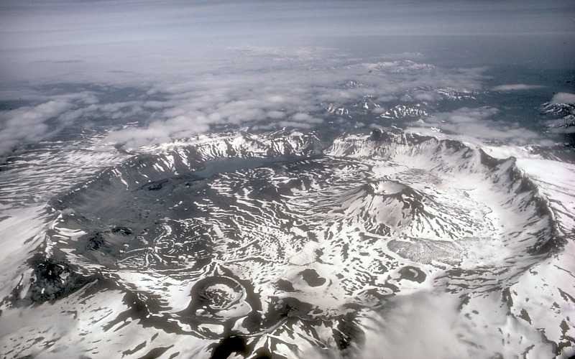
B. What is a caldera?
A caldera is sometimes confused with a crater.
They differ in size.
A caldera is around 50 km in diameter, while a crater is at most 1 km in diameter.

Slide 4
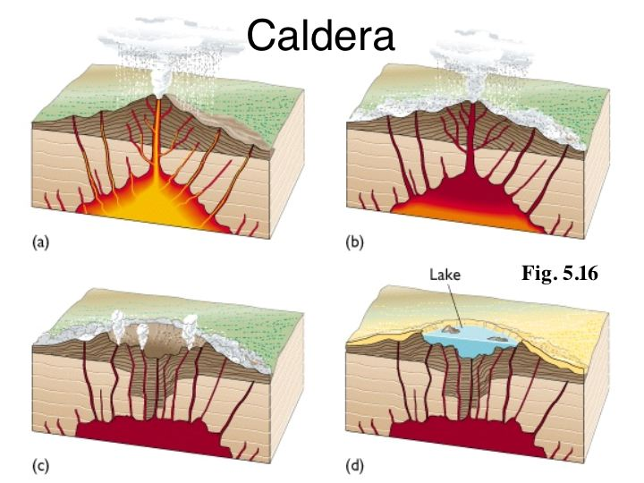
C. How is a caldera formed?
A caldera is formed when the slopes of a volcano collapse.
The top of the magma chamber becomes empty from lava flow.
The caldera then fills up with water forming a lake.

Slide 5
This powerpoint was kindly donated to www.worldofteaching.com
http://www.worldofteaching.com is home to over a thousand powerpoints submitted by teachers. This is a completely free site and requires no registration. Please visit and I hope it will help in your teaching.

