Slide 1
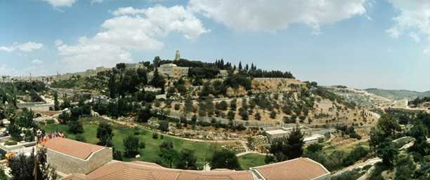
Jerusalem
An early history
Mount Zion, Jerusalem

Slide 2
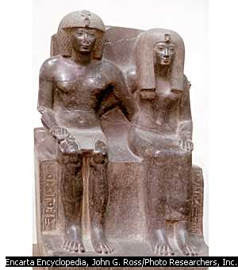
Ancient Canaan 1700 - 1386 B.C.E
Pharaoh Amenhotep ruled over Egypt and Canaan
The Pharoah Ramses III forced the Philistines to settle in Canaan
In 1750 B.C.E - The12 tribes of Israel settled in Egypt from Mesopotamia, the bands of ancient Hebrews descended from the patriarch Jacob

Slide 3
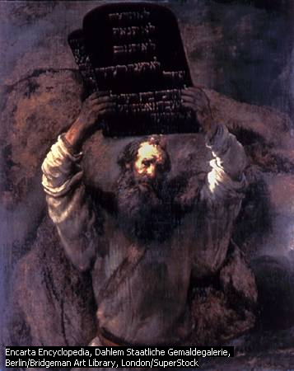
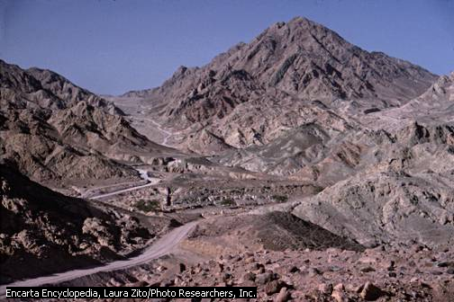
Moses
In 1250 B.C.E , the Israelites led by Moses, escaped from Egypt and lived in the desert.
Mount Sinai is where Moses received the ten commandments from God

Slide 4
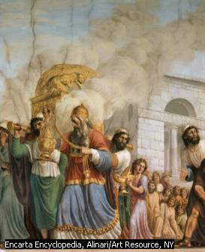
The Taking of Canaan
Moses appointed Joshua and Caleb as military leaders
Joshua and the Israelites defeated the Philistines living in Canaan.
Later, Saul was anointed the first King of Israel 1020- 1000 B.C.E
Later, David defeated Goliath and became King. He also took over the city of Jerusalem. David brought the Ark of the Covenant to Jerusalem

Slide 5
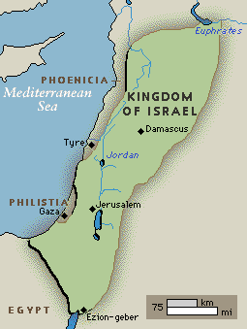
Kingdom of Israel
The kingdom of Israel reached the height of its existence and included the most territory under the reign of King David (1000–961 B.C.E).
Its borders stretched far beyond present-day Israeli borders and included parts of what is now Lebanon, Syria, Jordan, and Egypt.

Slide 6
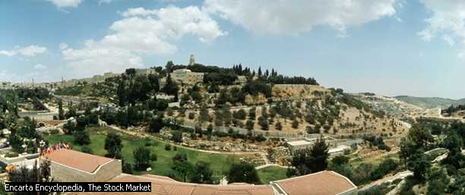
The First Temple is Built
King Solomon, the second son of David had the first temple built on Mount Zion in Jerusalem. (reigned 961-922 B.C.E)
By 970 B.C.E, Jerusalem was a very powerful city.
The Temple housing the Ark became
the House of Yahweh for the Israelites.
After Solomon's death, Israel split into two: Israel and Judah.
During this time, Isaiah prophesies
that a Messiah is to appear on earth
as a savior of humankind.

Slide 7
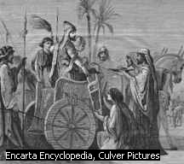
Nebuchadnezzar II destroys Jerusalem
The Babylonians worshipped Marduk.
Nebuchadnezzar, the King of Babylon defeated Assyria and Egypt in 605 B.C.E
During his 43-year reign, Nebuchadnezzar II expanded the kingdom of Babylonia by conquering much of south-western Asia.
He also captured Jerusalem, taking many of the captive Jews to Babylon.
He had the Temple destroyed and the Ark of the Covenant disappeared.
Most of the Jews where forced into exile and Jerusalem became a wasteland.

Slide 8
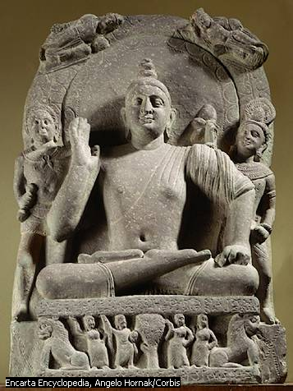
Ezekiel : The Prophet
The prophet Ezekiel believed that Yahweh had used the Babylonian Empire to punish the Israelites for their sins.
In 592 B.C.E, Ezekiel had a vision of a ‘New Jerusalem”.
Ezekiel preached that Jerusalem was Yahweh’s sacred zone. Over the years, the Jews in exile started to return. Others began to realise that God was everywhere.
An Indian Prince, Siddharta Gautama, also known as Buddha, made it possible to enter the ultimate reality by the practice of meditation and compassion. ( 563 – 483 B.C.E)

Slide 9
Alexander the Great (356-323 B.C.E)
Alexander led his troops in campaigns against Greek city states, Egypt, and the Persian Empire, ruling most of the civilized world by the time he died in 323 b.c.e at the age of 33. His celebrated military and tactical genius share renown with his ego and ruthlessness.

Slide 10
ANTIOCHUS III bans the practice of Judaism 223 – 190 B.C.E
First religious persecution in history, Sabbath and temple gatherings forbidden
Renamed Jerusalem ‘Antioch”
Many Jews forced to go into hiding
One of the great Jewish generals, Judas Maccabee retook Jerusalem three years later.
He purified the temple and restored the Jewish faith
This purification and restoration is commemorated by the Jewish festival Hanukkah.

Slide 11
King Herod 39 B.C.E
Herod the Great was the Roman-backed king of Judea who, according to Matthew 2:16, tried to kill the infant Jesus by ordering the massacre of all male babies in Bethlehem.
King Herod rebuilds the temple with huge walls

Slide 12
Jesus Christ
Ministry of Jesus
After receiving his baptism from John the Baptist on the shore of the Jordan River, Jesus began three years of ministry. During that time, Jesus travelled throughout the provinces of Judea and Galilee—areas now part of Israel and the West Bank. At the conclusion of his ministry, Jesus travelled to Jerusalem, where he was crucified.

Slide 13
This powerpoint was kindly donated to www.worldofteaching.com
http://www.worldofteaching.com is home to over a thousand powerpoints submitted by teachers. This is a completely free site and requires no registration. Please visit and I hope it will help in your teaching.

