Slide 1
The Norman Yoke…
conquest
castles
war & waste
forest law
rebels & outlaws
merrie England

Slide 2
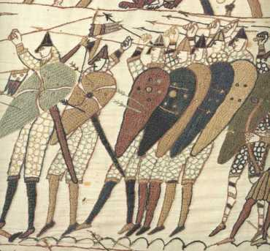
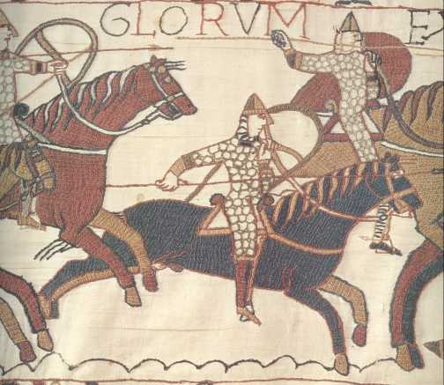
The day England acquired a new royal dynasty, a new aristocracy, a new Church, a new language, a new …
Hastings, 13 October 1066

Slide 3
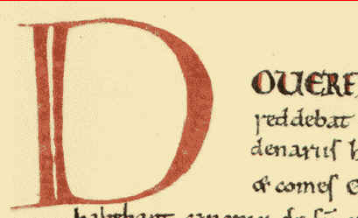
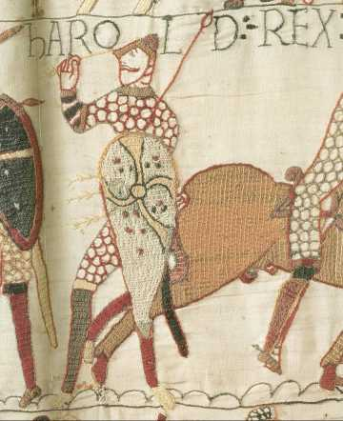
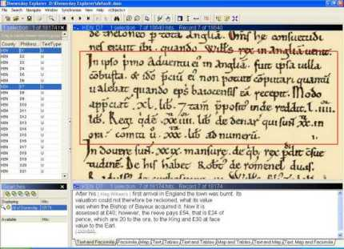
Dover burnt
Harold killed

Slide 4
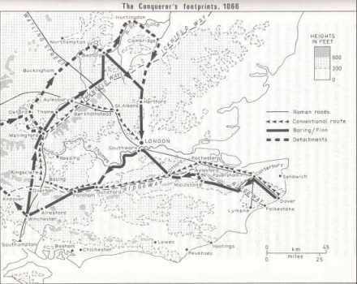
The Conqueror’s footprints
Plotted by the destruction recorded in Domesday Book

Slide 5
Castles of the Conquest
The castle was introduced into England by the Normans, who built them:
‘far and wide throughout the country, and oppressed the wretched people’
(Anglo-Saxon Chronicle)
It has been estimated that possibly 500 castles were built by the end of the eleventh century, an enormous capital investment; but fewer than 100 can be securely documented
Castles of the Conquest

Slide 6
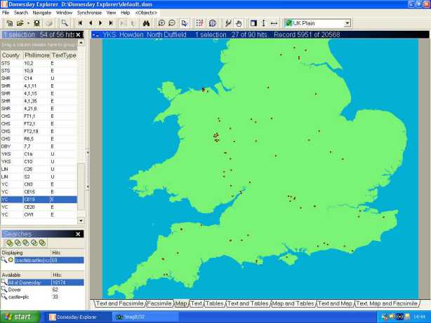
Castles of the Conquest
Domesday Book names the majority of those castles known to have existed by 1086

Slide 7
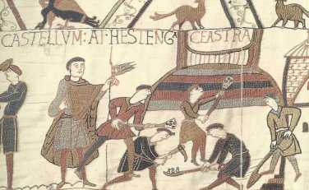
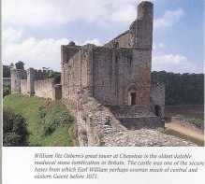
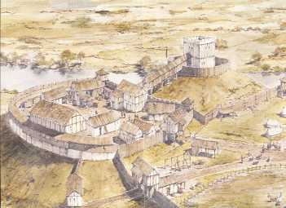
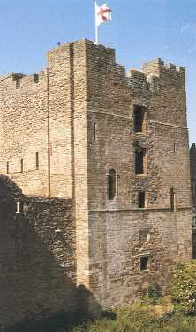
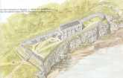
Castles of the Conquest
Hastings
Chepstow
Ludlow
Shrewsbury
Chepstow

Slide 8
Genocide in Yorkshire
The Conquest, the rebellions which followed the Conqueror's coronation, and the ferocity with which some were suppressed, laid waste large areas of England. The infamous ‘harrying of the north’ between 1069 and 1070 was an act of genocide which left much of northern England uninhabited for a generation. One chronicler, Ordericus Vitalis, wrote of this ‘harrying’:

Slide 9
Genocide in Yorkshire
‘He [the Conqueror] harried the land and burnt homes to ashes. Nowhere else had William shown such cruelty. In his anger he commanded that all crops and herds, chattels and food of every kind, should be brought together and burned to ashes with consuming fire, so that the whole region north of the Humber might be stripped of all means of sustenance. In consequence, so serious a scarcity was felt in England, and so terrible a famine fell upon the humble and defenceless populace, that more than 100,000 Christian folk of both sexes, young and old, perished of hunger’

Slide 10
Genocide in Yorkshire
The same writer says that this act haunted the Conqueror to his dying day. On his death-bed, he repented:
‘I ... caused the death of thousands by starvation and war,
especially in Yorkshire. In a mad fury,
I descended on the English of the north like a raging lion,
and ordered that all their homes and crops,
and all their equipment and furnishings,
should be burnt at once;
and their great flocks and herds of sheep and cattle
slaughtered everywhere.
So I chastised a great multitude of men and women
with the lash of starvation and, alas,
was the cruel murderer of many thousands’

Slide 11
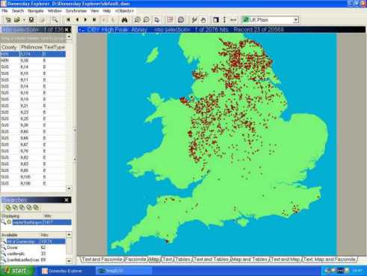
On the basis of recorded waste in Domesday Book, it has been calculated that 15 years after the ‘harrying’ Yorkshire still had only 25% of the men and ploughs there had been on the day in 1066 ’when King Edward was alive and dead’
Genocide in Yorkshire
recorded waste in Domesday Book

Slide 12
Forest Law Forest law was another oppressive feature of Norman rule. One chronicler, half-Norman himself, described the death of two of the Conqueror's sons in hunting accidents in the New Forest as a just punishment for his excesses committed in the name of the royal sport of hunting:
‘Now, reader, let me explain why the forest ... is called 'new'. That part of the country had been populous in earlier days ... But after William I conquered the realm of England, so great was his love of woods that he laid waste more than 60 parishes, forced the peasants to move to other places, and replaced the men with beasts of the forest so that he might hunt to his heart's content. There he lost two sons, Richard and William Rufus, and his grandson Richard ... by which the Lord plainly showed his anger’ (Ordericus Vitalis).

Slide 13
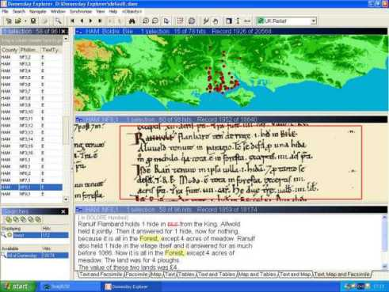
Forest Law
Domesday Book shows many depopulated areas in what is now the New Forest, where the ploughs and peasants of King Edward's days had been replaced with royal forest by 1086
the New Forest in 1086

Slide 14
These and other disinherited native nobles fought back against Norman tyranny from the shelter of the forests the Normans had created
Rebels and outlaws
Small wonder then that the forest features largely in myths of the Norman Yoke from the days of Hereward the Wake and Edric the Wild to Robin Hood

Slide 15
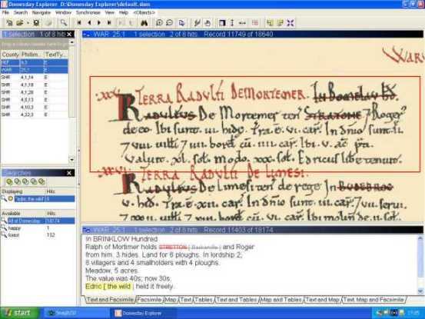
Rebels and outlaws
Edric the Wild - or Edric of the Woods – was, like Robin Hood after him, a disinherited nobleman who took to the forest to fight Norman tyranny
Edric the Wild features in many Domesday entries

Slide 16
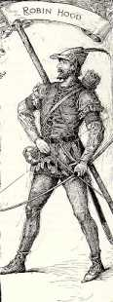
Rebels and outlaws
The origins of the legend of Robin Hood are unknown; but the Norman Conquest would provide the perfect setting

Slide 17
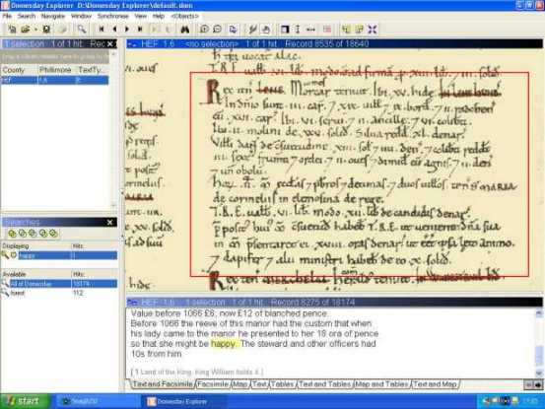
Unsurprisingly, nostalgia for the Good Old Days can be detected in Domesday
as in this custom which made the Lady of the Manor ‘happy’

Slide 18
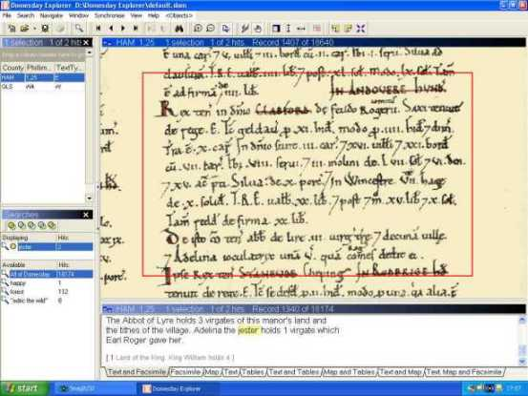
Fools and jesters
one of two jesters named in Domesday (whose quips may have had a bitter edge)

Slide 19
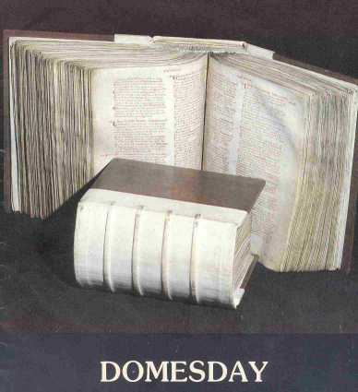
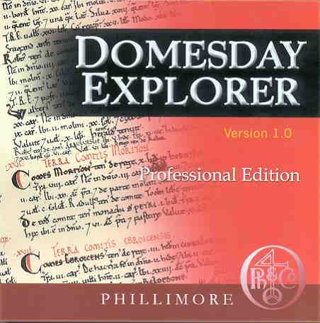
Domesday Book
All this, and much more, is recorded in Domesday Book, the single most valuable source for early medieval history
…......
Domesday 1086
Domesday 2000

Slide 20
Domesday Book
Domesday Book is a major source for the disciplines of:
Archaeology
Geography
Genealogy
Law
Linguistics
Onomastics
Palaeography
Philology
Prosopography
Topography

Slide 21
Domesday Book
Domesday Book is known and studied world-wide. Scholars from the following countries have published significant work on Domesday Book:
Australia
Belgium
Canada
Denmark
France
Germany
Holland
Japan
Norway
Russia
Sweden
U.S.A.
as well as the U.K.
A complete bibliography of Domesday Book would probably number 10,000 publications

Slide 22
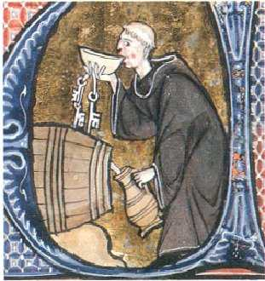
Thank
you
for
watching

Slide 23
This powerpoint was kindly donated to www.worldofteaching.com
http://www.worldofteaching.com is home to over a thousand powerpoints submitted by teachers. This is a completely free site and requires no registration. Please visit and I hope it will help in your teaching.

