Slide 1
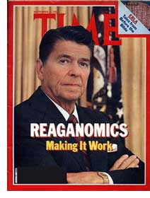
Reaganomics
A fix to the unemployment and inflation of the time.

Slide 2
ELECTING RONALD REAGAN…TWICE
Ronald Reagan for Reagan/Bush '84
http://www.youtube.com/watch?v=SDMksN-ZTR4&feature=related
Ronald Reagan TV Ad: "Reaganomics"
http://www.youtube.com/watch`?v=GhgiOSgBEYY
Reagan won 525 electoral votes and 49/50 states leaving Mondale with his only state of Minnesota and 3800 votes.
Reagan received 58.8% of the popular vote to Mondale’s 40.6%. (This was Reagan’s Second Term)
(Wikipedia)
(Youtube)

Slide 3
Stagflation
-time before Reagan’s Administration
-Political pressure results in expansion of money supply.
-Nixon's wage and price controls abandoned
-Under Ford the problems continued, but policy was more prudent.
-federal oil reserves created to ease future short term shocks
-Carter started phasing out price controls on petroleum
(Wikipedia)

Slide 5
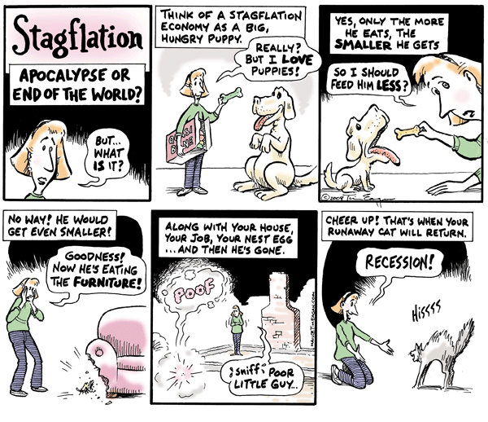

Slide 6
Stagflation
-Much of credit for resolution of the stagflation is given to…
…a three year contraction of the money supply by the Federal Reserve under Paul Volcker to long term easing of supply and pricing in oil during the 1980s oil glut
(Wikipedia)

Slide 7
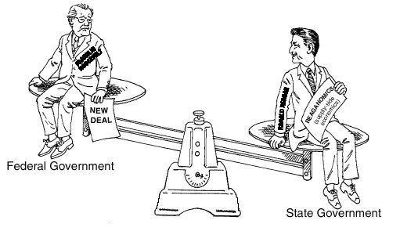
This Cartoon Shows the differences between Reaganomics and FDR’s economic policies like the New Deal.

Slide 8
The Four Pillars
Reagan+Economics=Reaganomics
1. reduce govt. spending
2. reduce marginal tax rates on income from labor and capital
3. reduce government regulation of the economy
4. control the money supply to reduce inflation
Reduce government Spending
Reduce Marginal Tax Rates
Control $ supply to reduce inflation
Reduce govt. Regulation of Economy
(Wikipedia)

Slide 9
The Roots
-Reaganomics roots in two of Reagan's campaign promises:
1) lower taxes
2) a smaller government
-reduced income tax rates
→ with the largest rate reductions on the high incomes
-in a time of battling inflation Reagan raised deficit spending to its highest level since World War II.
(Reeves, 203) (Wikipedia)

Slide 10
The Beginnings
lifted remaining domestic petroleum price and allocation controls on January 28, 1981
lowered Oil Windfall profits tax in August 1981, helping end the 1979 energy crisis
ended Oil Windfall profits tax in 1988 during 1980s oil glut
Tax Reform Act of 1986, Reagan and Congress sought to broaden the tax base and reduce perceived tax favoritism
(Reeves, 203)

Slide 11
The Growing Economy
income tax rates dropped from 70% to 28% in 7 years
payroll taxes increased
Real Gross Domestic Product (GDP) growth recovered strongly after the 1982 recession at annual rate of 3.4% per year slightly lower than post-World War II average of 3.6%
Unemployment peaked over 10.7% percent in 1982 then dropped during rest Reagan's terms
inflation significantly decreased
job increase of 16 million occurred
Nelson, 64.

Slide 12
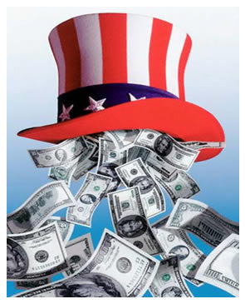
Trickle Down Affect
- policies derided as "Trickle-down economics“
→due to the significant cuts in the upper tax brackets
- massive increase in Cold War related defense spending caused large budget deficits
- the U.S. trade deficit expansion contributed to Savings and Loan crisis
- cover new federal budget deficits, United States borrowed heavily both domestically and abroad raising national debt $700 billion to $3 trillion
Reagan described the new debt as the "greatest disappointment" of his presidency
(Wikipedia)
Notes:
- order cover new federal budget deficits, United States borrowed heavily both domestically and abroad raising national debt $700 billion to $3 trillion; Reagan described the new debt as the "greatest disappointment" of his presidency

Slide 13
Tax Revenue
(Wikipedia)
Number of Years after Enactment
Tax Bill | 1 | 2 | 3 | 4 | First 2 yr avg | 4 yr avg
Econ. Recovery Tax Act of 1981 | -1.21 | -2.60 | -3.58 | -4.15 | -1.91 | -2.89
Tax Equity and Fiscal Responsibility Act of 1982 | 0.53 | 1.07 | 1.08 | 1.23 | 0.80 | 0.98
Highway Revenue Act of 1982 | 0.05 | 0.11 | 0.10 | 0.09 | 0.08 | 0.09
Social Security Amendments of 1983 | 0.17 | 0.22 | 0.22 | 0.24 | 0.20 | 0.21
Interest and Dividend Tax Compliance Act of 1983 | -0.07 | -0.06 | -0.05 | -0.04 | -0.07 | -0.05
Deficit Reduction Act of 1984 | 0.24 | 0.37 | 0.47 | 0.49 | 0.30 | 0.39
Omnibus Budget Reconciliation Act of 1985 | 0.02 | 0.06 | 0.06 | 0.06 | 0.04 | 0.05
Tax Reform Act of 1986 | 0.41 | 0.02 | -0.23 | -0.16 | 0.22 | 0.01
Omnibus Budget Reconciliation Act of 1987 | 0.19 | 0.28 | 0.30 | 0.27 | 0.24 | 0.26
Notes:
The major tax bills enacted under Reagan reduced government tax receipts.

Slide 14
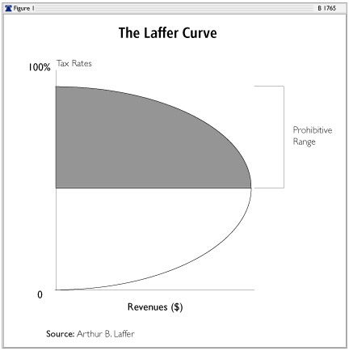
Laffer Curve
Arthur Laffer’s model predicting excessive tax rates reduce tax reveues by lowering production.
Theoretical taxation model
Vogue among some American Conservatives during 1970’s
if tax rates lowered, tax revenues will lower by the amount of decrease in rate
-reverse is true for an increase in tax rates
The Laffer Curve: Past Present and Future

Slide 15
Achievements
American economy did better than any other pre- or post- Reagan years
Median family income grew by $4,000, during Reagan Era and after wards decreased by $1500
Interest Rates, Inflation, and Unemployment decreased faster than pre- and post- Reagan years
Productivity Rate increased, declined and then stayed the same
(Wikipedia)

Slide 16
Perspectives…
President Ronald Wilson Reagan
Clintonomics vs. Reaganomics
Tony Horwitz – journalist
Conservatives vs. Liberals- Redistribution of Wealth
Belgian Prime Minister, Guy Verhofstadt

Slide 17
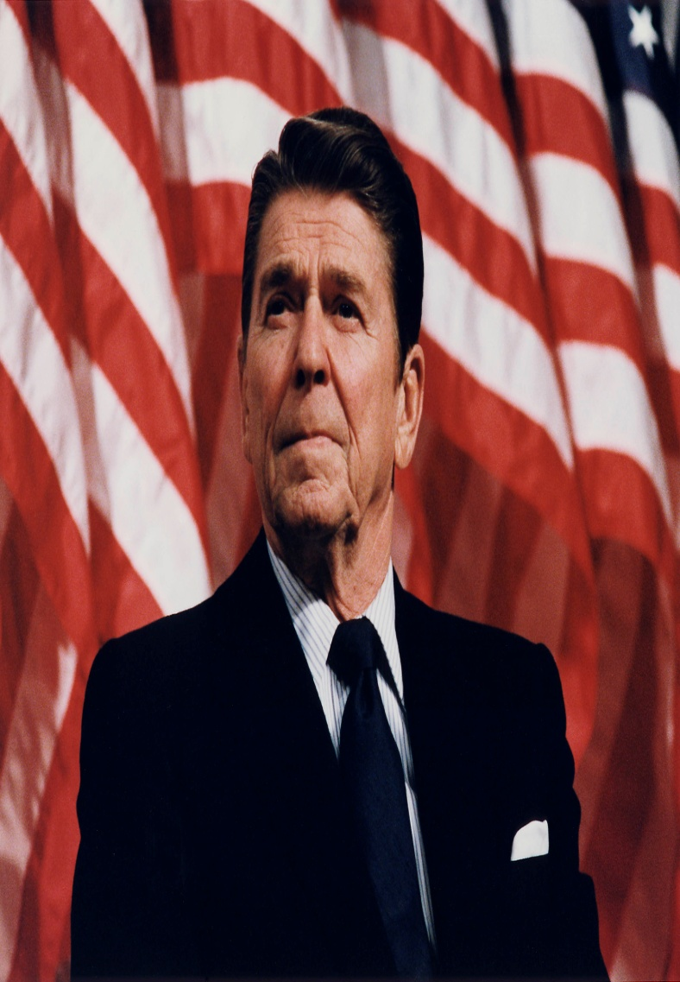
Ronald Reagan
As seen in the previous videos, Reagan feels that Reaganomics are essential to helping the American People move forward and grow economically as Reaganomics allows for a decrease in interest rates, inflation, and unemployment.
with Reaganomics, America’s beliefs will grow in time as the promises of prosperity will become true
(Smith , 250-259)
The pictures above represent Reagan’s pride and approval of the idea of Reaganomics.
Notes:
As seen in the previous videos, Reagan feels that Reaganomics are essential to helping the American People move forward and grow economically as Reaganomics allows for a decrease in interest rates, inflation, and unemployment. Reagan feels that with Reaganomics, America’s beliefs will grow in time as the promises of prosperity will become true as some have in his first term in office. Opportunity was also something Reagan believed would come out of Reaganomics, which a lot of people didn’t have during this time period. And opportunity would be achieved through Reaganomics for the everyday American as the economic increase would provide the people with items that they would not normally have. He also felt that education increased in people, as well as children, began to grow in their education, and the opportunities education provides. (Better jobs=more family income to spend.) The Faith in the people however made the ideas of Reaganomics come true, in Reagan’s eyes, as the people began to feel the success of the tax cuts and benefits from the Reaganomic Plan.

Slide 18
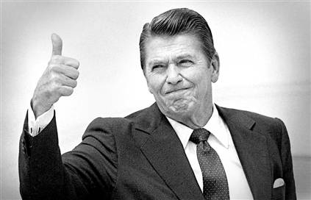
Opportunity believed come out of Reaganomics, which people didn’t have during this time period
opportunity achieved through Reaganomics for everyday American as economic increase provide people with items that they would not normally have
education increased in people as they began to grow in their education, and the opportunities education provides.
Better jobs=more family income to spend
Faith in the people however made the ideas of Reaganomics come true
(Smith, 250-259)

Slide 19
-Ronald Wilson Reagan
A quote connecting Economics to Society by Ronald Reagan.
“We who live in free market societies believe that growth, prosperity, and ultimately human fulfillment, are created from the bottom up, not the government down. Only when the human spirit is allowed to invent, and create, only when individuals are given a personal stake in deciding economic policies…only then can societies remain economically alive, dynamic, progressive, and free.”
(Smith, 251)

Slide 20
Clintonomics vs. Reaganomics
“A vote for a Republican is a vote for Less Success. A vote to reduce the Standard of Living for all Americans.” –Clarence Swinney
(Clinton’s Greatest Record by Far)

Slide 21
Clintonomics vs. Reaganomics
-Rep. and Dem. Differed views as the Dem liked Clintonomics and Rep liked Reaganomics.
-Clarence Swinney is a die-hard democrat that is expressing the pluses of Clinton but refuses to highlight the pluses of Reagan. And some of the facts shown from the information are not necessarily true as a lot of the issues overlap.
-As the quote above was taken from Swinney, it implies that he is pure Democrat.
Clinton’s Greatest Record by Far

Slide 22
CLINTON-GORE ACCOMPLISHMENTS ALL AMERICAN TEAM
1.JOBS—grew by 43% more under Clinton.
2.GDP---grew by 57% more under Clinton.
3.DOW—grew by 700% more under Clinton..
4.NASDAQ-grew by 18 times as much under Clinton.
5.SPENDING--grew by 28% under Clinton---80% under Reagan.
6.DEBT—grew by 43% under Clinton—187% under Reagan.
7. DEFICITS—Clinton got a large surplus--grew by 112% under Reagan.
8.NATIONAL INCOME—grew by100% more under Clinton.
9.PERSONAL INCOME—Grew by 110% more under Clinton.
(Clinton’s Greatest Record by Far)

Slide 23
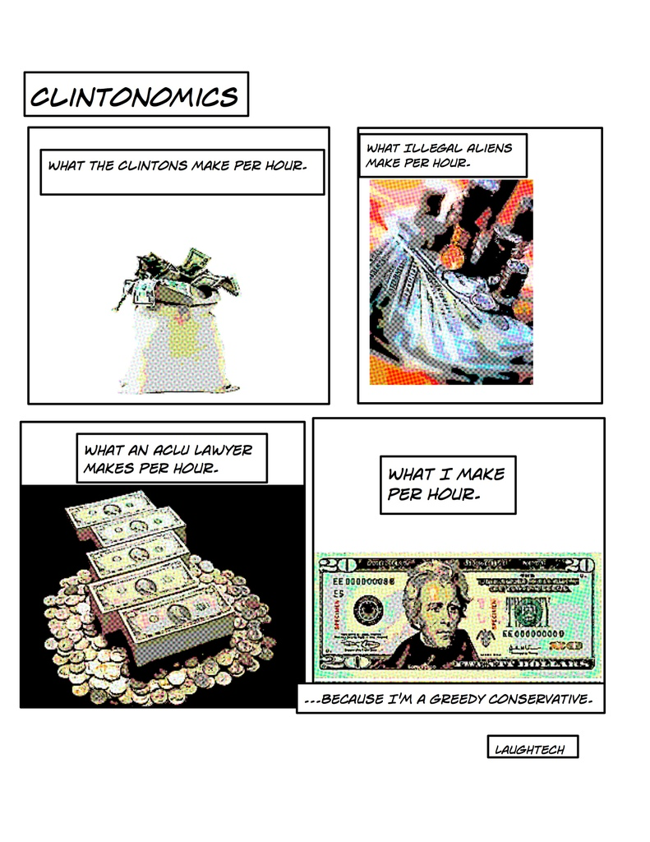

Slide 24
“Let’s Bury Reaganomics with it’s Founder”
“Reagan's unashamed wielding of US power and money may have hastened Soviet collapse. But at home, what he really made Americans feel good about was getting rich, no matter the social cost….. So while others laud Reagan this week, I'm one who won't mourn his departure. If only we could bury his legacy with him.”
-Tony Horwitz
(Let’s Bury Reaganomics with it’s Founder)

Slide 25
“Lets Bury Reaganomics with it’s Founder”
Horwitz feels Reaganomics hurts the American People as it makes people feel good about getting rich quick. He feels that Reagan was reviving the old ways of the Gilded Age Economy, and he believed that this hurt America socially as “the rich got richer, and the poor got poorer”.
(Let’s Bury Reaganomics with it’s Founder)

Slide 26
Tony Horwitz

Slide 27
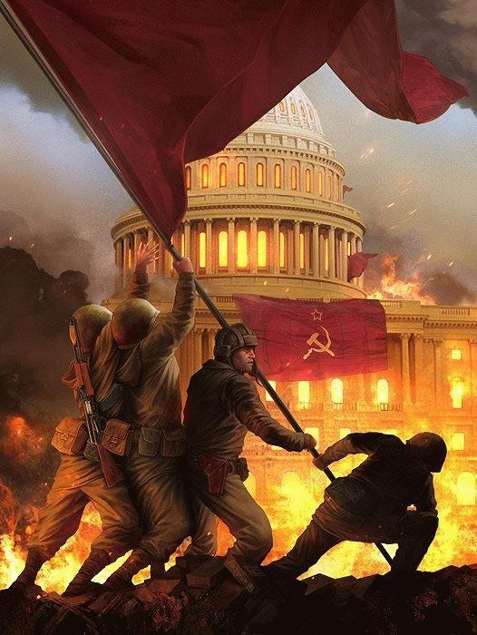
Horwitz view of Reaganomics (right). This picture expresses how Horwitz feels as the new “communist” regime was taking affect thru Reagan, and how he believed that Reaganomics was putting the government ahead, but the lower and middle classes as the Russian peasants would be in the USSR at the peak of it’s Communistic Society.

Slide 28
Conservative or Liberal???? Redistribution of Wealth…
“For conservatives, wealth is redistributed by companies, via profits. What is not returned to the masses directly (to employees in the form of pay and benefits) is passed on to the consumer in terms of goods and services (both products and charity work that many corporations participate in.) For liberals, wealth is redistributed by the government, via taxes. What is not returned to the masses directly (rebate checks, for instance) are returned in services (usually infrastructure.)”
(Reaganomics, Wealth Distribution…)

Slide 29
The Redistribution of Wealth…
-The author of this piece explains how Reaganomics is a form of REDISTRIBUTING THE WEALTH, as is Obama’s economic plan.
-Reaganomics, however, differs from Obamaanomics, where the author claims that Obama is helping the middle class and lower class.
-He then goes to state how Reagan is helping the rich get richer by spreading the wealth to the businesses and the wealthier peoples.
(Reaganomics., Wealth Distribution…)

Slide 30
The Redistribution of Wealth…
-The author criticizes Conservatives as hypocrites as they approve of Reaganomics, which hurts the lower and middle classes, and Obamanomics hurts, the upper class by taxing them a larger percent.
-In the eyes of the author, Obama steals from the rich and gives to the poor, like Robin Hood, and Reagan steals from the poor and gives to the rich.
(Reaganomics, Wealth Distribution…)

Slide 31
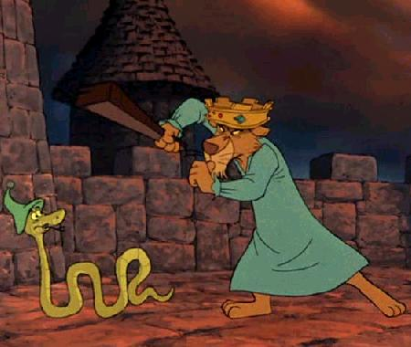
The Author’s view of Reagan (to the left).
The Author’s view of Obama (bottom).

Slide 32
A Foreign Look on Reaganomics
“When I think of Reagan, I'm thinking of Reaganomics and the Laffer curve. Do you remember: a tax cut could create more revenues! Reagan is dead now, but several of his ideas are now self-evident”
-Guy Verhorstadt (Belgian Prime Minister)
(Reaganomics, as a Success Story)

Slide 33
Belgium loves Reaganomics
-On the global scale, other governments, like Belgian’s, find Reaganomics helpful as they see pluses in the lowering of taxes.
-As the government lowered the estate and gift taxes, the government got a higher revenue.
-This allows for a higher amount of money the government can use for public works, along with up keeping and the maintaining of the military to protect the nation.
(Reaganomics, a Success Story)

Slide 34
Belgium loves Reagan
The Following 6 points are how the Belgian government uses Reaganomics.
1) gradual but considerable cut of the highest marginal tax rates to 28%.
2) complete abolition of corporate taxes,with a repeal of all subsidies to corporations
3) abolition of taxes on dividends: Investment and risk taking has to be encouraged, not punished
4) abolition of all agricultural subsidies
5) shrinking of the size of government
6) abolition of the transfers of tax money from Flanders to Wallonia: 10 billion euro is transferred each year from the Flemish tax payers to the French speaking part of Belgium. The reason invoked for these transfers is that Wallonia has an unemployment rate of 18% compared with 8% for Flanders
(Reaganomics a Success Story)

Slide 35
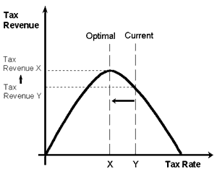
Guy Verhorstadt (left).
How Reaganomics is working
in Belgium.

Slide 36
Works Cited
Horwitz, Tony. Let’s Bury Reaganomics With It’s Founder. 8 June 2004. 26 December 2008. http://www.commondreams.org/views04/0608-13.htm.
Laffer, B. Arthur. The Laffer Curve: Past, Present, and Future. 1 June 2004. http://www.heritage.org/Research/Taxes/bg1765.cfm.
Nelson, Rebecca. The Handy History Answer Book. Canton, Michigan: Visible Ink Press, 1999.
Reaganomics. Wikipedia. 23 December 2008. 24 December 2008. http://en.wikipedia.org/wiki/Reaganomics.
Reaganomics, a Success Story. 29 March 2005. 6 January 2009. http://lvb.net/item/820.
Reaganomics, Wealth Redistribution, and Corporate Accountability: In which conservatives fail to understand their own policies. 5 August 2008. 6 January 2009. http://robot-heart.tumblr.com/post/44868981/reaganomics-wealth-redistribution-and-corporate.
Reeves, Richard. President Reagan: The Triumph of Imagination. New York: Simon & Schuster Paperbacks, 2005.

Slide 37
Works Cited #2
Ridenour, Amy. Reaganomics: Were the 1980s the Decade of Greed?. 8 January 2004. http://www.nationalcenter.org/WCT010804.html.
Smith, Carter. Presidents: All You Need to Know. New York: Hylas Publishing, 2004.
Swinney, Clarence. PRAISE CLINTON GREATEST RECORD BY FAR. 2001 - 2008 . 31 December 2008. http://demopedia.democraticunderground.com/discuss/duboard.php?az=show_mesg&forum=296&topic_id=7858&mesg_id=7858 .
The Onion: Reaganomics Finally Trickles Down To Area Man. 22 October 2007. 26 December 2008. http://dialogic.blogspot.com/2007/10/onion-reaganomics-finally-trickles-down.html .

Slide 38
Works Cited # 3
24 December 2008. http://reagan2020.us/images/1982ReaganomicsTime.jpg . Reaganomics Time picture.
24 December 2008. http://capitolstreet.files.wordpress.com/2008/06/stagflation.gif . Stagflation Cartoon #1.
24 December 2008. http://www.marketoracle.co.uk/images/united_states_rebate_check.jpg. Trickle down picture.
24 December 2008. http://images.google.com/imgres?imgurl=http://bp3.blogger.com/ . Stagflation Cartoon# 2.
24 December 2008. http://www.heritage.org/Research/Taxes/images/35038257.gif . Laffer Image.
25 December 2008. http://www.youtube.com/watch?v=SDMksN-ZTR4&feature=related . Reagan Video # 1.
25 December 2008. http://www.youtube.com/watch?v=GhgiOSgBEYY. Reagan Video #2.
26 December 2008. http://www.archives.gov/press/press-kits/picturing-the-century-photos/images/reagan-at-durenberger-rally.jpg . Reagan with the Flag Picture.
27 December 2008. http://www.tea.state.tx.us/student.assessment/resources/online/eoc00/ushistory/p28no40.gif. Reaganomics Cartoon.
27 December 2008. http://blogs.e-rockford.com/applesauce/files/2008/07/1a1.jpg . Reagan Thumbs Up Picture.
31 December 2008. http://timesonline.typepad.com/comment/images/bill_clinton_at_the_labour_party_confere.jpg. Clinton Picture.
31 December 2008. http://i272.photobucket.com/albums/jj183/laughtech/Page_1-30.jpg . Clintonomics Cartoon.
6 January 2009. http://img.photobucket.com/albums/v423/meh_cd/06_podborka_09.jpg. Horowitz view of Reaganomics.
6 January 2009. http://www.worldhum.com/images/c_uploads/TonyHorwitz_225.jpg. Picture of Tony Horwitz.
6 January 2009. http://chud.com/nextraimages/RobinHoodFreudian.jpg. Picture of The King from Robin Hood.
6 January 2009. http://www.disneythemes.com/disney-robin-hood/disney-robin-hood-wallpapers-preview.jpg. Picture of Robin Hood.
6 January 2009. http://www.gfmd-fmmd.org/en/system/files/images/verhofstadt.preview.jpg. Picture of Guy Verhofstadt, The Belgian Prime Minister.
6 January 2009. http://lvb.net/item/954. Picture of Reaganomics and how it works in Belgium.

Slide 39
This powerpoint was kindly donated to
www.worldofteaching.com
http://www.worldofteaching.com
Is home to well over a thousand powerpoints submitted by teachers. This a free site. Please visit and I hope it will help in your teaching
Notes:
39

