Slide 1
France
Louis XIV and Versailles

Slide 2
Overview of Versailles palace and grounds.

Slide 3
Gardens
The palace and gardens take up an area of 10 square miles.

Slide 4
The Palace Gardens (Gardens of Versailles) match the grandeur and splendour of the château in every way, with literally hundreds of fountains, and a Grand Canal, which is intersected by the Petit Canal to make a cross shape, best explored by rowing boat. Also within the grounds of the Palace of Versailles are the private palaces known as the Grand Trianon and the Petit Trianon, and also Marie Antoinette's Village and its thatched cottages. Away from the palace, both the Arboretum de Chevrèloup and the Désert de Rez Park may be of particular interest.

Slide 8
http://paris.arounder.com/versailles/

Slide 11
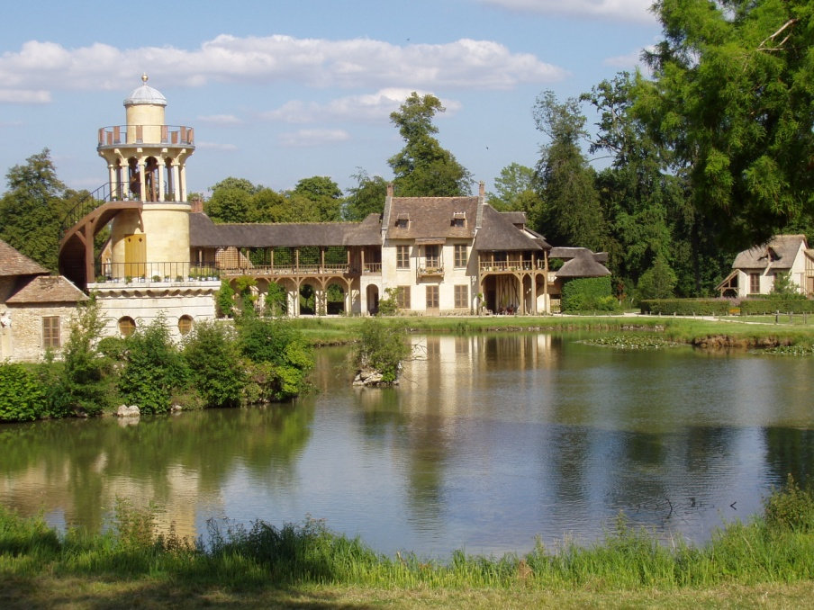
Also within the grounds of the Palace of Versailles are the private palaces known as the Grand Trianon and the Petit Trianon, and also Marie Antoinette's Village and its thatched cottages.

Slide 14
Chapel in the palace

Slide 15
The famous Hall of Mirrors

Slide 17
Interior rooms

Slide 18
Bedrooms

Slide 19
Part of The Battle Gallery
Crusades Room

Slide 21
Louis XIV

Slide 22
This powerpoint was kindly donated to
www.worldofteaching.com
http://www.worldofteaching.com
Is home to well over a thousand powerpoints submitted by teachers. This a free site. Please visit and I hope it will help in your teaching
Notes:
22

