Slide 1


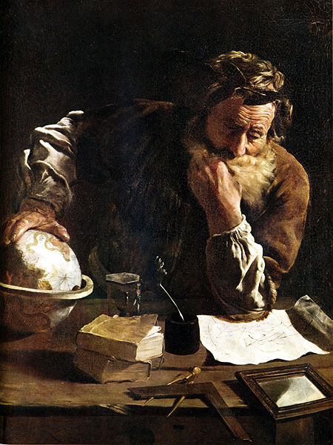

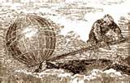

Math Blast
From the Past

Slide 2
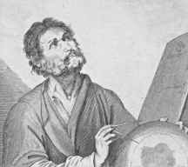

Archimedes
Syracuse
(then part of Greece)
287-212 BC

Slide 3

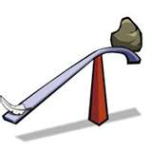
Discovered how to calculate the volume of a sphere, and even wanted this diagram on his tombstone. He made so much progress in this area that nothing could be added for 18 centuries.
EUREKA (I have found it!) – Bouyancy
Developed Exponential system of writing large numbers
Discovered the Law of the Lever
x²

Slide 4
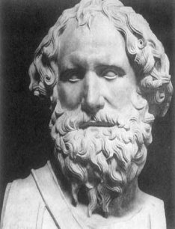

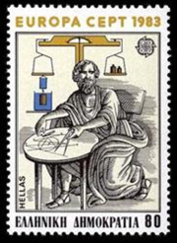

This statue in the National Museum in Naples, Italy, was widely claimed to be Archimedes.
It is actually a bust of Archidamos III, a third century BC king of Sparta
Italian postage stamp honoring Archimedes May 2, 1983
Scott Catalogue Number 1559
Archimedes is commemorated on a
Greek postage stamp from 1983.
The Fields Medal carries a portrait of Archimedes.

Slide 5
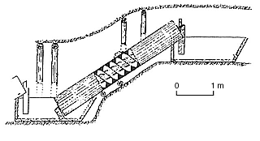
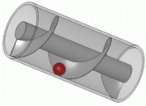
Archimedes water screw
This is a pump, still used in many parts of the world.

Slide 6
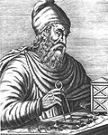
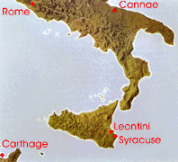
A 1740 engraving of Archimedes planning the defenses of Syracuse. The Greek writing on his cap is
(Archimedes the geometer).

Slide 7
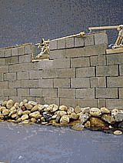
Archimedes designed many tools for defending Syracuse from invasion. This is a model of how one of Archimedes
war gadgets may have worked.

Slide 8
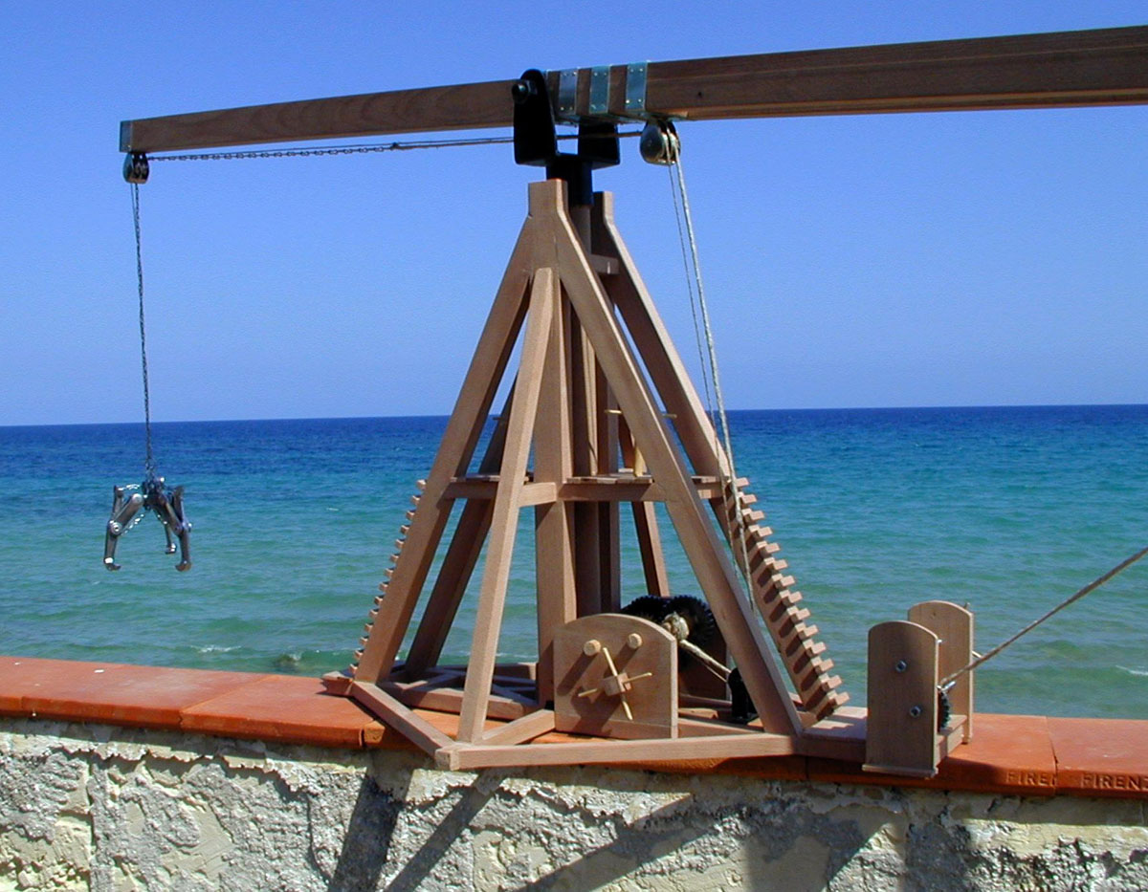

Slide 9
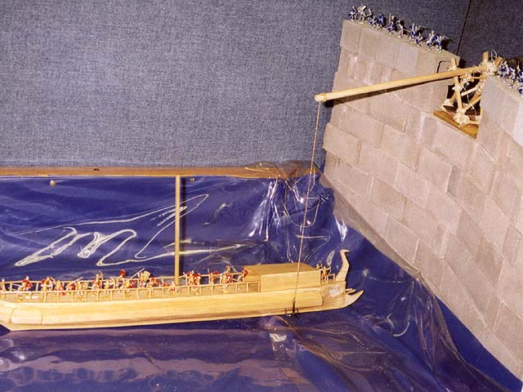
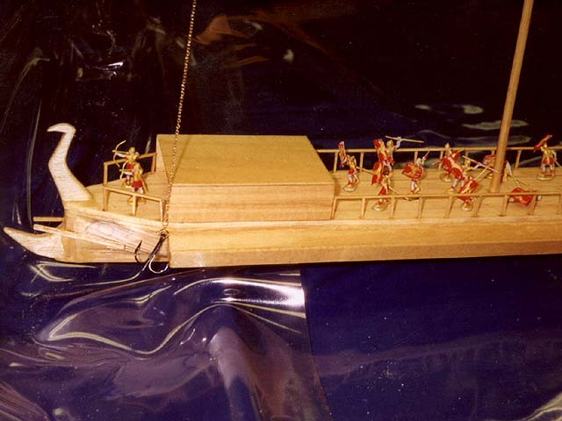

Slide 10
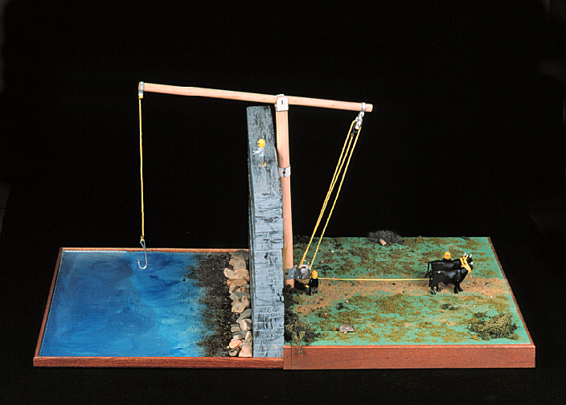

Slide 11
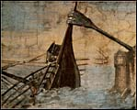
A detail of a wall painting in the Stanzino delle Matematiche in the Galleria degli Uffizi in Florence, Italy. Painted by Giulio Parigi (1571-1635) in the years 1599-1600.

Slide 12
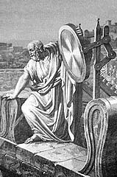
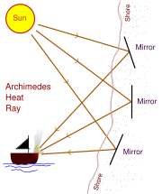
Burning Mirror
Archimedes used mirrors to reflect and intensify the sun, causing the ships to catch on fire.

Slide 13
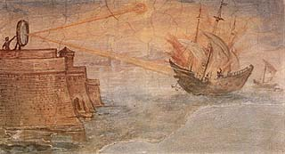
Wall painting from the Stanzino delle Matematiche in the Galleria degli Uffizi (Florence, Italy). Painted by Giulio Parigi (1571-1635) in the years 1599-1600.

Slide 14
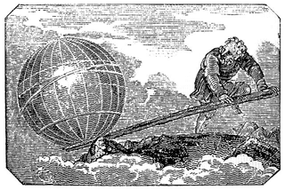
Give me a place to stand and I will move the earth
Engraving from
Mechanics Magazine
London, 1824

Slide 15
The Law of the Lever
w₂
w₁
d₁
d₂
fulcrum
w₁ x d₁ = w₂ x d₂

Slide 16

400 pounds
?
5 feet
5 feet
w1 x d1 = w2 x d2
w1 x 5 = 400 x 5
w1 = 400
400 pounds
?
8 feet
2 feet
w1 x d1 = w2 x d2
w1 x 8 = 400 x 2
w1 = 100

Slide 17
Lever Problems
Now it is your turn
How long would the lever need to be so that you can lift a 20 ton dinosaur? Place the dinosaur 10 feet from the fulcrum and pretend you weigh 100 pounds.
How long would the lever need to be so that you can lift a team of 10 football players (weighing 200 pounds each)? Use the same set-up as above.
How long would the lever need to be so that you can lift a lifetime supply of candy bars? Estimate that you can eat 2 pounds of candy each week for 70 years. Use the same set-up as above.

Slide 18
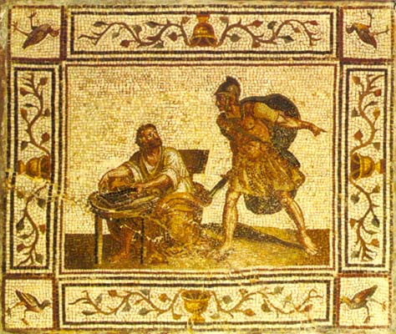
The death of Archimedes depicted on a Roman floor mosaic

Slide 19
This powerpoint was kindly donated to www.worldofteaching.com
http://www.worldofteaching.com is home to over a thousand powerpoints submitted by teachers. This is a completely free site and requires no registration. Please visit and I hope it will help in your teaching.

