Slide 1

Area Formulas

Slide 2


Rectangle

Slide 3
Rectangle
What is the area formula?

Slide 4
Rectangle
What is the area formula?
bh

Slide 5
Rectangle
What is the area formula?
bh
What other shape has 4 right angles?

Slide 6

Rectangle
What is the area formula?
bh
What other shape has 4 right angles?
Square!

Slide 7
Rectangle
What is the area formula?
bh
What other shape has 4 right angles?
Square!
Can we use the same
area formula?

Slide 8
Rectangle
What is the area formula?
bh
What other shape has 4 right angles?
Square!
Can we use the same
area formula?
Yes

Slide 9

Practice!
17m
Rectangle
10m
Square
14cm

Slide 10
Answers
17m
Rectangle
10m
170 m²
Square
196 cm²
14cm

Slide 11
So then what happens if we cut a rectangle in half?
What shape is made?

Slide 12
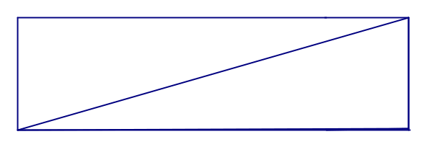
Triangle
So then what happens if we cut a rectangle in half?
What shape is made?

Slide 13
Triangle
So then what happens if we cut a rectangle in half?
What shape is made?
2 Triangles

Slide 14
Triangle
So then what happens if we cut a rectangle in half?
What shape is made?
2 Triangles
So then what happens to the formula?

Slide 15
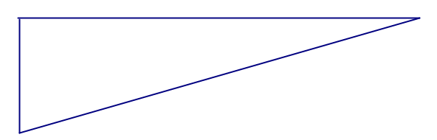
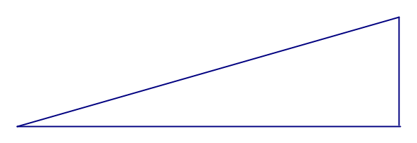
Triangle
So then what happens if we cut a rectangle in half?
What shape is made?
2 Triangles
So then what happens to the formula?

Slide 16
Triangle
So then what happens if we cut a rectangle in half?
What shape is made?
2 Triangles
bh
So then what happens to the formula?

Slide 17
Triangle
So then what happens if we cut a rectangle in half?
What shape is made?
2 Triangles
bh
2
So then what happens to the formula?

Slide 18
Practice!
Triangle
14 ft
5 ft

Slide 19
Answers
Triangle
14 ft
35 ft²
5 ft

Slide 20
Summary so far...
bh

Slide 21
Summary so far...
bh

Slide 22
Summary so far...
bh

Slide 23
Summary so far...
bh
bh

Slide 24
Summary so far...
bh
bh
2

Slide 25
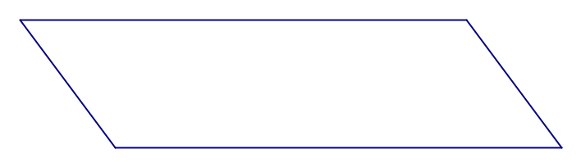
Parallelogram
Let’s look at a parallelogram.

Slide 26
Parallelogram
Let’s look at a parallelogram.
What happens if we slice off the slanted parts on the ends?

Slide 27
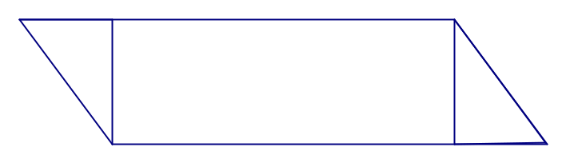
Parallelogram
Let’s look at a parallelogram.
What happens if we slice off the slanted parts on the ends?

Slide 28
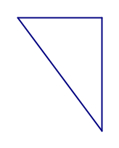
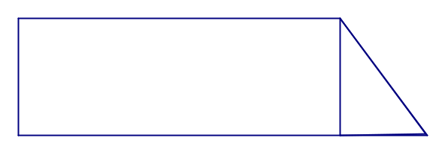
Parallelogram
Let’s look at a parallelogram.
What happens if we slice off the slanted parts on the ends?

Slide 29
Parallelogram
Let’s look at a parallelogram.
What happens if we slice off the slanted parts on the ends?

Slide 30
Parallelogram
Let’s look at a parallelogram.
What happens if we slice off the slanted parts on the ends?

Slide 31
Parallelogram
Let’s look at a parallelogram.
What happens if we slice off the slanted parts on the ends?

Slide 32
Parallelogram
Let’s look at a parallelogram.
What happens if we slice off the slanted parts on the ends?

Slide 33
Parallelogram
Let’s look at a parallelogram.
What happens if we slice off the slanted parts on the ends?

Slide 34
Parallelogram
Let’s look at a parallelogram.
What happens if we slice off the slanted parts on the ends?

Slide 35
Parallelogram
Let’s look at a parallelogram.
What happens if we slice off the slanted parts on the ends?

Slide 36
Parallelogram
Let’s look at a parallelogram.
What happens if we slice off the slanted parts on the ends?
What will the area formula be now that it is a rectangle?

Slide 37
Parallelogram
Let’s look at a parallelogram.
What happens if we slice off the slanted parts on the ends?
What will the area formula be now that it is a rectangle?
bh

Slide 38
Parallelogram
Be careful though! The height has to be perpendicular from the base, just like the side of a rectangle!
bh

Slide 39
Parallelogram
Be careful though! The height has to be perpendicular from the base, just like the side of a rectangle!
bh

Slide 40
Parallelogram
Be careful though! The height has to be perpendicular from the base, just like the side of a rectangle!
bh

Slide 41
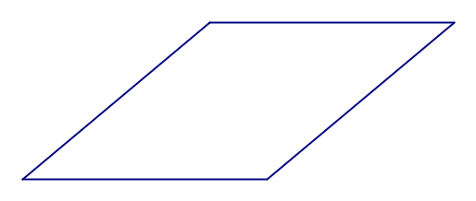
Rhombus
The rhombus is just a parallelogram with all equal sides! So it also has bh for an area formula.
bh

Slide 42
Practice!
9 in
Parallelogram
3 in
Rhombus
2.7 cm
4 cm

Slide 43
Answers
9 in
Parallelogram
27 in²
3 in
Rhombus
2.7 cm
10.8 cm²
4 cm

Slide 44
Let’s try something new with the parallelogram.

Slide 45
Let’s try something new with the parallelogram.
Earlier, you saw that you could use two trapezoids to make a parallelogram.

Slide 46
Let’s try something new with the parallelogram.
Earlier, you saw that you could use two trapezoids to make a parallelogram.
Let’s try to figure out the formula since we now know the area formula for a parallelogram.

Slide 47
Trapezoid

Slide 48
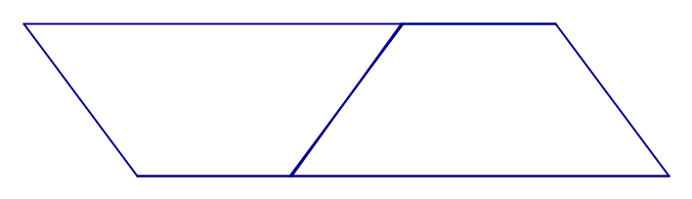
Trapezoid

Slide 49
Trapezoid
So we see that we are dividing the parallelogram in half. What will that do to the formula?

Slide 50
Trapezoid
So we see that we are dividing the parallelogram in half. What will that do to the formula?
bh

Slide 51
Trapezoid
So we see that we are dividing the parallelogram in half. What will that do to the formula?
bh
2

Slide 52
Trapezoid
But now there is a problem.
What is wrong with the base?
bh
2

Slide 53
Trapezoid
So we need to account for the split base, by calling the top base, base 1, and the bottom base, base 2. By adding them together, we get the original base from the parallelogram. The heights are the same, so no problem there.
bh
2

Slide 54
Trapezoid
So we need to account for the split base, by calling the top base, base 1, and the bottom base, base 2. By adding them together, we get the original base from the parallelogram. The heights are the same, so no problem there.
base 2
base 1
base 1
base 2
(b1 + b2)h
2

Slide 55
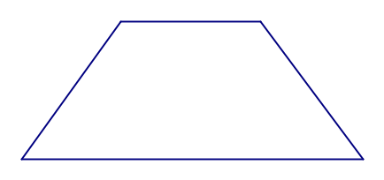
Practice!
3 m
Trapezoid
5 m
11 m

Slide 56
Answers
3 m
Trapezoid
35 m²
5 m
11 m

Slide 57
Summary so far...
bh

Slide 58
Summary so far...
bh

Slide 59
Summary so far...
bh

Slide 60
Summary so far...
bh
bh

Slide 61
Summary so far...
bh
bh
2

Slide 62
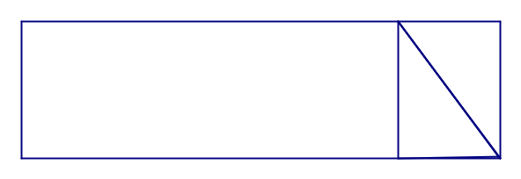
Summary so far...
bh
bh
2

Slide 63
Summary so far...
bh
bh
2

Slide 64
Summary so far...
bh
bh
2

Slide 65
Summary so far...
bh
bh
2

Slide 66
Summary so far...
bh
bh
2

Slide 67
Summary so far...
bh
bh
2

Slide 68
Summary so far...
bh
bh
2

Slide 69
Summary so far...
bh
bh
2

Slide 70
Summary so far...
bh
bh
2

Slide 71
Summary so far...
bh
bh
(b1 + b2)h
2
2

Slide 72
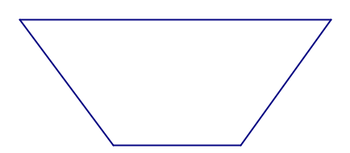
Summary so far...
bh
bh
(b1 + b2)h
2
2

Slide 73
Summary so far...
bh
bh
(b1 + b2)h
2
2

Slide 74
Summary so far...
bh
bh
(b1 + b2)h
2
2

Slide 75
Summary so far...
bh
bh
(b1 + b2)h
2
2

Slide 76
Summary so far...
bh
bh
(b1 + b2)h
2
2

Slide 77
So there is just one more left!

Slide 78
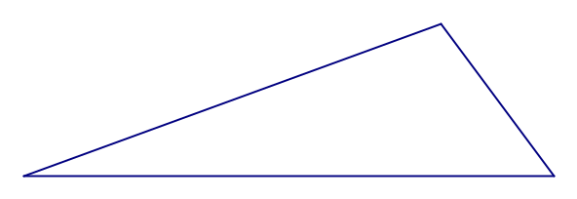
So there is just one more left!
Let’s go back to the triangle.
A few weeks ago you learned that by reflecting a triangle, you can make a kite.

Slide 79
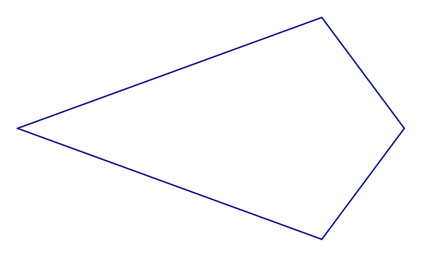
Kite
So there is just one more left!
Let’s go back to the triangle.
A few weeks ago you learned that by reflecting a triangle, you can make a kite.

Slide 80
Kite
Now we have to determine the formula. What is the area of a triangle formula again?

Slide 81
Kite
Now we have to determine the formula. What is the area of a triangle formula again?
bh
2

Slide 82
Kite
Now we have to determine the formula. What is the area of a triangle formula again?
bh
2
Fill in the blank. A kite is made up of ____ triangles.

Slide 83
Kite
Now we have to determine the formula. What is the area of a triangle formula again?
bh
2
Fill in the blank. A kite is made up of ____ triangles.
So it seems we should multiply the formula by 2.

Slide 84
Kite
bh
bh
*2 =
2

Slide 85
Kite
bh
bh
*2 =
2
Now we have a different problem. What is the base and height of a kite? The green line is called the symmetry line, and the red line is half the other diagonal.

Slide 86
Kite
Let’s use kite vocabulary instead to create our formula.
Symmetry Line*Half the Other Diagonal

Slide 87
Practice!
Kite
2 ft
10 ft

Slide 88
Answers
Kite
20 ft²
2 ft
10 ft

Slide 89
Summary so far...
bh

Slide 90
Summary so far...
bh

Slide 91
Summary so far...
bh

Slide 92
Summary so far...
bh
bh

Slide 93
Summary so far...
bh
bh
2

Slide 94
Summary so far...
bh
bh
2

Slide 95
Summary so far...
bh
bh
2

Slide 96
Summary so far...
bh
bh
2

Slide 97
Summary so far...
bh
bh
2

Slide 98
Summary so far...
bh
bh
2

Slide 99
Summary so far...
bh
bh
2

Slide 100
Summary so far...
bh
bh
2

Slide 101
Summary so far...
bh
bh
2

Slide 102
Summary so far...
bh
bh
2

Slide 103
Summary so far...
bh
bh
(b1 + b2)h
2
2

Slide 104
Summary so far...
bh
bh
(b1 + b2)h
2
2

Slide 105
Summary so far...
bh
bh
(b1 + b2)h
2
2

Slide 106
Summary so far...
bh
bh
(b1 + b2)h
2
2

Slide 107
Summary so far...
bh
bh
(b1 + b2)h
2
2

Slide 108
Summary so far...
bh
bh
(b1 + b2)h
2
2

Slide 109
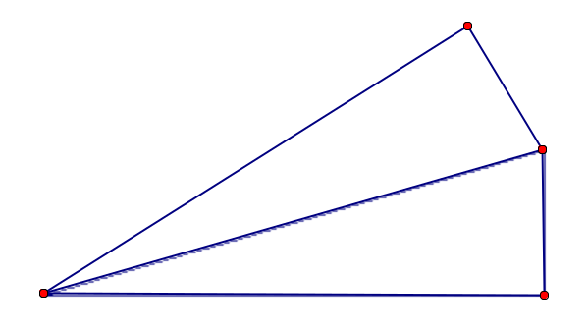
Summary so far...
bh
bh
(b1 + b2)h
2
2

Slide 110
Summary so far...
bh
bh
(b1 + b2)h
2
2

Slide 111
Summary so far...
bh
bh
(b1 + b2)h
2
2

Slide 112
Summary so far...
bh
bh
(b1 + b2)h
2
2
Symmetry Line * Half the Other Diagonal

Slide 113
Final Summary
Make sure all your formulas are written down!
bh
bh
(b1 + b2)h
2
2
Symmetry Line * Half the Other Diagonal

