Slide 1


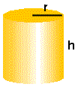



The Cone
A Cone is a three dimensional solid with a circular base and a curved surface that gradually narrows to a vertex.
+
+
=
Volume of a Cone
=

Slide 2


Exercise #1
Find the volume of a cylinder with a radius r=1 m and height h=2 m. Find the volume of a cone with a radius r=1 m and height h=1 m
Volume of a Cylinder = base x height = πr²h
= 3.14(1)²(2)
= 6.28 m³
Volume of a Cone = (1/3) πr²h
= (1/3)(3.14)(1)²(2)
= 2.09 m³

Slide 3
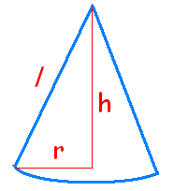

Surface Area of a Cone
Find the area of a cone with a radius r=3 m and height h=4 m.
r = the radius h = the height l = the slant height
Use the Pythagorean Theorem to find l
l ² = r² + h²
l ²= (3)² + (4)²
l ²= 25
l = 5
Surface Area of a Cone
= πr² + πrl
= 3.14(3)² + 3.14(3)(5)
= 75.36 m²

Slide 4



Cones – Practice Questions
Textbook:
P. 421 - 422 # 2a, 3b, 9
P. 439 – 441 # 2abcd, 3, 4c, 5ab, 10abc

Slide 5
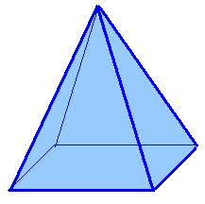
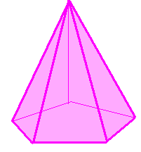
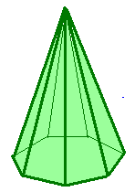
Pyramids
A Pyramid is a three dimensional figure with a regular polygon as its base and lateral faces are identical isosceles triangles meeting at a point.
Identical isosceles triangles
base = quadrilateral
base = pentagon
base = heptagon

Slide 6
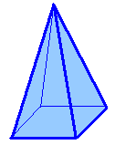
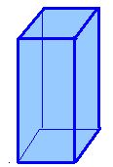
Volume of Pyramids
Volume of a Pyramid:
V = (1/3) Area of the base x height
V = (1/3) Ah
Volume of a Pyramid = 1/3 x Volume of a Prism
+
+
=

Slide 7
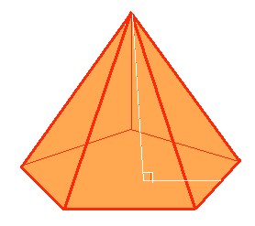
Exercise #2
Find the volume of the pyramid. height h = 8 m apothem a = 4 m side s = 6 m
Volume = 1/3 (area of base) (height)
= 1/3 ( 60m²)(8m)
= 160 m³
h
Area of base = ½ Pa
a
s
= ½ (5)(6)(4)
= 60 m²

Slide 8
Area of Pyramids
Find the surface area of the pyramid. height h = 8 m apothem a = 4 m side s = 6 m
Surface Area
= area of base
+ 5 (area of one lateral face)
What shape is the base?
Area of a pentagon
h
= ½ Pa
= ½ (5)(6)(4)
= 60 m²
l
a
s

Slide 9
Area of Pyramids
Find the surface area of the pyramid. height h = 8 m apothem a = 4 m side s = 6 m
What shape are the lateral sides?
Area of a triangle = ½ base (height)
= ½ (6)(8.9)
= 26.7 m²
Attention! the height of the triangle is the slant height ”l ”
h
l
a
l ² = h² + a²
= 8² + 4²
= 80 m²
l = 8.9 m
s

Slide 10
Area of Pyramids
Find the surface area of the pyramid. height h = 8 m apothem a = 4 m side s = 6 m
Surface Area of the Pyramid
= 60 m² + 5(26.7) m²
= 60 m² + 133.5 m²
= 193.5 m²
h
l
a
s

Slide 11
Cones – Practice Questions
Textbook:
P. 421 - 422 # 1, 2, 3, 8
P. 439 – 441 # 1, 2, 3, 4
Challenging Questions:
P. 421 - 422 # 6, 9

Slide 12
This powerpoint was kindly donated to www.worldofteaching.com
http://www.worldofteaching.com is home to over a thousand powerpoints submitted by teachers. This is a completely free site and requires no registration. Please visit and I hope it will help in your teaching.

