Slide 1
Bar Graphs and Histograms
PRINCESS C. BARCEGA
APG SCHOOL, MANAMA, BAHRAIN
Powerpoint hosted on www.worldofteaching.com
Please visit for 100’s more free powerpoints

Slide 2
What do you know about
bar graph?
double bar graph?
Histogram?

Slide 3
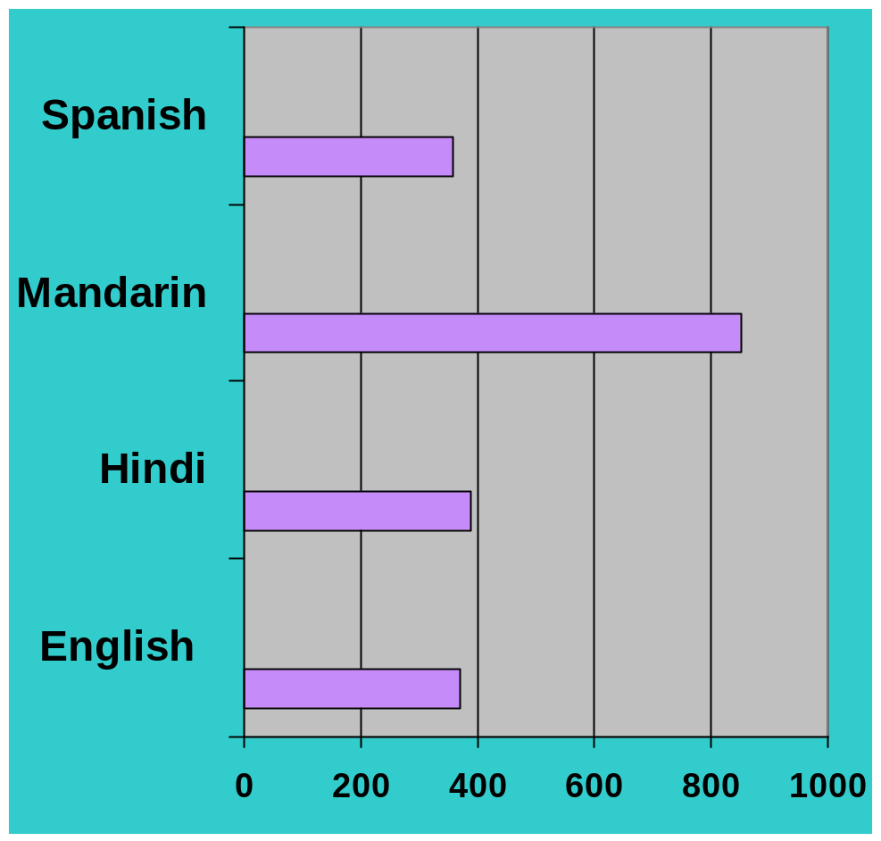
Bar Graph
A bar graph can be used to display and compare data
The scale should include all the data values and be easily divided into equal intervals.

Slide 4
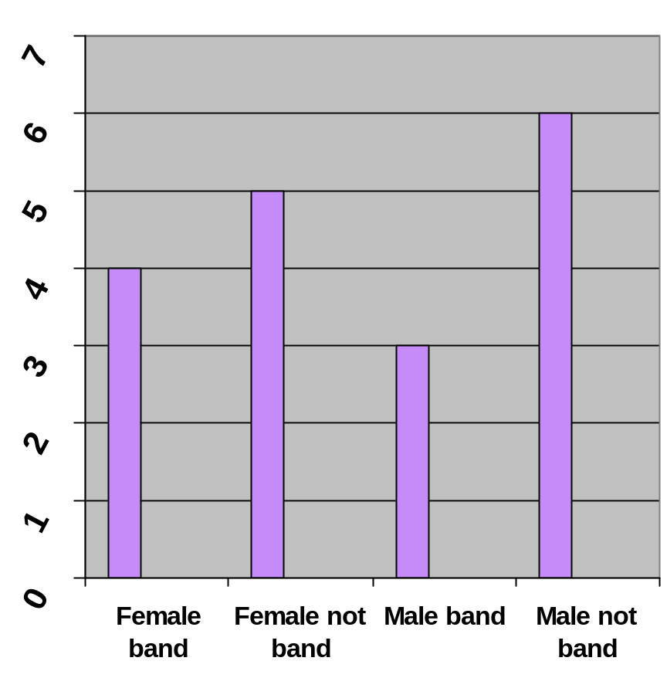
How to interpret a Bar Graph?
The bar graph shows Mr. Snowden’s students by gender and band membership.
How many of Mr. Snowden’s students are band members?
How many of Mr. Snowden’s students are not band members?

Slide 5
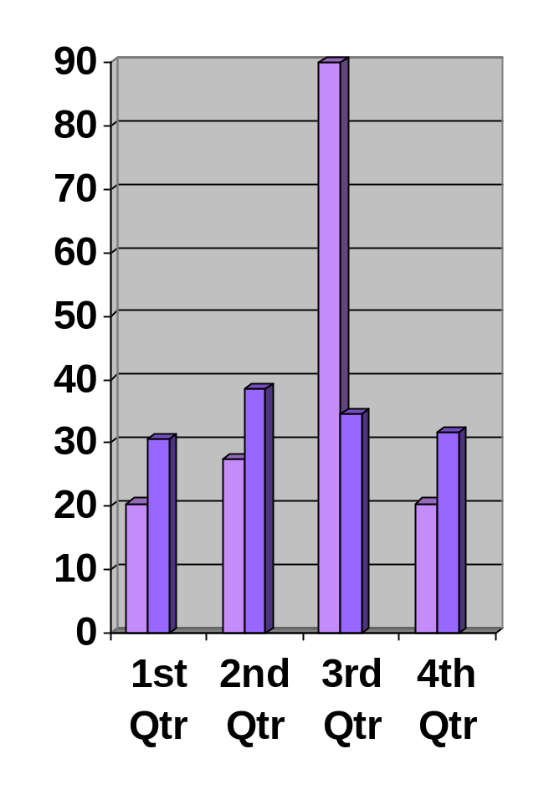
Double Bar Graph
Can be used to compare two related sets of data

Slide 6
How to make a Double-Bar Graph?
Choose a scale and interval for the vertical axis.
Draw a pair of bars for each country’s data. Use different colors to show males and females.
Label the axes and give the graph a title.
Make a key to show what each bar represents.

Slide 7
The table shows the highway speed limits on interstate roads .within three states
Rural | Urban | State
70 mi/h | 65mi/h | Florida
70 mi/h | 70 mi/h | Texas
65 mi/h | 55mi/h | Vermont

Slide 8
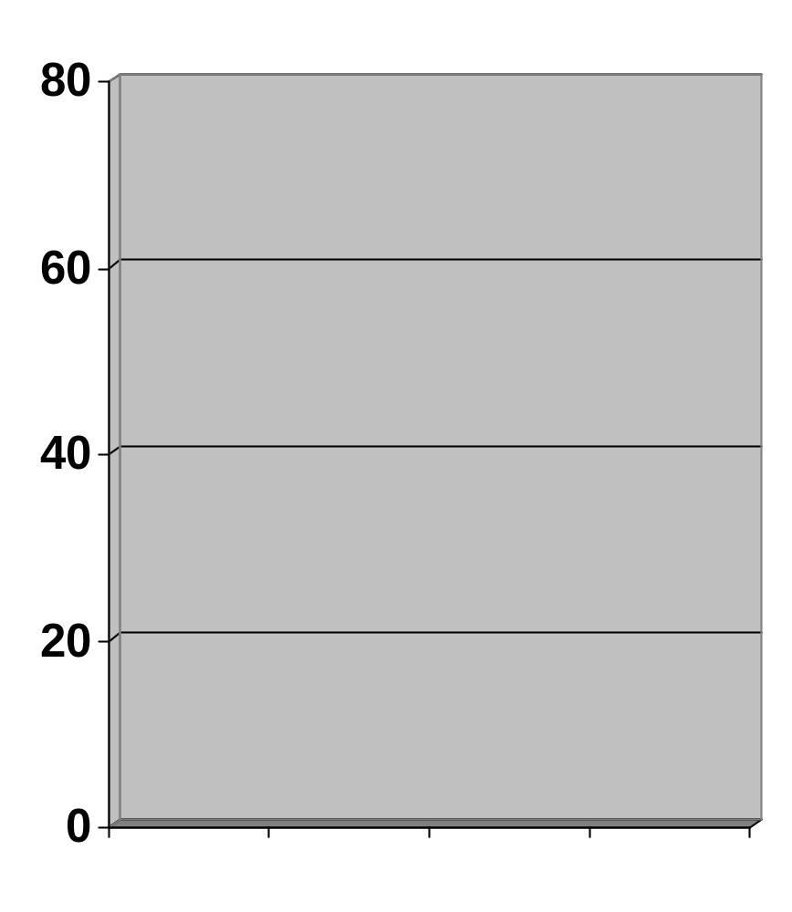
Step 1
Choose a scale and interval for the vertical axis.
Rural | Urban | State
70 mi/h | 65mi/h | Florida
70 mi/h | 70 mi/h | Texas
65 mi/h | 55mi/h | Vermont

Slide 9
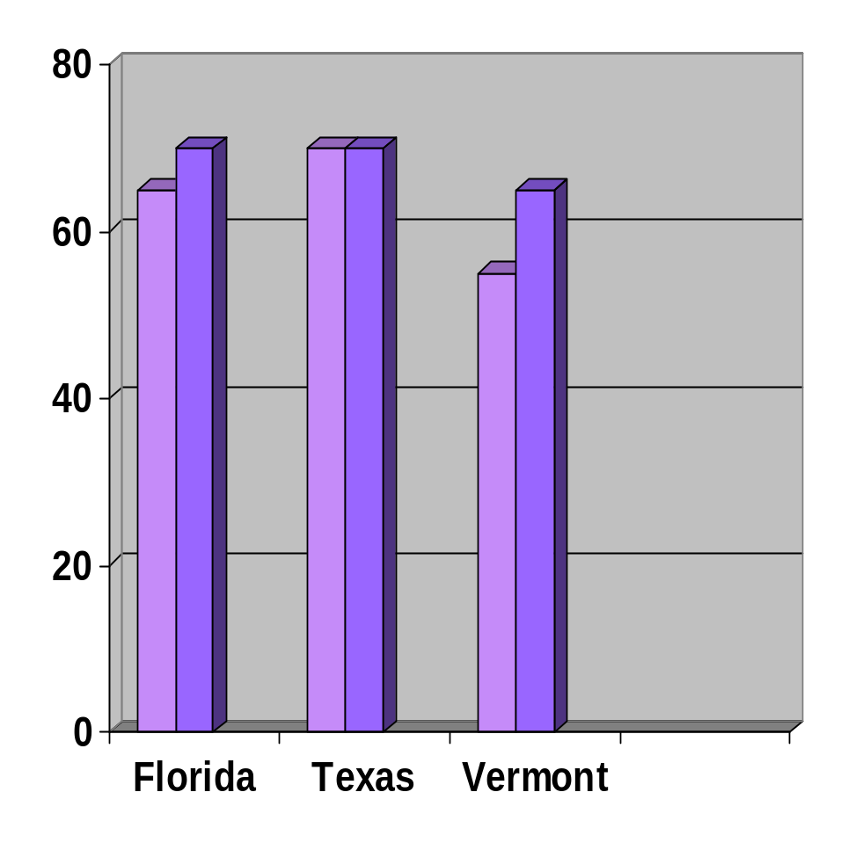
Step 2
Draw a pair of bars for each state’s data. Use different colors to show urban and rural.
Rural | Urban | State
70 mi/h | 65mi/h | Florida
70 mi/h | 70 mi/h | Texas
65 mi/h | 55mi/h | Vermont

Slide 10
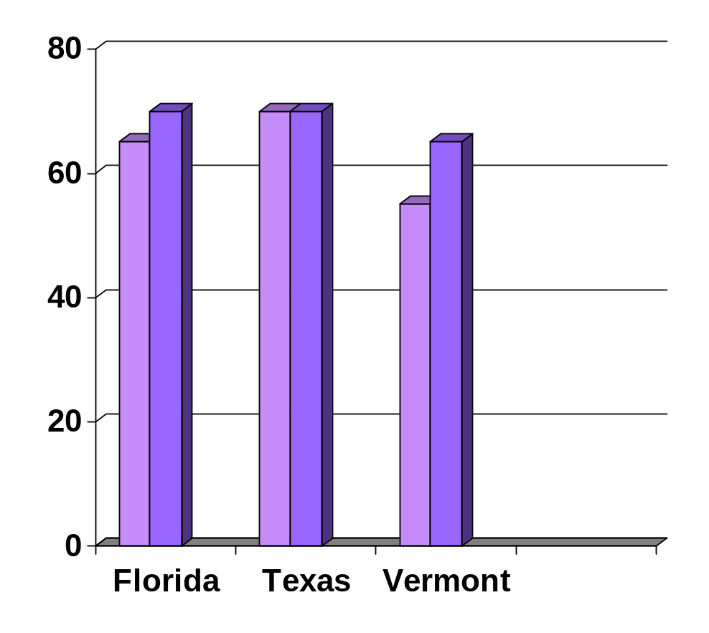
Step 3 and 4
Speed Limit on Interstate Roads
Label the axes and give the graph a title.
Make a key to show what each bar represents
Urban
Rural
Speed Limit (mi/h)

Slide 11
Histogram
Histogram is a bar graph that shows the frequency of data within equal intervals.
There is no space in between the bars.

Slide 12
How to make a histogram?

Slide 13
The table below shows the number of hours students watch TV in one week Make a histogram of all the data.
Number of hours of TV
III | 6 | II | 1
IIII - IIII | 7 | IIII | 2
III | 8 | IIII - IIII | 3
IIII | 9 | IIII - I | 4
 |  | IIII - III | 5

Slide 14
Step 1
Make a frequency table of the data. Be sure to use equal intervals
Frequency | Number of hours of TV
15 | 1-3
17 | 4-6
16 | 7-9
Number of hours of TV
III | 6 | II | 1
IIII - IIII | 7 | IIII | 2
III | 8 | IIII - IIII | 3
IIII | 9 | IIII - I | 4
 |  | IIII - III | 5

Slide 15
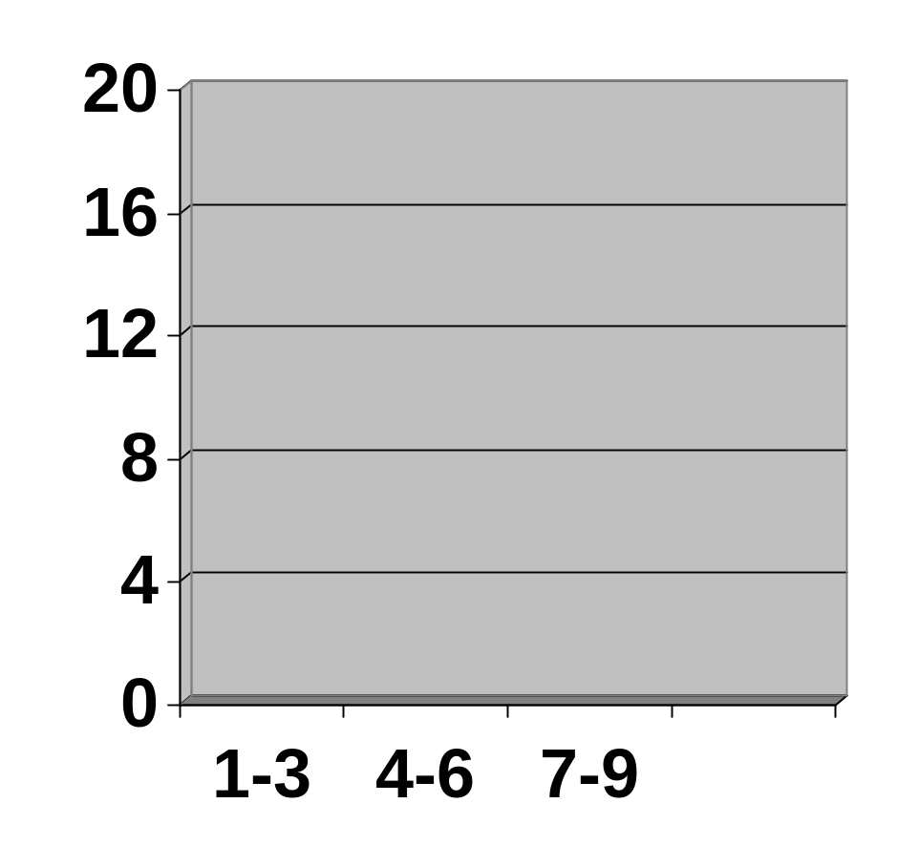
Step 2
Choose an appropriate scale and interval for the vertical axis. The greatest value on the scale should be at least as great as the greatest frequency.
Frequency | Number of hours of TV
15 | 1-3
17 | 4-6
16 | 7-9

Slide 16
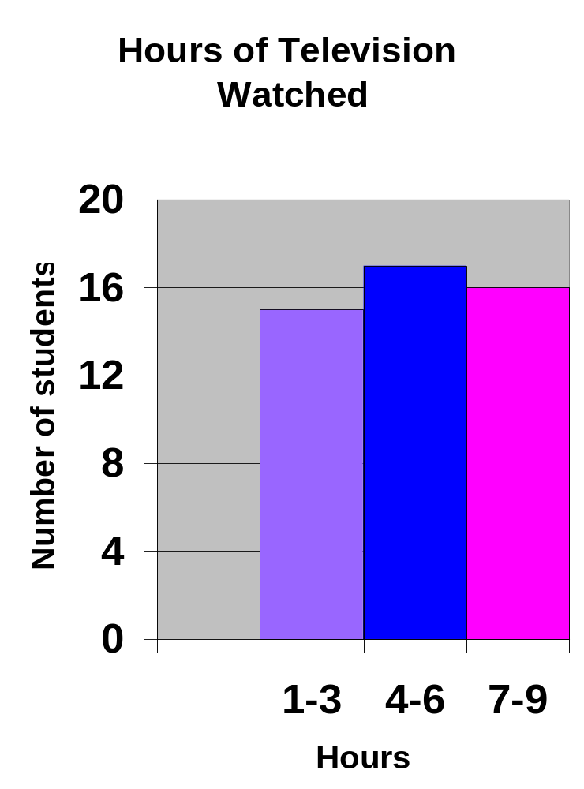
Step 3
Draw a bar for each interval. The height of the bar is the frequency for that interval. Bars must touch but not overlap.
Label the axes and give the graph title
Frequency | Number of hours of TV
15 | 1-3
17 | 4-6
16 | 7-9

Slide 17
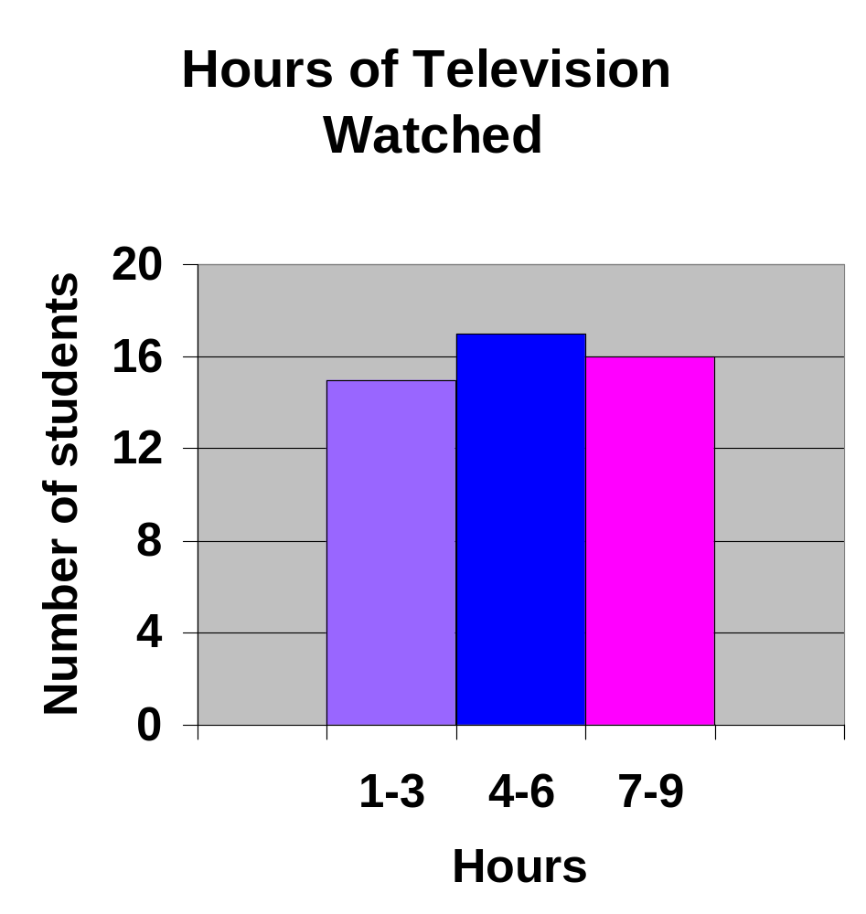

Slide 18
Can you now make a bar graph, double bar Graph and a histogram?

Slide 19
The list below shows the results of a typing test in words per minute. Make a histogram of the data.
62, 55, 68, 47, 50, 41, 62, 39, 54, 70, 56, 70, 56, 47, 71, 55, 60, 42

Slide 20
The end

