Slide 1
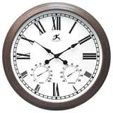
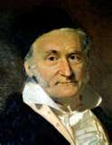
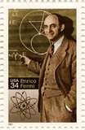
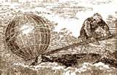

Math Blast
From the Past

Slide 2
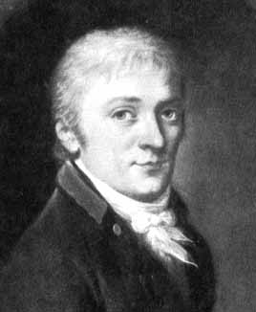
Carl Friedrich Gauss
Germany
1777-1855
1 + 2 + 3 + … + 98 + 99 + 100 =
5050

Slide 3
In primary school his teacher tried to occupy pupils by making them add a list of integers. The young Gauss reputedly produced the correct answer within seconds, to the astonishment of his teacher. Gauss' presumed method, which supposes the list of numbers was from 1 to 100, was to realise that pairwise addition of terms from opposite ends of the list yielded identical intermediate sums: 1 + 100 = 101, 2 + 99 = 101, 3 + 98 = 101, and so on, for a total sum of 50 × 101 = 5050

Slide 4
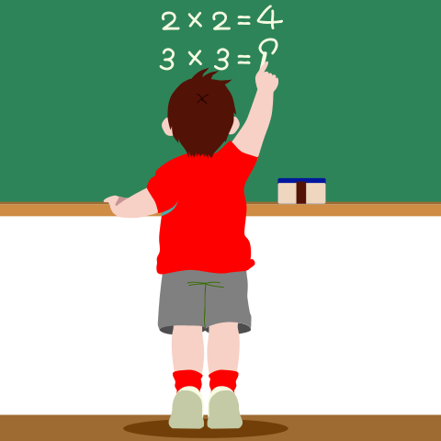
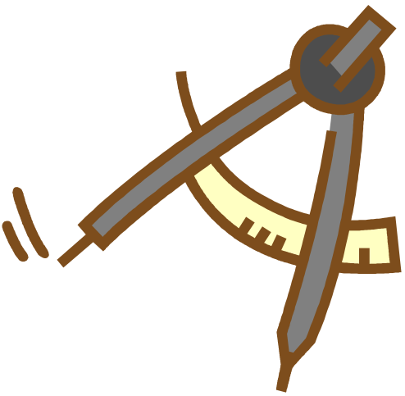
Helped his father with payroll accounts at the age of 3
Remembers he could “reckon” before he could talk
Knew seven languages
by the age of 19
Proved construction of a 17 sided
polygon with only a compass and
straight edge, thought impossible
for 2000 years.
English
German
Danish
Spanish
Latin
Greek
French

Slide 5
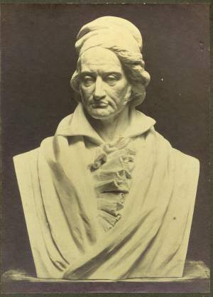
"Ask her to wait a moment - I am almost done. "
while working, when informed that his wife is dying.
Gauss's personal life was overshadowed by the early death of his first wife, Johanna Osthoff, in 1809, soon followed by the death of one child, Louis. Gauss plunged into a depression from which he never fully recovered. He married again, to Johanna's best friend named Friederica Wilhelmine Waldeck but commonly known as Minna. This second marriage does not seem to have been very happy as it was plagued by Minna's continuous illness. When his second wife died in 1831 after a long illness,one of his daughters, Therese, took over the household and cared for Gauss until the end of his life.
Gauss had six children with Johanna.
Gauss died in Göttingen, Hannover (now part of Lower Saxony, Germany) in 1855.

Slide 6
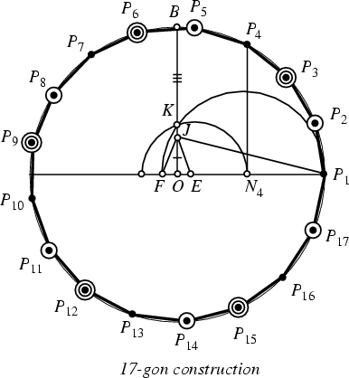

Slide 7
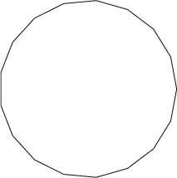
Gauss wanted a heptadecagon placed on his gravestone, but the carver refused, saying it would look like a circle. The heptadecagon is used as the shape of the pedestal with a statue honoring Gauss in his home town of Braunschweig.

Slide 8
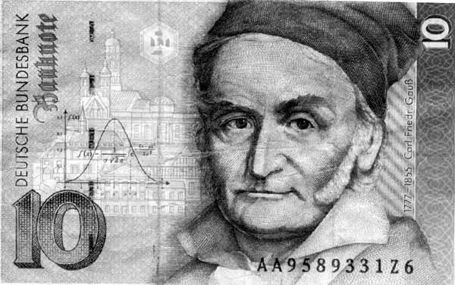
Gauss on the 10 Mark note

Slide 9
"Normal" Curve used in statistics
C
C
C
C
C
C
D
D
D
D
B
B
B
B
F
F
A
A

Slide 10
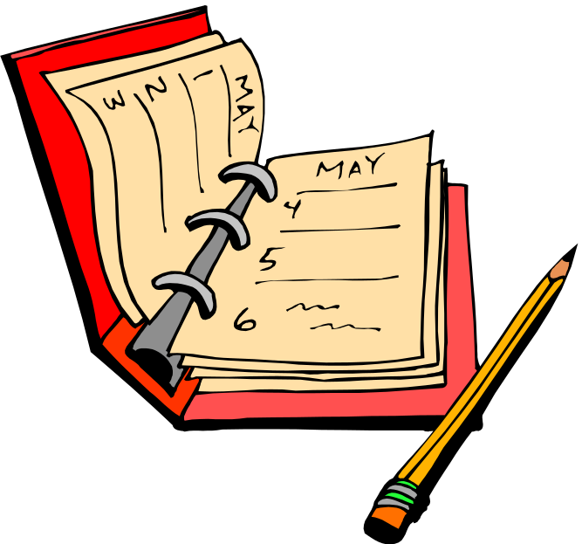
His motto was "pauca sed matura" (few but ripe).
His diary that covered 20 years of work only contained 19 pages. Gauss was a perfectionist. After his death it was discovered that many discoveries credited to others had first been worked on by Gauss years earlier. Much of his work was never published because he felt it wasn’t finished yet.

Slide 11
Eureka (num) = + +

Slide 12
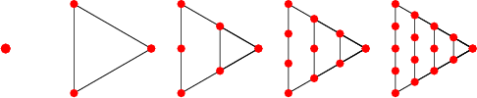
Triangular Numbers
1 3 6 10 15
This entry from Gauss’ diary meant that every number could be written as a sum of three or fewer triangular numbers.
Eureka (num) = + +

Slide 13
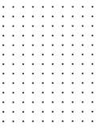
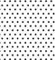
Triangular Numbers

Slide 14
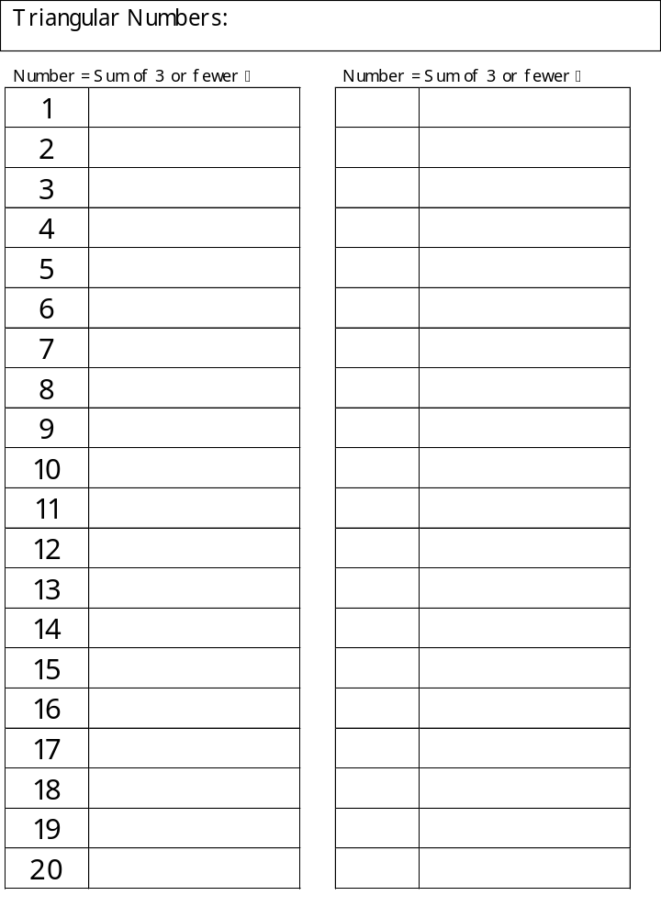
1, 3, 6, 10, 15, 21, 28…
37

21 + 15 + 1


6 + 1
6 + 1 + 1
6 + 3


Slide 15
This powerpoint was kindly donated to www.worldofteaching.com
http://www.worldofteaching.com is home to over a thousand powerpoints submitted by teachers. This is a completely free site and requires no registration. Please visit and I hope it will help in your teaching.

