Slide 1
CARTESIAN COMPONENTS OF VECTORS

Slide 2
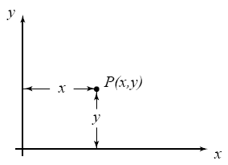
Two-dimensional Coordinate frames
The diagram shows a two-dimensional coordinate frame.
Any point P in the plane of the figure can be defined in terms of its x and y coordinates.

Slide 3
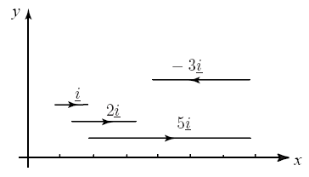
(All these vectors are multiples of i.)
A unit vector pointing in the positive direction of the x-axis is denoted by i.
Any vector in the direction of the x-axis will be a multiple of i.
A vector of length l in the direction of the x-axis can be written li.

Slide 4
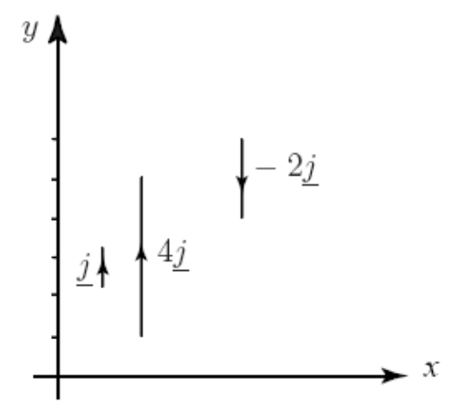
(All these vectors are
multiples of j.)
A unit vector pointing in the positive direction of the y-axis is denoted by j.
Any vector in the direction of the y-axis will be a multiple of j.
A vector of length l in the direction of the y-axis can be written lj.

Slide 5
Key Point
i represents a unit vector in the direction of the positive x-axis.
j represents a unit vector in the direction of the positive y-axis.

Slide 6
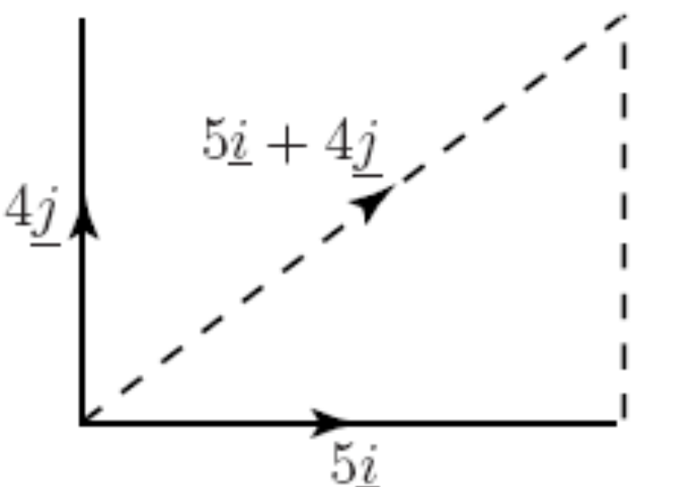
Example
Draw the vectors 5i and 4j. Use your diagram and the triangle law of addition to add these two vectors together.

Slide 7
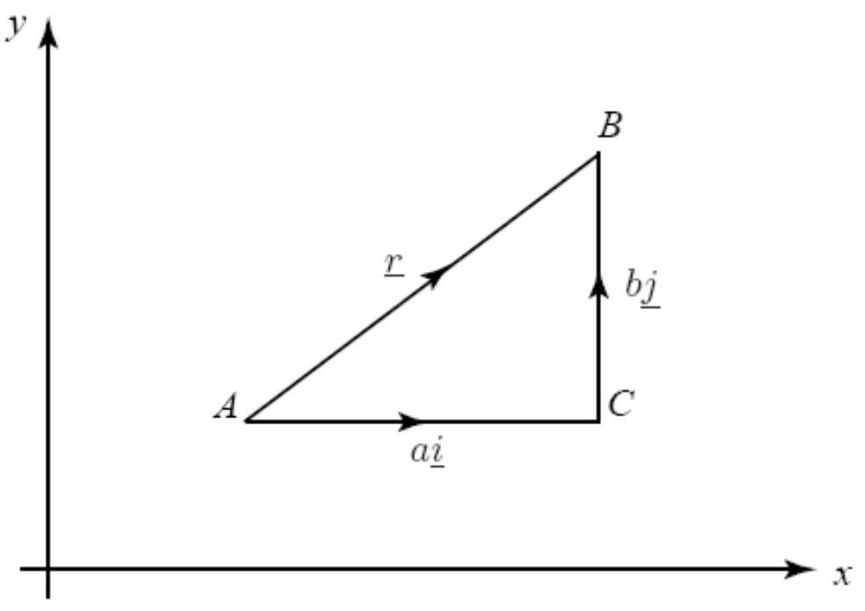
Any vector in the xy plane can be expressed in the form
r = ai + bj
The numbers a and b are called the components of r in the
x and y directions.

Slide 8
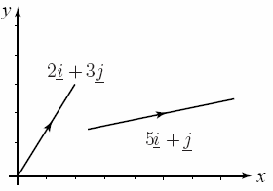
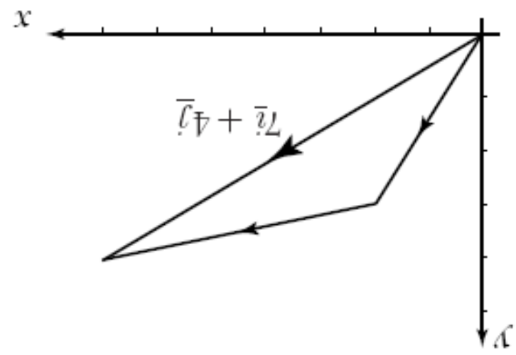
Example
a) Draw an xy plane and show the vectors p = 2i + 3j, and q = 5i + j.
b) Express p and q using column vector notation.
c) Show the sum p + q.
d) Express the resultant p + q in terms of i and j.

Slide 9
Example
If a = 9i + 7j and b = 8i + 3j, find:
a) a + b
b) a − b

Slide 10
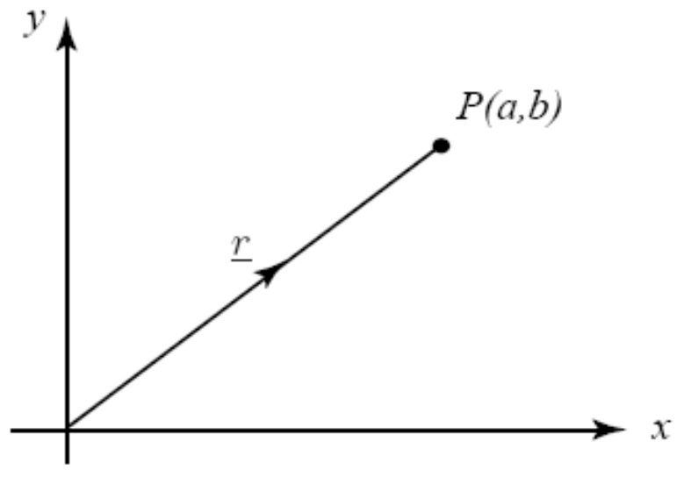
Key Point
The position vector of P with coordinates (a, b) is:
r = OP = ai + bj

Slide 11
Example
State the position vectors of the points with coordinates:
a) P(2, 4)
b) Q(−1, 5)
c) R(−1,−7)
d) S(8,−4)

Slide 12
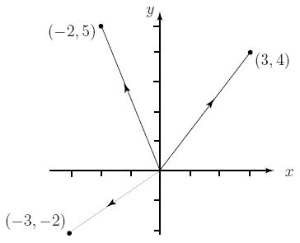
Example
Sketch the position vectors:
r = 3i + 4j,
r = −2i + 5j,
r = −3i − 2j.
1
2
3

Slide 13
The modulus of any vector r is equal to its length. As we have noted earlier the modulus of r is usually denoted by |r|. When r = ai + bj the modulus can be obtained using Pythagoras’ theorem. If r is the position vector of point P then the modulus is clearly the distance of P from the origin.

Slide 14
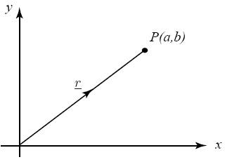
Key Point
if r = ai + bj
then |r| = √(a² + b²)

Slide 15
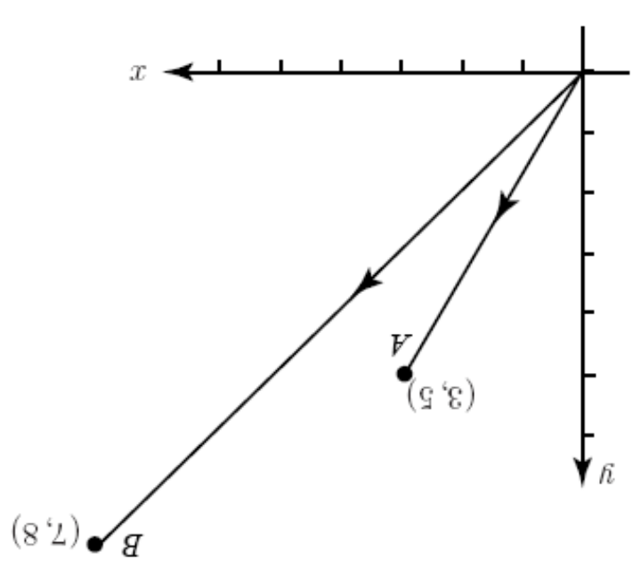
Example
Point A has coordinates (3, 5). Point B has coordinates (7, 8).
a) Depict these points on a diagram.
b) State the position vectors of A and B.
c) Find an expression for AB.
d) Find |AB|.

Slide 16
This powerpoint was kindly donated to www.worldofteaching.com
http://www.worldofteaching.com is home to over a thousand powerpoints submitted by teachers. This is a completely free site and requires no registration. Please visit and I hope it will help in your teaching.

