Slide 1
Directly and inversely proportional
Use with student whiteboards, or paper
Objective- a mini lesson on writing equations based on definitions that use the words directly and inversely proportional

Slide 2
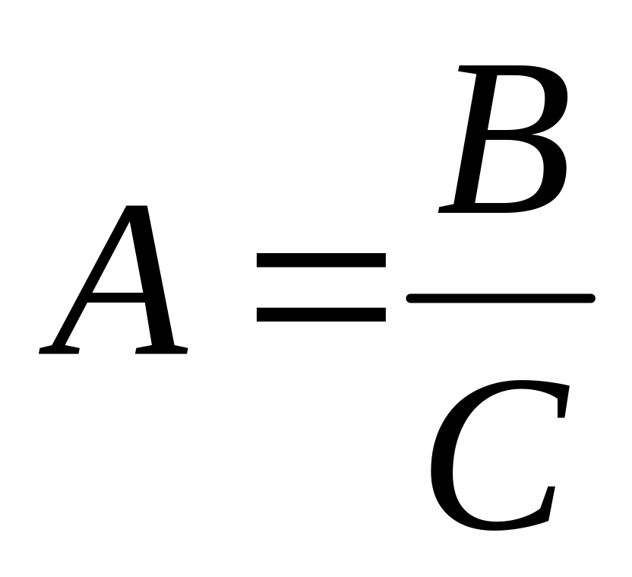
A is directly proportional to B
A is inveresly proportional to C

Slide 3
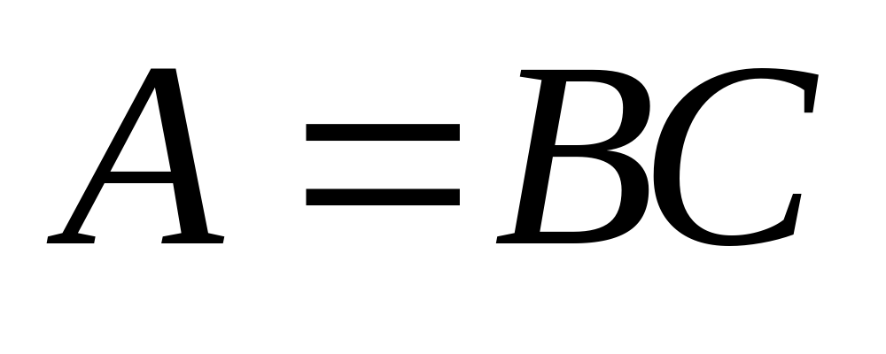
A is directly proportional to B
A is directly proportional to C

Slide 4
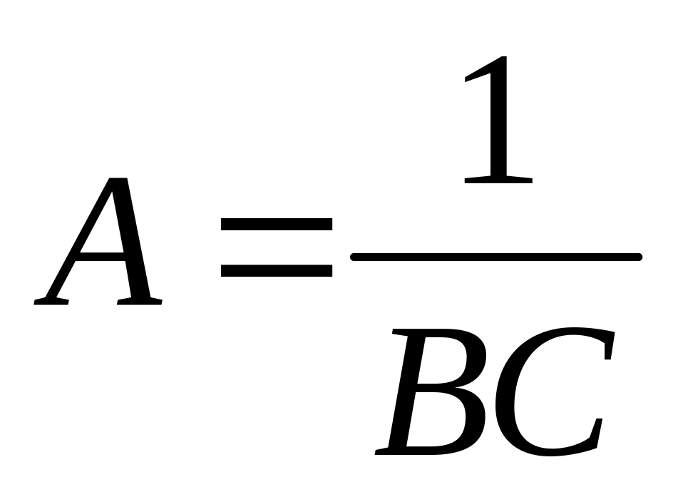
In the equation
A is inveresly proportional to B
A is inveresly proportional to C

Slide 5
On your whiteboards- practice writing the equations according to the definitions provided.

Slide 6
#1
weight(w) is directly proportional to mass(m) and directly proportional to acceleration due to gravity(g)

Slide 7
#2
Pressure(P) is directly proportional to the Force(F)and inversely proportional to the area(A)

Slide 8
#3
Frequency(f) is inversely proportional to the time(t)

Slide 9
#4
Acceleration(a) is directly proportional to the Force(F) and inversely proportional to the mass(m)

Slide 10
#5
Jis directly proportional to the , X directly proportional to the L and inversely proportional to theN

Slide 11
ANSWERS

Slide 12
#1
weight(w) is directly proportional to mass(m) and directly proportional to acceleration due to gravity(g)
w=mg

Slide 13
#2
Pressure(P) is directly proportional to the Force(F)and inversely proportional to the area(A)
P=F/A

Slide 14
#3
Frequency(f) is inversely proportional to the time(t)
f=1/t

Slide 15
#4
Acceleration(a) is directly proportional to the Force(F) and inversely proportional to the mass(m)
a=F/m

Slide 16
#5
Jis directly proportional to the , X directly proportional to the L and inversely proportional to theN
J = (XL)/N

Slide 17
This powerpoint was kindly donated to www.worldofteaching.com
http://www.worldofteaching.com is home to over a thousand powerpoints submitted by teachers. This is a completely free site and requires no registration. Please visit and I hope it will help in your teaching.

