Slide 1


Slide 2
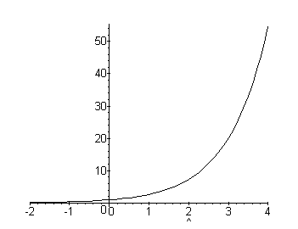
Exponential Functions are functions which can be represented by graphs similar to the graph on the right

Slide 3
All base exponential functions are similar because they all go through the point (0,1), regardless of the size of their base number
Exponential Functions are written in the form:
y = ab^{x}
a= constant b = base x = variable

Slide 4
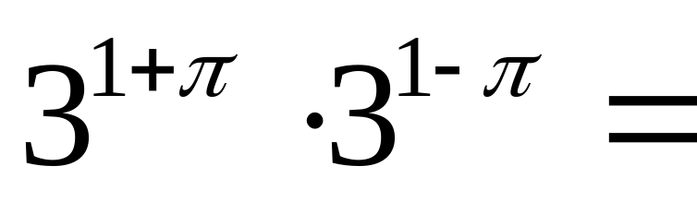
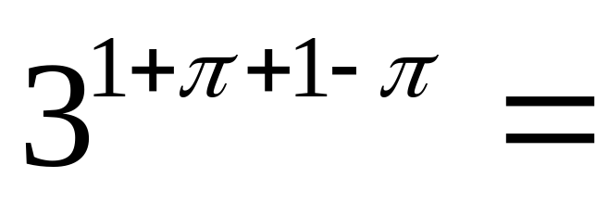
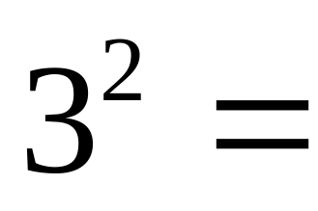
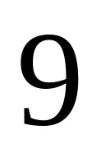
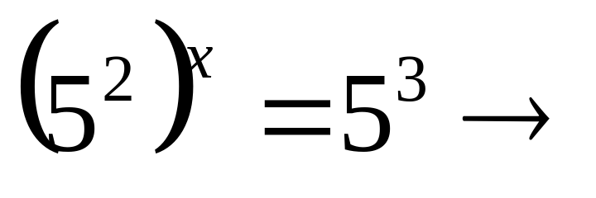
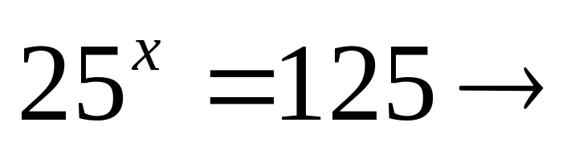
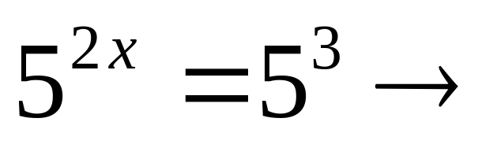
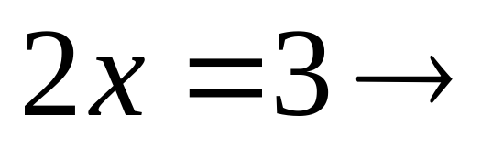
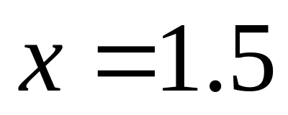
When working with exponential equations, the Laws of Exponents still hold true
When solving exponential equations, it is important to have both sides of the equation set to the same base

Slide 5
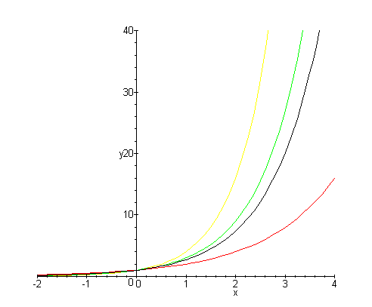
Yellow = 4^{x} Green = e^{x}
Black = 3^{x} Red = 2^{x}

Slide 6
As you could see in the graph, the larger the base, the faster the function increased
If we place a negative sign in front of the x, the graphs will be reflected(flipped) across the y-axis

Slide 7
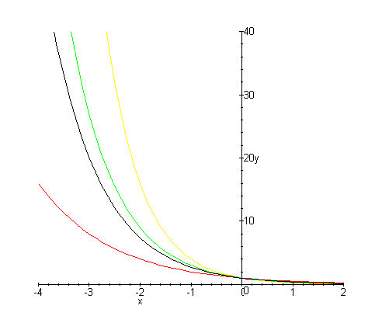
Yellow = 4^{-x} Green = e^{-x}
Black = 3^{-x} Red = 2^{-x}

Slide 8
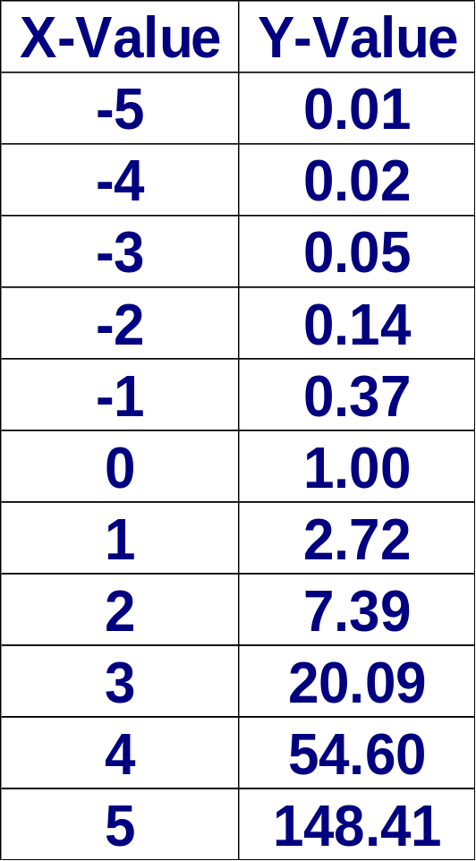
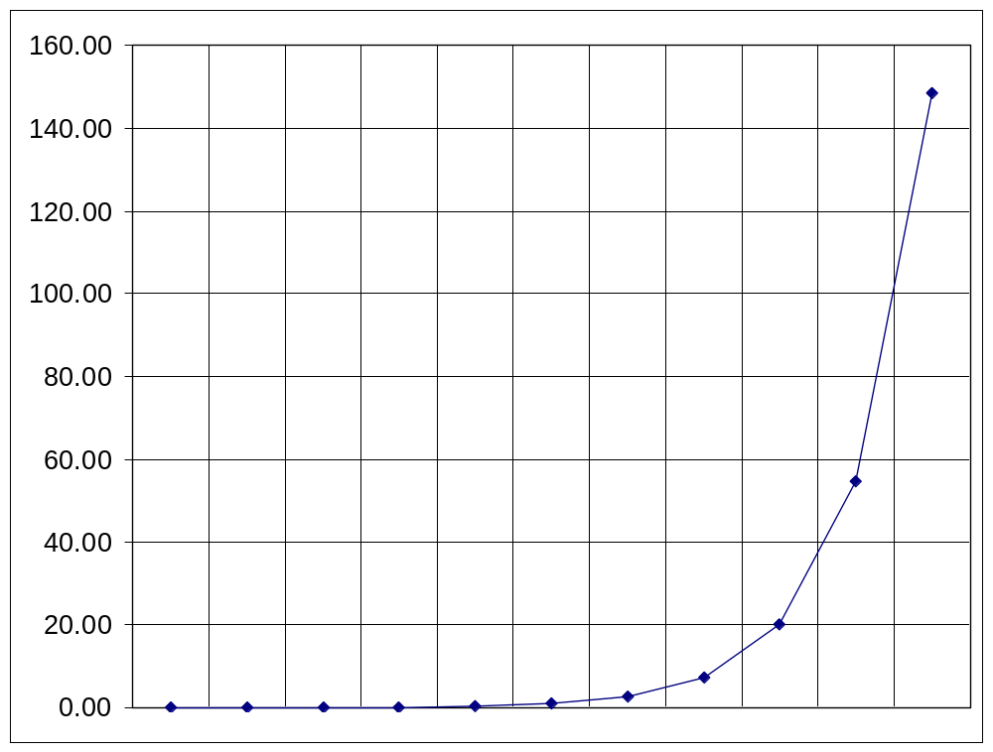
By using Microsoft Excel, we can make a table of values and a graph of the data
y = e^{x}

Slide 9
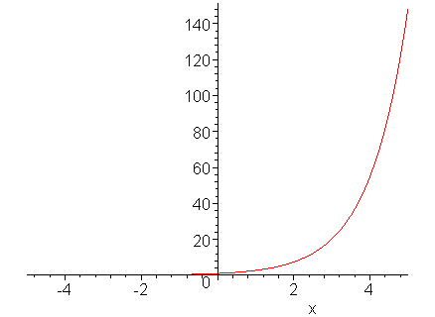
We can also use Maple 7 to plot exponential graphs
> plot (exp(x),x=-5..5);

Slide 10

The previous pages show what exponential growth looks like as a curve, but what happens in real life.
You start with one item which replicates continuously.

Slide 11
Homework:
Pages ?

Slide 12
This powerpoint was kindly donated to www.worldofteaching.com
http://www.worldofteaching.com is home to over a thousand powerpoints submitted by teachers. This is a completely free site and requires no registration. Please visit and I hope it will help in your teaching.

