Slide 1
Graphs of Straight Lines
How to graph equations and find equations from graphs.

Slide 2
Tables of Values
A table of values is used to generate points.
These points can be plotted on the coordinate plane.
A straight line drawn through these points creates the graph of the equation.

Slide 3
Example
Graph y = 2x – 5
x | 1 | 2 | 3 | 4 | 5
y
-3
-1
1
3
5

Slide 4
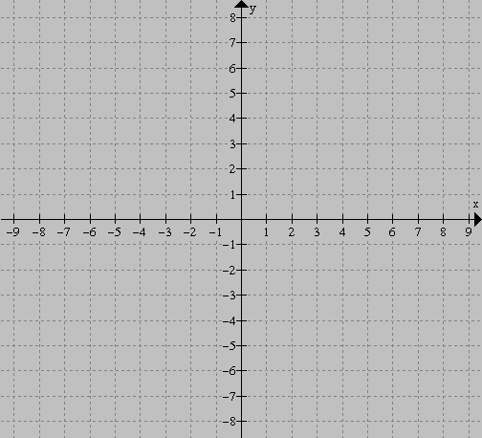
Plot these points on the coordinate plane.
x | 1 | 2 | 3 | 4 | 5
y | -3 | -1 | 1 | 3 | 5

Slide 5
Draw a straight line through the points

Slide 6
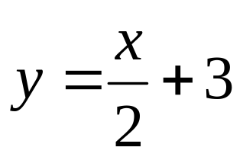
Exercises
Graph the following straight lines:
y = 3x – 4
y = 2x + 1
y = x – 5
y = -3x +2
Look for a relationship between the graphs and their algebraic expressions!!!

Slide 7
The Gradient-Intercept Form of a Straight Line
When a linear function is written in the form
y = mx + b
the m is its gradient and the b is its y-intercept.

Slide 8
What’s the Equation?
For the following graphs, determine their equation.

Slide 9
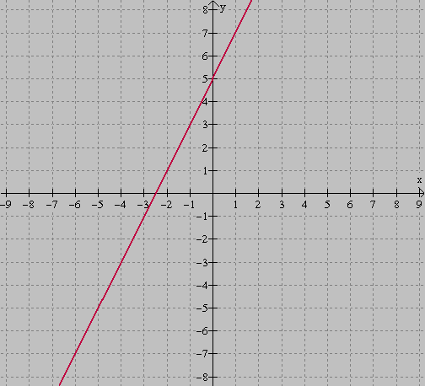

Slide 10
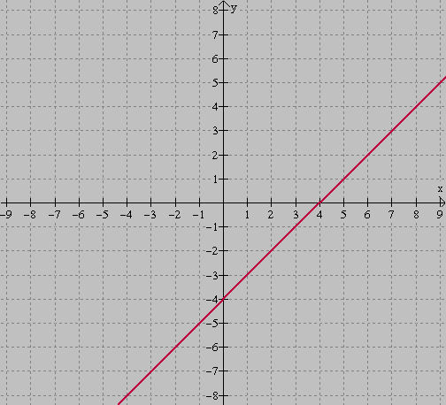

Slide 11
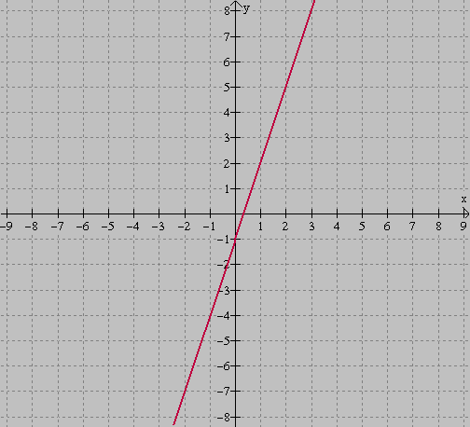

Slide 12
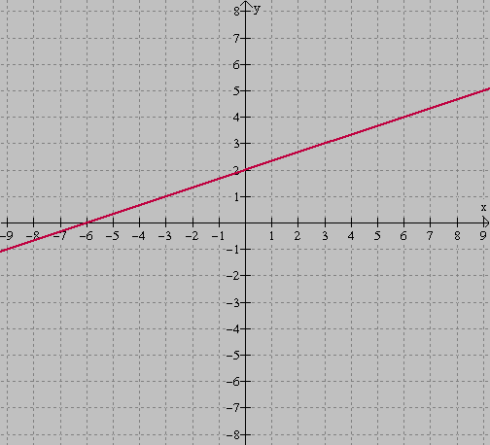

Slide 13
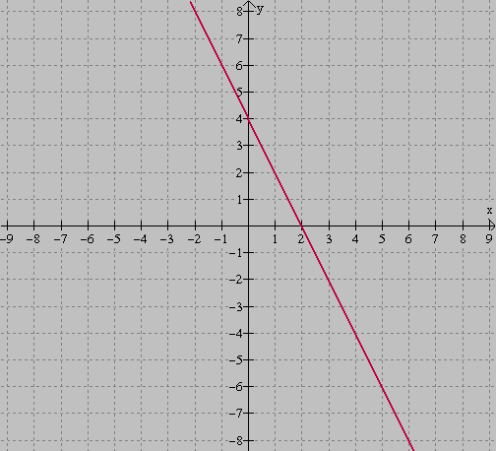

Slide 14
This powerpoint was kindly donated to
www.worldofteaching.com
http://www.worldofteaching.com
Is home to well over a thousand powerpoints submitted by teachers. This a free site. Please visit and I hope it will help in your teaching
Notes:
14

