Slide 1
Jeopardy
Operations
Start

Slide 2
Addition | Subtraction | Division | Multiplication | Exponents
10 | 10 | 10 | 10 | 10
20 | 20 | 20 | 20 | 20
30 | 30 | 30 | 30 | 30
40 | 40 | 40 | 40 | 40
Final Jeopardy Question
Notes:
Click and highlight the Category, then type in your own topic.

Slide 3
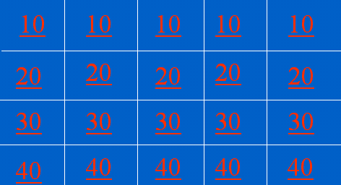
10 Point Question
6
0
10
1
2
3
4
5
3+7
Back to the Game Board

Slide 4
20 Point Question
6
0
30
1
2
3
4
5
24+6
Back to the Game Board

Slide 5
30 Point Question
6
0
88
1
2
3
4
5
35+53
Back to the Game Board

Slide 6
40 Point Question
6
0
1,030
1
2
3
4
5
122+908
Back to the Game Board

Slide 7
10 Point Question
6
0
7
1
2
3
4
5
10-3
Back to the Game Board

Slide 8
20 Point Question
6
0
24
1
2
3
4
5
30-6
Back to the Game Board

Slide 9
30 Point Question
6
0
35
1
2
3
4
5
88-53
Back to the Game Board

Slide 10
40 Point Question
6
0
-92
1
2
3
4
5
908-1000
Back to the Game Board

Slide 11
10 Point Question
6
0
1
1
2
3
4
5
97÷97
Back to the Game Board

Slide 12
20 Point Question
6
0
0
1
2
3
4
5
0÷97
Back to the Game Board

Slide 13
30 Point Question
6
0
5.6
1
2
3
4
5
56 ÷10
Back to the Game Board

Slide 14
40 Point Question
6
0
5
1
2
3
4
5
125 ÷25
Back to the Game Board

Slide 15
10 Point Question
6
0
97
1
2
3
4
5
97x1
Back to the Game Board

Slide 16
20 Point Question
6
0
9,080
1
2
3
4
5
908x10
Back to the Game Board

Slide 17
30 Point Question
6
0
100
1
2
3
4
5
25x4
Back to the Game Board

Slide 18
40 Point Question
6
0
341
1
2
3
4
5
31x11
Back to the Game Board

Slide 19
10 Point Question
6
0
9
1
2
3
4
5
3²
Back to the Game Board

Slide 20
20 Point Question
6
0
8
1
2
3
4
5
2³
Back to the Game Board

Slide 21
30 Point Question
6
0
100
1
2
3
4
5
10²
Back to the Game Board

Slide 22
40 Point Question
6
0
1,000
1
2
3
4
5
1.5x10³
Back to the Game Board

Slide 23
Final Jeopardy Question
2+3-4x5 ÷10¹
7
6
5
4
3
2
1
3

