Slide 1
Length and Area
Year 7 Maths

Slide 2
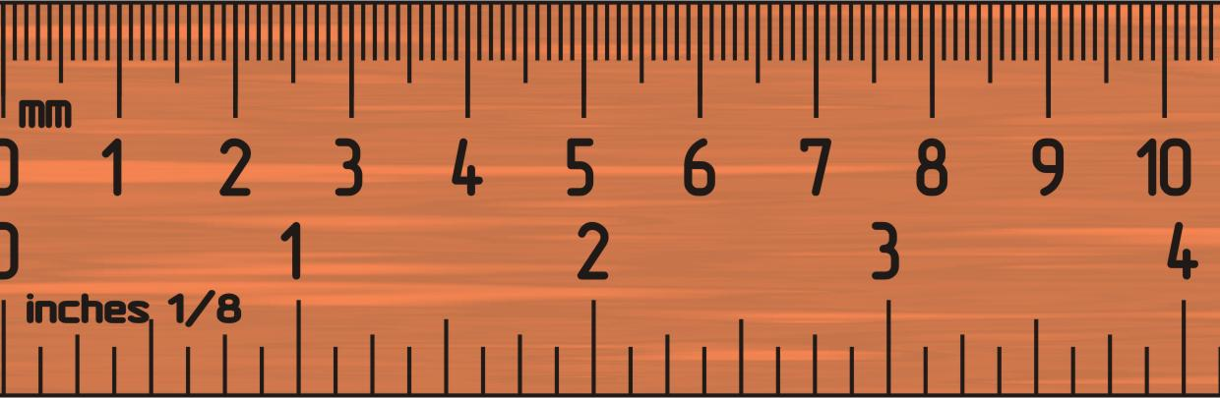
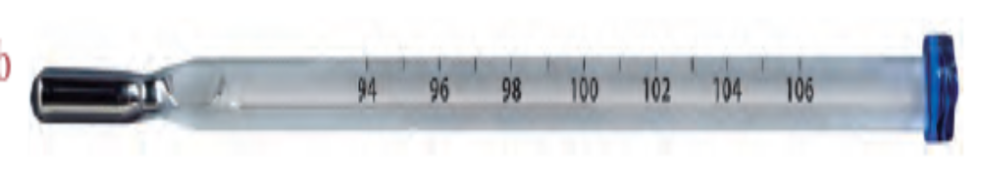
Measurements

Slide 3
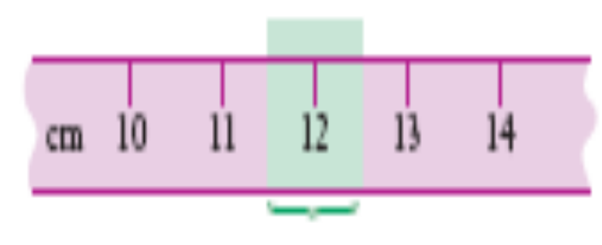
Limits of accuracy
The accuracy of a measurement is how close that measurement is to the true value.
This is restricted or limited by the accuracy of the measuring instrument.
The ruler is marked in centimetres, so any length measured with it can only be given to the nearest centimetre.

Slide 4
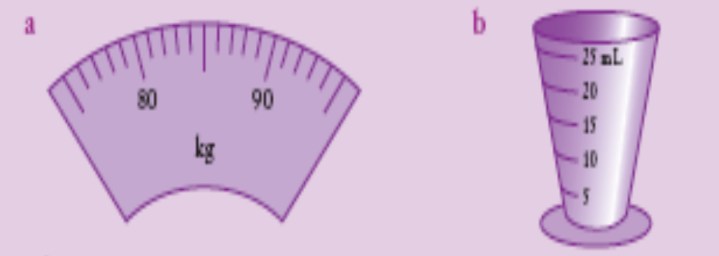
Limit of Accuracy
For each of these measuring scales, state the size of one unit on the scale and state the limit of accuracy.
The size of one unit is 1 kg. The limits of accuracy are ±0.5 × 1 kg = ±0.5 kg.
The size of one unit is 5 mL. The limits of accuracy are ±0.5 × 5 mL = ±2.5 mL.

Slide 5

Area
The Area of a Shape is the Amount of Surface that is Enclosed by the shape

Slide 6
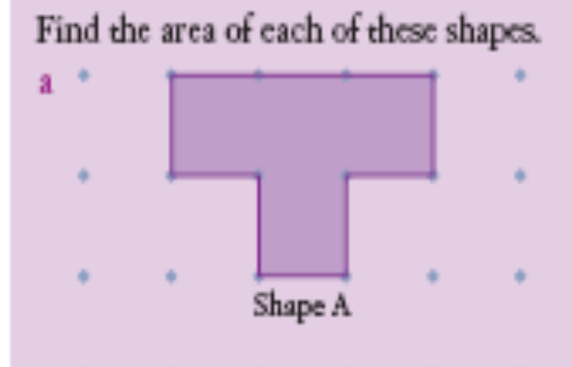
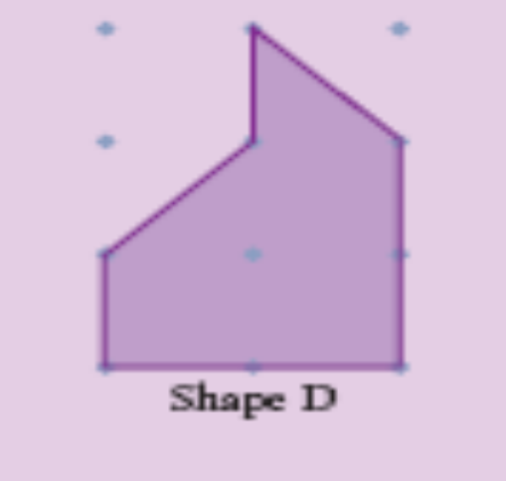
Area
Can use grid paper to determine size of area
Area = 4cm2
        Area = 3 squares + ½ square + ½ square = 4 cm 2

Slide 7
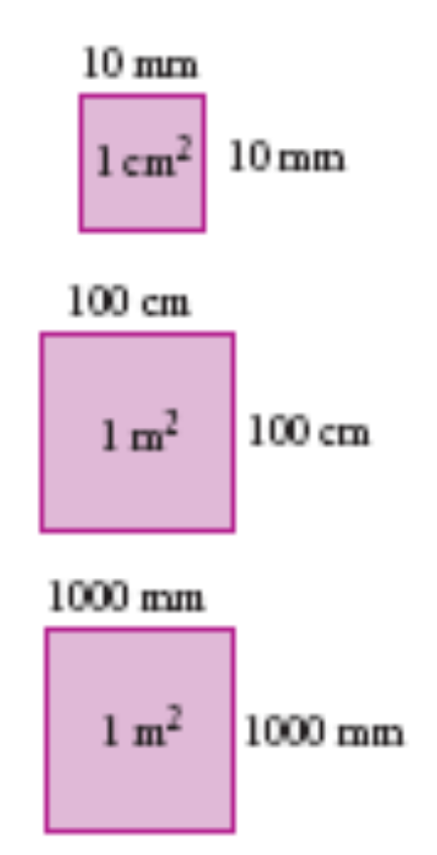
Converting units of area
1 cm = 10 mm
1 cm2 = 10 × 10 mm2 = 100 mm2
(double the number of zeros)
1 m = 100 cm
1 m2 = 100 × 100 cm2 = 10 000 cm2
(double the number of zeros)
1 m = 1000 mm
1 m2 = 1000 × 1000 mm = 1 000 000 mm2
(double the number of zeros)

Slide 8
Conversions of Units
1cm² = 100mm²
1m² = 10 000cm²
1m² = 1 000 000mm²

Slide 9
Investigation of Area of Triangles
Area of right-angled triangles
You will need 1-cm grid paper.
a On your grid paper, draw a rectangle 6 cm by 4 cm.
b Cut the rectangle in half along a diagonal. What shape have you made?
c Area of rectangle = ×
  = cm2
d What is the area of each triangle?
What do you notice regarding the area of the triangle and the area of the rectangle?

Slide 10
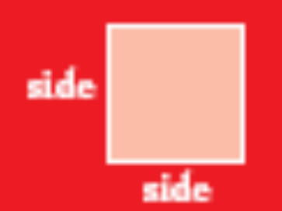

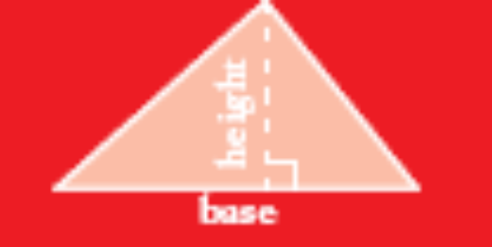
Area of squares, rectangles and triangles
Area of square = side × side
= s × s
= s2
Area of rectangle = length × breadth
= l × b
Area of triangle = ½ × base × height
= ½ × b × h

Slide 11


Examples
1 What is the area of this square?
Solution
Area = s × s
= 3.2 × 3.2
= 1024 cm2
2 What is the area of this rectangle?
Solution
Area = l × b 6 cm = 60 mm
= 60 × 5
= 300 mm2

Slide 12
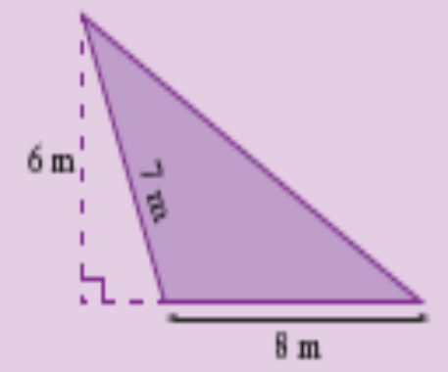

Area of a Triangle
1 Find the area of this triangle.
Solution
Area of triangle = ½ × b × h
= ½ × 8 × 6
= 24 m²
Note: The length of 7 m was not required to find this triangle’s area.
2 Find the area of this triangle.
Solution
Area of triangle = ½ × b × h
= ½ × 4.2 × 3
= 6.3 cm²

Slide 14
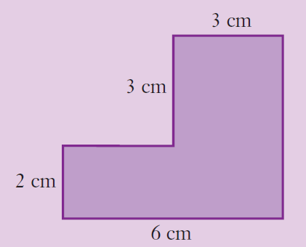
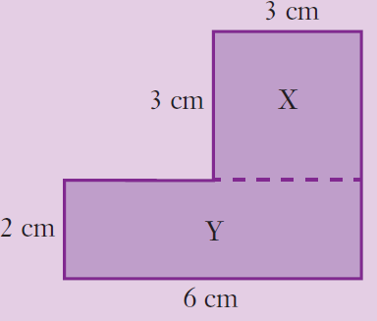
Areas of composite shapes
Find the area of this shape.
Solution
Method 1
Area of shape = area of rectangle Y + area of square X
= (6 × 2) + (3 × 3)
= 12 + 9
= 21 cm²

Slide 15
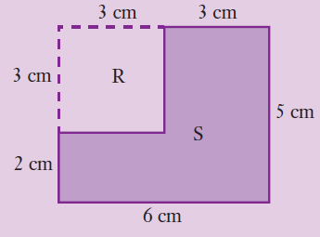
Method 2
This can also be done by subtracting areas.
Area of shape = area of rectangle S − area of square R
= 6 × 5 − 3 × 3
= 30 − 9
= 21 cm²

Slide 16
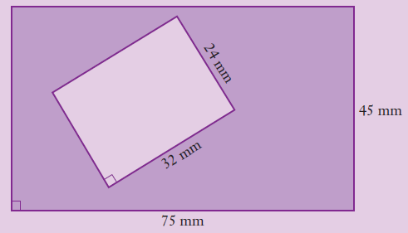
What about this shaded area?
Area of purple shape = area of big rectangle − area of small rectangle
= (75 × 45) − (32 × 24)
= 3375 − 768
= 2607 mm²

Slide 17
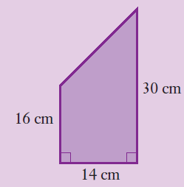
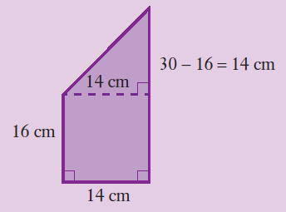
What shapes can you see?
Solution
Divide the shape into a
triangle and a rectangle.
Area of shape = area of rectangle + area of triangle
= (16 × 14) + (½ × 14 × 14)
= 224 + 98
= 322 cm²
98cm²
A = ½bh
224cm²

Slide 18
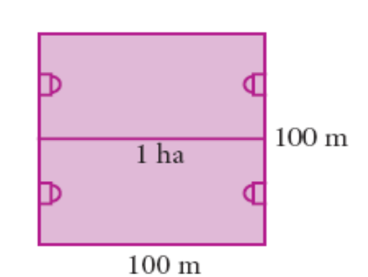
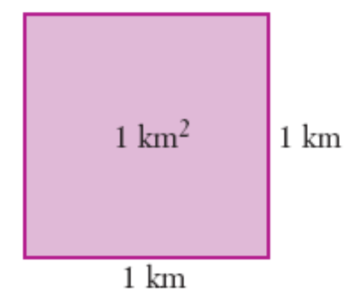
Measuring Large Areas
1 hectare is about the size of 2 football fields
1 hectare = (100 × 100) m2
1 ha = 10 000 m2
1 square kilometre is a square 1km by 1km
1 km2 = 1000m x 1000m
= 1 000 000 m2
= 100 hectares (ha)

Slide 19
A nature reserve has an area of 9 577 000 000 m2.
a What is its area in hectares? b What is its area in square kilometres?
Solution
a Area of reserve = 9 577 000 000 m² (1ha = 10000m²)
= (9 577 000 000 ÷ 10 000) ha
= 957 700 ha
The area of the reserve is 957 700 hectares.
b Area of reserve = 9 577 000 000 m2 (1 km² ⁼ 1 000 000m²)
= (9 577 000 000 ÷ 1 000 000) km2
= 9577 km²
The area of the reserve is 9577 square kilometres.

Slide 20
This powerpoint was kindly donated to
www.worldofteaching.com
http://www.worldofteaching.com
Is home to well over a thousand powerpoints submitted by teachers. This a free site. Please visit and I hope it will help in your teaching
Notes:
20

