Slide 1

LINES AND ANGLES
:
AMAN PUNIA
CLASS IX-”A”
ROLL NO -23

Slide 2
PARALLEL LINES
Def: line that do not intersect.
Illustration:
Notation: l || m AB || CD
B
l
A
D
m
C

Slide 3

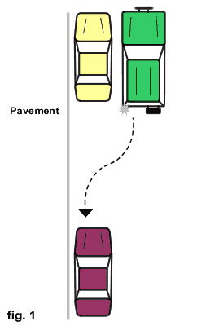
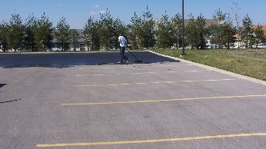
Examples of Parallel Lines
Hardwood Floor
Opposite sides of windows, desks, etc.
Parking slots in parking lot
Parallel Parking

Slide 4
Examples of Parallel Lines
LINE A
LINE B
HERE LINE A and LINE B Are PARALLEL

Slide 5
PERPENDICULAR LINES
Def: Lines that intersect to form a right angle.
Illustration:
Notation: m ⊥ n
Key Fact: 4 right angles are formed.
m
n

Slide 6
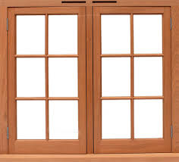
Ex. of Perpendicular Lines
Window panes : The Window Panes are
PERPENDICULAR to each other

Slide 7
Transversal
Def: a line that intersects two lines at different points
Illustration:
t

Slide 8
Vertical Angles
Two angles that are opposite angles.
t
1 = ∠ 4
2 = ∠ 3
5 = ∠ 8
6 = ∠ 7
1
2
3
4
5
6
7
8

Slide 9
Vertical Angles
Find the measures of the missing angles
t
125 °
?
125 °
55 °
?
55 °

Slide 10
Supplementary Angles/
Linear Pair
Two angles that form a line (sum=180°)
t
1+∠2=180
2+∠4=180
4+∠3=180
3+∠1=180
5+∠6=180
6+∠8=180
8+∠7=180
7+∠5=180
1
2
3
4
5
6
7
8

Slide 11
Supplementary Angles/
Linear Pair
Find the measures of the missing angles
t
?
108 °
72 °
180 - 72
?
108 °

Slide 12
Corresponding Angles
Two angles that occupy corresponding positions.
t
1 = ∠ 5
2 =∠ 6
3 = ∠ 7
4 = ∠ 8
Top Left
Top Right
1
2
3
4
Bottom Left
Bottom Right
Top Left
5
Top Right
6
7
8
Bottom Left
Bottom Right

Slide 13
Corresponding Angles
Find the measures of the missing angles
t
145 °
35 °
?
145 °

Slide 14
Alternate Interior Angles
Two angles that lie between parallel lines on opposite sides of the transversal
t
3 = ∠ 6
4 = ∠ 5
1
2
3
4
5
6
7
8

Slide 15
Alternate Interior Angles
Find the measures of the missing angles
t
82 °
98 °
82 °
?

Slide 16
Alternate Exterior Angles
Two angles that lie outside parallel lines on opposite sides of the transversal
t
2 = ∠ 7
1 = ∠ 8
1
2
3
4
5
6
7
8

Slide 17
Alternate Exterior Angles
Find the measures of the missing angles
t
120 °
?
60 °
120 °

Slide 18
Consecutive Interior Angles
Two angles that lie between parallel lines on the same sides of the transversal
t
3 +∠5 = 180
4 +∠6 = 180
1
2
3
4
5
6
7
8

Slide 19
Consecutive Interior Angles
Find the measures of the missing angles
t
180 - 135
135 °
45 °
?

Slide 20

THANK YOU ☺
THANK YOU ☺

