Slide 1
Geometry Vocabulary
Mr. Fiore
&
Mr. Ryan

Slide 2

What is Geometry?
Geometry is the study of shapes
They studied Geometry in Ancient Mesopotamia & Ancient Egypt
Geometry is important in the art and construction fields

Slide 3
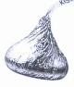
POINT
A POINT is an exact location on a graph, shape or in “space”.
The Hershey Kiss is a POINT on the line
●

Slide 4
LINE
A LINE goes in opposite directions and never, never, never ends.
Imagine if this Twizzler went on forever and ever and ever and ever and ever and ever

Slide 5
RAY
A RAY is part of a line, but it has one endpoint and the other end keeps going.
●
Raaaaaaaaaaaaaaaaaaaaaaaayyyyyyyyyyyyyyyyyyyyyyyyyyy
Endpoint

Slide 6
ENDPOINT
An ENDPOINT is a point at the end of a ray or line segment.
Endpoint

Slide 7
LINE SEGMENT
A LINE SEGMENT is part of a ray or line.
It has two endpoints
Line Segment
Line
●
●
Line
●
Endpoints
Ray

Slide 8
VERTEX
A VERTEX is a fancy name for “angle”
Two rays or lines that have the same endpoint make a VERTEX/angle
VERTEX/angles are measured in “degrees”
When two lines cross, they make vertex/angles
The Corners of a square are its vertex/angles

Slide 9

CONGRUENT
CONGRUENT means the “same”
CONGRUENT LINE SEGMENTS means two line segments are the same
CONGRUENT Vertex/Angles means two angles are the same
●
●
●
●
The Hershey & Crunch Bar are a Congruent size

Slide 10

VERTICAL LINE
A VERTICAL LINE goes up & down
The candy bars are vertical

Slide 11
HORIZONTAL LINE
A HORIZONTAL LINE goes “across” (left and right)
The candy bars are Horizontal

Slide 12
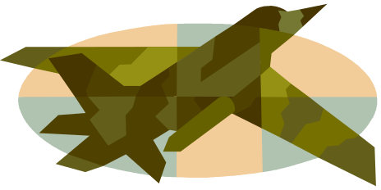

PLANE
A PLANE (no, not the one that flies!) is a flat surface that goes on forever in all directions.
Imagine sitting on a row boat in the middle of the ocean. No matter which way you look…all you see is water…forever.

Slide 13
OPEN & CLOSED FIGURES
A CLOSED FIGURE/SHAPE starts and ends at the same point.
An OPEN FIGURE/SHAPE does NOT start and end at the same point.
CLOSED
OPEN
Start
Start
●
●
●
End
End

Slide 14
POLYGON
A POLYGON is a “closed” shape
A POLYGON is made up of line segments that do not cross.
The number of sides gives a POLYGON its name
NOT POLYGON
POLYGON

Slide 15


PROTRACTOR
We use a PROTRACTOR to measure vertex/angles in degrees

Slide 16

4 TYPES OF ANGLES
ACUTE ANGLES are less than 90°

Slide 17


4 TYPES OF ANGLES
RIGHT ANGLES measure exactly 90 °
The “square” symbol means 90’

Slide 18

4 TYPES OF ANGLES
OBTUES ANGLES are greater than 90 ° but less than 180 °

Slide 19

4 TYPES OF ANGLES
STRAIGHT ANGLE is exactly 180 °

Slide 20
ANGLES
When you “name” an angle. The vertex/angle “letter/number” goes in the center of the label
B
A
C
If I wanted to know the measurement of Angle A…I would ask:” What is the measurement for BAC?” (Notice A is in the center)

Slide 21
The End
Once you study all the “fancy words”, Geometry is very easy to understand…so STUDY!

Slide 22
This powerpoint was kindly donated to www.worldofteaching.com
http://www.worldofteaching.com is home to over a thousand powerpoints submitted by teachers. This is a completely free site and requires no registration. Please visit and I hope it will help in your teaching.

