Slide 1
ASSET MODEL QUESTIONS
GRADE 7 MATHS

Slide 2
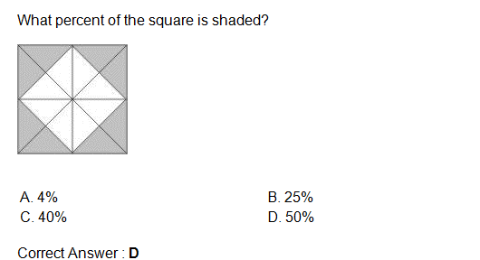
CORRECT ANSWER : - D

Slide 3
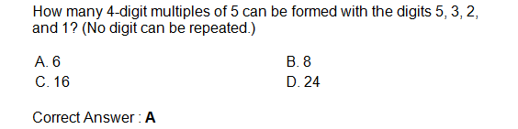
CORRECT ANSWER : - A

Slide 4
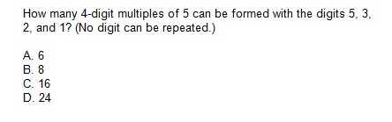
CORRECT ANSWER : - B

Slide 5
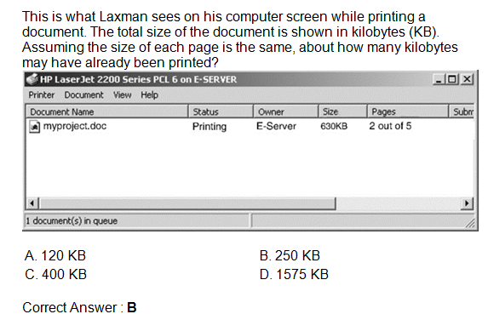
CORRECT ANSWER : - B

Slide 6
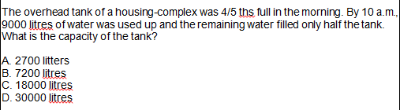
CORRECT ANSWER : -

Slide 7
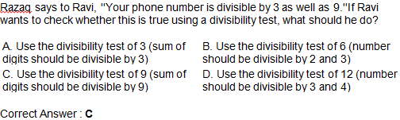
CORRECT ANSWER : -C

Slide 8
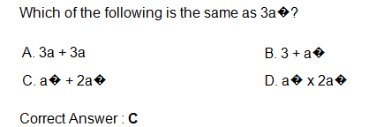
CORRECT ANSWER : - C

Slide 9

CORRECT ANSWER : - C

Slide 10
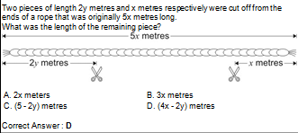
CORRECT ANSWER : - D

Slide 11
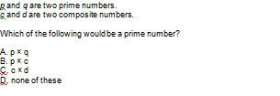
CORRECT ANSWER : -D

Slide 12
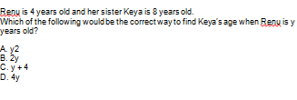
CORRECT ANSWER : - B

Slide 13

CORRECT ANSWER : - B

Slide 14
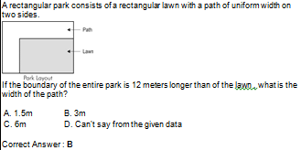
CORRECT ANSWER : - B

Slide 15
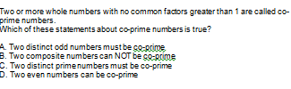
CORRECT ANSWER : -

Slide 16
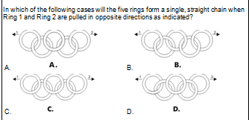
CORRECT ANSWER : -

Slide 17
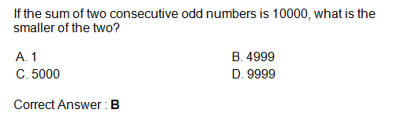
CORRECT ANSWER : -B

Slide 18
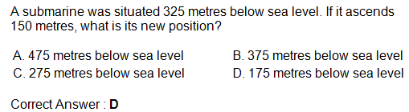
CORRECT ANSWER : -D

